Slide 1
(Regulatory-) Motif Finding

Slide 2
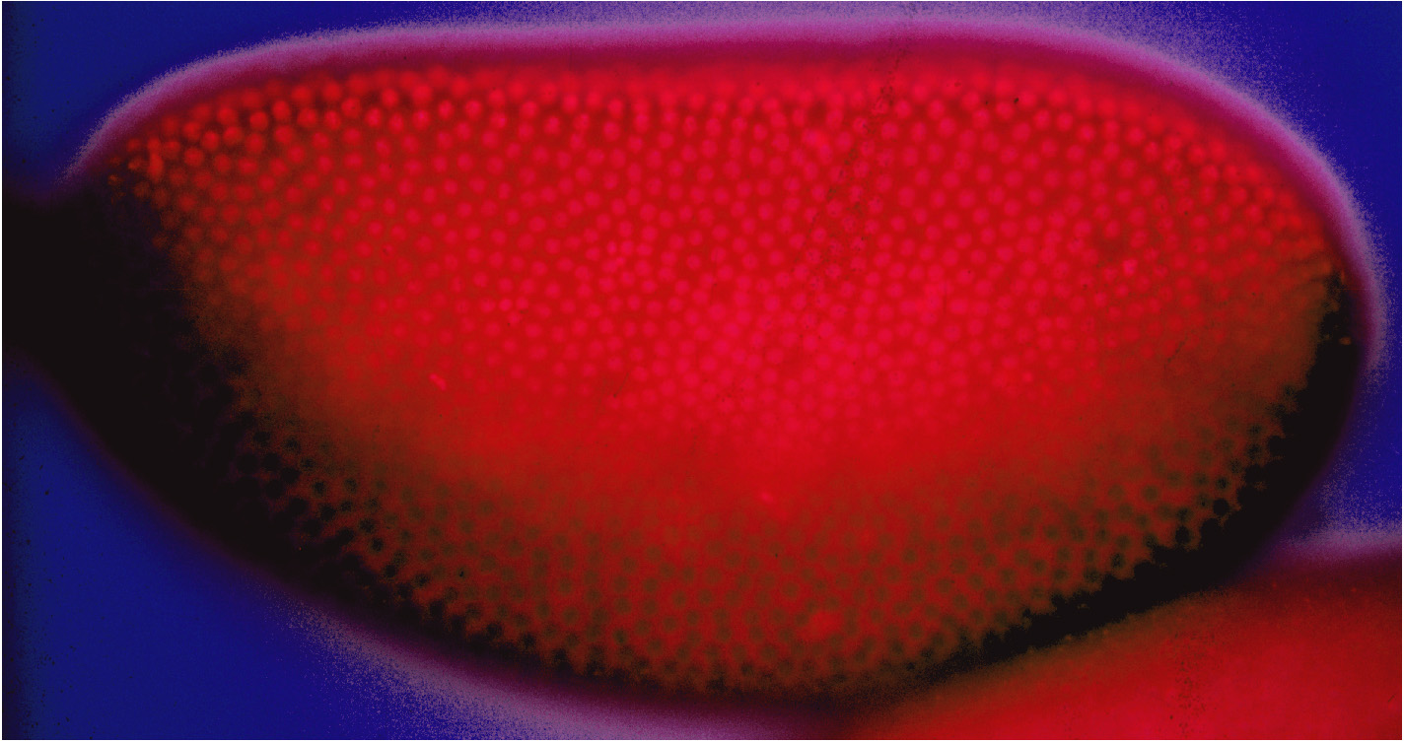
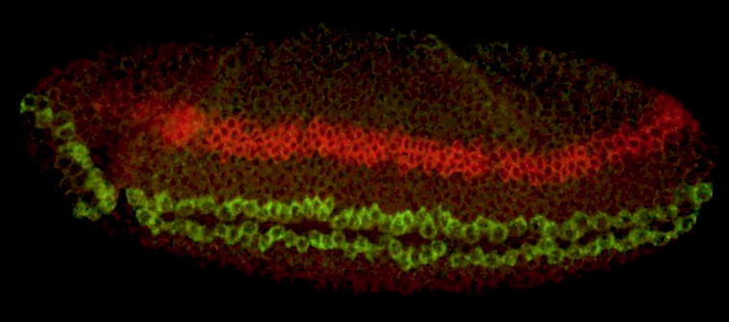
Dorsal thresholds establish the dorsal-ventral axis
ind
sim

Slide 3
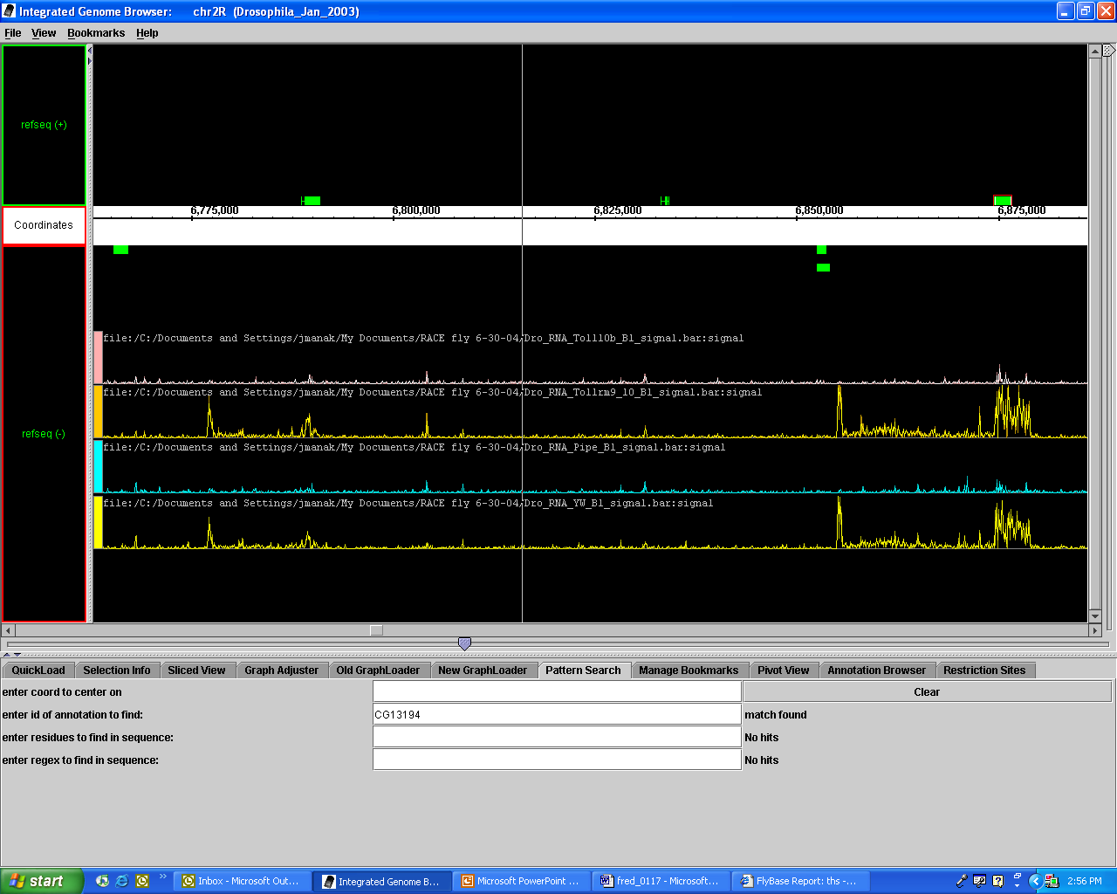
pyr
ths

Slide 4
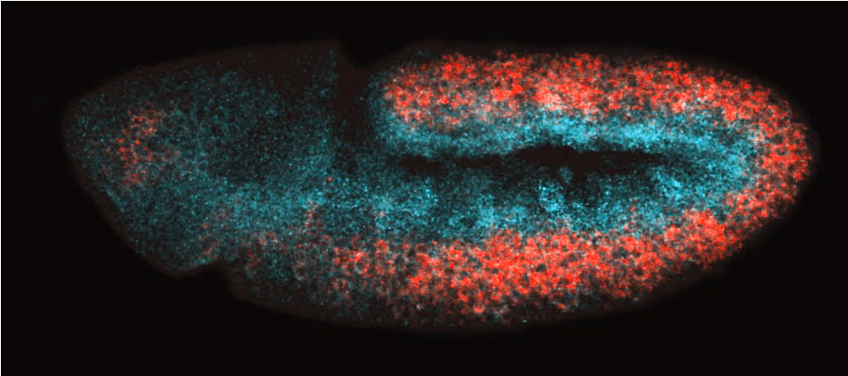
Ths and Pyr exhibit complementary expression patterns
Thisbe
Pyramus

Slide 5
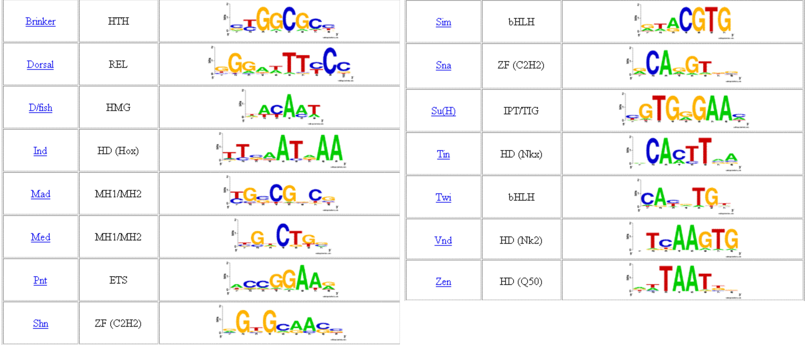
Consensus binding sites for DV regulatory factors

Slide 6
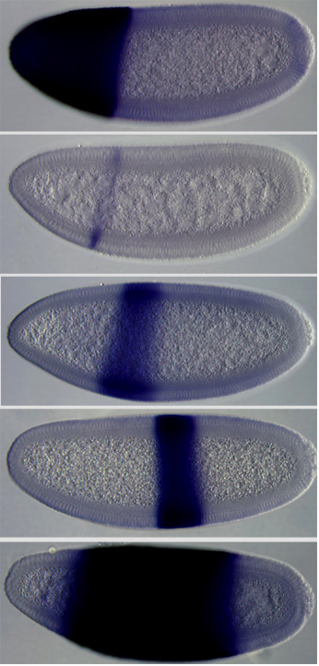





Distinct Dorsal threshold enhancers
SNAIL
SIM
VND
IND
SOG

Slide 7
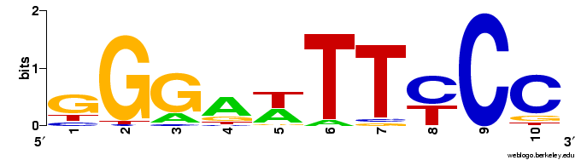
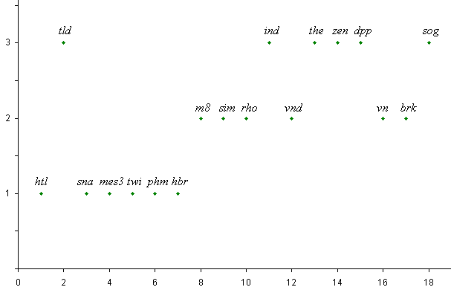
THRESHOLDS
RANK ORDER

Slide 8
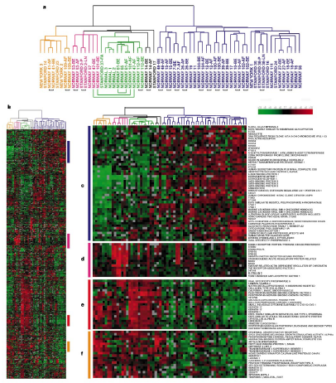
Clustering of Genes
Find binding sites
responsible for
common expression
patterns

Slide 9
Finding Regulatory Motifs
.
.
.
Given a collection of genes with common expression,
Find the TF-binding motif in common

Slide 10
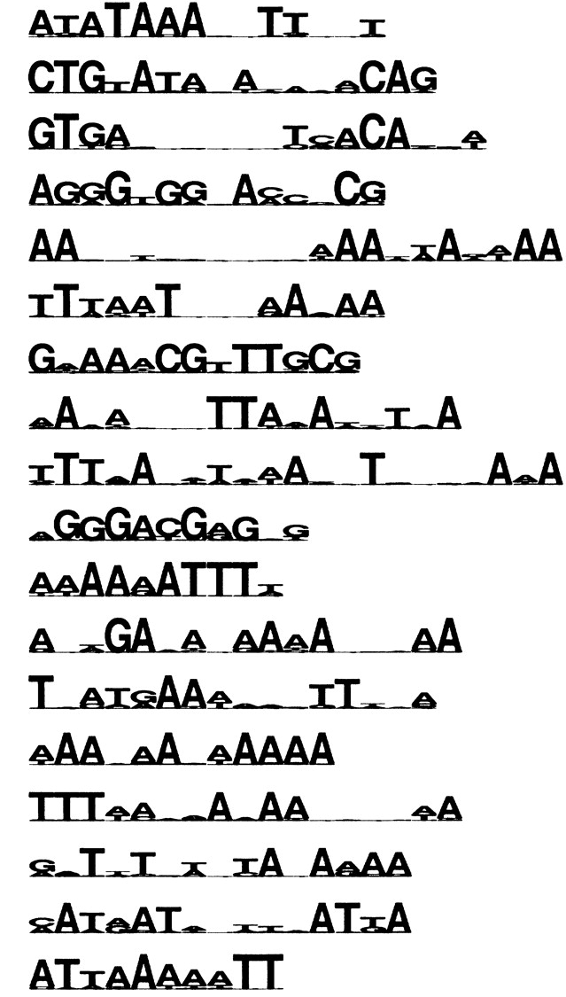
Characteristics of Regulatory Motifs
Tiny
Highly Variable
~Constant Size
  Because a constant-size transcription factor binds
Often repeated
Low-complexity-ish

Slide 11
Essentially a Multiple Local Alignment
.
.
.
Find “best” multiple local alignment
Alignment score defined differently in probabilistic/combinatorial cases

Slide 12
Algorithms
Combinatorial
    CONSENSUS, TEIRESIAS, SP-STAR, others
Probabilistic
  Expectation Maximization:
    MEME
  Gibbs Sampling:
    AlignACE, BioProspector

Slide 13
Combinatorial Approaches to Motif Finding

Slide 14
Discrete Formulations
Given sequences S = {x¹, …, x^{n}}
A motif W is a consensus string w₁…w_{K}
Find motif W* with “best” match to x¹, …, x^{n}
Definition of “best”:
    d(W, x^{i}) = min hamming dist. between W and any word in x^{i}
    d(W, S) = Σ_{i} d(W, x^{i})

Slide 15
Approaches
Exhaustive Searches
CONSENSUS
MULTIPROFILER
TEIRESIAS, SP-STAR, WINNOWER

Slide 16
Exhaustive Searches
1. Pattern-driven algorithm:
For W = AA…A to TT…T (4^{K} possibilities)
Find d( W, S )
Report W* = argmin( d(W, S) )
Running time: O( K N 4^{K} )
(where N = Σ_{i} |x^{i}|)
Advantage: Finds provably “best” motif W
Disadvantage: Time

Slide 17
Exhaustive Searches
2. Sample-driven algorithm:
For W = any K-long word occurring in some x^{i}
Find d( W, S )
Report W* = argmin( d( W, S ) )
or, Report a local improvement of W*
Running time: O( K N² )
Advantage: Time
Disadvantage: If the true motif is weak and does not occur in data
then a random motif may score better than any instance of true motif

Slide 18
MULTIPROFILER
Extended sample-driven approach
Given a K-long word W, define:
N_{α}(W) = words W’ in S s.t. d(W,W’) ≤ α
Idea:
Assume W is occurrence of true motif W*
Will use N_{α}(W) to correct “errors” in W

Slide 19
MULTIPROFILER
Assume W differs from true motif W* in at most L positions
Define:
A wordlet G of W is a L-long pattern with blanks, differing from W
  L is smaller than the word length K
Example:
K = 7; L = 3
W = ACGTTGA
G = --A--CG

Slide 20
MULTIPROFILER
Algorithm:
For each W in S:
For L = 1 to L_{max}
  Find the α-neighbors of W in S → N_{α}(W)
  Find all “strong” L-long wordlets G in N_{a}(W)
  For each wordlet G,
    Modify W by the wordlet G → W’
    Compute d(W’, S)
Report W* = argmin d(W’, S)
Step 1 above: Smaller motif-finding problem;
Use exhaustive search

Slide 21
CONSENSUS
Algorithm:
Cycle 1:
For each word W in S (of fixed length!)
For each word W’ in S
Create alignment (gap free) of W, W’
Keep the C₁ best alignments, A₁, …, A_{C1}
ACGGTTG , CGAACTT , GGGCTCT …
ACGCCTG , AGAACTA , GGGGTGT …

Slide 22
CONSENSUS
Algorithm:
Cycle t:
For each word W in S
For each alignment A_{j} from cycle t-1
Create alignment (gap free) of W, A_{j}
Keep the C_{l} best alignments A₁, …, A_{Ct}
ACGGTTG , CGAACTT , GGGCTCT …
ACGCCTG , AGAACTA , GGGGTGT …
… … …
ACGGCTC , AGATCTT , GGCGTCT …

Slide 23
CONSENSUS
C₁, …, C_{n} are user-defined heuristic constants
  N is sum of sequence lengths
  n is the number of sequences
Running time:
O(N²) + O(N C₁) + O(N C₂) + … + O(N C_{n})
= O( N² + NC_{total})
Where C_{total} = Σ_{i} C_{i}, typically O(nC), where C is a big constant

