Slide 1
CSCI 1810
Computational Molecular Biology 2018
Genome Assembly – short intro

Slide 2
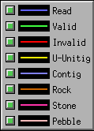
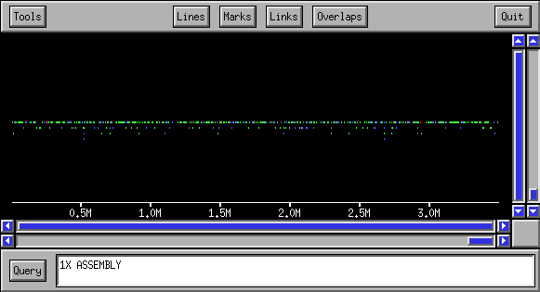
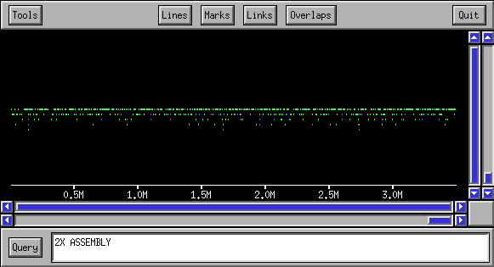
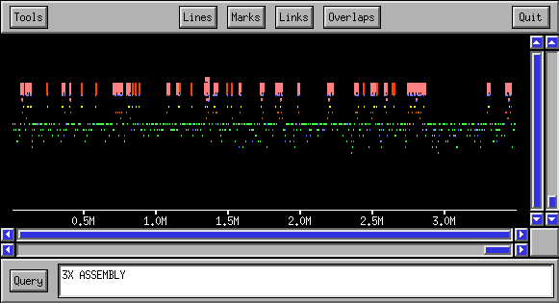
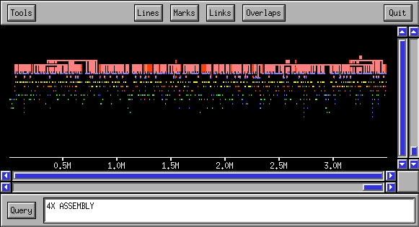
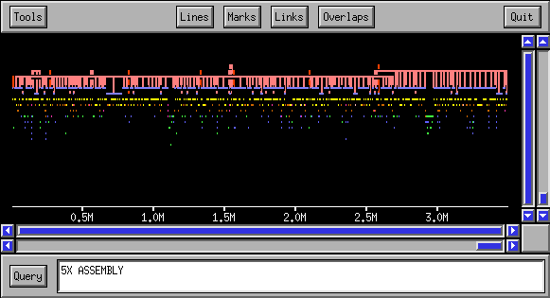
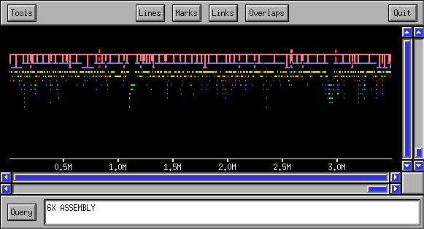

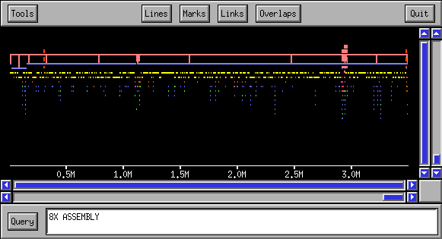

Assembly Progression
(Macro View)

Slide 3
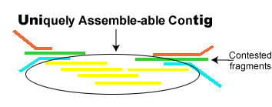
Review-Assembly
Step 1: Compare sequences all against all and find all fragment intersections of at least 40 bases with up to 6% error. (For the human genome this took 10,000 CPU hours)
Step 2: Cluster into groups of overlapping fragments that agree on a common sequence, and do not overlap fragments that dispute this sequence. Such clusters are called contigs.

Slide 4

Review-Assembly
Step 3: Identify contigs the originated from repeats by using the “depth” of the fragments.
Step 4: Determine the consensus sequence of contig.

Slide 5
Repeats
Classes of Repeats
  Transposon derived repeats (45% of genome)
  Pseudugenes (inactive copies of genes)
  Short Kmer repeats ( (A)_{n} (CA)_{n} )
  Segmental duplication
  Blocks of tandemly repeated segments
Uses of repeats
  Passively repeats help study evolution
  Actively repeats case genome rearrangements

Slide 6
Repeats in the Human Genome
Hitch-hikers: molecules that use our genetic machinery for their replication - viruses and repeats:
  DNA transposons
    3% of our genome
    Use our DNA replication machinery, encode transposase.
    Many small unrelated families (common ancestor).
  RNA transposons (retroposons)
    41% of our genome, Alu 400bpX10⁶ copies
    Use our transcription machinery, encode reverse transcriptase.

Slide 7
History of Sequencing
BAC to BAC sequencing: Used by HGP in the early stages when sequencing was slow and time consuming.
BAC end shotgun sequencing: Used by HGP in later stages.
Whole genome shotgun sequencing: Used by Celera.
  The success of whole genome shotgun sequencing is a victory for computer science.

Slide 8
BAC to BAC sequencing
Several copies of the genome are randomly cut into pieces of about 150,000 bp.
Each of these fragments is inserted into a BAC creating a BAC library of entire genome.
Fingerprint each fragment using restriction enzymes.
Use fingerprint to create a physical map determining order and orientation of fragments (tedious process which many CS people earned their living on.
Distribute BACS between laboratories, perform shotgun sequencing on each BAC

Slide 9
BAC end shotgun sequencing
Several copies of a chromosome are randomly cut into pieces of about 150,000 bp.
Sequence 500 bp of both ends from each BAC.
Randomly chose a single BAC and perform shotgun sequence.
“walk” along the chromosome using the sequenced ends to chose next BAC.
Problem: is not parallel

Slide 10
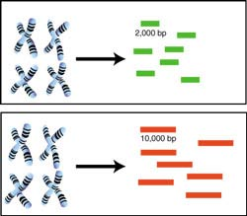
Whole genome shotgun sequencing
Several copies of the whole are randomly cut into pieces of about 2000bp and 10000bp
Sequence 500 bp of both ends from each fragment. Each such pair of sequences ends are called mates.
Perform assembly over all sequences to create contigs.
Use the mates to put contigs together.

Slide 11
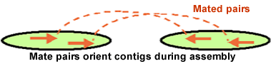

Whole genome shotgun sequencing
We know each mate pair is either 2000 or 10000 bps apart and we know their orientation.
The process of ordering and placing the contigs is called scaffolding.
More than one mate pair supports each pair of contigs
The long 10000bp sequences allow us to jump over problematic repetative regions.

Slide 12
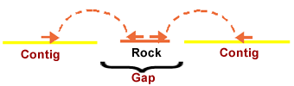


Handling repeats
Assembler classifies repeat sequences by size and reliability. Rocks are the most reliable and must be supported by at least 2 mates one for each neighboring contig
Stones are linked by only one mate
Finally pebbles fill in the holes

