Slide 1


Slide 2
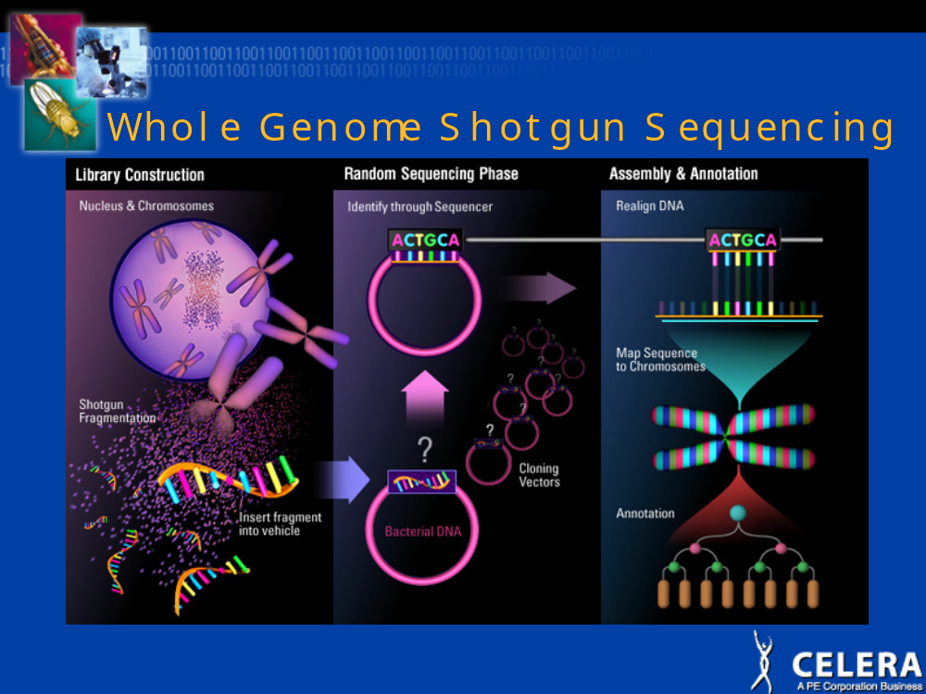

Slide 3




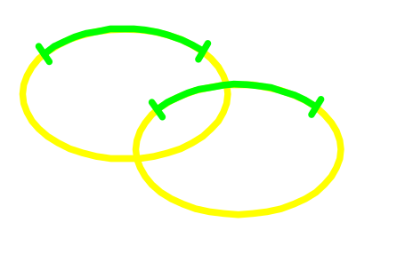
Shotgun DNA Sequencing (Technology)
DNA target sample
SHEAR
SIZE SELECT
End Reads (Mates)
Primer
LIGATE & CLONE
SEQUENCE
Vector

Slide 4

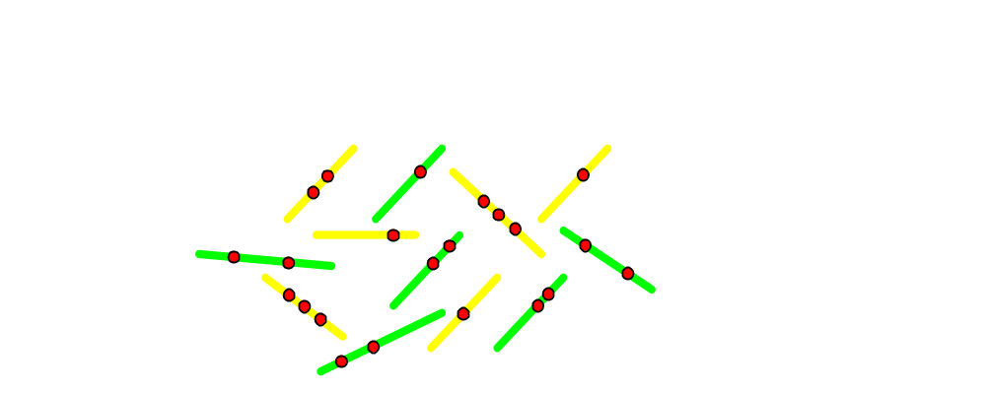
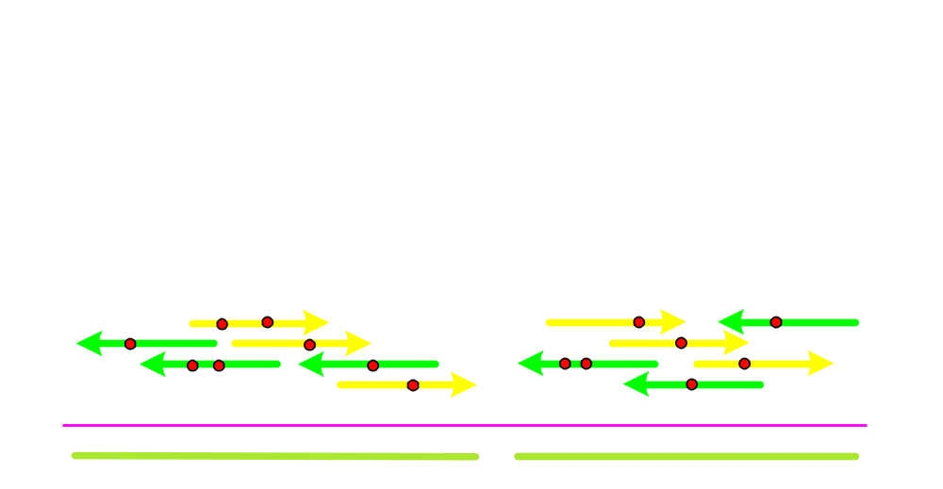
Shotgun DNA Sequencing (Computation)
Unknown “Target” DNA Sequence
Randomly Sample (“Shotgun”) Fragments
G = 100Kbp Target Length
(e.g., BAC, P1, PAC)
F = 1600 # of Fragments
L = 500 Avg. Fragment Length
N = FL = 800Kbp Total Bases Sequenced
c = N/G = 8 Avg. Coverage
Fragments
UNKNOWN ORIENTATION
SEQUENCING ERRORS
INCOMPLETE COVERAGE
CONSTRAINTS (MATES)
REPEATS
Layout
Consensus
Contigs

Slide 5


Whole Genome Sequencing Approaches
Hierarchical HGP Approach:
Target
Physical Mapping
Minimum Tiling Set
(~30,000 BACs
for human)
Shotgun Sequencing
– 2 separate processes
– maps very hard to complete, libraries unstable
– must make shotgun library of each BAC
+ infrastructure is already developed
+ quality of outcome is known

Slide 6
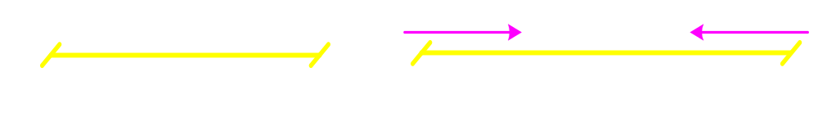
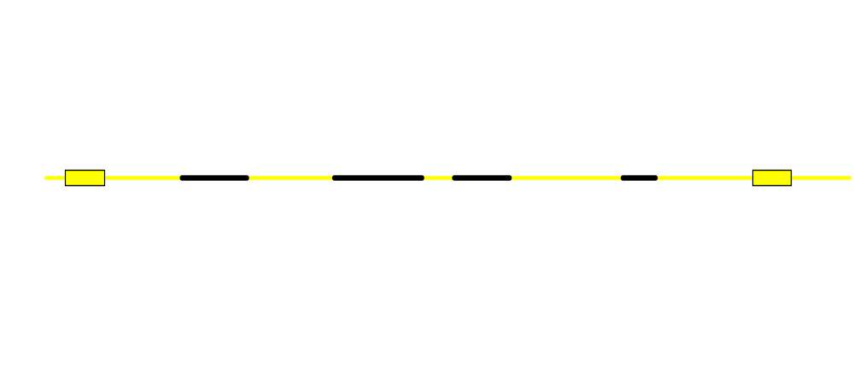



Whole Genome Sequencing Approaches
Whole Genome Shotgun Sequencing:
Collect 10x sequence in a 1 -1 ratio of two types of read pairs:
~ 70million reads for Human.
Short
Long
2Kbp
10Kbp
Collect 10-15x BAC inserts and end sequence:
~ 300K pairs for Human.
Early simulations showed that if repeats were considered black boxes, one could still cover 99.7% of the genome unambiguously.
BAC 5’
BAC 3’
+ single process, three library constructions
– assembly is much more difficult

Slide 7
Sequencing Factory
300 ABI 3700 DNA Sequencers installed
50 Production Staff
40 Support Staff (R&D, QC/QA, Service)
20,000 sq. ft. of wet lab
20,000 sq. ft. of sequencing space
800 tons of A/C (160,000 cfm)
4,000 amps electrical service

Slide 8
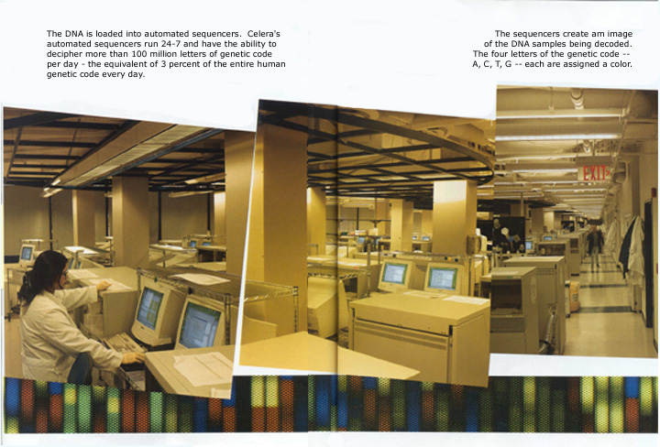

Slide 9
True vs. Repeat-Induced Overlaps
A
B
implies
TRUE
A
B
OR
REPEAT-INDUCED
A
B

Slide 10
Assembly Pipeline
167:41 cpu hrs. for Dros
Screener
Mask heterochromatin and ribo-DNA,
Tag known interspersed repeats.
8:37
Overlapper
Find all overlaps ≥ 40bp allowing 6% mismatch. (1000X Blast)
86:25
ASSEMBLER CORE:
Compute all consistent sub-assemblies = unitigs
Identify those that cover unique DNA = U-unitigs
Scaffold U-unitigs with confirmed shorts & longs
Then with BAC ends
Fill repeat gaps with:
  I. Doubly anchored mates
Unitiger
38:29
Scaffolder
4:12
Repeat Rez I
Repeat Rez I, II, III
II. O-path confirmed singly-anchored mates
III. Greedy path completion using QVs
5:44+4:21+19:53
Consensus
Bayesian “SNP” consensus using quality values.
Occurs throughout assembler core.
(~25)

Slide 11
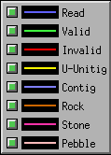
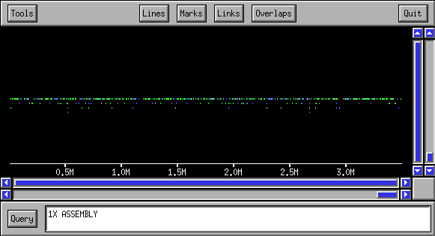
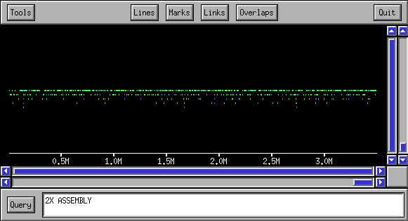
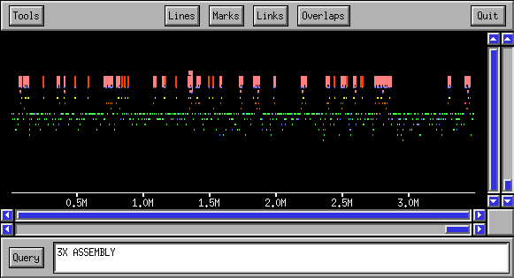
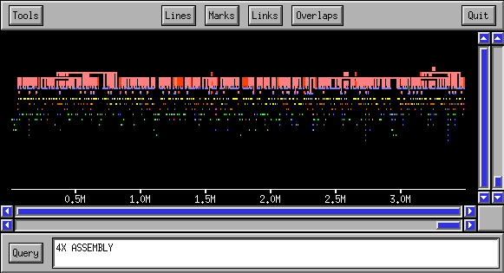
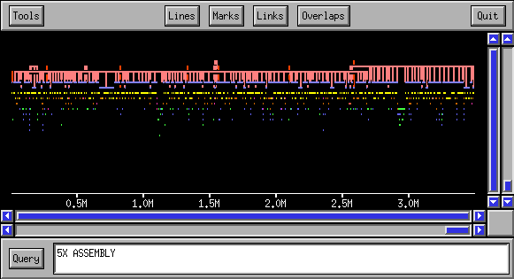
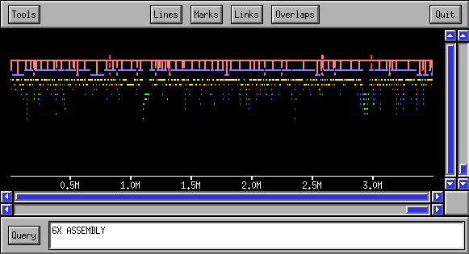

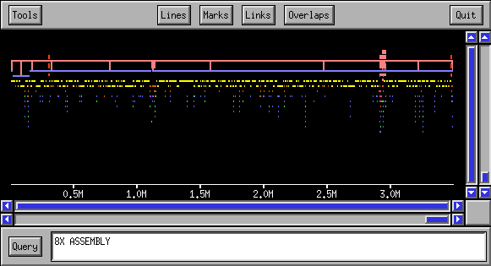

Assembly Progression
(Macro View)

Slide 12
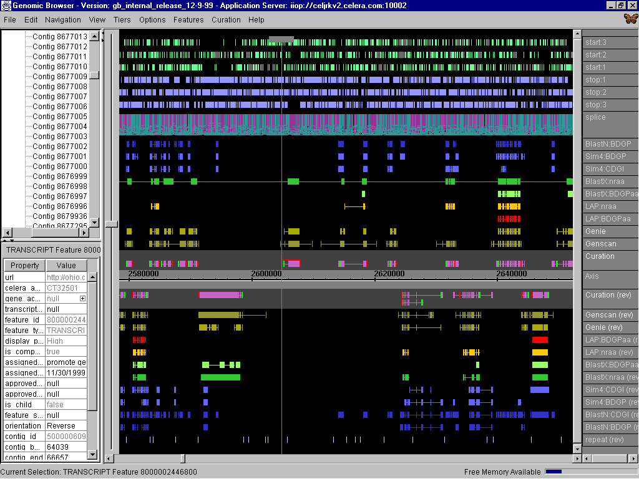
Proteomics Discovery (insert browser slide) 3.0
start and stop site predictions
Unique identifiers
Splice site predictions
Homology based exon predictions
computational exon predictions
Tracking information
Consensus gene
structure (both strands)

