Slide 1
Algorithmic Foundations of Computational Biology
CS196-1 -- 2007
DNA Sequencing and Genome Assembly

Slide 2
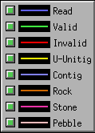
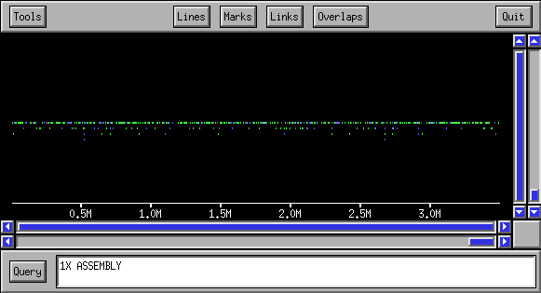
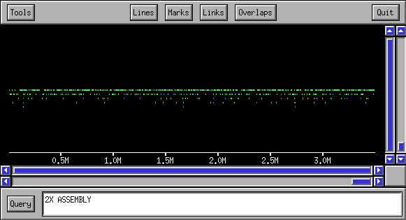
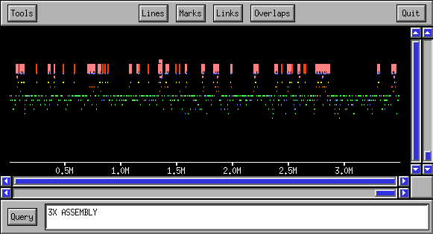
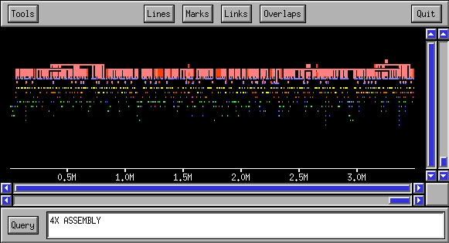
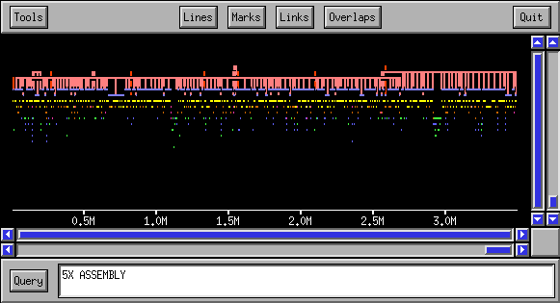
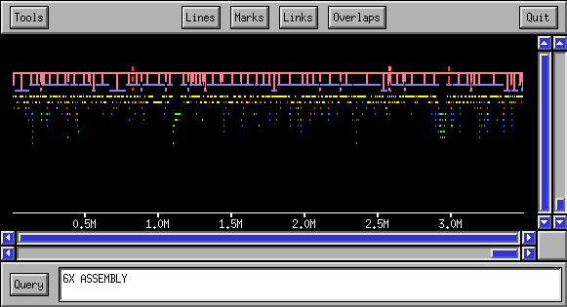

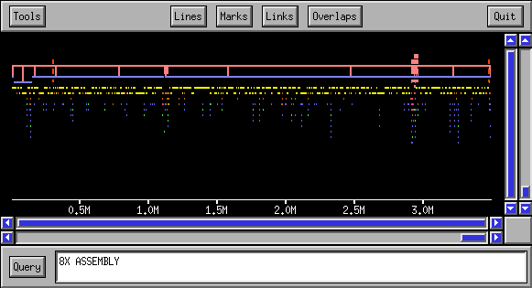

Assembly Progression
(Macro View)

Slide 3
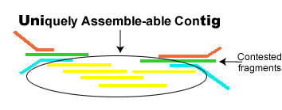
Review-Assembly
Step 1: Compare sequences all against all and find all fragment intersections of at least 40 bases with up to 6% error. (For the human genome this took 10,000 CPU hours)
Step 2: Cluster into groups of overlapping fragments that agree on a common sequence, and do not overlap fragments that dispute this sequence. Such clusters are called contigs.

Slide 4

Review-Assembly
Step 3: Identify contigs the originated from repeats by using the “depth” of the fragments.
Step 4: Determine the consensus sequence of contig.

Slide 5
Conditions
Question: When can assembly of shot gun sequencing be performed?
Requirements:
  Contains only a small (~1.5%) amount of repeats.
  Can be uniformly sampled at random
Problem: The human genome is filled (>50%) with repeated sequences.
  Large duplicated segments 50-500kb.
  High sequence identity 98-99.9%

Slide 6
Repeats
Classes of Repeats
  Transposon derived repeats (45% of genome)
  Pseudugenes (inactive copies of genes)
  Short Kmer repeats ( (A)_{n} (CA)_{n} )
  Segmental duplication
  Blocks of tandemly repeated segments
Uses of repeats
  Passively repeats help study evolution
  Actively repeats case genome rearrangements

Slide 7
Repeats in the Human Genome
Hitch-hikers: molecules that use our genetic machinery for their replication - viruses and repeats:
  DNA transposons
    3% of our genome
    Use our DNA replication machinery, encode transposase.
    Many small unrelated families (common ancestor).
  RNA transposons (retroposons)
    41% of our genome, Alu 400bpX10⁶ copies
    Use our transcription machinery, encode reverse transcriptase.

Slide 8
History of Sequencing
BAC to BAC sequencing: Used by HGP in the early stages when sequencing was slow and time consuming.
BAC end shotgun sequencing: Used by HGP in later stages.
Whole genome shotgun sequencing: Used by Celera.
  The success of whole genome shotgun sequencing is a victory for computer science.

Slide 9
BAC to BAC sequencing
Several copies of the genome are randomly cut into pieces of about 150,000 bp.
Each of these fragments is inserted into a BAC creating a BAC library of entire genome.
Fingerprint each fragment using restriction enzymes.
Use fingerprint to create a physical map determining order and orientation of fragments (tedious process which many CS people earned their living on.
Distribute BACS between laboratories, perform shotgun sequencing on each BAC

Slide 10
BAC end shotgun sequencing
Several copies of a chromosome are randomly cut into pieces of about 150,000 bp.
Sequence 500 bp of both ends from each BAC.
Randomly chose a single BAC and perform shotgun sequence.
“walk” along the chromosome using the sequenced ends to chose next BAC.
Problem: is not parallel

Slide 11
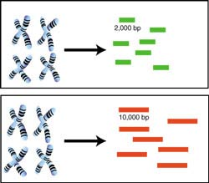
Whole genome shotgun sequencing
Several copies of the whole are randomly cut into pieces of about 2000bp and 10000bp
Sequence 500 bp of both ends from each fragment. Each such pair of sequences ends are called mates.
Perform assembly over all sequences to create contigs.
Use the mates to put contigs together.

Slide 12
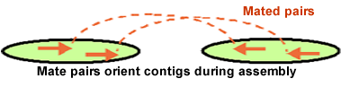

Whole genome shotgun sequencing
We know each mate pair is either 2000 or 10000 bps apart and we know their orientation.
The process of ordering and placing the contigs is called scaffolding.
More than one mate pair supports each pair of contigs
The long 10000bp sequences allow us to jump over problematic repetitive regions.

Slide 13
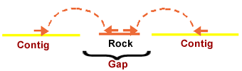


Handling repeats
Assembler classifies repeat sequences by size and reliability. Rocks are the most reliable and must be supported by at least 2 mates one for each neighboring contig
Stones are linked by only one mate
Finally pebbles fill in the holes

Slide 14
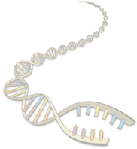
DNA Sequencing

Slide 15
The Walking Method
Build a very redundant library of BACs with sequenced clone-ends (cheap to build)
Sequence some “seed” clones
“Walk” from seeds using clone-ends to pick library clones that extend left & right

Slide 16
Walking: An Example

Slide 17
Advantages & Disadvantages of
Hierarchical Sequencing
Hierarchical Sequencing
  ADV. Easy assembly
  DIS. Build library & physical map;
  redundant sequencing
Whole Genome Shotgun (WGS)
  ADV. No mapping, no redundant sequencing
  DIS. Difficult to assemble and resolve repeats
The Walking method – motivation
Sequence the genome clone-by-clone without a physical map
The only costs involved are:
  Library of end-sequenced clones (cheap)
  Sequencing

Slide 18
Walking off a Single Seed
Low redundant sequencing
Many sequential steps

Slide 19
Walking off a single clone is impractical
Cycle time to process one clone: 1-2 months
    Grow clone
    Prepare & Shear DNA
    Prepare shotgun library & perform shotgun
    Assemble in a computer
    Close remaining gaps
A mammalian genome would need 15,000 walking steps !

Slide 20
Walking off several seeds in parallel
Efficient
Inefficient
Few sequential steps
Additional redundant sequencing
In general, can sequence a genome in ~5 walking steps,
with <20% redundant sequencing

Slide 21
Using Two Libraries
Most inefficiency comes from closing a small ocean with a much larger clone
Solution: Use a second library of small clones

Slide 22
Whole-Genome Shotgun Sequencing

Slide 23
Whole Genome Shotgun Sequencing
genome
cut many times at random
plasmids (2 – 10 Kbp)
forward-reverse paired reads
cosmids (40 Kbp)
known dist
~500 bp
~500 bp

Slide 24
Steps to Assemble a Genome
1. Find overlapping reads
2. Merge good pairs of reads into longer contigs
3. Link contigs to form supercontigs
4. Derive consensus sequence
..ACGATTACAATAGGTT..

Slide 25
4. Derive consensus sequence (by voting)
TAGATTACACAGATTACTGA TTGATGGCGTAA CTA
TAGATTACACAGATTACTGACTTGATGGCGTAAACTA
TAG TTACACAGATTATTGACTTCATGGCGTAA CTA
TAGATTACACAGATTACTGACTTGATGGCGTAA CTA
TAGATTACACAGATTACTGACTTGATGGGGTAA CTA
TAGATTACACAGATTACTGACTTGATGGCGTAA CTA

Slide 26
1. Find Overlapping Reads
Sort all k-mers in reads (k ~ 24)
Find pairs of reads sharing a k-mer
Extend to full alignment – throw away if not >95% similar
TACA
TAGATTACACAGATTAC
T GA
||
|||||||||||||||||
| ||
TAGT
TAGATTACACAGATTAC
TAGA

Slide 27
1. Find Overlapping Reads
One caveat: repeats
A k-mer that appears N times, initiates N² comparisons
ALU: 1,000,000 times
Solution:
Discard all k-mers that appear more than c × Coverage, (c ~ 10)

Slide 28
1. Find Overlapping Reads
Create local multiple alignments from the overlapping reads
TAGATTACACAGATTACTGA
TAGATTACACAGATTACTGA
TAG TTACACAGATTATTGA
TAGATTACACAGATTACTGA
TAGATTACACAGATTACTGA
TAGATTACACAGATTACTGA
TAG TTACACAGATTATTGA
TAGATTACACAGATTACTGA

Slide 29
1. Find Overlapping Reads (cont’d)
Correct errors using multiple alignment
C: 20
C: 20
C: 35
C: 35
T: 30
C: 0
C: 35
C: 35
TAGATTACACAGATTACTGA
C: 40
C: 40
TAGATTACACAGATTACTGA
TAG TTACACAGATTATTGA
TAGATTACACAGATTACTGA
TAGATTACACAGATTACTGA
A: 15
A: 15
A: 25
A: 25
-
A: 0
A: 40
A: 40
A: 25
A: 25
Score alignments
Accept alignments with good scores

Slide 30
2. Merge Reads into Contigs
repeat region
Merge reads up to potential repeat boundaries

Slide 31
Repeats, errors, and contig lengths
Repeats shorter than read length are OK
Repeats with more base pair diffs than sequencing error rate are OK
To make a smaller portion of the genome appear repetitive, try to:
  Increase read length
  Decrease sequencing error rate
Role of error correction:
Discards ~90% of single-letter sequencing errors
decreases error rate
⇒ decreases effective repeat content
⇒ increases contig length

Slide 32
2. Merge Reads into Contigs
repeat region
Ignore non-maximal reads
Merge only maximal reads into contigs

Slide 33
2. Merge Reads into Contigs
sequencing error
repeat boundary???
b
a
Ignore “hanging” reads, when detecting repeat boundaries

Slide 34
2. Merge Reads into Contigs
?????
Unambiguous
Insert non-maximal reads whenever unambiguous

Slide 35
3. Link Contigs into Supercontigs
Normal density
Too dense: Overcollapsed?
(Myers et al. 2000)
Inconsistent links: Overcollapsed?

Slide 36
3. Link Contigs into Supercontigs
Find all links between unique contigs
Connect contigs incrementally, if ≥ 2 links

Slide 37
3. Link Contigs into Supercontigs
Fill gaps in supercontigs with paths of overcollapsed contigs

Slide 38
3. Link Contigs into Supercontigs
d ( A, B )
Contig A
Contig B
Define G = ( V, E )
  V := contigs
E := ( A, B ) such that d( A, B ) < C
Reason to do so: Efficiency; full shortest paths cannot be computed

Slide 39
3. Link Contigs into Supercontigs
Contig A
Contig B
Define T: contigs linked to either A or B
Fill gap between A and B if there is a path in G passing only from contigs in T

Slide 40
4. Derive Consensus Sequence
TAGATTACACAGATTACTGA TTGATGGCGTAA CTA
TAGATTACACAGATTACTGACTTGATGGCGTAAACTA
TAG TTACACAGATTATTGACTTCATGGCGTAA CTA
TAGATTACACAGATTACTGACTTGATGGCGTAA CTA
TAGATTACACAGATTACTGACTTGATGGGGTAA CTA
TAGATTACACAGATTACTGACTTGATGGCGTAA CTA
Derive multiple alignment from pairwise read alignments
Derive each consensus base by weighted voting

Slide 41
Simulated Whole Genome Shotgun
Known genomes
  Flu, yeast, fly, Human chromosomes 21, 22
Make “realistic” shotgun reads
Run ARACHNE
Align output with genome and compare

Slide 42
Making a Simulated Read
artificial shotgun read
ERRORIZER
Simulated read
real read
Simulated reads have error patterns taken from random real reads

Slide 43
Assembly Progression
(Macro View)

