Slide 1
Introduction to Command Line
Alexis Black Pyrkosz
SROP Comp Workshop: Day 1

Slide 2
Why Use the Command Line?
Flexibility
Speed
Automation
Cross-Platform
Reproducibility

Slide 3
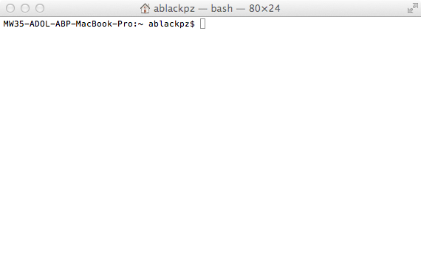
What is a Shell?

Slide 4
What is a Shell?
A shell translates a user’s command into operating system instructions
Most common shell is Bourne-again or bash
Shells can be used in two ways:
User interface to the OS
Programming environment

Slide 5
Terminology
Command lines: commands typed into the shell
Prompt: the info string/dollar sign that precedes the area where commands are typed
Commands: first word on the line that indicates an action for the OS to perform
Arguments/parameters: names of things that the command will act upon
Option: particular argument that modifies the command
Example 1

Slide 6
Directories (Folders)
Directories are essentially folders
The arrangement of directories is a directory tree
Directory1
Directory2
Note: avoid using spaces
Directory3
Directory4
Example 2

Slide 7
Your Home Directory
/home/yourname or ~/
References to directories and files will be made relative to your home directory unless you use the full pathname
Cd: change directory
.. : go up one directory
Pwd: show the full pathname for the current directory

Slide 8
Problem 1.1
Go to https://dl.dropboxusercontent.com/u/77362135/problem001.zip
Unzip the file
Use the command line to navigate through the directories and make a directory tree.

Slide 9
Answer 1
Alpha
Beta
Gamma
Delta
Zeta
Epsilon
Eta
Kappa
Mu

Slide 10
Commands for looking at text files
More: print one screen of text at a time
Less: print one screen of text at a time and allow user to move forward and backward
Head: print first 10 lines of the file to the screen
Tail: print last 10 lines of the file to the screen
| : pipe output from one command into a second command as input
Example 3

Slide 11
Problem 1.2
What message is in directory alpha?
The answer to Life, the Universe, and Everything is 42.
What message is in directory eta?
You ain't seen nothing yet!
What message is in directory kappa?
Hello World!

Slide 12
Problem 1.3 (using longOutput.txt)
What number is on line 11?
9539
What number is on line 20041?
5748
What numbers are on lines 60001, 60002, and 60003?
5406, 7205, 8775
What are the last two numbers in the file?
9093, 6723
Notes:
Head -11 longOutput.txt | tail -1
Head -20041 longOutput.txt | tail -1
Head -60003 longOutput.txt | tail -3
Tail -2 longOutput.txt

Slide 13
A few text parsing functions
Wc –l: count the number of lines in a file
Wc –w: count the number of words in a file
Sort: sort the file based on the first column in alphabetical order
Sort –n: sort the file based on the first column in numerical order
Sort –k 3,4: sort the file based on the third and fourth columns in alphabetical order
Uniq: remove duplicate lines
Uniq –c: count number of duplicate lines and then delete the duplicate lines
Example 4

Slide 14
Problem 1.4 (using longOutput.txt)
Sort the data numerically and find the 1400th number:
140
Sort the data alphabetically and find the 200th number:
1013
How many unique numbers are in the file?
10001
How many times is 42 in the file?
5
Notes:
Sort –n longOutput.txt | head -1400 | tail -1
Sort longOutput.txt | head -200 | tail -1
Sort longOutput.txt | uniq | wc –l
Sort longOutput.txt | uniq –c | less

Slide 15
Moving files around
Cp: copy a file to a new file (with new name)
Mv: move a file or rename it
Rm: remove a file
> : direct the output from a command to a file
Cat: catenate multiple files
Mkdir: make a new directory in the current directory
Note: never use the following kind of command
$ uniq data.txt > data.txt
Example 4

Slide 16
Problem 1.5 (Using directory tree)
Go to directory mu and make directories omicron and theta.
Go to directory theta and copy longOutput.txt into the directory.
Rename the file to randomNumbers1to10000_2.txt
Sort the file numerically, select the first 200th line, and save the results.
Sort the random numbers file alphabetically, select the 20000th line, and save the results.
Catenate the two results files into a new file.
What numbers and in what order are in the final file?
18, 2782
Notes:
Mkdir omicron
Mkdir theta
Cd theta
Cp ../../../../../longOutput.txt .
Mv longOutput.txt randomNumbers1to10000_2.txt
Sort –n randomNumbers1to10000_2.txt | head -200 | tail -1 > randomNumbers1to10000_2_numericSort_200line.txt
Sort randomNumbers1to10000_2.txt | head -20000 | tail -1 > randomNumbers1to10000_2_alphaSort_20000line.txt
Cat randomNumbers1to10000_2_* > randomNumbers1to10000_2_numericSort200line_alphaSort200000line.txt
Less randomNumbers1to10000_2_numericSort200line_alphaSort200000line.txt

Slide 17
A few other useful commands
History: list previous commands
Ls –la: list files in a directory with their file attributes
Gunzip: unzip files
Diff: show differences between two files
Man: when used with a command name, will bring up the short manual for the command

