Slide 1
Reproducible Research with IPython Notebook
Likit Preeyanon

Slide 2
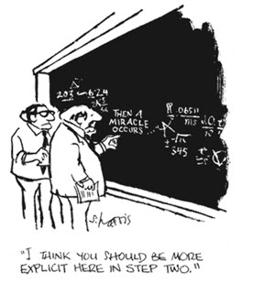
What is reproducible research?
Same procedure = same results
Transparent

Slide 3
Why do we care?
You want to verify the results
You want to test the software
It is required by scientific journals
You want to collaborate with other researchers

Slide 4
Example
Your collaborator wants the 4000th value in numerical order
You run this in a second
sort longOutput.txt | head -4000 | tail -1
Result = 5505
He/she uses the result for his/her grant proposal, research design, experiment, etc.

Slide 5
What is needed to reproduce research/analysis?
Data
Software, compiler, interpreter, OS
Machine
Protocol / computer code
Results
Table
Plot
Image
IPython notebook

Slide 6
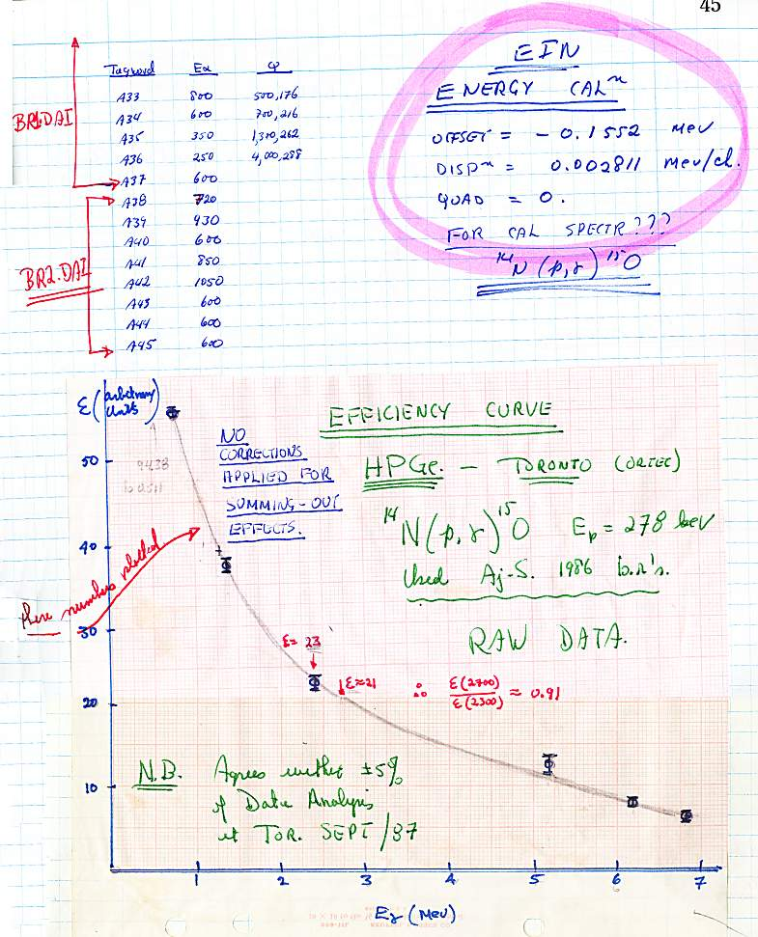
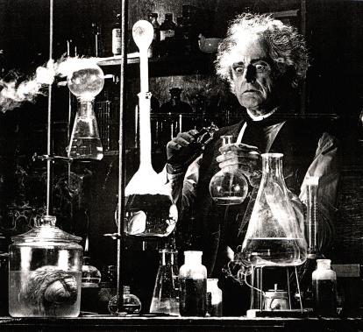
What is lab notebook?

Slide 7

What is Python?
Python
A general purpose, high-level programming language
Free and open source
Easy to learn
Batteries included (NumPy, SciPy, BioPython, etc.)
Used by Google, NASA, YouTube, Industrial lights and magic etc
Interpreted (no edit-compile-debug cycle)
Support object oriented, functional and imperative programming paradigms
C, Java (Jython), .NET (IronPython) and Python (PyPy) implementation are available
It’s been around for more than 20 years!!
Learn more at www.python.org

Slide 8
What is IPython?
Python interactive shell + cool features
Text interface
GUI interface (Qt backend)
Web interface (IPython notebook)
Parallel computing
And many more!
Check out www.ipython.org

Slide 9
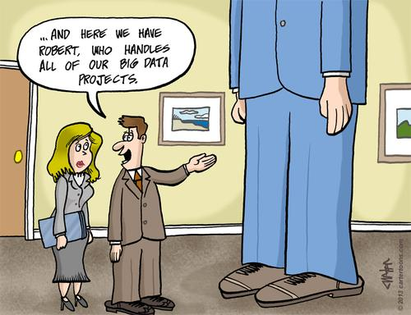
What is IPython Notebook
IPython shell + web interface
Support
Inline plot, image, video
HTML, LATEX, JavaScript
Shell commands
Other languages (Perl, R, Octave)
Output format
HTML
PDF
JSON
Plain text
Python code

Slide 10
Let’s get started
Go to https://github.com/ged-lab/2013-srop-summer
Click notebook link
Click ipython notebook file -> raw format and save page as a text file to your documents folder

Slide 11
Launch IPython notebook
Click All Programs -> Enthought → Canopy
Click Run
Type CMD hit enter
In Windows terminal, type ipython notebook

