Slide 1
Version Control!
[And why you should use it]
Chris Welcher
5/21/2013

Slide 2

“What shall I work on today?”

Slide 3

*scroll*
*click*
*scroll*
*scroll*
*click*
*scroll*
*click*

Slide 4
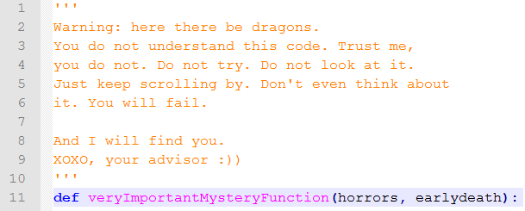

“I bet it could run a little faster… and what would the harm be?”
Notes:
Being the intrepid young scientists you are…

Slide 5


Slide 6

1 hour later…

Slide 7

2 hours later…

Slide 8

Early afternoon…

Slide 9

‘Round 5 o’clock…

Slide 10

By midnight.

Slide 11

“Wellll, that didn’t work out so well. Guess I’ll just have to switch it back to the way it was! I’ll just pull up that old file…”

Slide 12

“Where has it gone…”
Notes:
Only to discover that its been relegated to cybernetic oblivion.

Slide 13
“Oh, the humanity! What cruel twist of fate finds me in this dark time!
IF ONLY WE USED VERSION CONTROL!!!”

Slide 14

What is version control?
Version control gives you a history of all the changes that have been made to a file or set of files
It’s like an infinite undo button for your code, and much more…
Notes:
Keeps track of each file line by line
Can give a listing of which lines were edited, when, and by whom
Lets your revert to older versions when things hit the fan

Slide 15
What is version control?
Version control can also keep track of changes made by different authors, without conflicts
Like google docs, without that group member constantly inserting profanities (well, maybe)
Notes:
Can track history in multiple locations, and then merge together the results
Or, in the simplest case, notifies you when your changes are in conflict with other changes

Slide 16
Git
For our purposes, we’ll be using a version control system called ‘Git’
Git is a distributed version control system which is easy to learn and quite powerful
Originally designed to manage the core of the Linux operating system
Only requires a few easy commands to use

Slide 17

How it Works
Git creates a “repository” or “repo” in the directory containing your files
You tell Git which files you want it to track
When you want to set a checkpoint, you “commit” your changes
Notes:
The repo itself is just a file that tracks the history and content
The repo files will be hidden, and can be viewed by making hidden files visible, but you won’t need to edit them
The repo can be cloned (copied), and changes from other repos can be combined with different version

Slide 18
GitHub
We’ll be using a public repo server called GitHub
GitHub keeps a copy of your repository, which you can “push” changes to and “pull” changes from
This let’s you have multiple repos of the same project, which can be kept synchronized with the “master” copy on GitHub

Slide 19
www.github.com
But enough of that, let’s start version controlling!
Notes:
Go to github, and create an account
It’s free, and just needs a username and email address

Slide 20
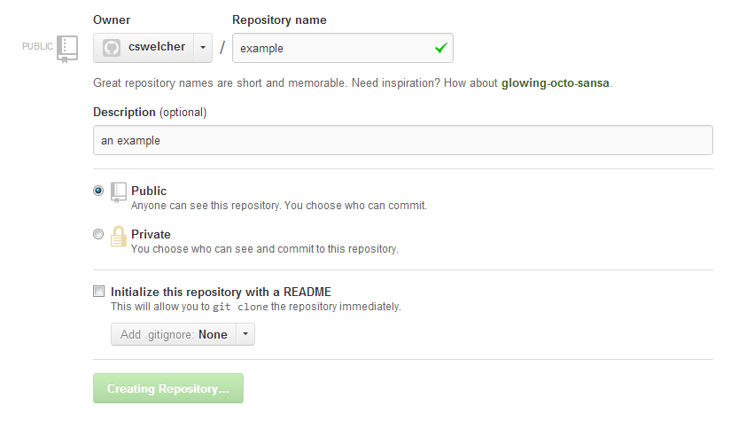
Notes:
Creating a repo
We won’t add a readme yet, because you already have files

Slide 21
Creating your Repo
First, you’ll need to navigate to your directory
Open up git, and navigate to your project
In this version for Windows, your root drive (the C: drive) is called /c, your personal network space is ‘/p’, and directories are separated by ‘/’
So, you can use:
“cd /p/path/to/your/project”

Slide 22
Now, run:
“git init”
This initializes a repo
Then,
“git add <your files>
“git add .” will add everything in your directory
This tells git which files to track

Slide 23
Then, you want to commit your first changes
“git commit –m “some message”
The –m flag tells git to include a message about the changes
At first this can be something like “initialized repo,” but for other changes you’ll want something more descriptive

Slide 24
Now we tell the local repo about your GitHub repo
“git remote add origin <url to your repo>”
This can just be copied from the page after your GitHub repo is created
Now, push our local files to GitHub
“git push –u origin master”

Slide 25

The location of your GitHub repo

Slide 26
Committing New Changes
In the future, you can just add the files you’re currently working on with “git add”
When you want to push changes to GitHub, just use “git push”
The repo can be cloned to any other computer using “git clone <url to repo>”
The Git website provides the URL for your repo

Slide 27
Moar!
Git has a host of other features:
diff: shows differences between files
merge: cleanly merges in changes from conflicting file version
branch: creates a working copy of a repo to be merged back at a later date

Slide 28
Summary
git init: create a new repo
git pull: pull changes from a remote repo
git push: push/send changes to a remote repo
git clone: create a local copy of a repo
http://git-scm.com/documentation

Slide 29
Image Credits
“rage comic” images courtesy of http://ragefac.es/
“brilliant!” meme image from http://www.brainygamer.com/photos/uncategorized/2008/09/16/brilliant.jpg
Git Logo from http://git-scm.com/

