Slide 1
Command Line Tools
Alexis Black Pyrkosz
SROP Comp Workshop: Day 1

Slide 2
Several powerful text editing tools
Grep: search
Sed: find and replace
Awk: manipulate columns of data
Text editors: manually edit files

Slide 3
Grep
Grep is a search utility that matches a user-text to all lines in a file.
The name is derived from the syntax that was used to launch it back when it was part of the ed text editor (g/re/p).
It is case sensitive.
Regular expressions, also known as regex or re can be used.

Slide 4
Grep Options
Grep: searches a file or files for a user-text and returns all lines containing the text
Grep –v: search a file or files for a user-text and returns all lines not containing the text
Grep –l: search a set of files for a user-text and return the names of the files containing the text

Slide 5
Problem 2.1
Download ftp://ftp.ensembl.org/pub/release-71/fasta/homo_sapiens/cdna/Homo_sapiens.GRCh37.71.cdna.all.fa.gz
Determine the number of transcripts in humans
191495
Determine the number of retained_introns in human transcripts
27920
Notes:
Grep ‘>’ Homo_sapiencs.GTCh37.71.cdna.all.fa | wc –l
Grep ‘retained_introns’ Homo_sapiencs.GTCh37.71.cdna.all.fa | wc –l

Slide 6
Sed
Sed is a stream editor, meaning that it reads input text, line by line, and processes it
The name is derived from the old ed text editor
Sed also supports regular expressions
Standard syntax: sed ‘s/old/new/g’
Where s indicates substitute
Where g indicates global

Slide 7
Problem 2.2
Using the human transcriptome file, change all the T’s in the sequences to U’s and save it under a new name (preferably with RNA in the filename)
Make a list of all the transcript names and delete the ‘>’ from the beginning of each name. Save this to another file with an appropriate name.
Notes:
Sed ‘s/T/U/g’ Homo_sapiens.GRCh37.71.cdna.all.fa > Homo_sapiens.GRCh37.71.cdna.all.fa_TtoU.txt
Grep ‘>’ Homo_sapiens.GRCh37.71.cdna.all.fa | sed ‘s/>//g’ > Homo_sapiens.GRCh37.71.cdna.all.fa_transcriptNames_noSymbols.txt

Slide 8
Awk
Awk is considered a programming language, but can be used fairly simply to extract data.
It is named for its authors: Alfred Aho, Peter Weinberg, and Brian Kernighan.
Awk usually written as a series of action pairs and is useful for print specific columns of data:
E.x. Awk ‘{if ($1 == ‘true’) print $0}’
E.x. Awk ‘{if ($1 == ‘true’) print $2, $3, $4}’

Slide 9
Awk Built-in variables
NR: keeps a count of the number of input records
NF: keeps a count of the number of columns (fields) in a record
FS: field separator or delimiter, usually a tab or space, but can be reassigned to commas and other characters as needed
Several others

Slide 10
Problem 2.3
Use your last file with the list of transcript names and select only the first column (ENST…). Sort this column numerically and save it in a new file.
Download https://dl.dropboxusercontent.com/u/77362135/6_spec_snps_refAlt_browser_decrement.pgSnp
Notes:
Awk ‘{print $1}’ Homo_sapiens.GRCh37.71.cdna.all.fa_transcriptNames_noSymbols.txt | sort –n > Homo_sapiens.GRCh37.71.cdna.all.fa_transcriptNames_noSymbols_firstColumn_numericSort.txt

Slide 11
Problem 2.3 continued
Determine the number of SNPs in chr1.
598806
Find the number of SNPs in chr2 between 100005112 and 100250811.
718
Make a file containing the SNPs in chr1 in the previous interval and include columns 1, 3, and 4.
Notes:
Grep ‘chr1 ’ 6_spec_snps_refAlt_browser_decrement.pgSnp | wc –l
Grep ‘chr 2 ’ 6_spec_snps_refAlt_browser_decrement.pgSnp | awk ‘{if ($2 >= 100005112 && $3 <= 100250811) print $0}’ | wc –l
Grep ‘chr 1 ’ 6_spec_snps_refAlt_browser_decrement.pgSnp | awk ‘{if ($2 >= 100005112 && $3 <= 100250811) print $1, $3, $4}’ > ’ 6_spec_snps_refAlt_browser_decrement.pgSnp_chr1_100005112to100250811_cols134.txt

Slide 12
UNIX text editors
Command line text editors have been standard since the 1970s
They are useful for producing plain-text files. Word and other advanced word processors save formatting characters in files that render them useless for programming.
Many editors exist, some are general purpose, some are specialized for specific tasks or programming languages, some are well-supported
Most common production editors: vi (or vim) and emacs
Most common beginner editors: pico and nano

Slide 13
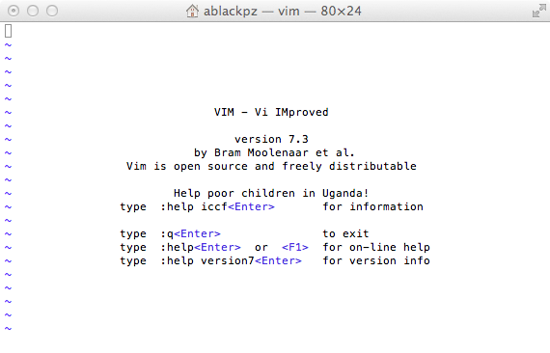
Vi and vim

Slide 14
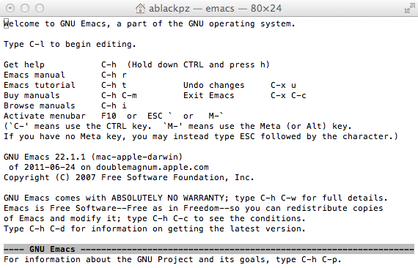
Emacs

Slide 15
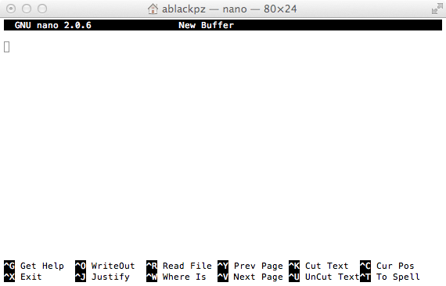
Nano

