Slide 1
CSSE 220
Course Evals
Notes:
No quiz today
1

Slide 2
Student Evaluations
The school treats these very seriously
We treat them very seriously too...usually reading them multiple times
Try to be as honest and detailed as you can
If you liked the course, don’t say nice things about us (though we like that of course), tell me what topics you thought were most exciting or useful
Notes:
2

Slide 3
Next Class: Your Presentations
8 minutes long
~3 minutes showing off your extra features
~5 minutes explaining JUST ONE technical decision in detail
Could be a design decision, feature implementation, or tricky bug
Be careful about code examples (good – but in moderation)
Should include prepared slides usually including diagrams
Notes:
3

Slide 4
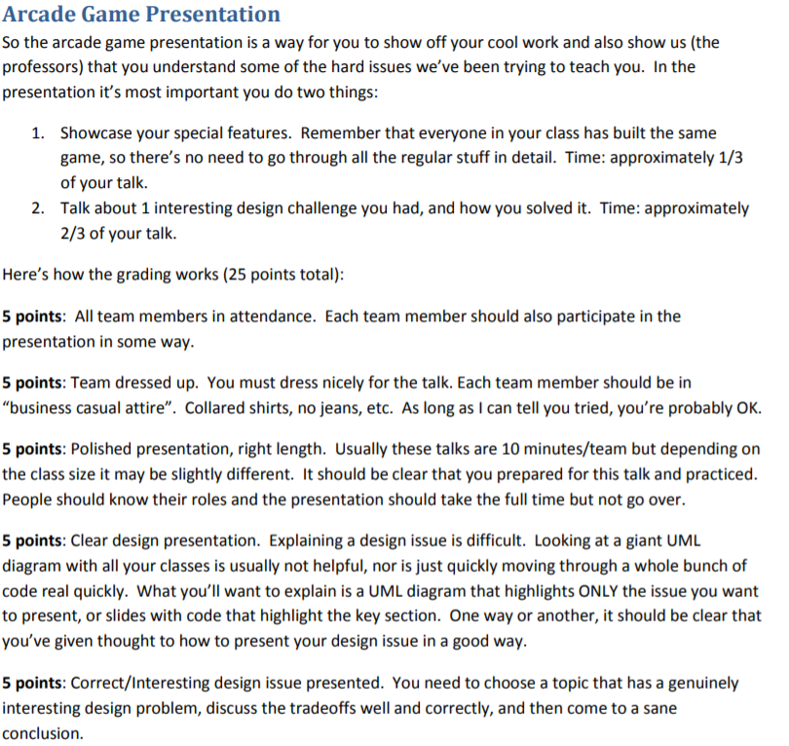
Notes:
Dress 1 step up form your normal dress level

Slide 5
Work time
PRESENTATION IS TOMORROW!!!
Team Project
Notes:
5

