Slide 1
Source Control 101

Slide 2
If a team of developers is collaborating on a project why can't you use something like Dropbox to keep in sync?
Question:

Slide 3
If a team of developers is collaborating on a project why can't you use something like Dropbox to keep in sync?
Question:
Answers:
If two people are editing different files at once it is likely to break the code
If two people edit the same file it is easy for one save to destroy changes made by an earlier save

Slide 4
Source control is syncing help for developers
Your changes are broken into "chunks" called commits that can change multiple files at one time on a local copy
You only sync with the shared repository when you intend to
Source controls system allows you to go back to any historical version
The source control system will prevent you from accidentally destroying someone else changes by overwriting files they changed

Slide 5
Git basic workflow
Before you start work, you PULL, syncing your local system with any changes other developers have made to the shared repository since you last worked
On your local copy, you add some code, make a feature, etc.
When you are finished, you combine (ADD) all your changes into a COMMIT and PUSH that commit to the shared repository

Slide 6
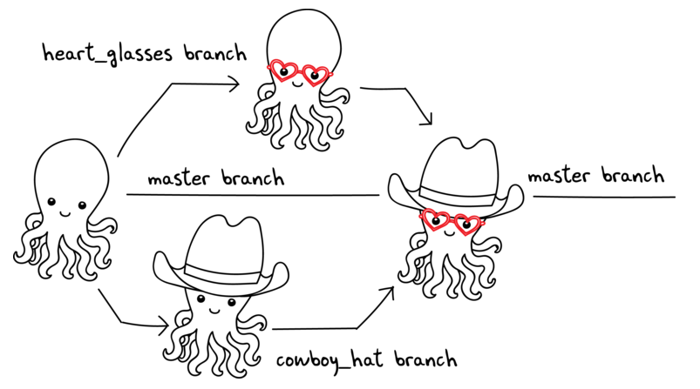
Merge conflicts
A merge conflict happens when two developers edit the same file at (approximately) the same time
merge conflict

Slide 7
Git more complicated workflow
Before you start work, you PULL, syncing your local system with any changes other developers have made to the shared repository since you last worked
On your local copy, you add some code, make a feature, etc.
You try to COMMIT and PUSH, but it fails because your code was not up to date
On the PUSH, git usually gives an error reading: ''not fast forward"
So you PULL again
On your local system, git potentially marks several of the code files to be in conflict, you fix the conflicts in your code by making more edits
You test your code
You stage the changed files (ADD)
You COMMIT and PUSH

Slide 8
Fixing conflicts – what it looks like
SomeFile.java
SomeCode
>>>>>>>>> HEAD
YourCode();
==========
TheirCode();
<<<<<<<<<<
MoreCode
You will see eclipse errors – do not get weirded out
Realize that you are merging two branches of the code
Edit the code to fix the problems
Do not forget to test

Slide 9
To Reduce the Occurrence of Conflicts
Always PULL before you begin coding
Quickly COMMIT/PUSH after you finish
Pair program on one computer so each member of the team is not modifying the same code at the same time

Slide 10
Practice
With your team, follow the instructions to get your repo setup
https://github.com/hewner/csse220/blob/master/Homework/ArcadeGame/GitlabInstructions.md
You will submit your ArcadeGame from your repo

