Slide 1
CSSE220 Final Project Tools: Pair Programming and Source Control 101
The project for today is just your final code repository

Slide 2
Agenda
Explanation of Normal Pair Programming
Explanation of Remote Pair Programming
Source Control Overview
Project Specific Guidelines to using Github

Slide 3
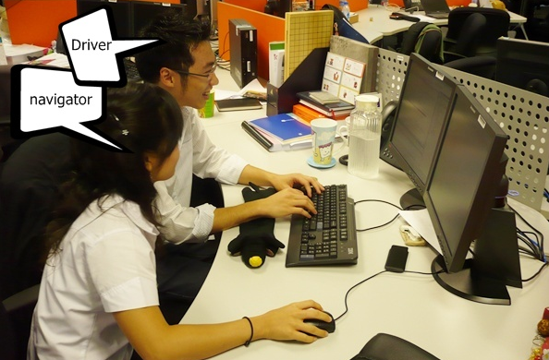
Pair Programming (Normally)
Working in pairs on a single computer
The driver, uses the keyboard, talks/thinks out-loud
The navigator, watches, thinks, comments, and takes notes
Person who really understands should start by navigating
Enable the pair to produce higher quality code than that produced by the sum of their individual efforts
Reduces number of errors
Saves time in the long run
Notes:
Q: What are the two roles in Pair Programming? [driver and navigator]

Slide 4
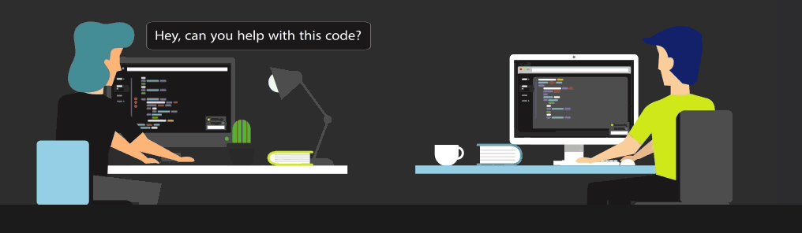
Pair Programming (Remotely)
Working in pairs on two different, remote computers
The driver, uses the keyboard, talks/thinks out-loud
The navigator, watches, thinks, comments, and takes notes
Person who really understands should start by navigating ☺
To allow the navigator to see what driver is doing, you must use some kind of tool such as
Screen sharing via MS Team (or Zoom/etc)
https://www.codetogether.com/ Eclipse plugin allows you to work together through a browser
If you have trouble sharing screens because of internet bandwidth issues or find it too clunky:
the https://www.codetogether.com/ Eclipse plugin might be a good tool for you and your partner to use
You could do a phone call or audio only call via MS Teams
Similarly, remote pair programming enables the pair to produce higher quality code than that produced by the sum of their individual efforts
Driver
Navigator
Notes:
Q: What are the two roles in Pair Programming? [driver and navigator]

Slide 5
Things to DO
Meet Regularly – setup times when you will regularly work on the project
Talk – not a minute should go by when you are not communicating
Listen – each partner should be fully involved in the project
Rotate Roles – change roles to gain new perspectives and share the work
Be Patient – It’s a virtue, by explaining yourself, you help yourself learn
Respect – everyone has something to offer
Take Breaks – When you return, you may notice something you missed
Prepare – Do any preliminary work ahead of time (not code)
Have Fun – Working with someone else can be a lot more fun!

Slide 6
Things NOT to do
Don’t: Force your opinion as the only option
Always assume your partner may have equally good ideas to contribute!
Don’t: Be intimidated
You know more than give yourself credit for!
Don’t: Be Quiet
Don’t be afraid to speak up if you don’t agree with your partner!
Don’t: Suffer in Silence
If you have a problem with your partner, let your TA or professor know right away!

Slide 7
Agenda
Explanation of Normal Pair Programming
Explanation of Remote Pair Programming
Source Control Overview
Project Specific Guidelines to using Github

Slide 8
If a team of developers is collaborating on a project why can't you use something like Dropbox to keep in sync?
Question:

Slide 9
If a team of developers is collaborating on a project why can't you use something like Dropbox to keep in sync?
Question:
Answers:
If two people are editing different files at once it is likely to break the code
If two people edit the same file it is easy for one save to destroy changes made by an earlier save

Slide 10
Source control is syncing help for developers
Your changes are broken into "chunks" called commits that can change multiple files at one time on a local copy
You only sync with the shared repository when you intend to
Source controls system allows you to go back to any historical version
The source control system will prevent you from accidentally destroying someone else changes by overwriting files they changed

Slide 11
Team Version Control
Version control tracks multiple versions
Enables old versions to be recovered
Allows multiple versions to exist simultaneously
Always:
Pull BEFORE working
Pull AGAIN before committing
Commit + Push often and with good messages
Communicate with teammates so you don’t edit the same code simultaneously
Pair programming ameliorates this issue ☺
Q2
Notes:
QUIZ QUESTION 2
If you only use one computer then this will never happen.

Slide 12
Git basic workflow
Before you start work, you PULL, syncing your local system with any changes other developers have made to the shared repository since you last worked
On your local copy, you add some code, make a feature, etc.
You PULL again just in case something else go updated when you were working (i.e. your partner made a change)
When you are finished, you combine (ADD) all your changes into a COMMIT and PUSH that makes changes to the shared repository

Slide 13
What if Two+ People Edit the Same Code?
Math.java
Alice edits sqrt method
Bob edits sqrt method
Alice commits and pushes changes
Bob attempts to commit and push changes
ERROR
Source control system cannot
resolve multiple changes on the
same code, Bob should have
updated and resolved conflicts
before committing.
Updated Math.java

Slide 14
Team Version Control Simple Workflow
git clone
(one time)
Pull and
Commit + Push often!
Pull BEFORE editing!
Pull
Edit
Commit + Push
Pull
Pull BEFORE committing!
Notes:
Update before editing or committing to make sure you don't get out of sync with changes made by others (like your instructor, or later your teammates).

Slide 15
Git more complicated workflow
Before you start work, you PULL, syncing your local system with any changes other developers have made to the shared repository since you last worked
On your local copy, you add some code, make a feature, etc.
You try to COMMIT and PUSH, but it fails because your code was not up to date
On the PUSH, git usually gives an error reading: ''not fast forward"
So you PULL again
On your local system, git potentially marks several of the code files to be in conflict, you fix the conflicts in your code by making more edits
You test your code
You stage the changed files (ADD)
You COMMIT and PUSH

Slide 16
Fixing conflicts – what it looks like
SomeFile.java
SomeCode
>>>>>>>>> HEAD
YourCode();
==========
TheirCode();
<<<<<<<<<<
MoreCode
You will see eclipse errors – do not get weirded out
Realize that you are merging two branches of the code
Edit the code to fix the problems
Do not forget to test

Slide 17
To Reduce the Occurrence of Conflicts
Always PULL before you begin coding
Quickly COMMIT/PUSH after you finish
Pair program so each member of the team is not modifying the same code in two DIFFERENT local copies at the same time
https://www.codetogether.com/ Eclipse plugin allows you to both edit, but it is only linked to ONE local set of files.

Slide 18
Code Together Workflow
Driver initiates a CodeTogether session and shares it with Navigator
git clone
(one time, both Driver and Navigator)
Pull
(Driver’s computer)
Navigator connects and then watches and gives feedback via phone/conference call
Navigator: Pull
(files are now on Driver, Navigator AND github.com)
Driver: Commit + Push
(files are now on Driver and github.com)
Driver + Navigator work together to make progress and then save their files
(only on Driver’s computer)
Pull
Pull just to be safe here
Notes:
Update before editing or committing to make sure you don't get out of sync with changes made by others (like your instructor, or later your teammates).

Slide 19
Remote Programming Code Edits Visualized
Github.com repo
Main.java
David (Driver)
Natalie (Navigator)
Clone
Github.com repo
Main.java
David (Driver)
Main.java
Natalie (Navigator)
Main.java
Edit
Github.com repo
Main.java
David (Driver)
Main.java
Level.java
Natalie (Navigator)
Main.java
Commit +
Push
Github.com repo
Main.java
Level.java
David (Driver)
Main.java
Level.java
Natalie (Navigator)
Main.java
Github.com repo
Main.java
Level.java
Pull
David (Driver)
Main.java
Level.java
Natalie (Navigator)
Main.java
Level.java
Notes:
Update before editing or committing to make sure you don't get out of sync with changes made by others (like your instructor, or later your teammates).

Slide 20
Git Problem Resolution Guide
How to update to latest version of code when you don’t care about your local changes (i.e. Team->Pull gives a “'not fast forward“ error)
Replace With-> HEAD and then Pull (removes all local changes)
Still unable to Pull?
Simply delete project and re-clone
Want to revert to an earlier commit? Simplest way:
clone the repo again as a new project (use a different name for new project)
checkout the version you want (How to go to previous commits in eclipse and egit)
copy the files you want from this new project into your original and then commit + push
delete the new project since you don't want to get them mixed up

Slide 21
Practice
With your team, follow the instructions on Piazza to get your repo setup
You will submit your ArcadeGame from your repo

