Slide 1
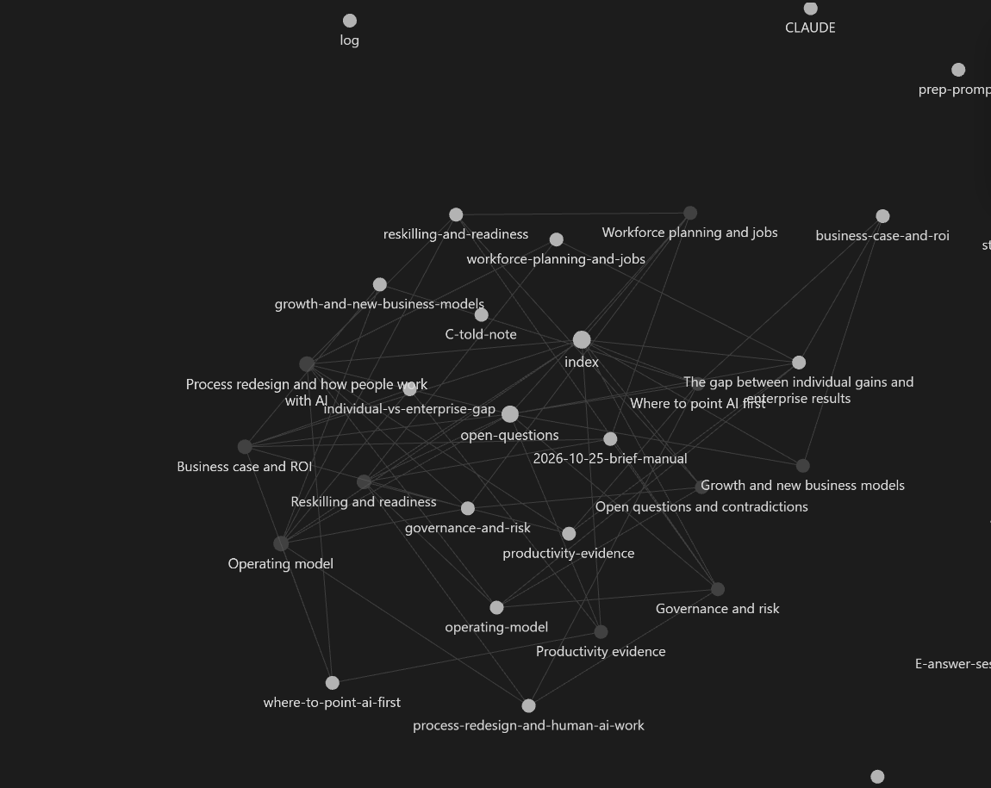
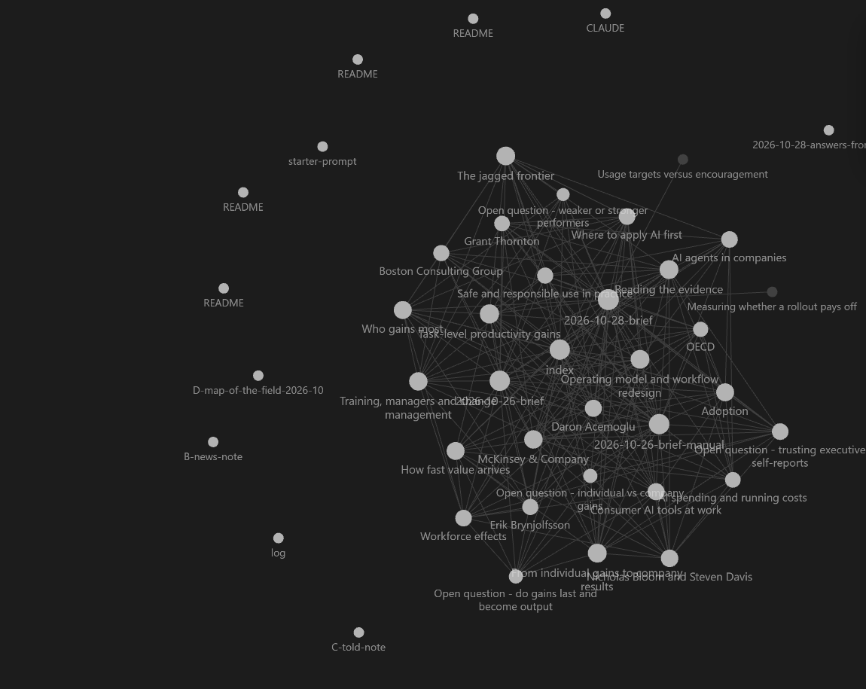
SO WHAT, NOW WHAT · ISSUE 10
Same subject, two brains: one links up, one does not
Each point is a page; each line is a link between pages. Obsidian graph view, 28 October 2026.
Brain A, built in Claude Code: 11 pages
The links name page titles, but the files have short names, so 0 of 11 links resolve. Each page shows up twice: once as a file, once as a faded title that leads nowhere.
Brain B, built in the Claude app: 26 pages
Each file is named exactly like its page, so every link resolves. The two faded points are pages the latest brief proposes and I had not yet approved.
Screenshots from my own computer. The fix is one line in the kit: name each file exactly like its page.

