Slide 1
Welcome
Thank you for joining us for today’s Test CoP event.
For those who are using AT&T Connect to attend this event:
We will begin the meeting promptly at 12:00 PM EST.
Please mute your phone lines to avoid system feedback.
Please do not use the Hold feature on your phone if your system plays music or an automated message.
There will be a structured Q&A Session at the end of the presentation.
Thank you! We will get started shortly!

Slide 2
USCIS OIT Test CoP
Continuous Integration/Delivery
March 12, 2015

Slide 3


Introductions
Moderator
Presenter
Karen Szymczak, Test CoE Training Lead
Robert Brown,
Test CoE DevOps
CISSP, ITILv3, CSM, JNCIA

Slide 4
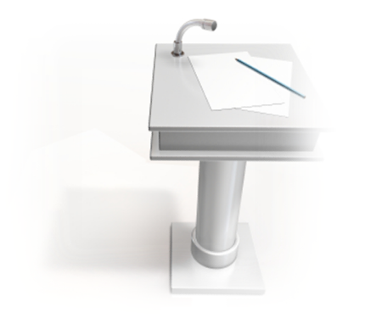
Today’s Agenda
Objectives
Background
Continuous Integration (CI)
Continuous Delivery (CD)
Delivery Pipeline
CI/CD Fitness
Q&A
Wrap-Up

Slide 5
Objectives
Upon completion of this event, you will be able to …
Explain the origins of CI/CD
Describe key CI/CD concepts and practices
Describe a Delivery Pipeline
Explain the purpose of the CI/CD Fitness Model

Slide 6
Definitions
Agile Development Process
“An iterative and incremental (evolutionary) approach to software development which is performed in a highly collaborative manner by self-organizing teams within an effective governance framework with "just enough" ceremony that produces high quality solutions in a cost effective and timely manner which meets the changing needs of its stakeholders.” – Scott Ambler
Agile Manifesto
Principles that outline the Agile Process
Notes:
Start at the beginning
Agile Development process – key components –
Evolutionary approach
Collaboration
Timely customer focused solutions

Slide 7


Definitions
Continuous Integration
“Continuous Integration is a software development practice where members of a team integrate their work frequently, usually each person integrates at least daily - leading to multiple integrations per day. Each integration is verified by an automated build (including test) to detect integration errors as quickly as possible” – Martin Fowler (2006)
“Continuous Integration represents a way of thinking about your development process rather than a concrete or speciﬁc technique.” – Cauldwell (2008)
Notes:
Glenn Beck – Extreme Programming – LEAN Principles – direct result of this work
Integrate Continuously
CI is a process/practice not a product…..

Slide 8
Motivations
Why do engineers care about integration?
New problems will inevitably surface
Many systems now together that have never been before
If done poorly, all problems present themselves at once
Hard to diagnose, debug, and fix
Cascade of interdependencies
Cannot find and solve problems one-at-a-time
Notes:
Multiple people working in tandem on same system
All about change
Manually…You get
Merge Conflicts: Modifications of same line of code concurrently
Compile Conflicts: Modifications of dependencies or class
Test Conflicts: concurrent file modification resulting in system not executing
Cannot forecast correctly for fix time in a non-integrated environment… costly.

Slide 9
Continuous Integration
Continuous Integration
Design
Code
Build
Test
Release
Deploy
Operate
Agile Development
Idea
Innovation
Feature
Fix
Feedback
Continuous Improvement
Notes:
Illustrate the iterative nature of the practices in a manner similar to a manufacturing plant –
Emphasize culture/feedback loops and automation

Slide 10
Continuous Integration: What is it?
At a regular frequency (ideally at every commit), the system is:
Integrated - All changes up until that point are combined into the project
Built - The code is compiled into an executable or package
Tested - Automated test suites are run
Archived - Versioned and stored so it can be distributed as is, if desired
Deployed - Loaded onto a system where the developers can interact with it
Notes:
Makes development easier, organized and simplifies team/group development.
Iterative Development + Automated Testing
Environments based on stability
Maintain a code repository
Commit frequently and build every commit
Make the build self-testing
Store every build
You have to be disciplined to make continuous integration work.
There is a very high cost to re-writing things.
When you think of Hershey's, you think of chocolate. Here's something else to think about:
Hershey has a history of embracing changes. Unfortunately some of Hershey's changes were not well executed. For instance, in the summer of 1999, Hershey demonstrated a new computer system that was going to automate and modernize Hershey's operation. The computer system was going to control everything from taking candy orders to loading shipments on trucks. Instead, the new system has paralyzed Hershey's ordering and distribution system, leaving numerous stores without inventory. The problems with the implementation of the automated system created numerous problems between Hershey and their customers.
Hershey worked around the clock to fix the problems, but the problems persisted through the heavy holiday seasons. Since almost one-half of annual candy sales are made between October and December, Hershey lost significant revenues. Hershey took a considerable risk when the company decided to implement the entire computer system all at once. As a direct result of the blunder, the company's stock declined by over fifty percent from a high of over $70 in the fourth quarter of 1998 to about $35 in the first quarter of 2000

Slide 11
Ten Principles of Continuous Integration
Maintain a single source repository
Automate the build
Make your build self-testing
Everyone commits to mainline every day
Every commit should build mainline on an integration machine
Keep the build fast
Test in a clone of the production environment
Make it easy for anyone to get the latest executable
Everyone can see what's happening
Automate deployment
Notes:
2-4 are critical Principles to adopt – a baseline whereas the others can be built upon.

Slide 12
Continuous Integration Prerequisites
Version control
An automated build, outside integrated developer environment (IDE)
Collaboration
Check in frequently
Maintain a large automated test suite
Keep build and test phase short
Notes:
Vital step when practicing CD
Recall: To practice CI, every developer on a project must integrate their work daily with every other developer
Everyone on the team needs to practice this for it to work
Continuous integration is not a tool, but a technique
But there are many open source tools to help practice CI

Slide 13
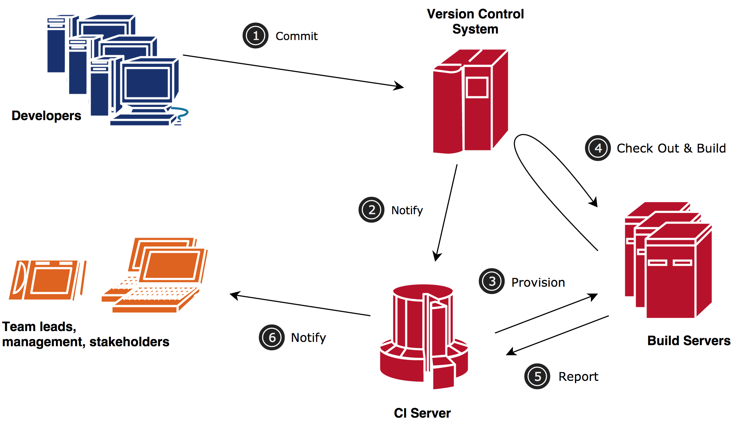
Continuous Integration Workflow
Notes:
Very basic – missing testing, notifications and artifact repo.
a svn/git commit launches the Continuous Integration process
Components:
DEV->Commit to Repo
CI server pulls form repo and performs the the build
Nexus or Artifact repo:
Keep built libraries in local Build tool (Maven/Gradle) repository
Nexus proxies Maven Central and stores local libraries
Hudson pushes to Nexus
Hudson keeps builds of deployable project
This maybe goes without saying, but when you are small enough, say just one developer, you probably are tempted to work on your files on your desktop machine. Maybe you copy the files to a network share every night. That's a good start, but you should really consider investing some time in setting up a code repository, using it, and backing it up off site.
Committing Stable code to trunk
Trunk is the source of record for the main build server
When instability is introduced, stabilization is first priority
One thing continuous integration and a source repository gives you is the ability to test that you have all the artifacts needed to build your code and run your business.
Commit code to trunk that could be released. This requires a shift in your mindset. One might initially think that everyone should work on branches until their code is high enough quality to merge back to trunk. This is a bad idea, and I'll get into why this is bad later on. But think about this: Either you are working on brand new code that nothing else is calling, or you are fixing existing code. If its new, and no one calls it, then check it into trunk! Why branch it? If it's existing, you should follow the Boy Scout's camping motto and leave it better than you found it.
If the code builds on one persons box and not another's, you don't know if you need to fix the source or fix someone's environment.
If it doesn't build on the build server, it's a problem, and you don't need to argue with someone who claims that it builds fine on their own box.
If it builds on the build server but not on your box, than it's a problem on your box.

Slide 14
Continuous Integration Basics
Never check in a broken build!!
When you’re done developing:
Check to see if build is running - wait to see if it succeeds
Update to latest version
Build everything locally, and if it passes
Check your code into version control
Wait until CI server succeeds (don’t go home)
Notes:
Teams that are not in the same room need to have better agreements
Time zone differences need to be managed (and especially: never go home on a broken build)
Branches degrade CI usefulness
Distributed version control systems can be a pain and need to be managed very well if they are really distributed
Write unit tests with sufficient coverage for the important parts
Trigger a code build on every checkin or maybe every 5 minutes
Run unit tests as part of the build
Write integration tests for both UI and backend
Run integration tests frequently
Tests must be high quality & cover major functions
Detect issues early, and as they happen

Slide 15
What a CI Server can do
After you check-in code it can:
Run build/test scripts (automated)
Notify developers of a failed build or failed tests
Show all past check-ins and if they failed or passed all the tests
Keep track of multiple projects
Lots of other things…..
Notes:
Chef tastes food while cooking? Taste your code!

Slide 16












Continuous Integration: Tools
Code Repositories
SVN, Mercurial, Git, Perforce
Continuous Build Systems
Jenkins, Hudson, Bamboo, Cruise Control,
GitLab CI, Travis, TFS
Test Frameworks
Junit, Cucumber, CppUnit
Artifact Repositories
Nexus, Artifactory, Archiva
Notes:
Many more….

Slide 17
CI Benefits
Increases traceability of defects
Increases visibility of progress
Early feedback from end users
Allows for staged, or partial delivery
Reduces risk of major rework, and project slippage or failure
Notes:
Immediate bug detection
No integration step in the lifecycle
A deployable system at any given point (again if done correctly – e.g. commit early & often)
Record of evolution of the project

Slide 18
Anti-Pattern: Deploying Software Manually
Needs lots of documentation with steps
That are misinterpreted, and untested in a production-like environment
Many corrections during a release
Manual testing to confirm deployment
Releases take hours instead of minutes
Frequent roll-backs
Fingers crossed/weekend work
Notes:
Raise hand 3 or more

Slide 19
Correct Pattern
Automate deployments as much as possible
Scripts equal up-to-date documentation, encourage cooperation and sharing
Encapsulate expertise and are version-controlled like any other source code
Automation makes processes repeatable, testable, less boring and fast
Notes:
Raise hand 3 or more
Total up vs anti-pattern

Slide 20
Anti-Pattern: First to Production-like after Dev finished
Testers have only tested in a development environment
Production deplorers have never done deployment before
All kinds of infrastructure-related problems appear after the RRP said that development was done
Lots of fighting between operations and development
Notes:
Raise hand 3 or more

Slide 21
Correct Pattern
Start deploying to a production-like environment (staging) as soon as you start developing
Integrate testing, deployment and release into a standard part of your development process
If you already have good Continuous Integration, this means: add deployment/release to it (correctly)
Notes:
Raise hand 3
Total vs AP

Slide 22
Anti-Pattern: Config of Prod Environment
Configuration of an environment is a lot
Deployments to production fails after successful deployments to other environments
Differences between nodes in production
Cannot roll back your environment
Different versions of packages
Basically: No overview, no control

Slide 23
Correct Pattern
Set up your entire environment using an automated process that is stored in version control
Specifically any and all configuration - of your OS, of OS tools and middleware, and of your application
Your production environment is key - it must be reproducible in your staging and dev environments

Slide 24
Continuous Delivery
Continuous Delivery
Continuous Integration
Design
Code
Build
Test
Release
Deploy
Operate
Agile Development
Idea
Innovation
Feature
Fix
Feedback
Continuous Improvement
Notes:
Illustrate the iterative nature of the practices in a manner similar to a manufacturing plant –
Emphasize culture/feedback loops and automation

Slide 25
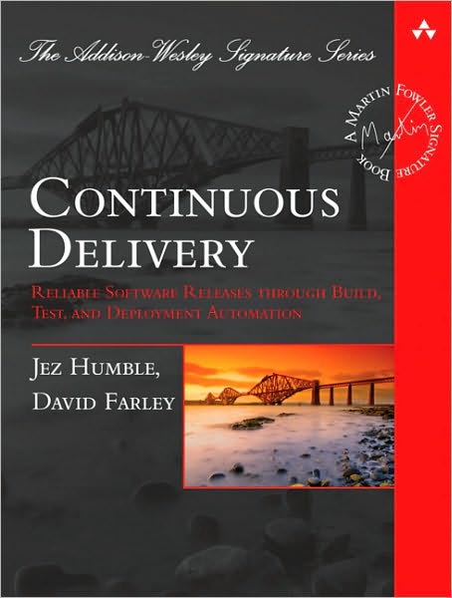
Definition
Continuous Delivery: “Releasing high quality software fast through build, test and deployment automation.”
Keywords:
Automation
Quality
Releasing (as opposed to ‘just’ deploying)
Written by Jez Humble and David Farley in 2010
1st principle of the Agile Manifesto:
“Our highest priority is to satisfy the customer through early and continuous delivery of valuable software.“
Notes:
Definition and reference CD book
Explains how to design/set up your continuous delivery process
Including CI, deployments, etc.
Explains good software development practices that are necessary for CD

Slide 26
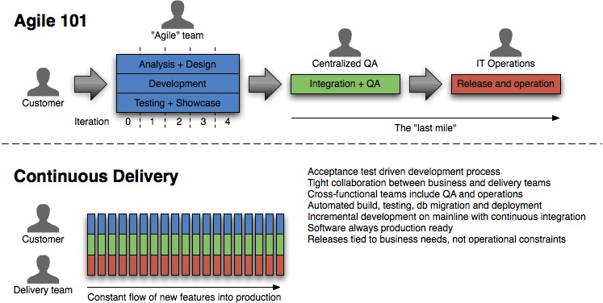
Continuous Delivery: Overview
Notes:
Agile and lean software development
Potentially shippable product (Scrum)
Deliver as Fast as possible (Lean)
Many concepts in Continuous Delivery come from Lean
Release Early, Release Often
Software is always in a releasable state.
From Continuous Delivery Jez Humble
http://ptgmedia.pearsoncmg.com/images/art_humble_continuousdelivery/elementLinks/humble_fig01.jpg

Slide 27
Continuous Delivery Basics
Basics to start practicing Continuous Delivery
Configuration Management
What needs to be kept under CM?
Everything!
Code
Tests
Configuration Files
Build Scripts
Environments
Documentation
Etc.
Notes:
C_D i_s_ _c_o_n_c_e_r_n_e_d_ _w_i_t_h_ _“…h_o_w_ _a_l_l_ _t_h_e_ _m_o_v_i_n_g_ _p_a_r_t_s_ _f_i_t_ _t_o_g_e_t_h_e_r_:_ _c_o_n_f_i_g_u_r_a_t_i_o_n_ _m_a_n_a_g_e_m_e_n_t_,_ _a_u_t_o_m_a_t_e_d_ _t_e_s_t_i_n_g_,_ _c_o_n_t_i_n_u_o_u_s_ _i_n_t_e_g_r_a_t_i_o_n_ _a_n_d_ _d_e_p_l_o_y_m_e_n_t_,_ _d_a_t_a_ _m_a_n_a_g_e_m_e_n_t_,_ _e_n_v_i_r_o_n_m_e_n_t_ _m_a_n_a_g_e_m_e_n_t_,_ _a_n_d_ _r_e_l_e_a_s_e_ _m_a_n_a_g_e_m_e_n_t_._”

Slide 28
CM Branching
Minimize branching and check into the main line/trunk
What if your project team is releasing to production every week, but you’re working on a feature that will take longer than the release cycle to implement?
First option: Gradually release feature into production
Second option: Feature toggle
Notes:
Stay away from branching except in special cases
Branch on releases
You must always check into the trunk!
Otherwise you’re not continuously integrating
Etsy – Canary release – illustrate value feedback to business.

Slide 29
Managing Environments
Must have multiple environments when developing software
Need to be able to duplicate environments with ease
Environments configurations to take consideration of:
Operating systems including their framework and settings
Packages needed to be installed for the application to function properly
Network settings
Common tools include:
CHEF
Puppet
Ansible
Notes:
Snowflake metaphor
Treat servers like cattle not pets…

Slide 30
Continuous Delivery Benefits
Build the right product
Constant feedback from customers
Write thorough acceptance tests
Earlier benefits
Find bugs earlier
Ability to react quickly to change
Not a huge amount of time and money can be abandoned to adopt new requirements
Save money and time
Notes:
Save money and time is project goes bad
Save money and time with automation
As deploying to production becomes easier, more time can be spent developing valuable features
Don’t think requirements — think testable hypotheses

Slide 31
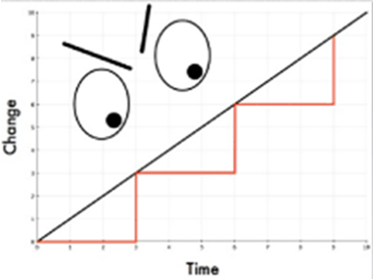
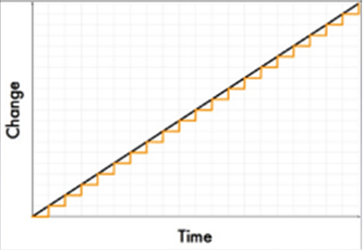
Continuous Delivery Benefits (cont’d)
Reliable

Slide 32
Deployment Pipeline
Describes your process of getting software from version control into the hands of users
Visibility: All aspects of the delivery system - building, deploying, testing, and releasing – are visible to all team members promoting collaboration
Feedback: Team members learn of problems as soon as they occur so that issues are fixed as soon as possible
Continually Deploy: Through a fully automated process, you can deploy and release any version of the software to any environment
Each step in the pipeline produces output which is taken up (pulled) by the next step when ready
Other names – CI pipeline, build pipeline, CD Pipeline, etc.
Notes:
Queston: Who uses a Pipeline?
Inspired by
Value Stream Maps - Lean Software Development: An Agile Toolkit. Mary and Tom Poppendieck
http://en.wikipedia.org/wiki/Value_stream_mapping
See page 106 of the Continuous Delivery Book

Slide 33
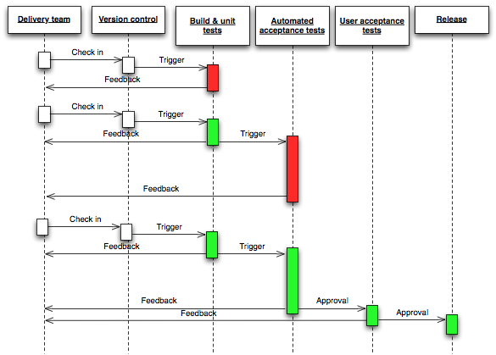
Deployment Pipeline

Slide 34


Continuous Delivery: Pipeline
How do you package the application?
Where did it come from?
How does it get deployed?
What is in production now? How do you know?

Slide 35
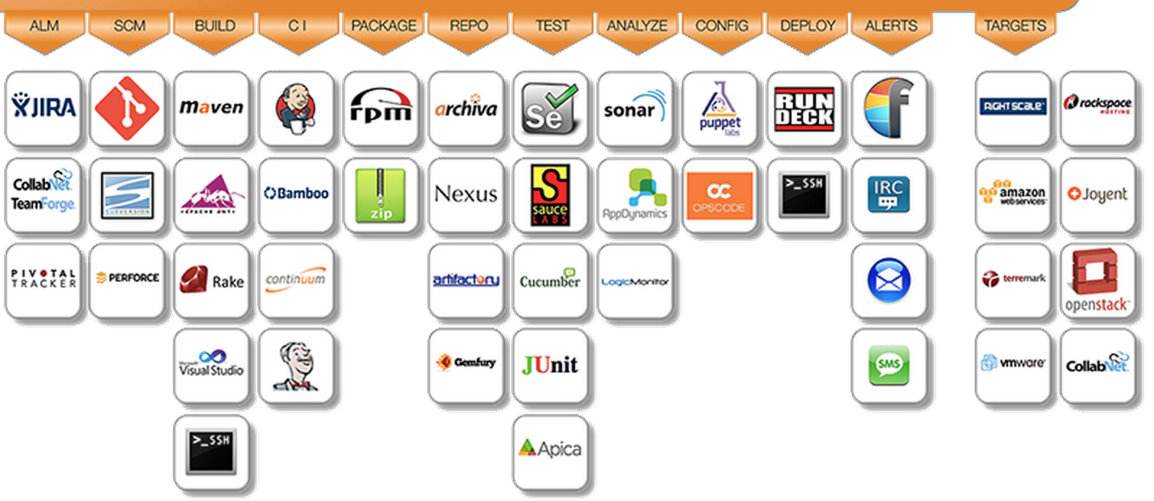
Continuous Delivery Tools

Slide 36
CI/CD Summary
Use version control
Automate testing as part of the build
Automate deployment to staging, test or production
Automate rollback
Deploy continuously to production
Incremental new features initially enabled for small set of users, then turned on for a wider audience
Let us help you with your CI/CD implementation!

Slide 37
CI…CD…DevOps
DevOps
Continuous Delivery
Continuous Integration
Design
Code
Build
Test
Release
Deploy
Operate
Collaborate
Agile Development
Idea
Innovation
Feature
Fix
Feedback
Continuous Improvement
Notes:
Illustrate the iterative nature of the practices in a manner similar to a manufacturing plant –
Emphasize culture/feedback loops and automation

Slide 38
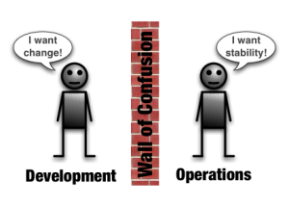
CI/CD - DevOps
The DevOps movement
Shares common goals
Development vs. Operations
Deployment automation
Loads of scripts, tools, commercial and open source products
Part/Extension of Continuous Delivery
Goal: Minimize cycle time, amplify feedback and deliver value smarter/faster
Notes:
DevOps: general explanation, then: it’s mainly from operations side. Operational stability is the goal, and thinking of software development and operations as a whole. Continuous Delivery approaches it from development side but shares many of the same goals. And many of the same tools.
Discuss how Agile improved the software development – business saw the cost savings and efficiencies but Operations was left out. Goal is to include Operations.
Deployment automation: tools like wsadmin, scripts, capistrano, loads of commercial tools
whole goal of continuous delivery is to minimize cycle time, which is the time between the decision to implement a change (feature, enhancement, bugfix, whatever) and its delivery to users

Slide 39
DevOps Myths
DevOps replaces Agile
DevOps replaces ITIL
DevOps means NoOps
DevOps is only for open source software
DevOps is just “infrastructure as code” or automation
DevOps is only for startups and unicorns

Slide 40
"Simply put, all unicorns were once horses. DevOps is how any horse can become a unicorn, if they want to become one. And in fact, the list of enterprises adopting DevOps continues to grow." Gene Kim

Slide 41
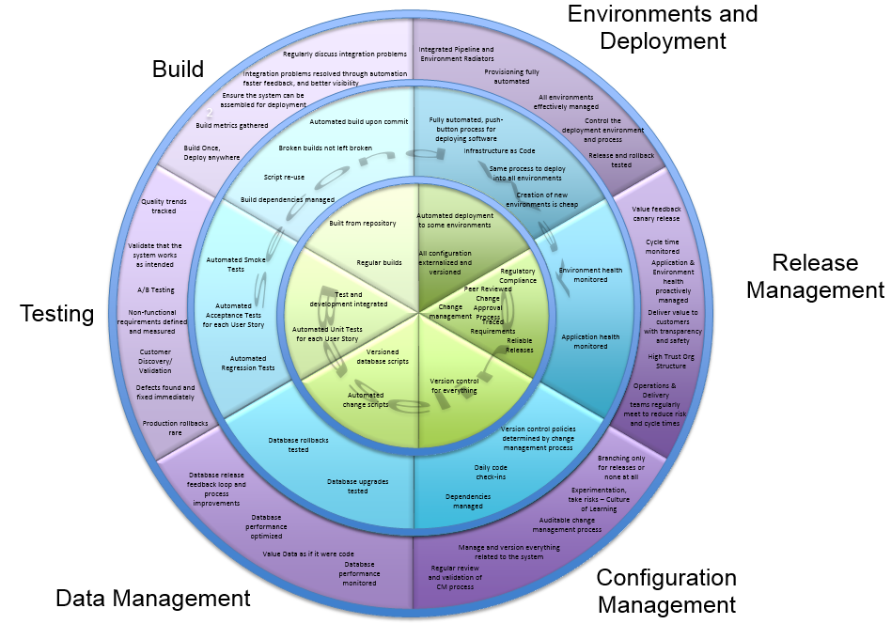
DevOps Fitness Model
Notes:
The Fitness Model is an organization specific collection of recommended practices, technologies, and tools to achieve the improve your Systems SDLC.
Help to create an organizational standard around a central set of tools and technologies
Provide a catalyst for teams looking to improve their existing Software Development Life Cycle
Continuously evolving to match with the organizational changes in policy, infrastructure, and available tools

Slide 42

Questions

Slide 43
Wrap-Up
For more information
If you have further questions or would like more information about today’s presentation, please contact Robert.D.Brown@uscis.dhs.gov
For more information about the Test CoP events, please visit the Test Center of Excellence ECN Wiki Page
http://ecn.uscis.dhs.gov/team/mgmt/Offices/oit/EUS/ccrm/CCRM_Team_Site/ITE/ITE_Team/ITE_Wiki/AETAS/
We value your feedback
For those of you attending in-person, please fill out the survey and leave it in the room
For those of you online, a survey was emailed to you with the reminder notice. Please fill it out and return it to TCOE@uscis.dhs.gov
Upcoming events
3/19, 3/24 Introduction to Test Automation Course
3/26 Test CoP, Pair Programming

