Slide 1
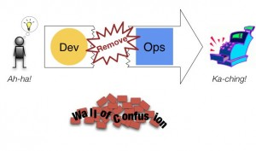
DevOps Tearing Down the Walls

Slide 2
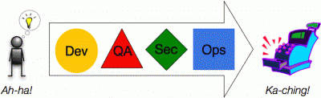

Slide 3
What does DevOps
mean to
YOU?

Slide 4
DevOps is…
About creating visibility between Dev and Ops
Not a set of tools
About creating self-service infrastructure for teams
Knowing that good software doesn't end with development/release
Not a role
Ensuring a continual feedback loop between development and operations
Not just CI/CD
Automation over documentation (and more automation... and more...)
Not a prescriptive process
Notes:
Cross-functional teams over organizational silos

Slide 5
What is DevOps?
DevOps is the practice of operations and development engineers participating together in the entire service lifecycle, from design through the development process to production support.
http://theagileadmin.com/
Notes:
Tricky to define, like its big brother Agile “I do what this Scrum book says so I’m doing Agile” is like “I’m using Chef so I’m DevOps, right?”
extending Agile principles beyond the boundaries of “the code” to the entire delivered service
Patrick Debois, (@patrickdebois) godfather of the DevOps movement, always says DevOps is a human problem. Most DevOpserati would agree

Slide 6
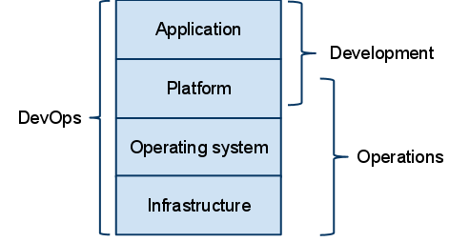
Agile Operations
Operations has 4 Work Types:
1.Business Projects (New Service)
2.Internal Projects (Implement CM)
3.Planned Changes (Tickets)
4. Unplanned Changes (Break-fix)
Notes:
Agile For Operations – 2009 – then 2010 DevOps (Velocity conferences – check them out)
Attempts to use Agile for Operations – Scrum
Failure:
From The Phoenix Project - Gene Kim

Slide 7
Goals
Quality
Continuous Improvement
(Adapt)
Limit WIP
Customer
Value
(short lead times)
Single Piece Flow
Embedded
Culture Change (no silos)
Reduce Risk
Governance without gates
Notes:
*Continuous release of software in easily accessed chunks that provide capability for meeting the user’s most urgent requirements
*Automatic integration and testing of applets, ensuring that they work together, access the correct version of the data, and do not make unregulated changes to data files or databases
*Minimal user training requirements through use of a commonly understood interface and simple access to needed features
*Support for a heterogeneous environment comprised of different types of devices, different operating systems, and different critical platforms
*A high degree of resilience due to the ability to make changes easily, as well as through distributed access as provided by the cloud

Slide 8
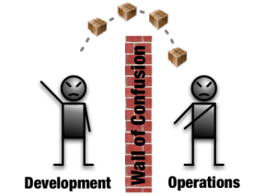
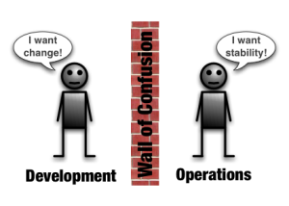
The “wall” caused by conflicting motivations, processes, and tooling
Historical Divide
Icons: http://dev2ops.org
Notes:
Development-centric folks tend to come from a mindset where change is the thing that they are paid to accomplish. The business depends on them to respond to changing needs.
Operations folks tend to come from a mindset where change is the enemy. The business depends on them to keep the lights on and deliver the services that make the business money today. Operations is motivated to resist change as it undermines stability and reliability.
Development and operations teams tend to fall into different parts of a company’s organizational structure and often work at different geographic locations.
With a few notable exceptions, like bug trackers and maybe SCM, it’s doubtful you’ll see much interest in using each others tools or significant integration between them.
Nowhere is the Wall of Confusion more obvious than when it comes time for application changes to be pushed from development operations to production. Development kicks things off by “tossing” a software release “over the wall” to Operations. Operations picks up the release artifacts and begins preparing for their deployment. Operations manually hacks the deployment scripts provided by the developers or creates their own scripts. They also hand edit configuration files to reflect the production environment, which is significantly different than the Development or QA environments. At best they are duplicating work that was already done in previous environments, at worst they are about to introduce or uncover new bugs.
Operations then embarks on what they understand to be the currently correct deployment process, which at this point is essentially being performed for the first time due to the script, configuration, process, and environment differences between Development and Operations. Of course, somewhere along the way a problem occurs and the developers are called in to help troubleshoot. Operations claims that Development gave them faulty artifacts. Developers respond by pointing out that it worked just fine in their environments, so it must be the case that Operations did something wrong. Developers are having a difficult time even diagnosing the problem because the configuration, file locations, and procedure used to get into this state is different then what they expect (if security policies even allow them to access the production servers!).
Time is running out on the change window and, of course, there isn’t a reliable way to roll the environment back to a previously known good state. So what should have been an eventless deployment ended up being an all-hands-on-deck fire drill where a lot of trial and error finally hacked the production environment into a usable state.

Slide 9
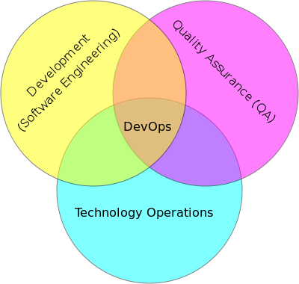
Closing the divide
To bring about true business agility, the entire development-to-operations lifecycle should be treated as a single end-to-end unified process
Image: devops.png
Notes:
To bring about true business agility, the entire development-to-operations
lifecycle should be treated as a one single end-to-end unified process
The adoption of DevOps is being driven by factors such as:
- Use of Agile/iterative development processes and methodologies
Demand for an increased rate of production releases from application and business unit stakeholders
Increased usage of automation and CM tools

Slide 10
The Three Ways
Guiding Principles of DevOps
Notes:
Three Ways,” which are the principles that all of the DevOps patterns can be derived from, which we’re using in both the “DevOps Cookbook” and “The Phoenix Project: A Novel About IT, DevOps, and Helping Your Business Win.” We assert that the Three Ways describe the values and philosophies that frame the processes, procedures, practices of DevOps, as well as the prescriptive steps.

Slide 11
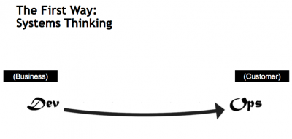
The First Way
Emphasizes performance of the entire system
Outcomes
Focus on all IT-enabled business value streams
Continuous Integration
Increase flow
Increase system understanding
Notes:
The First Way emphasizes the performance of the entire system, as opposed to the performance of a specific silo of work or department — this as can be as large a division (e.g., Development or IT Operations) or as small as an individual contributor (e.g., a developer, system administrator).
The focus is on all business value streams that are enabled by IT. In other words, it begins when requirements are identified (e.g., by the business or IT), are built in Development, and then transitioned into IT Operations, where the value is then delivered to the customer as a form of a service.
The outcomes of putting the First Way into practice include never passing a known defect to downstream work centers, never allowing local optimization to create global degradation, always seeking to increase flow, and always seeking to achieve profound understanding of the system (as per Deming).

Slide 12
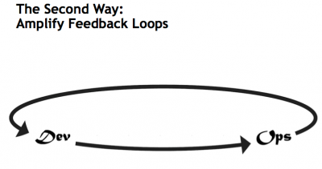
The Second Way
Creating the right to left feedback loops
Outcomes
Shorten and Amplify feedback loops
Continuous Delivery
Understand & respond to customers (internal/external)
Knowledge is embedded
Notes:
The Second Way is about creating the right to left feedback loops. The goal of almost any process improvement initiative is to shorten and amplify feedback loops so necessary corrections can be continually made.
The outcomes of the Second Way include understanding and responding to all customers, internal and external, shortening and amplifying all feedback loops, and embedding knowledge where we need it.

Slide 13
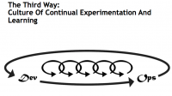
The Third Way
Creating a culture that fosters experimentation & mastery
Outcomes
Experimentation, fail fast and often
Repetition/Practice = Mastery precursor
Time allocated to improve daily work
Rewards for taking risks (culture)
Introduce faults into system to harden
Notes:
The Third Way is about creating a culture that fosters two things: continual experimentation, taking risks and learning from failure; and understanding that repetition and practice is the prerequisite to mastery.
We need both of these equally. Experimentation and taking risks are what ensures that we keep pushing to improve, even if it means going deeper into the danger zone than we’ve ever gone. And we need mastery of the skills that can help us retreat out of the danger zone when we’ve gone too far.
The outcomes of the Third Way include allocating time for the improvement of daily work, creating rituals that reward the team for taking risks, and introducing faults into the system to increase resilience.

Slide 14
Exploring the First Way
Continuous Integration
Design
Code
Build
Test
Release
Deploy
Operate
Agile Development
Idea
Innovation
Feature
Fix
Feedback
Continuous Improvement
Notes:
Illustrate the iterative nature of the practices in a manner similar to a manufacturing plant –
Emphasize culture/feedback loops and automation
Agiel Development enables feedback loops
“baby steps, pervasive feedback”

Slide 15
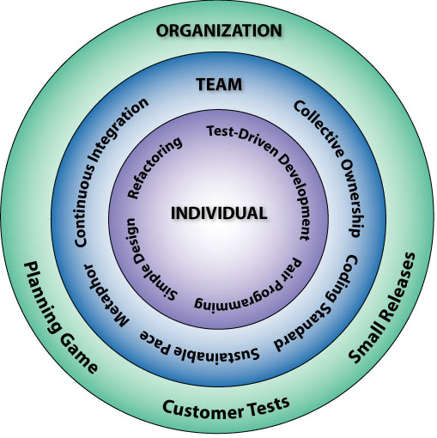
Build Automation & Continuous Integration
Bill Wake, http://www.xp123.com

Slide 16
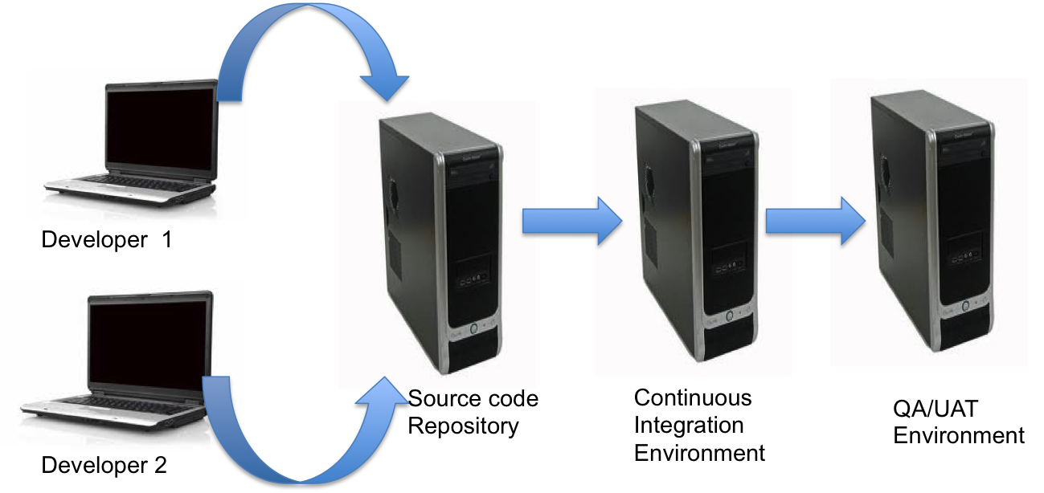
Continuous Integration (CI)
Process of testing your Build/Deploy/Test (BDT) cycle all the time with minimal manual intervention
16

Slide 17
CI: Basics
Frequently (ideally at every commit), the system is:
Integrated - All changes up until that point are combined into the project
Built - The code is compiled into an executable or package
Tested - Automated test suites are run
Archived - Versioned and stored so it can be distributed as is, if desired
Deployed - Loaded onto a system where the developers can interact with it
Notes:
Makes development easier, organized and simplifies team/group development.
Iterative Development + Automated Testing
Environments based on stability
Maintain a code repository
Commit frequently and build every commit
Make the build self-testing
Store every build
You have to be disciplined to make continuous integration work.
There is a very high cost to re-writing things.
When you think of Hershey's, you think of chocolate. Here's something else to think about:
Hershey has a history of embracing changes. Unfortunately some of Hershey's changes were not well executed. For instance, in the summer of 1999, Hershey demonstrated a new computer system that was going to automate and modernize Hershey's operation. The computer system was going to control everything from taking candy orders to loading shipments on trucks. Instead, the new system has paralyzed Hershey's ordering and distribution system, leaving numerous stores without inventory. The problems with the implementation of the automated system created numerous problems between Hershey and their customers.
Hershey worked around the clock to fix the problems, but the problems persisted through the heavy holiday seasons. Since almost one-half of annual candy sales are made between October and December, Hershey lost significant revenues. Hershey took a considerable risk when the company decided to implement the entire computer system all at once. As a direct result of the blunder, the company's stock declined by over fifty percent from a high of over $70 in the fourth quarter of 1998 to about $35 in the first quarter of 2000

Slide 18
CI: Ten Principles
Maintain a single source repository
Automate the build
Make your build self-testing
Everyone commits to mainline every day
Every commit should build mainline on an integration machine
Keep the build fast
Test in a clone of the production environment
Make it easy for anyone to get the latest executable
Everyone can see what's happening
Automate deployment
Notes:
2-4 are critical Principles to adopt – a baseline whereas the others can be built upon.

Slide 19
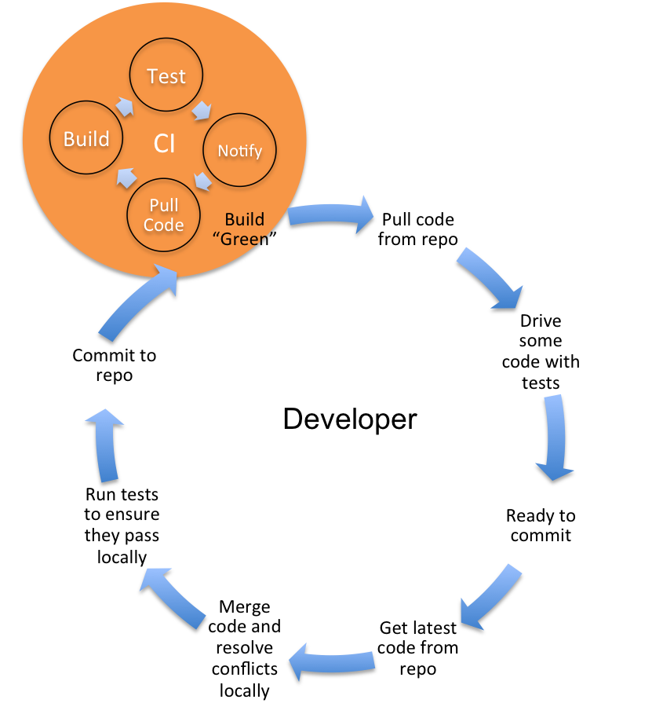
CI: Desired Habits
Frequent commits to a common code stream
Disallow commits into a "broken" build
A "broken" build on CI should be attended to immediately and its resolution should be of utmost priority
Rebuild the database (build from zero)
Provide capability for QA to deploy targeted builds to higher-level environments
Address long-running builds. Stage the builds if necessary.
19

Slide 20
CI: Benefits
Mitigates risk by
Promoting cohesiveness early
Early detection of integration errors
Sharply reduces the pain associated with infrequent merges
Rapid feedback – we know very soon when a mistake is made
Reduces waste by eliminating repetitive (and error prone) manual processes
20
Notes:
The greatest benefit of CI is that of reduced risk. Too often the issues with delayed and infrequent integration manifest during the latter part of the project, when the stakes are high and pressure to deliver is greatest. Continuous Integration makes creation of release builds almost a non-event. Further, it paves the way for automation at many levels, starting with build automation, test automation and more recently continuous delivery/continuous deployment, all of which aim to foster the creation of higher quality software, faster.

Slide 21
Exploring the Second Way
Continuous Delivery
Continuous Integration
Design
Code
Build
Test
Release
Deploy
Operate
Agile Development
Idea
Innovation
Feature
Fix
Feedback
Continuous Improvement
Notes:
Illustrate the iterative nature of the practices in a manner similar to a manufacturing plant –
Emphasize culture/feedback loops and automation

Slide 22
How long would it take to deploy a change involves just one single line of code?
Can you do this on a repeatable, reliable basis?
Mary & Tom Poppendieck – Lean Software Development

Slide 23
1st Agile Principle
Our highest priority is to satisfy the customer through early and continuous delivery of valuable software.

Slide 24
Continuous…
Integration is the process of eliciting fast, automated feedback on the correctness of your application every time there is a change to the code
Delivery builds upon the earlier concept by providing fast, automated feedback on the correctness and production readiness of your application every time there is a change to code, infrastructure, or configuration
Notes:
Continuous…
Integration is the process of eliciting fast, automated feedback on the correctness of your application every time there is a change to the code.
Delivery builds upon the earlier concept by providing fast, automated feedback on the correctness and production readiness of your application every time there is a change to code, infrastructure, or configuration.

Slide 25
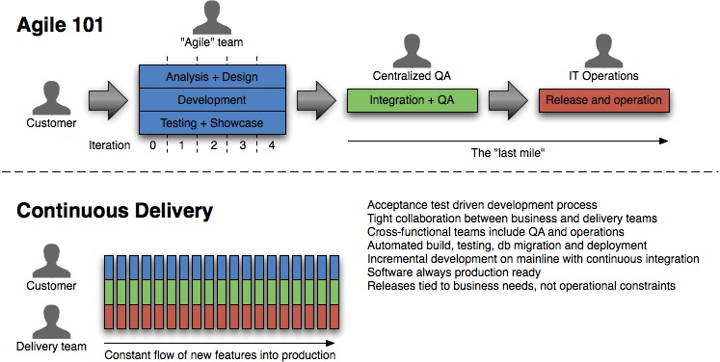
Continuous Delivery: Overview
Notes:
Agile and lean software development
Potentially shippable product (Scrum)
Deliver as Fast as possible (Lean)
Many concepts in Continuous Delivery come from Lean
Release Early, Release Often
Software is always in a releasable state.
From Continuous Delivery Jez Humble
http://ptgmedia.pearsoncmg.com/images/art_humble_continuousdelivery/elementLinks/humble_fig01.jpg
C_D i_s_ _c_o_n_c_e_r_n_e_d_ _w_i_t_h_ _“…h_o_w_ _a_l_l_ _t_h_e_ _m_o_v_i_n_g_ _p_a_r_t_s_ _f_i_t_ _t_o_g_e_t_h_e_r_:_ _c_o_n_f_i_g_u_r_a_t_i_o_n_ _m_a_n_a_g_e_m_e_n_t_,_ _a_u_t_o_m_a_t_e_d_ _t_e_s_t_i_n_g_,_ _c_o_n_t_i_n_u_o_u_s_ _i_n_t_e_g_r_a_t_i_o_n_ _a_n_d_ _d_e_p_l_o_y_m_e_n_t_,_ _d_a_t_a_ _m_a_n_a_g_e_m_e_n_t_,_ _e_n_v_i_r_o_n_m_e_n_t_ _m_a_n_a_g_e_m_e_n_t_,_ _a_n_d_ _r_e_l_e_a_s_e_ _m_a_n_a_g_e_m_e_n_t_._”

Slide 26
Principles
Software always production ready
Reliable Deployments
Self-serve deployments
Releases according to business needs, not operational constraints

Slide 27
Prerequisites
Continuous Integration
Automated testing at multiple levels
Comprehensive configuration management

Slide 28
Deployment Pipeline
An automated implementation of a system's build, deploy, test, & release process
Visibility
Feedback
Control

Slide 29
Pipeline Construction
Higher Confidence / More Production-Like Environments
Commit stage
Compile
Unit Tests
Acceptance test stage
User acceptance
testing
Deploy to Production
Performance testing
Faster Feedback
Pipeline stages = feedback opportunities

Slide 30
CD: Benefits
Feedback from production
Build the right product
Bringing the pain forward
Find bugs earlier; Higher Quality
Ability to react quickly to change
Notes:
Save money and time is project goes bad
Save money and time with automation
As deploying to production becomes easier, more time can be spent developing valuable features
Don’t think requirements — think testable hypotheses

Slide 31
Continuous
Integration
Integrate early and often
Continuous
Deployment
Deploy as the final stage of CI
Continuous
Delivery
Software is always deployable

Slide 32







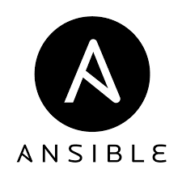
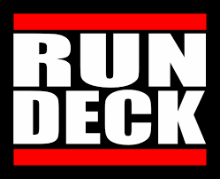
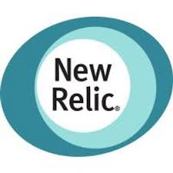
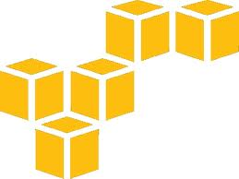

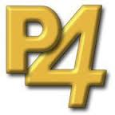






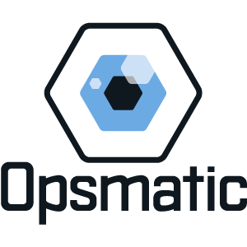











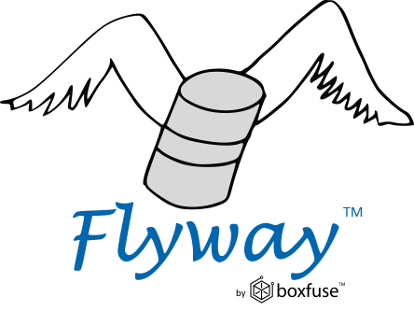


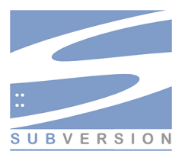




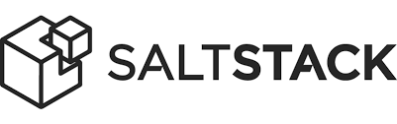


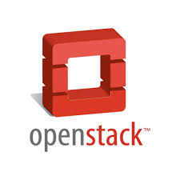
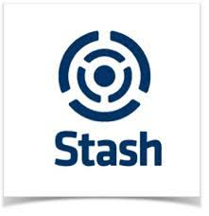



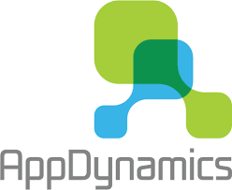

Build
Alerts
Targets
Deploy
Config
Analyze
Test
Repo
Pack
SCM
CI
ALM

Slide 33
Exploring The Third Way
DevOps
Continuous Delivery
2012
2010
Continuous Integration
Design
Code
Build
Test
Release
Deploy
Operate
2001
Collaborate
Agile Development
2001
Idea
Innovation
Feature
Fix
Feedback
Continuous Improvement
Notes:
Illustrate the iterative nature of the practices in a manner similar to a manufacturing plant –
Emphasize culture/feedback loops and automation
DevOps is not dependent on agile.

Slide 34
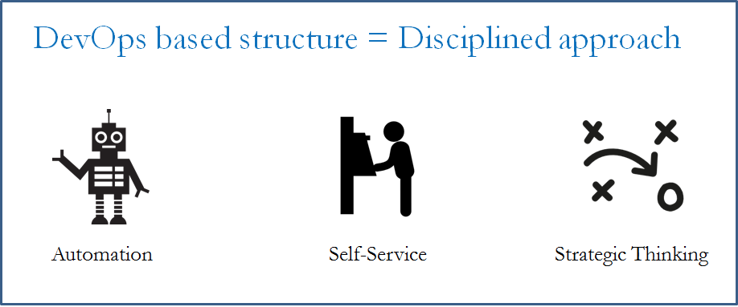
Slow down First, then speed up.

Slide 35

Synergy
Consistent process and effective feedback result in agility
Now use that agility to experiment
You only learn from failure
If it is hard – do it more often - repeat
So fail often, but recover quickly
Notes:
Break Things Before Production
Consistency in code, environments and configuration
ASSERTs to catch misconfigurations and inconsistencies
TECHNICAL Debt:
Allocate 20% of cycles to technical debt reduction
Before you end up allocating 100%
Remember they’re still visible stories with measurable metrics
Rapid cycling encourages experimentation
Every feature can be split-tested
Use Metric Driven Development
If you can’t tell which test is better, what’s the point?

Slide 36
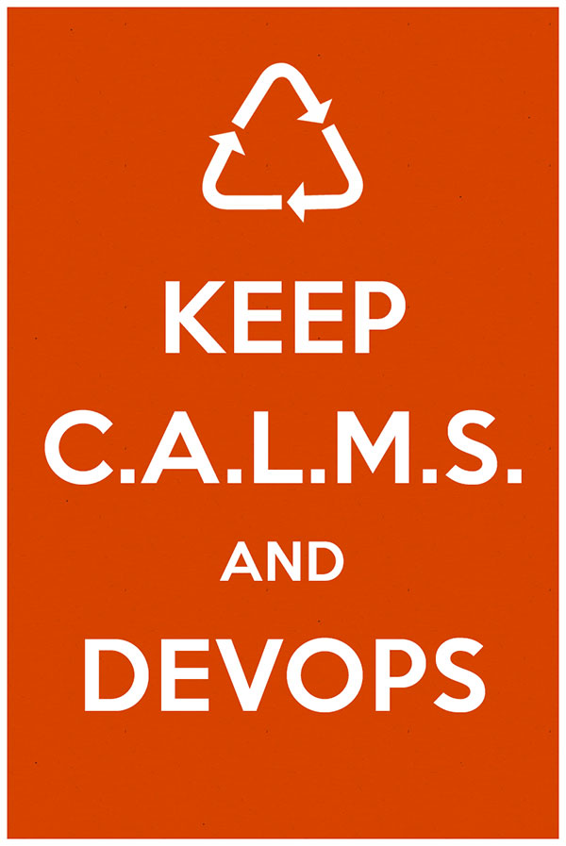
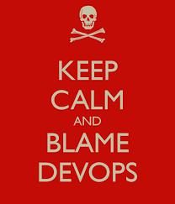
DevOps – CALMS Model
Notes:
There have been many smart people discussing DevOps processes and principles— Damon Edwards (DTO), John Wills coined CAMS – Jez Humble added in L - LEAN

Slide 37
DevOps – CALMS Model
Culture
Hearts and minds, Embrace
Automation
Of all (most) things; testing, deployment, infrastructure
Lean
Small batch sizes, value for end-users
Measurement
Of all things; show the improvement (adaption)
Sharing
Transparent, Open

Slide 38
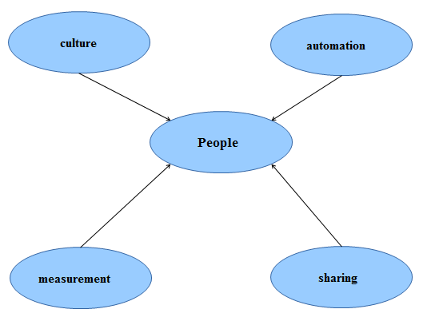
lean
Notes:
CALMS

Slide 39
Create a “High Trust” Culture
Need Right circumstances
Remove silos
Clarify goals and limits
Strike a balance between technology and employee interaction
Empower Teams
Focus on organizational business goals with teams driving towards them
Cross-functional business aligned teams
Experiment/Freedom– take risks – train with each other…
Maximize your IT professionals collective skills and experience.
Behavior change – culture will follow
Notes:
You don’t do DevOps!
Operations as a Service – Operations Engineering
Process, tools and systems
Service provider mindset
Can your developers easily create a development sandbox that closely matches the production environment, even when physical resources are constrained?
Does your organization structure support cross-functional teams that put more emphasis on getting quality software out the door than individuals’ roles?
Can your team provide overall visibility into your application release activities and timing to all major stakeholders?
Have you consolidated the tools required to monitor network, systems, database and other areas to reduce complexity and speed time to market?

Slide 40
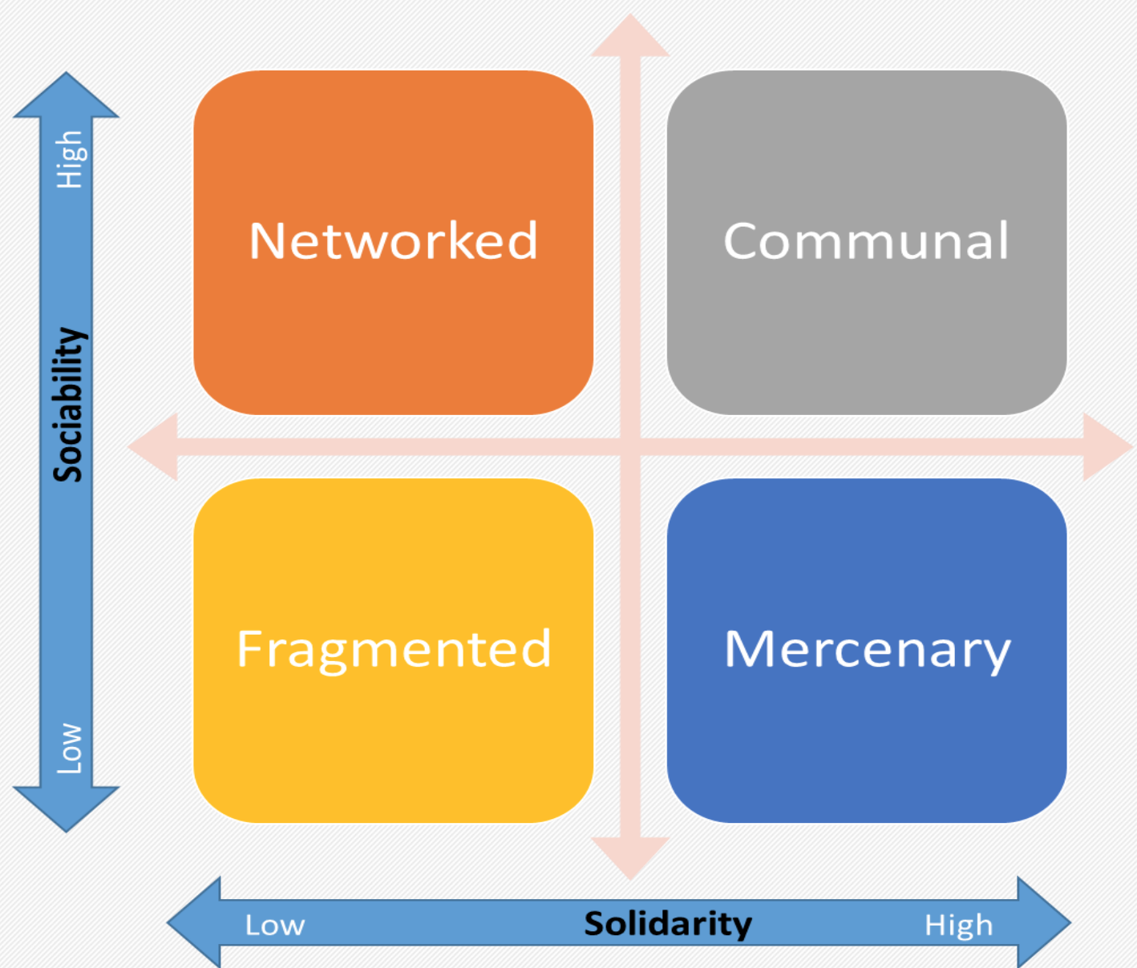
What does your Team Look like?
Notes:
Damon Edwards (From DTO – has visited CIS already) on Culture:
1. Build the “Why?”
2. Organizational Alignment:
2.1.Teach the basic concepts (Limit WIP, single piece flow, push-pull, CI/CD – small batches)
2.2 Same Page
a. Value Stream Mapping – a Lean concept detailing the flow of information and artifacts going on inside an organization, leading to value creation. b. Timeline Analysis – attempts to discover where time is spent, where are the bottlenecks. c. Waste Analysis – determining all sorts of waste that are produced by an organization in order to eliminate them as much as possible
2.3 Developing metrics chains, which are meant to measure the activity across the value delivery chain and how one’s activity impacts others’.
2.4 Identify projects/experiments against baseline. Identify which projects or activities deviate from the baseline and take corrective measures.
2.5 – Rinse and Repeat – Continuous Improvement
3. Continuous Improvement Loops
These loops are meant to continually improve the process by Making Plans, Implementing Plans, Measuring Outcomes, and Deciding on How to Continue.

Slide 41
3rd Way Goals
Ability to anticipate, even define new business needs through visibility in the systems
Ability to test and optimize new business opportunities in the system while managing risk
Pride and Joy

Slide 42

DevOps Myths
DevOps replaces Agile
DevOps replaces ITIL
DevOps means NoOps
DevOps is only for open source software
DevOps is just “infrastructure as code” or automation
DevOps is only for startups and unicorns
Notes:
1 – DevOps does replace agile – logical continuation of Agile
2 – ITIL – ITSM remain the best codifications of the processes that underpin IT Operations, and actually describe many of the capabilities needed in order for IT Operations to support a DevOps-style work stream.
In order to accommodate the faster lead times and higher deployment frequencies associated with DevOps, many areas of the ITIL processes require automation, specifically around the change, configuration, and release processes.
b/c we require faster detection and resolution the ITIL disciplines of service design and incident and problem management remain as relevant as ever.
3 – Providing Dev. Responsibility to release into production – certain tools are enablers of this.
In order to support fast lead times and enable developer productivity, DevOps does require many IT operations tasks to become self-service. In other words, instead of development opening up a work ticket and waiting for IT operations to complete the work, many of these activities will be automated so that developers can do it themselves (e.g. get a production-like dev environment or add a feature metric for production telemetry).
4 -

Slide 43
Wrap Up
Better Software, Faster
Pride in the Software You Build and Operate
Ability to Identify, Respond and Improve Business Needs

Slide 44
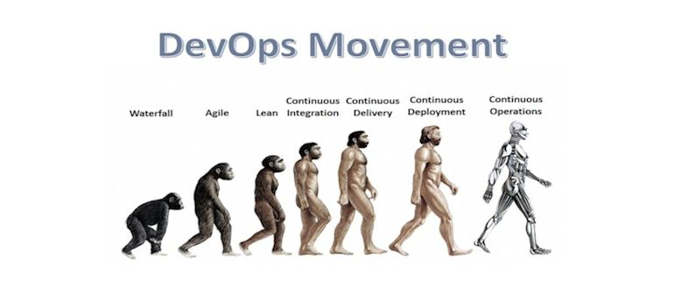
DevOps – Inspiration!!
"Simply put, all unicorns were once horses. DevOps is how any horse can become a unicorn, if they want to become one. And in fact, the list of enterprises adopting DevOps continues to grow." Gene Kim

