Slide 1
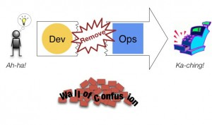
DevOps Tearing Down the Walls

Slide 2
DevOps is…
About creating visibility between Dev and Ops
Not a set of tools
About creating self-service infrastructure for teams
Knowing that good software doesn't end with development/release
Not a role
Ensuring a continual feedback loop between development and operations
Automation over documentation (and more automation... and more...)
Not a prescriptive process
Notes:
Cross-functional teams over organizational silos

Slide 3
What is DevOps?
The joining of two different primary goals – that of driving collaboration across the entire system lifecycle as well as adopting a newer set of more flexible tools and practices designed to generate rapid and flexible response
Extending Agile principles beyond the boundaries of “the code” to the entire delivered service
Notes:
Tricky to define, like its big brother Agile “I do what this Scrum book says so I’m doing Agile” is like “I’m using Chef so I’m DevOps, right?”
extending Agile principles beyond the boundaries of “the code” to the entire delivered service

Slide 4
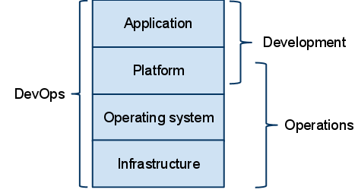
DevOps

Slide 5
The Three Ways
Guiding Principles of DevOps
Notes:
Three Ways,” which are the principles that all of the DevOps patterns can be derived from, which we’re using in both the “DevOps Cookbook” and “The Phoenix Project: A Novel About IT, DevOps, and Helping Your Business Win.” We assert that the Three Ways describe the values and philosophies that frame the processes, procedures, practices of DevOps, as well as the prescriptive steps.

Slide 6
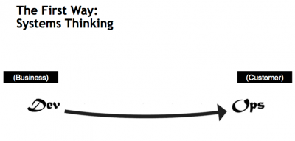
The First Way
Emphasizes performance of the entire system
Outcomes
Performance of entire system (no silos)
Business value streams are continuous
Continuous Integration
No downstream defects
Increase flow
Increase system understanding
Notes:
The First Way emphasizes the performance of the entire system, as opposed to the performance of a specific silo of work or department — this as can be as large a division (e.g., Development or IT Operations) or as small as an individual contributor (e.g., a developer, system administrator).
The focus is on all business value streams that are enabled by IT. In other words, it begins when requirements are identified (e.g., by the business or IT), are built in Development, and then transitioned into IT Operations, where the value is then delivered to the customer as a form of a service.
The outcomes of putting the First Way into practice include never passing a known defect to downstream work centers, never allowing local optimization to create global degradation, always seeking to increase flow, and always seeking to achieve profound understanding of the system (as per Deming).

Slide 7
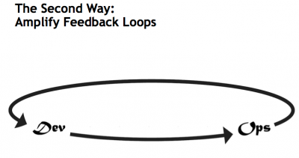
The Second Way
Creating the right to left feedback loops
Outcomes
Shorten and Amplify feedback loops
Continuous Delivery
Understand & respond to customers (internal/external)
Knowledge is embedded
Notes:
The Second Way is about creating the right to left feedback loops. The goal of almost any process improvement initiative is to shorten and amplify feedback loops so necessary corrections can be continually made.
The outcomes of the Second Way include understanding and responding to all customers, internal and external, shortening and amplifying all feedback loops, and embedding knowledge where we need it.

Slide 8
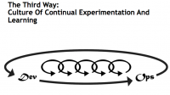
The Third Way
Creating a culture that fosters experimentation & mastery
Outcomes
Experimentation, fail fast and often
Repetition/Practice = Mastery precursor
Time allocated to improve daily work
Rewards for taking risks (culture)
Introduce faults into system to harden
Notes:
The Third Way is about creating a culture that fosters two things: continual experimentation, taking risks and learning from failure; and understanding that repetition and practice is the prerequisite to mastery.
We need both of these equally. Experimentation and taking risks are what ensures that we keep pushing to improve, even if it means going deeper into the danger zone than we’ve ever gone. And we need mastery of the skills that can help us retreat out of the danger zone when we’ve gone too far.
The outcomes of the Third Way include allocating time for the improvement of daily work, creating rituals that reward the team for taking risks, and introducing faults into the system to increase resilience.

Slide 9
Exploring the First Way
Continuous Integration
Design
Code
Build
Test
Release
Deploy
Operate
Agile Development
Idea
Innovation
Feature
Fix
Feedback
Continuous Improvement
Notes:
Illustrate the iterative nature of the practices in a manner similar to a manufacturing plant –
Emphasize culture/feedback loops and automation

Slide 10
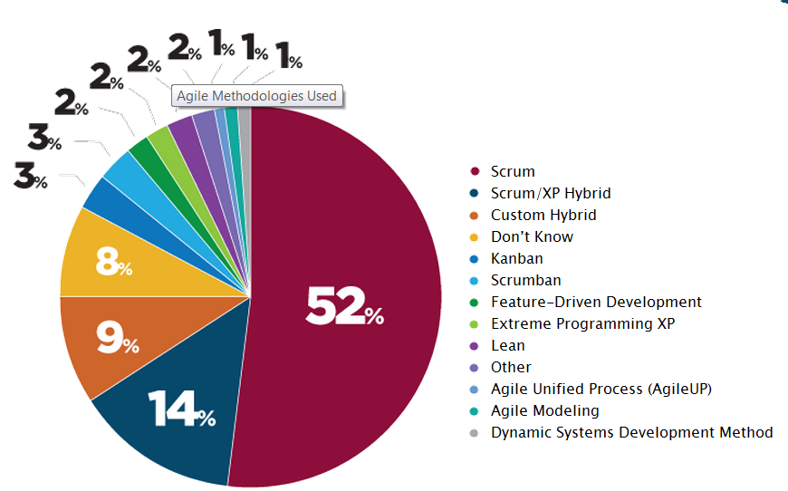
What is Agile Development?
Agility is:
The ability to create
and respond to change
Agile Development is:
An umbrella term for a
related group of iterative
and incremental software
development methods
Agile methods are characterized by:
Mindset, Principles, Practices

Slide 11
Agile Manifesto – February 2001
We are uncovering better ways of developing software by doing it and helping others do it. Through this work we have come to value:
Individuals & ___________
over
Processes & tools
Working ___________
over
Comprehensive documentation
Customer ___________
over
Contract negotiation
Responding to ___________
over
Following a plan
That is, while there is value in the items on the right, we value the items on the left more.
Choose From: change, collaboration, interactions, software
http://www.agilemanifesto.org
11
Notes:
http://tdwi.org/articles/2010/06/09/agile-bi-basics.aspx

Slide 12
Shared Context drives Quality
Individuals and interactions
Customer collaboration
Working software
Responding to change
12

Slide 13
At it’s Simplest
Cross functional team with collaboration across roles
Collaboration is early and often
Short feedback loops, including from end user
Feedback/learning is used to change plans, designs, approach
Deliver what makes sense instead of what we originally planned
13

Slide 14
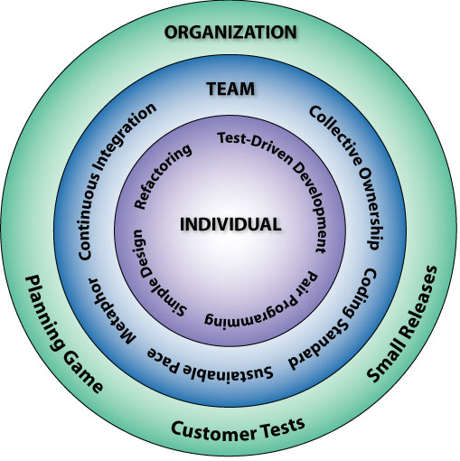
Build Automation & Continuous Integration
Bill Wake, http://www.xp123.com

Slide 15
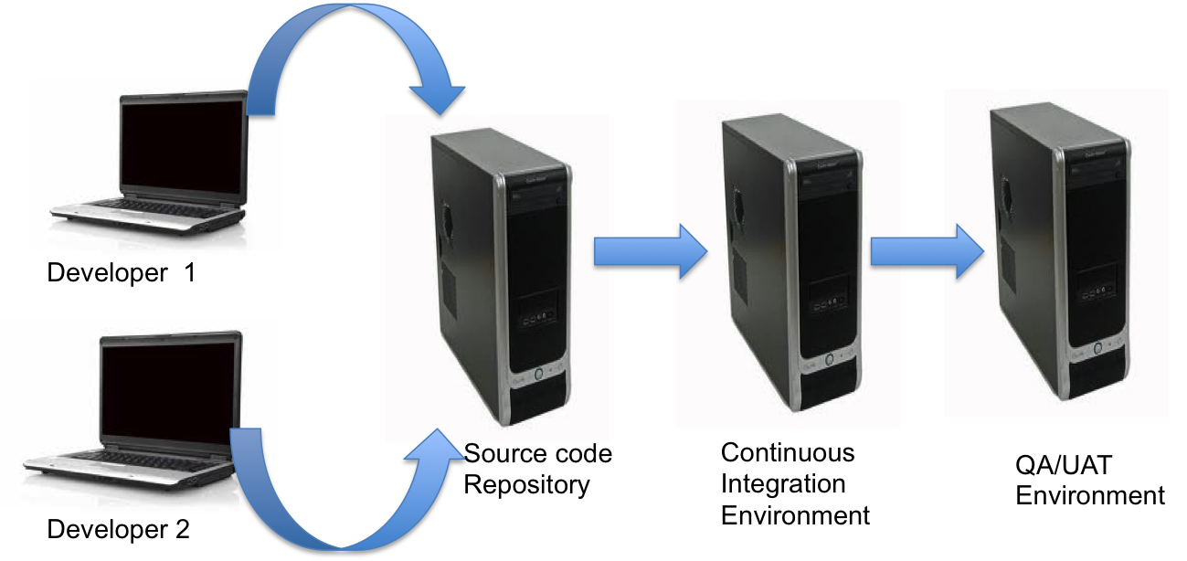
Continuous Integration (CI)
Process of testing your Build/Deploy/Test (BDT) cycle all the time (database, app etc.) with minimal manual intervention
Developer sandboxes
Source control
Build automation
Frequent integration
Rebuild database
Separate environments
15

Slide 16
CI: Basics
Frequently (ideally at every commit), the system is:
Integrated - All changes up until that point are combined into the project
Built - The code is compiled into an executable or package
Tested - Automated test suites are run
Archived - Versioned and stored so it can be distributed as is, if desired
Deployed - Loaded onto a system where the developers can interact with it
Notes:
Makes development easier, organized and simplifies team/group development.
Iterative Development + Automated Testing
Environments based on stability
Maintain a code repository
Commit frequently and build every commit
Make the build self-testing
Store every build
You have to be disciplined to make continuous integration work.
There is a very high cost to re-writing things.
When you think of Hershey's, you think of chocolate. Here's something else to think about:
Hershey has a history of embracing changes. Unfortunately some of Hershey's changes were not well executed. For instance, in the summer of 1999, Hershey demonstrated a new computer system that was going to automate and modernize Hershey's operation. The computer system was going to control everything from taking candy orders to loading shipments on trucks. Instead, the new system has paralyzed Hershey's ordering and distribution system, leaving numerous stores without inventory. The problems with the implementation of the automated system created numerous problems between Hershey and their customers.
Hershey worked around the clock to fix the problems, but the problems persisted through the heavy holiday seasons. Since almost one-half of annual candy sales are made between October and December, Hershey lost significant revenues. Hershey took a considerable risk when the company decided to implement the entire computer system all at once. As a direct result of the blunder, the company's stock declined by over fifty percent from a high of over $70 in the fourth quarter of 1998 to about $35 in the first quarter of 2000

Slide 17
CI: Benefits
Mitigates risk by
Promoting cohesiveness early
Early detection of integration errors
Sharply reduces the pain associated with infrequent merges
Rapid feedback – we know very soon when a mistake is made
Reduces waste by eliminating repetitive (and error prone) manual processes
17
Notes:
The greatest benefit of CI is that of reduced risk. Too often the issues with delayed and infrequent integration manifest during the latter part of the project, when the stakes are high and pressure to deliver is greatest. Continuous Integration makes creation of release builds almost a non-event. Further, it paves the way for automation at many levels, starting with build automation, test automation and more recently continuous delivery/continuous deployment, all of which aim to foster the creation of higher quality software, faster.

Slide 18
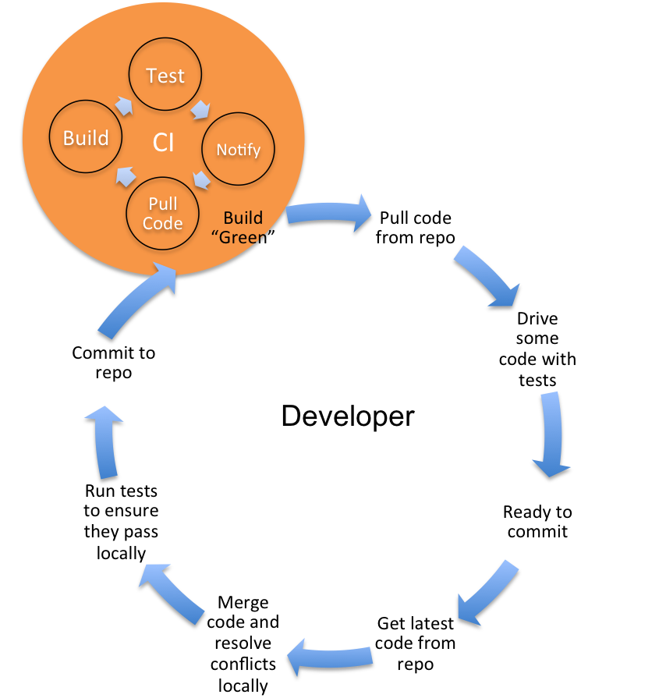
CI: Desired Habits
Frequent commits to a common code stream
Disallow commits into a "broken" build
A "broken" build on CI should be attended to immediately and its resolution should be of utmost priority
Rebuild the database (build from zero)
Provide capability for QA to deploy targeted builds to higher-level environments
Address long-running builds. Stage the builds if necessary.
18

Slide 19
CI: Ten Principles
Maintain a single source repository
Automate the build
Make your build self-testing
Everyone commits to mainline every day
Every commit should build mainline on an integration machine
Keep the build fast
Test in a clone of the production environment
Make it easy for anyone to get the latest executable
Everyone can see what's happening
Automate deployment
Notes:
2-4 are critical Principles to adopt – a baseline whereas the others can be built upon.

Slide 20
CI: Prerequisites
Version control
An automated build, outside integrated developer environment (IDE)
Collaboration
Check in frequently
Maintain a large automated test suite
Keep build and test phase short
Notes:
Vital step when practicing CD
Recall: To practice CI, every developer on a project must integrate their work daily with every other developer
Everyone on the team needs to practice this for it to work
Continuous integration is not a tool, but a technique
But there are many open source tools to help practice CI

Slide 21

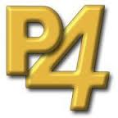










CI: Tools
Code Repositories
SVN, Mercurial, Git, Perforce
Continuous Build Systems
Jenkins, Hudson, Bamboo, Cruise Control,
GitLab CI, Travis, TFS
Test Frameworks
Junit, Cucumber, CppUnit
Artifact Repositories
Nexus, Artifactory, Archiva

Slide 22
Exploring the Second Way
Continuous Delivery
Continuous Integration
Design
Code
Build
Test
Release
Deploy
Operate
Agile Development
Idea
Innovation
Feature
Fix
Feedback
Continuous Improvement
Notes:
Illustrate the iterative nature of the practices in a manner similar to a manufacturing plant –
Emphasize culture/feedback loops and automation

Slide 23
Continuous
Integration
Integrate early and often
Continuous
Deployment
Deploy as the final stage of CI
Continuous
Delivery
Software is always deployable

Slide 24
1st Agile Principle
Our highest priority is to satisfy the customer through early and continuous delivery of valuable software.

Slide 25
Continuous…
Integration is the process of eliciting fast, automated feedback on the correctness of your application every time there is a change to the code
Delivery builds upon the earlier concept by providing fast, automated feedback on the correctness and production readiness of your application every time there is a change to code, infrastructure, or configuration
Notes:
Continuous…
Integration is the process of eliciting fast, automated feedback on the correctness of your application every time there is a change to the code.
Delivery builds upon the earlier concept by providing fast, automated feedback on the correctness and production readiness of your application every time there is a change to code, infrastructure, or configuration.

Slide 26
How long would it take to deploy a change involves just one single line of code?
Can you do this on a repeatable, reliable basis?
Mary & Tom Poppendieck – Lean Software Development

Slide 27
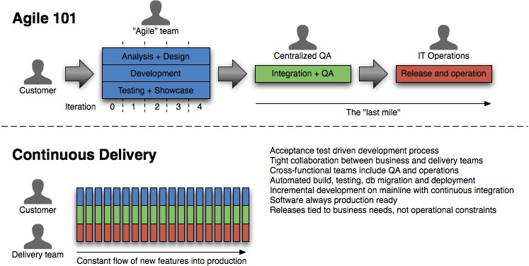
Continuous Delivery: Overview
Releases tied to business needs, NOT operational constraints
Software always production ready
Notes:
Agile and lean software development
Potentially shippable product (Scrum)
Deliver as Fast as possible (Lean)
Many concepts in Continuous Delivery come from Lean
Release Early, Release Often
Software is always in a releasable state.
From Continuous Delivery Jez Humble
http://ptgmedia.pearsoncmg.com/images/art_humble_continuousdelivery/elementLinks/humble_fig01.jpg
C_D i_s_ _c_o_n_c_e_r_n_e_d_ _w_i_t_h_ _“…h_o_w_ _a_l_l_ _t_h_e_ _m_o_v_i_n_g_ _p_a_r_t_s_ _f_i_t_ _t_o_g_e_t_h_e_r_:_ _c_o_n_f_i_g_u_r_a_t_i_o_n_ _m_a_n_a_g_e_m_e_n_t_,_ _a_u_t_o_m_a_t_e_d_ _t_e_s_t_i_n_g_,_ _c_o_n_t_i_n_u_o_u_s_ _i_n_t_e_g_r_a_t_i_o_n_ _a_n_d_ _d_e_p_l_o_y_m_e_n_t_,_ _d_a_t_a_ _m_a_n_a_g_e_m_e_n_t_,_ _e_n_v_i_r_o_n_m_e_n_t_ _m_a_n_a_g_e_m_e_n_t_,_ _a_n_d_ _r_e_l_e_a_s_e_ _m_a_n_a_g_e_m_e_n_t_._”

Slide 28
Principles
Software always production ready
Reliable Deployments
Self-serve deployments
Releases according to business needs, not operational constraints

Slide 29
Prerequisites
Continuous Integration
Automated testing at multiple levels
Comprehensive configuration management

Slide 30
Deployment Pipeline
An automated implementation of a system's build, deploy, test, & release process
Visibility
Feedback
Control

Slide 31
Agile Test Quadrants
Provides structure to ensure we meet all testing goals
Business-facing
Automated
Manual
Functional Tests
Story-level
API-level
(Behind the GUI)
ATDD/BDD
Exploratory
Usability
Scenarios
UAT
Q2
Q3
Support the team
Critique the product
Q1
Q4
Unit Tests
Component tests
TDD
Performance
Load
Security
Automated
Tools
Technology-facing
31

Slide 32
Test Automation Strategy
Exploratory Testing
Unit Tests
Selenium, PhantomJS etc.
UI Tests
Business-centric
Cucumber,
FitNesse, etc.
Service end-points, public interfaces
Are we building the right code?
Acceptance
Tests (API layer)
Faster execution
Integration Tests
xUnit, Mocks
Jasmine, Karma
Developer-centric
Are we building the code right?
Number of tests
Adaptation of Mike Cohn's Test Automation Pyramid
32

Slide 33
Pipeline Construction
Higher Confidence / More Production-Like Environments
Commit stage
Compile
Unit Tests
Analysis
Acceptance test stage
User acceptance
testing
Deploy to Production
Performance testing
Faster Feedback
Pipeline stages = feedback opportunities

Slide 34
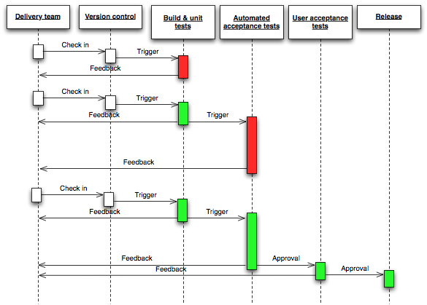

Slide 35
Commit Stage
Commit stage
Compile
Unit Tests
Assemble
Code Analysis
Artifact
Repository
Version control
Source code
Commit tests
Build scripts
Deployable
binaries
Run against every check-in
Creates a release candidate
If it fails, fix it immediately

Slide 36
Acceptance Stage
Version control
Acceptance tests
Deployment scripts
Config. data
Acceptance test stage
Configure env.
Deploy & smoke test
Accep. test
Artifact
Repository
Artifact
repository
Test reports
binaries
End-to-end tests in production like environment
Triggered whenever commit tests pass
If it fails, fix it immediately

Slide 37
Manual Stage
Version control
Deployment scripts
Config. data
Later stages
Configure env.
Deploy & smoke test
Other tests
Artifact
Repository
Artifact
repository
Test reports
binaries
UAT, staging, production
Deployments self-serviced

Slide 38
CD: Benefits
Build the right product
Constant feedback from customers
Higher Quality
Find bugs earlier
Ability to react quickly to change
Save money and time
Notes:
Save money and time is project goes bad
Save money and time with automation
As deploying to production becomes easier, more time can be spent developing valuable features
Don’t think requirements — think testable hypotheses

Slide 39
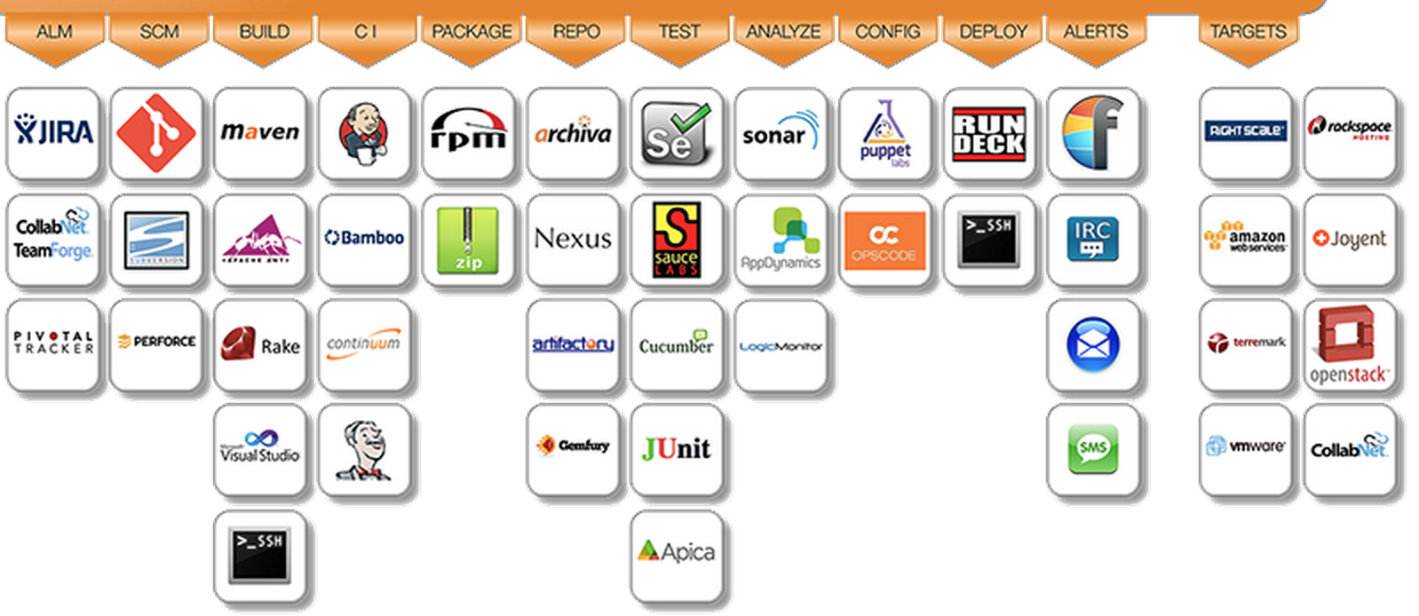
CD: Tools

Slide 40
Exploring The Third Way
DevOps
Continuous Delivery
2012
2010
Continuous Integration
Design
Code
Build
Test
Release
Deploy
Operate
2001
Collaborate
Agile Development
2001
Idea
Innovation
Feature
Fix
Feedback
Continuous Improvement
Notes:
Illustrate the iterative nature of the practices in a manner similar to a manufacturing plant –
Emphasize culture/feedback loops and automation
DevOps is not dependent on agile.

Slide 41
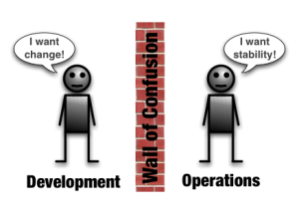
DevOps
The DevOps movement
Shares common goals
Development vs. Operations
Deployment automation
Loads of scripts, tools, commercial and open source products
Part/Extension of Continuous Delivery
Goal: Minimize cycle time, amplify feedback and deliver value smarter/faster
Notes:
DevOps --

Slide 42
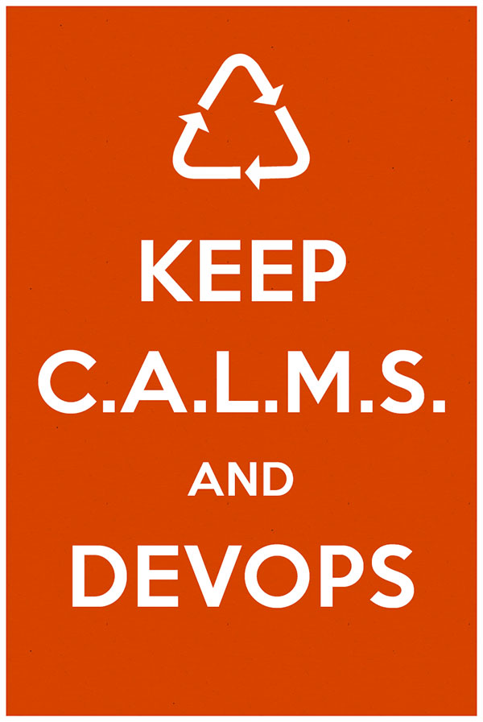
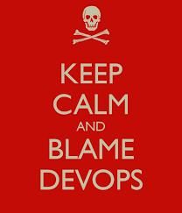
DevOps – CALMS Model

Slide 43
DevOps – CALMS Model
Culture
Hearts and minds, Embrace
Automation
Of all (most) things; testing, deployment, infrastructure
Lean
Small batch sizes, value for end-users
Measurement
Of all things; show the improvement (adaption)
Sharing
Transparent, Open

Slide 44
Create a “High Trust” Culture
Need Right circumstances
Remove silos
Clarify goals and limits
Strike a balance between technology and employee interaction
Empower Teams
Focus on organizational business goals with teams driving towards them
Cross-functional business aligned teams
Experiment/Freedom– take risks – train with each other…
Maximize your IT professionals collective skills and experience.
You don’t do DevOps! There is no recipe….

Slide 45
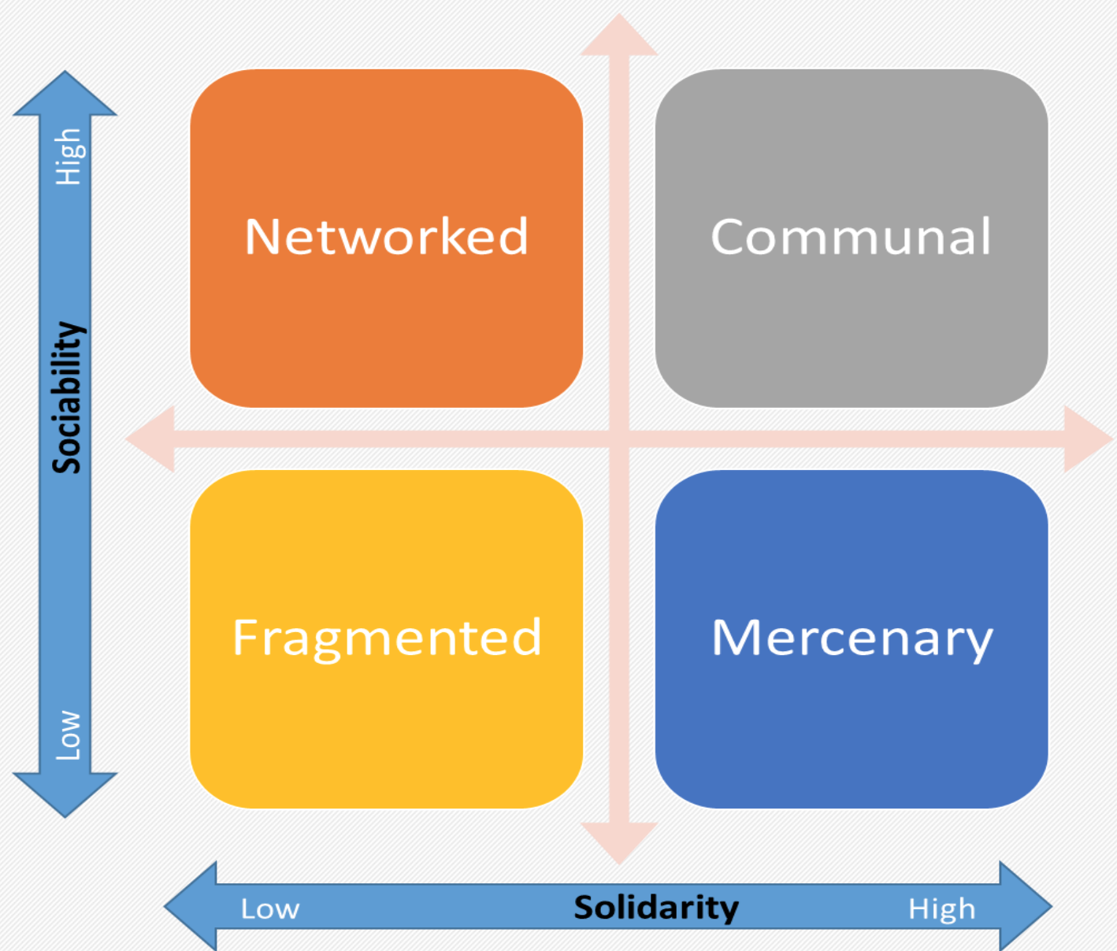
What does your Team Look like?

Slide 46
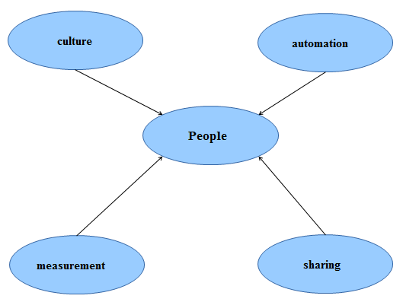

Slide 47
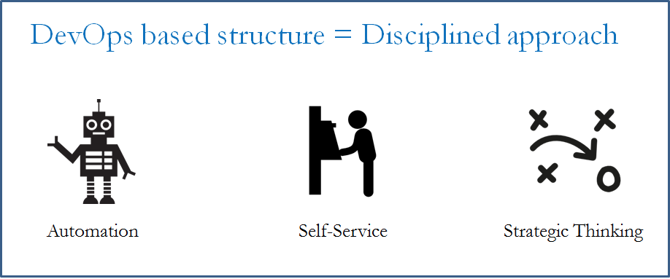
Slow down First, then speed up.
Notes:
Operations as a Service – Operations Engineering
Process, tools and systems
Service provider mindset
Can your developers easily create a development sandbox that closely matches the production environment, even when physical resources are constrained?
Does your organization structure support cross-functional teams that put more emphasis on getting quality software out the door than individuals’ roles?
Can your team provide overall visibility into your application release activities and timing to all major stakeholders?
Have you consolidated the tools required to monitor network, systems, database and other areas to reduce complexity and speed time to market?

Slide 48

DevOps Myths
DevOps replaces Agile
DevOps replaces ITIL
DevOps means NoOps
DevOps is only for open source software
DevOps is just “infrastructure as code” or automation
DevOps is only for startups and unicorns
Notes:
1 – DevOps does replace agile – logical continuation of Agile
2 – ITIL – ITSM remain the best codifications of the processes that underpin IT Operations, and actually describe many of the capabilities needed in order for IT Operations to support a DevOps-style work stream.
In order to accommodate the faster lead times and higher deployment frequencies associated with DevOps, many areas of the ITIL processes require automation, specifically around the change, configuration, and release processes.
b/c we require faster detection and resolution the ITIL disciplines of service design and incident and problem management remain as relevant as ever.
3 – Providing Dev. Responsibility to release into production – certain tools are enablers of this.
In order to support fast lead times and enable developer productivity, DevOps does require many IT operations tasks to become self-service. In other words, instead of development opening up a work ticket and waiting for IT operations to complete the work, many of these activities will be automated so that developers can do it themselves (e.g. get a production-like dev environment or add a feature metric for production telemetry).
4 -

Slide 49
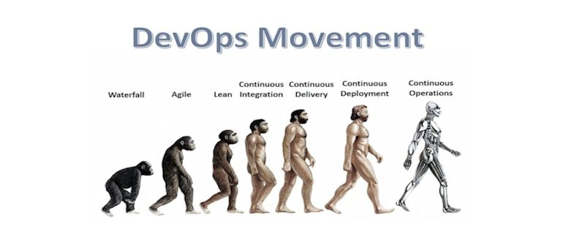
DevOps – Inspiration!!
"Simply put, all unicorns were once horses. DevOps is how any horse can become a unicorn, if they want to become one. And in fact, the list of enterprises adopting DevOps continues to grow." Gene Kim

