Slide 1
Sun Based Localization
Notes:
Please Note: This template has been created using the University of North Dakota brand guidelines. All colors and typefaces/fonts are within the brand guidelines and altering them isn’t suggested. Please visit UND.edu/brand for more information on using the UND brand or email identity@UND.edu with any UND branding questions.
TIPS:
Check out the Layout Dropdown for more layout design options
It’s recommended not going below 24-point font size for presentations
If your text overflows a placement text box it’s recommended to edit/delete down text content instead of increasing size of text box to accommodate more text
Guides are available under View tab > check Guides checkbox

Slide 2
Premise
The algorithms being used will assume that the object to be localized is in a GPS denied environment with no prior knowledge of location.
We want to find a general location based on calculable information relating to the position of the sun and current UTC time.
Notes:
TIPS:
Check out the Layout Dropdown for more layout design options
It’s recommended not going below 24-point font size for presentations
If your text overflows a placement text box it’s recommended to edit/delete down text content instead of increasing size of text box to accommodate more text
Guides for are available under View tab > check Guides checkbox

Slide 3
Assumed Variables and Conditions
We have a camera that can track onto the sun or we have the ability to gather object height and shadow lengths
We have the ability to know true north
We have the current time and date in Coordinated Universal Time (UTC)
Notes:
TIPS:
Check out the Layout Dropdown for more layout design options
It’s recommended not going below 24-point font size for presentations
If your text overflows a placement text box it’s recommended to edit/delete down text content instead of increasing size of text box to accommodate more text
Guides for are available under View tab > check Guides checkbox

Slide 4
What Needs to be Calculated Pre Search
The Solar Azimuth – This is the angle of the sun relative to North (Degrees)
Solar Altitude/Elevation – This is the angle of the sun over the horizon (Degrees)
Lat, Lon – Current Lat, Lon can be estimated using the calculated azimuth and elevation.
Notes:
TIPS:
Check out the Layout Dropdown for more layout design options
It’s recommended not going below 24-point font size for presentations
If your text overflows a placement text box it’s recommended to edit/delete down text content instead of increasing size of text box to accommodate more text
Guides for are available under View tab > check Guides checkbox

Slide 5
Pre Search Calculations
Solar Azimuth and Elevation with Camera
Assuming the camera at our disposal is on a gimble, we can take that data to extract our angles.
We will also need to account for the angle of the vehicle.
- IMU
- Horizon detection and leveling
Notes:
TIPS:
Check out the Layout Dropdown for more layout design options
It’s recommended not going below 24-point font size for presentations
If your text overflows a placement text box it’s recommended to edit/delete down text content instead of increasing size of text box to accommodate more text
Guides for textboxes are available under View tab > check Guides checkbox

Slide 6
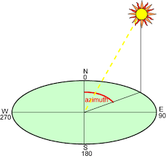
Pre Search Calculations Continued
Solar Azimuth with Shadow
If all we have is a shadow and object we can still find what we need.
The solar azimuth can be calculated by measuring the angle clockwise from north that a shadow takes from a top down view of the casting object.
Notes:
TIPS:
Check out the Layout Dropdown for more layout design options
It’s recommended not going below 24-point font size for presentations
If your text overflows a placement text box it’s recommended to edit/delete down text content instead of increasing size of text box to accommodate more text
Guides for textboxes are available under View tab > check Guides checkbox

Slide 7
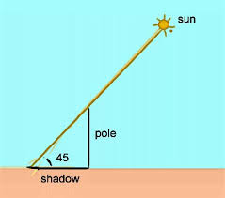
Pre Search Calculations Continued
Solar Elevation with Shadow
If all we have is a shadow and object we can still find what we need.
The solar elevation can be found using the tangent between the height of an object and its corresponding shadow
Notes:
TIPS:
Check out the Layout Dropdown for more layout design options
It’s recommended not going below 24-point font size for presentations
If your text overflows a placement text box it’s recommended to edit/delete down text content instead of increasing size of text box to accommodate more text
Guides for textboxes are available under View tab > check Guides checkbox

Slide 8
Starting the Search
Once a local azimuth and altitude have been found, we can use that along with our UTC time to begin testing for our current latitude and longitude
Notes:
TIPS:
Check out the Layout Dropdown for more layout design options
It’s recommended not going below 24-point font size for presentations
If your text overflows a placement text box it’s recommended to edit/delete down text content instead of increasing size of text box to accommodate more text
Guides for textboxes are available under View tab > check Guides checkbox

Slide 9
How we are Finding Lat Lon
To find our Lat Lon, we are going to use an iterative refinement search.
Iterative Refinement – We will begin by taking large steps across the globe to find generalizations and then stepping down our search size as we get closer
***Note, we could cut down the testing size simply by eliminating certain lat lons based on day or night
Notes:
TIPS:
Check out the Layout Dropdown for more layout design options
It’s recommended not going below 24-point font size for presentations
If your text overflows a placement text box it’s recommended to edit/delete down text content instead of increasing size of text box to accommodate more text
Guides for textboxes are available under View tab > check Guides checkbox

Slide 10
Calculating Solar Position Based On Lat and Lon
To Calculate the solar position we will need
- Latitude and Longitude (Iterative)
- Current Date and UTC Time at Location
- Elapsed Julian Days (calculated by subtracting current date from January 1st, 2000)
- Declination Angle
- Hour Angle
Notes:
TIPS:
Check out the Layout Dropdown for more layout design options
It’s recommended not going below 24-point font size for presentations
If your text overflows a placement text box it’s recommended to edit/delete down text content instead of increasing size of text box to accommodate more text
Guides for textboxes are available under View tab > check Guides checkbox

Slide 11
Testing
For Testing we used a manually imported expected azimuth and elevation.
In the future we hope to integrate this for use with camera calculations as previously discussed.
Tested on different global cities at there local noon in UTC time.
Ran each city 1800 times stepping 0.1 degrees between -3 and 3 for each alt and az.
Notes:
TIPS:
Check out the Layout Dropdown for more layout design options
It’s recommended not going below 24-point font size for presentations
If your text overflows a placement text box it’s recommended to edit/delete down text content instead of increasing size of text box to accommodate more text
Guides for textboxes are available under View tab > check Guides checkbox

Slide 12
Small Scale Testing With Intentional Error
National Oceanic and Atmospheric Administration (NOAA) data was used for small scale tests
The website provided azimuths and altitudes for specific locations and times
Allowed for testing on several cities around the the world
Notes:
TIPS:
Check out the Layout Dropdown for more layout design options
It’s recommended not going below 24-point font size for presentations
If your text overflows a placement text box it’s recommended to edit/delete down text content instead of increasing size of text box to accommodate more text
Guides for textboxes are available under View tab > check Guides checkbox

Slide 13
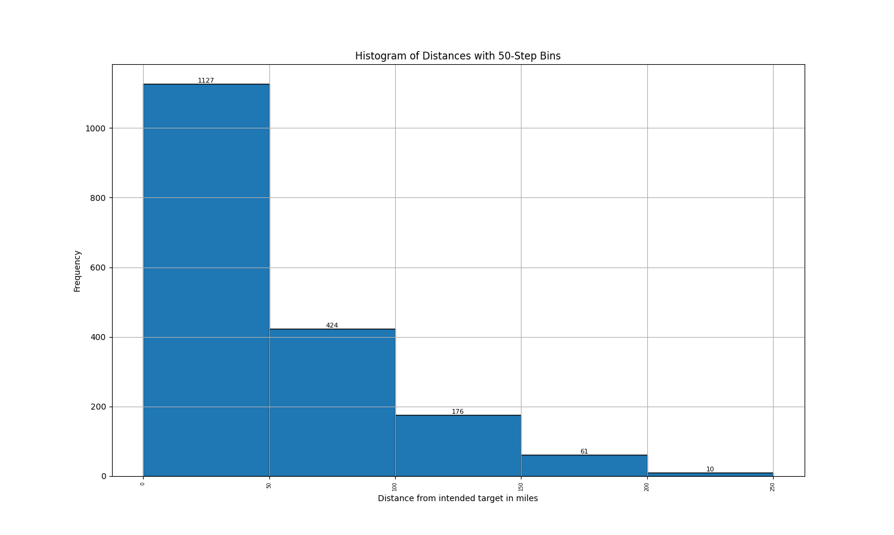
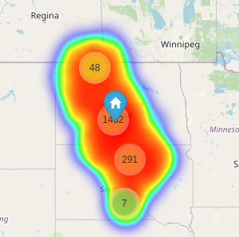
Example Result
Targeting Bismark, ND
Notes:
TIPS:
Check out the Layout Dropdown for more layout design options
It’s recommended not going below 24-point font size for presentations
If your text overflows a placement text box it’s recommended to edit/delete down text content instead of increasing size of text box to accommodate more text
Guides for textboxes are available under View tab > check Guides checkbox

Slide 14
Testing more locations
Once single run tests were working we than ran a large scale test on randomly generated Cities.
- We randomly generated over 9,000 (9,334 to be exact) random combinations of cities and times to be ran
- Each city followed the same parameters as the individual tests
Notes:
TIPS:
Check out the Layout Dropdown for more layout design options
It’s recommended not going below 24-point font size for presentations
If your text overflows a placement text box it’s recommended to edit/delete down text content instead of increasing size of text box to accommodate more text
Guides for textboxes are available under View tab > check Guides checkbox

Slide 15
Large Scale Testing Results
Compilation of Averages
Mean value: 196.993707216419
Median value: 55.55457680639056
Minimum value: 29.227490981688987
Maximum value: 9699.33423632315
Compilation of Medians
Mean value: 178.96427216416757
Median value: 41.884112161444136
Minimum value: 15.190449339455917
Maximum value: 9699.33423632315
Compilation of Minimums
Mean value: 74.78742967420385
Median value: 1.7626466878891627e-12
Minimum value: 0.0
Maximum value: 9699.33423632315
Compilation of Maximums
Mean value: 585.0457859436203
Median value: 211.83666487236312
Minimum value: 133.7012585901453
Maximum value: 10043.481649755993

Slide 16
Large Scale Testing Results
Compilation of Maximums
Mean value: 585.0457859436203
Median value: 211.83666487236312
Minimum value: 133.7012585901453
Maximum value: 10043.481649755993
Compilation of Averages
Mean value: 196.993707216419
Median value: 55.55457680639056
Minimum value: 29.227490981688987
Maximum value: 9699.33423632315
Of the values 7,164 or about 81% were within 300 miles
Approximately 97% of the average distances were within 300 miles

Slide 17
Appendix
- Supporting Math
- Single Test Images
- Large Test Result graphs
Notes:
TIPS:
Check out the Layout Dropdown for more layout design options
It’s recommended not going below 24-point font size for presentations
If your text overflows a placement text box it’s recommended to edit/delete down text content instead of increasing size of text box to accommodate more text
Guides for textboxes are available under View tab > check Guides checkbox

Slide 18
Calculating Solar Declination Angle
The angular distance from the zenith of the observer at the equator and the sun at solar noon
dOmega = 2.1429 - 0.0010394594 * dElapsedJulianDays
dMeanLongitude = 4.8950630 + 0.017202791698 * dElapsedJulianDays # Radians
dMeanAnomaly = (6.2400600 + 0.0172019699 * dElapsedJulianDays)
dEclipticLongitude = dMeanLongitude + 0.03341607 * math.sin(dMeanAnomaly) + 0.00034894 * math.sin(2 * dMeanAnomaly) - 0.0001134 - 0.0000203 * math.sin(dOmega)
dEclipticObliquity = 0.4090928 - 6.2140e-9 * dElapsedJulianDays + 0.0000396 * math.cos(dOmega)
dSin_EclipticLongitude = math.sin(dEclipticLongitude)
dY = math.cos(dEclipticObliquity) * dSin_EclipticLongitude
dX = math.cos(dEclipticLongitude)
dRightAscension = math.atan2(dY, dX) if dRightAscension < 0.0: dRightAscension += (2 * math.pi)
dDeclination = math.asin(math.sin(dEclipticObliquity) * dSin_EclipticLongitude)
Notes:
TIPS:
Check out the Layout Dropdown for more layout design options
It’s recommended not going below 24-point font size for presentations
If your text overflows a placement text box it’s recommended to edit/delete down text content instead of increasing size of text box to accommodate more text
Guides for textboxes are available under View tab > check Guides checkbox

Slide 19
Calculating Solar Hour Angle
The angular displacement of the sun east or west of the local meridian due to rotation of the earth on its axis at 15° per hour with morning being negative and afternoon being positive
# Local Standad Time Meridian
LSTM = 15 * abs(0) # LSTM = 15 * UTC Difference which is zero if given UTC Time
# Equation of time
B = math.radians((360/365) * (day_of_year - 81))
EoT = 9.87*math.sin(2*B) - 7.53*math.cos(B) - 1.5*math.sin(B)
# Time Correction Factor
TC = 4 * (longitude - LSTM) + EoT
# Local Solar Time
LST = ((60 * datetime.hour) + datetime.minute + TC) / 60
# Hour Angle
hour_angle = math.radians(15 * (LST - 12))
Notes:
TIPS:
Check out the Layout Dropdown for more layout design options
It’s recommended not going below 24-point font size for presentations
If your text overflows a placement text box it’s recommended to edit/delete down text content instead of increasing size of text box to accommodate more text
Guides for textboxes are available under View tab > check Guides checkbox

Slide 20
Calculating Solar Alt, and Azm Angles
altitude_angle = math.asin(math.sin(latitude) * math.sin(declination_angle) +
math.cos(latitude) * math.cos(declination_angle) *
math.cos(hour_angle))
azimuth_angle = math.atan2(-math.cos(declination_angle) * math.sin(hour_angle),
math.cos(latitude) * math.sin(declination_angle) -
math.sin(latitude) * math.cos(declination_angle) *
math.cos(hour_angle))
altitude_deg = math.degrees(altitude_angle)
azimuth_deg = math.degrees(azimuth_angle)
Notes:
TIPS:
Check out the Layout Dropdown for more layout design options
It’s recommended not going below 24-point font size for presentations
If your text overflows a placement text box it’s recommended to edit/delete down text content instead of increasing size of text box to accommodate more text
Guides for textboxes are available under View tab > check Guides checkbox

Slide 21
Results 1
Targeting Bismark, ND
Notes:
TIPS:
Check out the Layout Dropdown for more layout design options
It’s recommended not going below 24-point font size for presentations
If your text overflows a placement text box it’s recommended to edit/delete down text content instead of increasing size of text box to accommodate more text
Guides for textboxes are available under View tab > check Guides checkbox

Slide 22
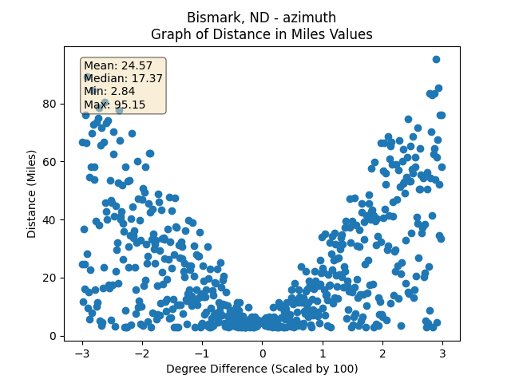
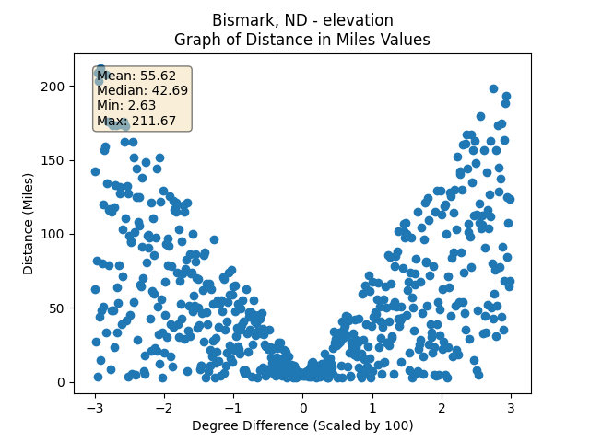
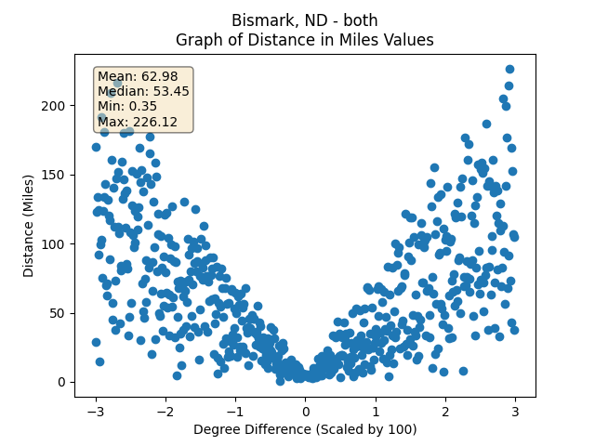
Results 1 Stats
Targeting Bismark, ND
Notes:
TIPS:
Check out the Layout Dropdown for more layout design options
It’s recommended not going below 24-point font size for presentations
If your text overflows a placement text box it’s recommended to edit/delete down text content instead of increasing size of text box to accommodate more text
Guides for textboxes are available under View tab > check Guides checkbox

Slide 23
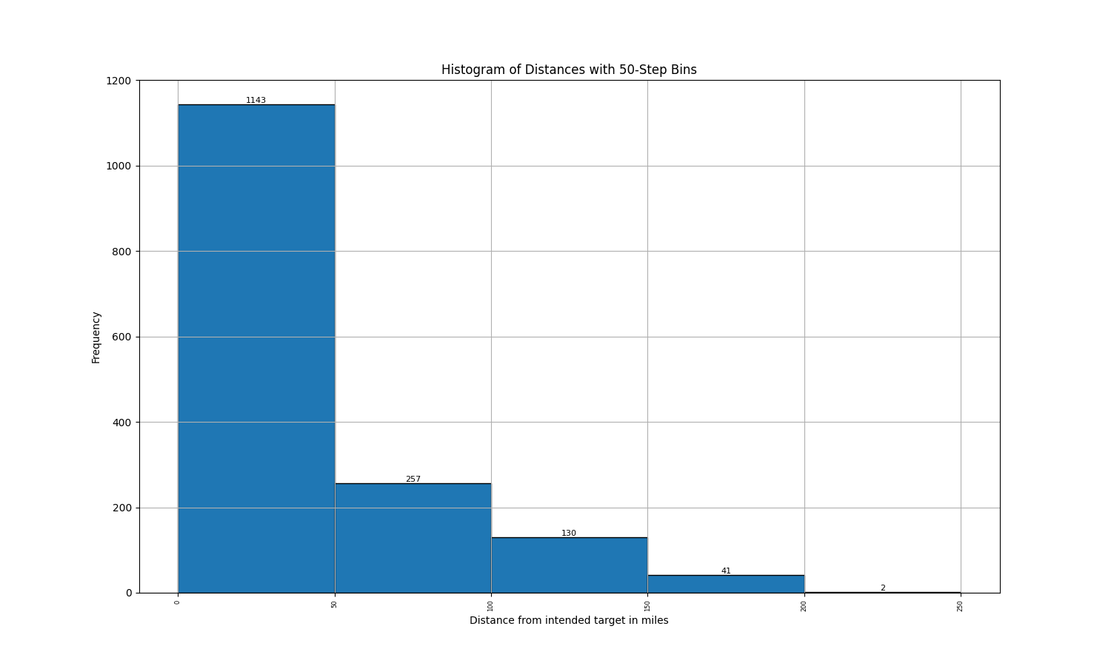
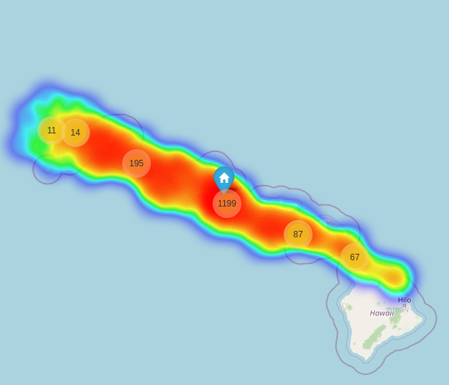
Results 2
Targeting Honolulu, HI
Notes:
TIPS:
Check out the Layout Dropdown for more layout design options
It’s recommended not going below 24-point font size for presentations
If your text overflows a placement text box it’s recommended to edit/delete down text content instead of increasing size of text box to accommodate more text
Guides for textboxes are available under View tab > check Guides checkbox

Slide 24
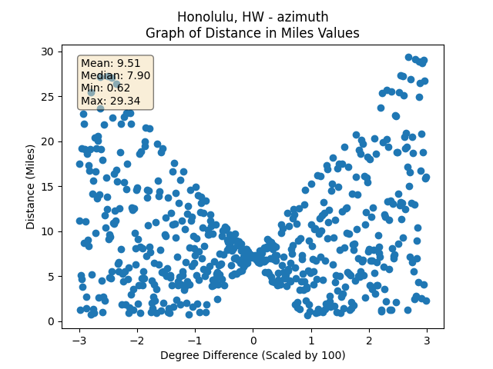
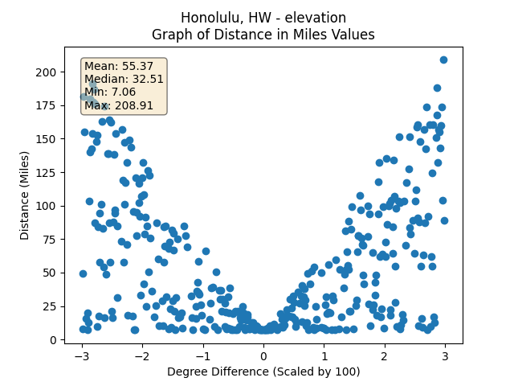
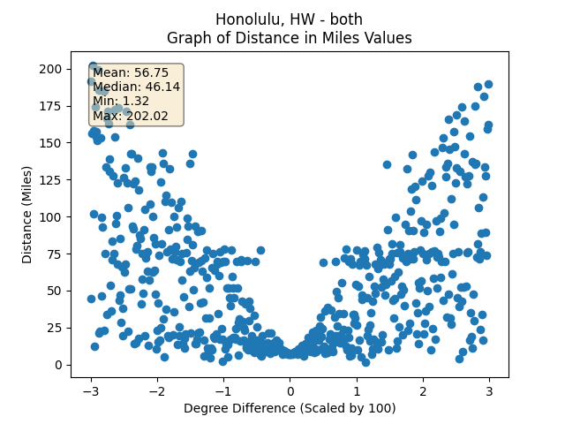
Results 1 Stats
Targeting Honolulu, HI
Notes:
TIPS:
Check out the Layout Dropdown for more layout design options
It’s recommended not going below 24-point font size for presentations
If your text overflows a placement text box it’s recommended to edit/delete down text content instead of increasing size of text box to accommodate more text
Guides for textboxes are available under View tab > check Guides checkbox

Slide 25
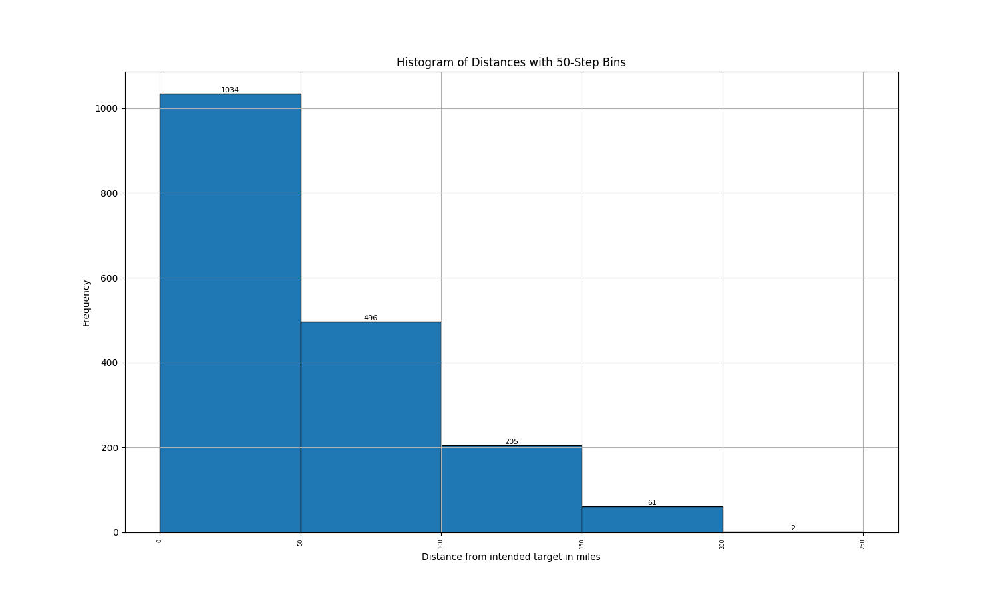
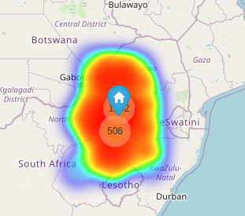
Results 3
Targeting Johannesberg, South Africa
Notes:
TIPS:
Check out the Layout Dropdown for more layout design options
It’s recommended not going below 24-point font size for presentations
If your text overflows a placement text box it’s recommended to edit/delete down text content instead of increasing size of text box to accommodate more text
Guides for textboxes are available under View tab > check Guides checkbox

Slide 26
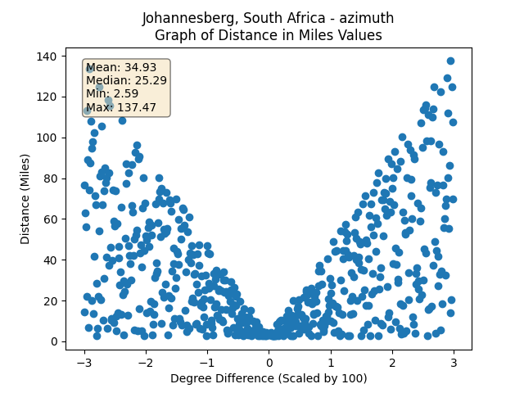
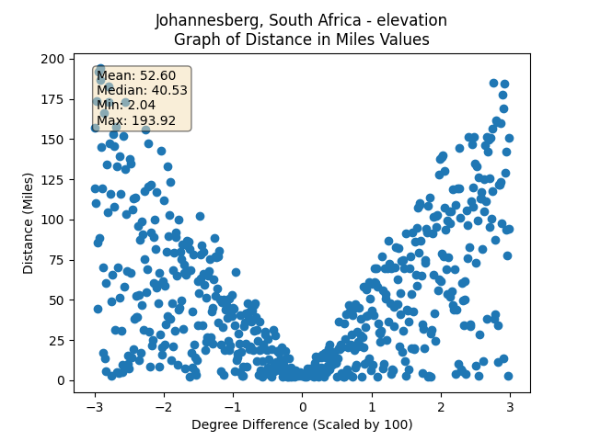
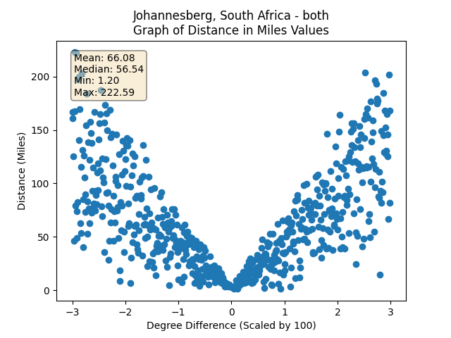
Results 1 Stats
Targeting Johannesberg, South Africa
Notes:
TIPS:
Check out the Layout Dropdown for more layout design options
It’s recommended not going below 24-point font size for presentations
If your text overflows a placement text box it’s recommended to edit/delete down text content instead of increasing size of text box to accommodate more text
Guides for textboxes are available under View tab > check Guides checkbox

Slide 27
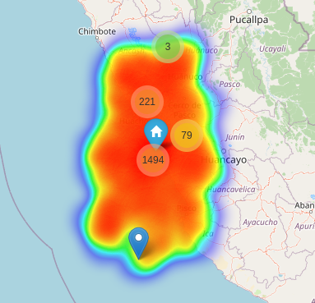
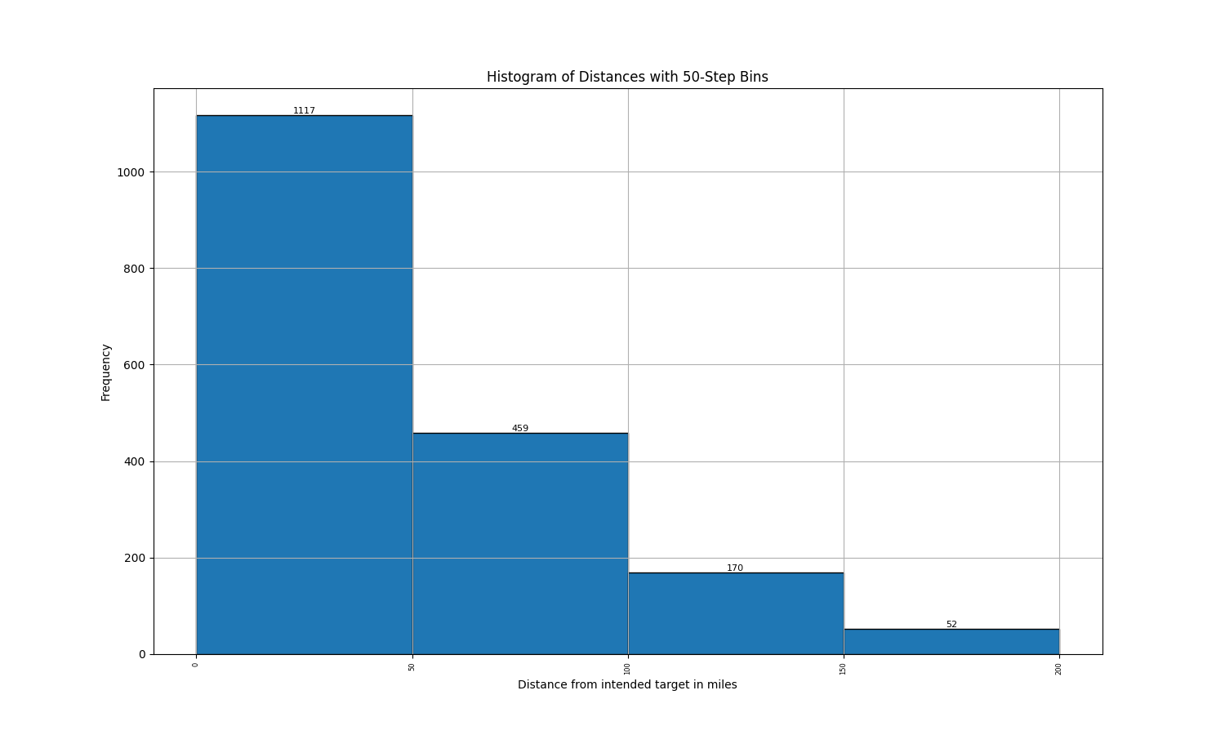
Results 4
Targeting Lima, Peru
Notes:
TIPS:
Check out the Layout Dropdown for more layout design options
It’s recommended not going below 24-point font size for presentations
If your text overflows a placement text box it’s recommended to edit/delete down text content instead of increasing size of text box to accommodate more text
Guides for textboxes are available under View tab > check Guides checkbox

Slide 28
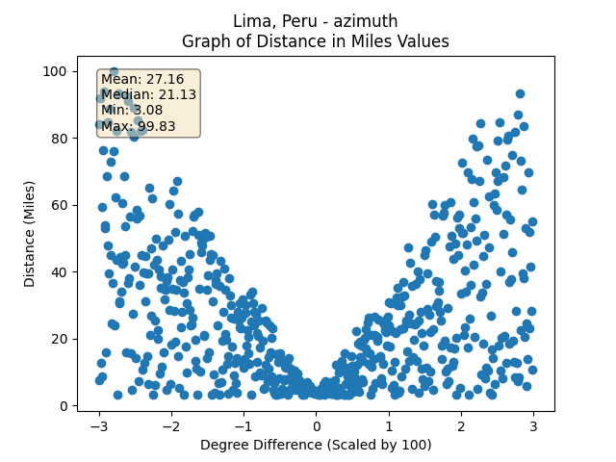
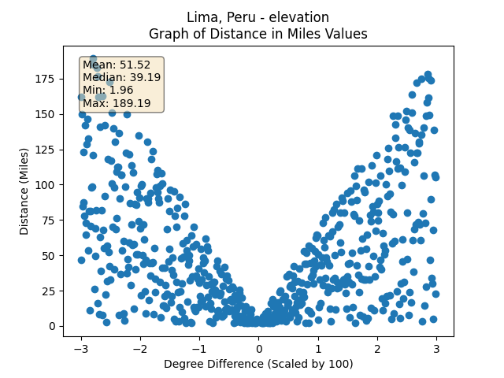
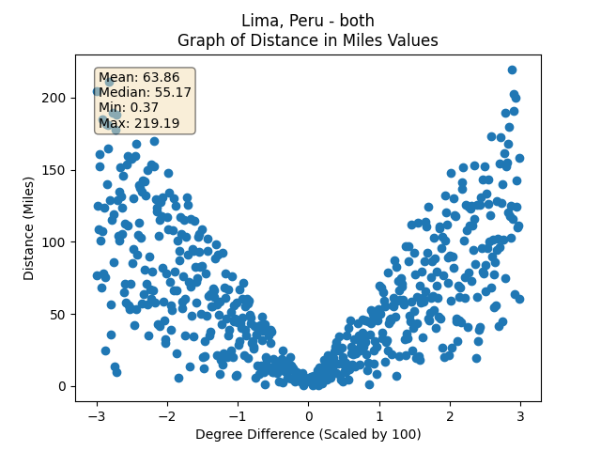
Results 1 Stats
Targeting Lima, Peru
Notes:
TIPS:
Check out the Layout Dropdown for more layout design options
It’s recommended not going below 24-point font size for presentations
If your text overflows a placement text box it’s recommended to edit/delete down text content instead of increasing size of text box to accommodate more text
Guides for textboxes are available under View tab > check Guides checkbox

Slide 29
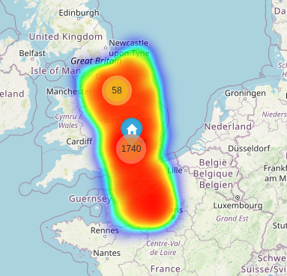
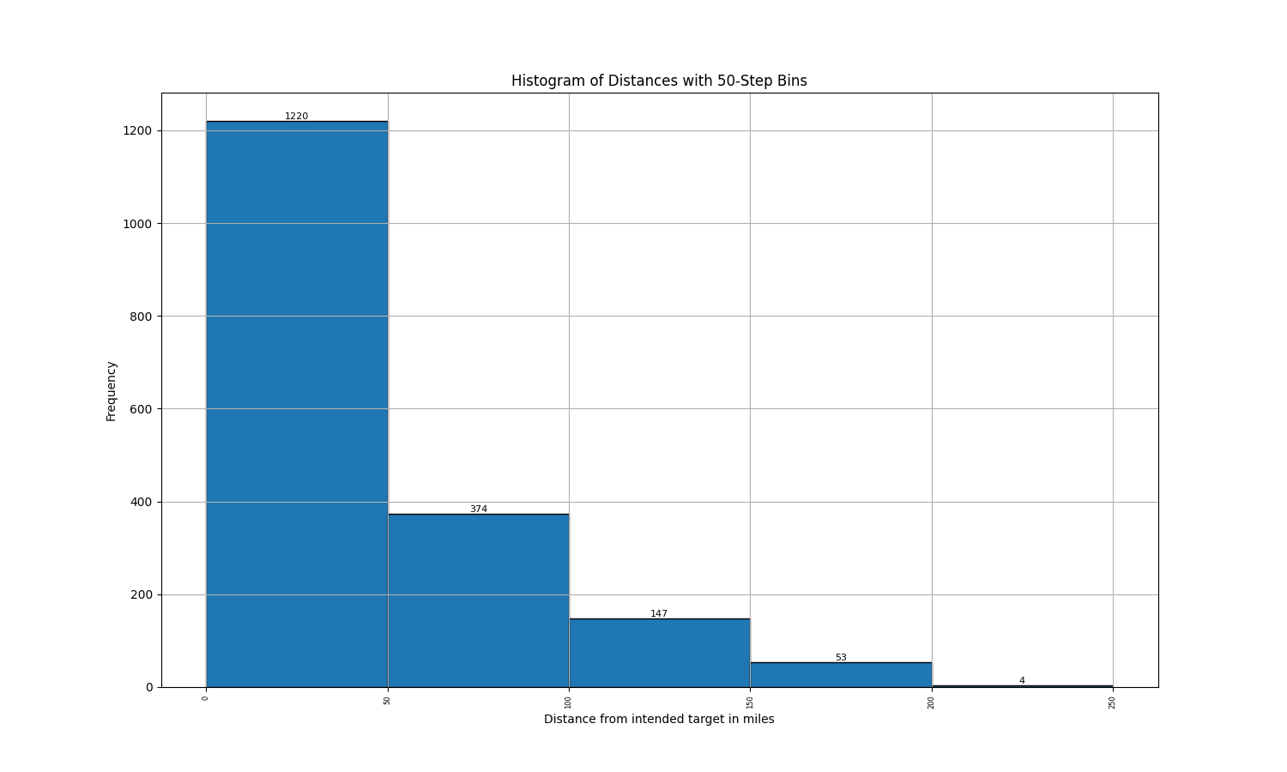
Results 5
Targeting London, England
Notes:
TIPS:
Check out the Layout Dropdown for more layout design options
It’s recommended not going below 24-point font size for presentations
If your text overflows a placement text box it’s recommended to edit/delete down text content instead of increasing size of text box to accommodate more text
Guides for textboxes are available under View tab > check Guides checkbox

Slide 30
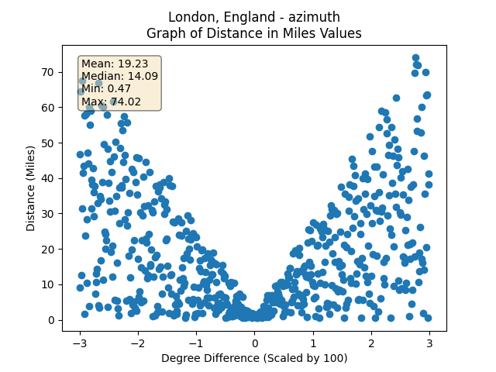
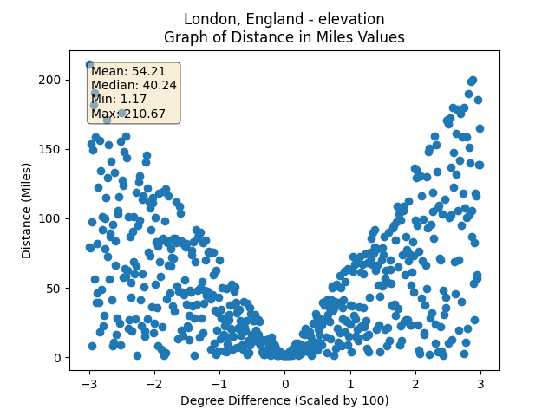
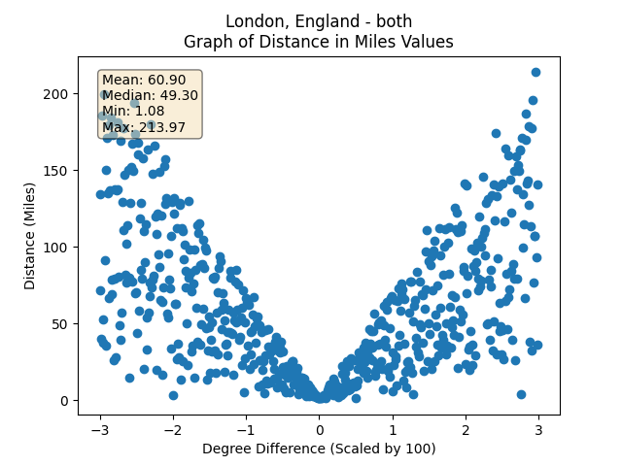
Results 1 Stats
Targeting London, England
Notes:
TIPS:
Check out the Layout Dropdown for more layout design options
It’s recommended not going below 24-point font size for presentations
If your text overflows a placement text box it’s recommended to edit/delete down text content instead of increasing size of text box to accommodate more text
Guides for textboxes are available under View tab > check Guides checkbox

Slide 31
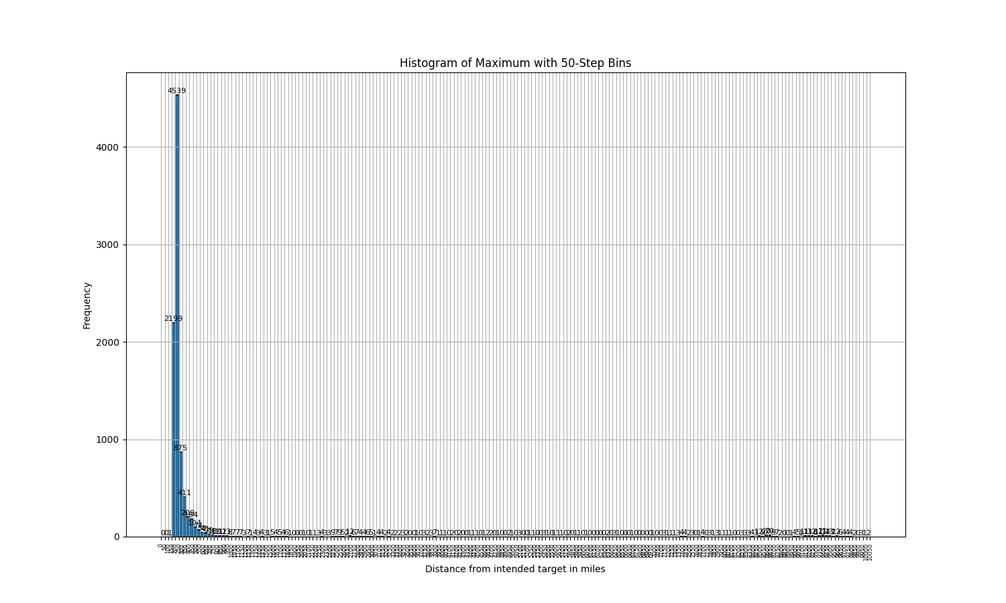

Slide 32
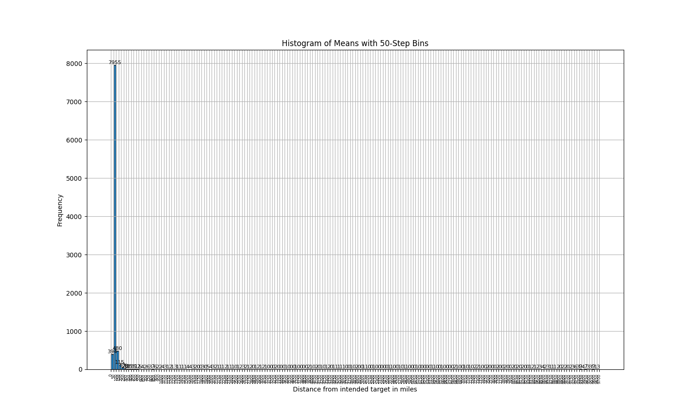

Slide 33
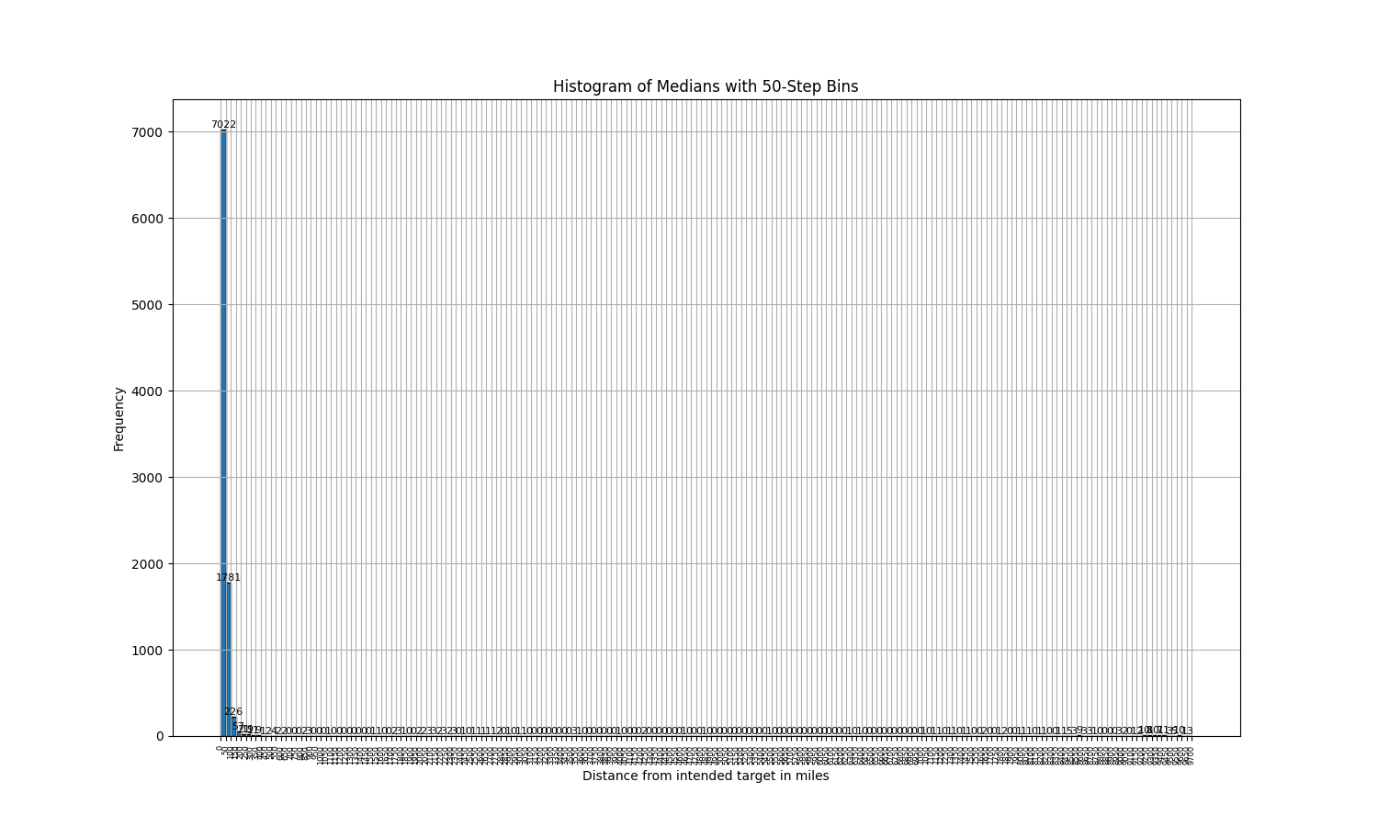

Slide 34
