Slide 1
Sun Based Localization

Slide 2
Premise
The algorithms being used will assume that the object to be localized is in a GPS denied environment with no prior knowledge of location.
We want to find a general location based on calculable information relating to the position of the sun and current UTC time.

Slide 3
Assumed Variables and Conditions
We have a camera that can track onto the sun or we have the ability to gather object height and shadow lengths
We have the ability to know true north
We have the current time and date in Coordinated Universal Time (UTC)

Slide 4
What Needs to be Calculated Pre Search
The Solar Azimuth – This is the angle of the sun relative to North (Degrees)
Solar Altitude/Elevation – This is the angle of the sun over the horizon (Degrees)
Lat, Lon – Current Lat, Lon can be estimated using the calculated azimuth and elevation.

Slide 5
Pre Search Calculations
Solar Azimuth and Elevation with Camera
Assuming the camera at our disposal is on a gimble, we can take that data to extract our angles.
We will also need to account for the angle of the vehicle.
- IMU
- Horizon detection and leveling

Slide 6
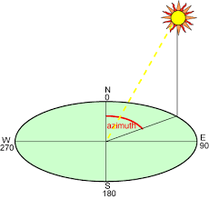
Pre Search Calculations Continued
Solar Azimuth with Shadow
If all we have is a shadow and object we can still find what we need.
The solar azimuth can be calculated by measuring the angle clockwise from north that a shadow takes from a top down view of the casting object.

Slide 7
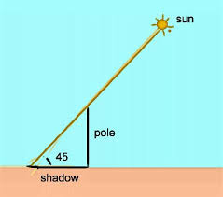
Pre Search Calculations Continued
Solar Elevation with Shadow
If all we have is a shadow and object we can still find what we need.
The solar elevation can be found using the tangent between the height of an object and its corresponding shadow

Slide 8
Starting the Search
Once a local azimuth and altitude have been found, we can use that along with our UTC time to begin testing for our current latitude and longitude

Slide 9
How we are Finding Lat Lon
To find our Lat Lon, we are going to use an iterative refinement search.
Iterative Refinement – We will begin by taking large steps across the globe to find generalizations and then stepping down our search size as we get closer
***Note, we could cut down the testing size simply by eliminating certain lat lons based on day or night

Slide 10
Calculating Solar Position Based On Lat and Lon
To Calculate the solar position we will need
- Latitude and Longitude (Iterative)
- Current Date and UTC Time at Location
- Elapsed Julian Days (calculated by subtracting current date from January 1st, 2000)
- Declination Angle
- Hour Angle

Slide 11
Testing
For Testing we used a manually imported expected azimuth and elevation.
In the future we hope to integrate this for use with camera calculations as previously discussed.
Tested on different global cities at there local noon in UTC time.
Ran each city 1800 times stepping 0.1 degrees between -3 and 3 for each alt and az.

Slide 12
Small Scale Testing With Intentional Error
NOAA data was used for small scale tests
The website provided azimuths and altitudes for specific locations and times
Allowed for testing on several cities around the the world
Notes:
NOAA = National Oceanic and Atmospheric Administration

Slide 13
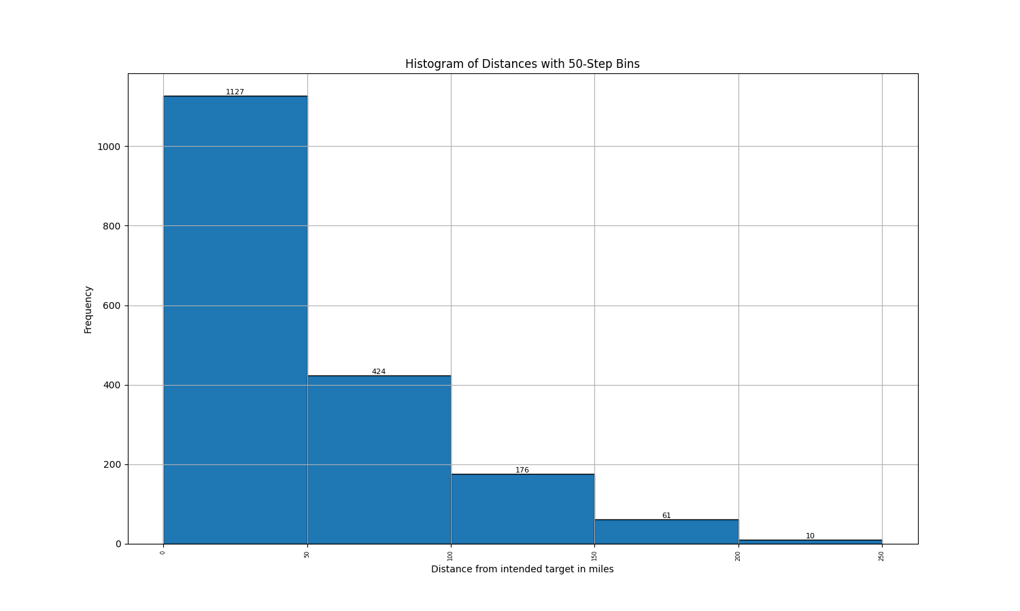
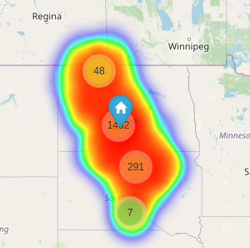
Example Result
Targeting Bismark, ND

Slide 14
Testing more locations
Once single run tests were working we than ran a large scale test on randomly generated Cities.
- We randomly generated over 9,000 (9,334 to be exact) random combinations of cities and times to be ran
- Each city followed the same parameters as the individual tests

Slide 15
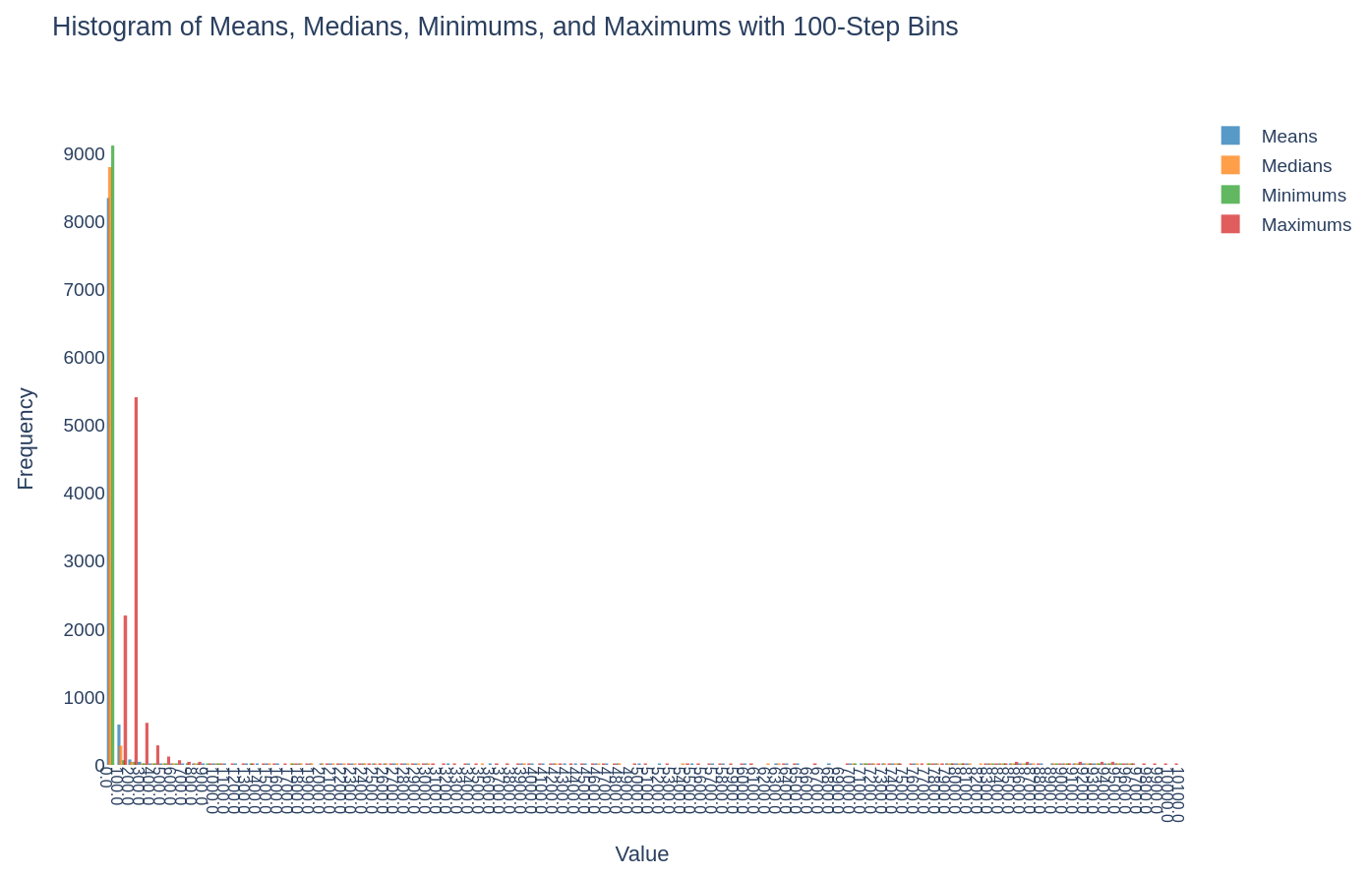
Large Scale Testing Results

Slide 16
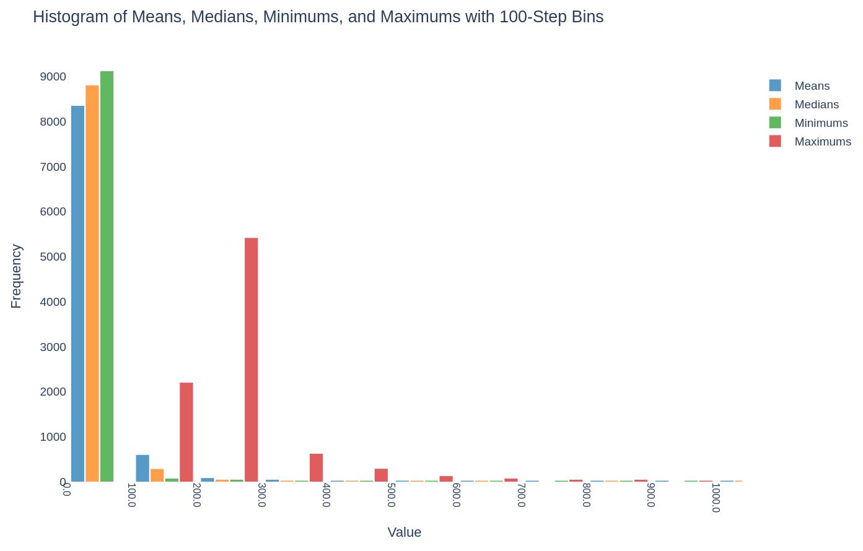
Large Scale Testing Results (Zoomed)
Notes:
Means percentile below 300: 96.69988213864781%
Medians percentile below 300: 97.78206364513018%
Minimums percentile below 300: 98.74638379942141%
Maximums percentile below 300: 81.58148505303761%

Slide 17
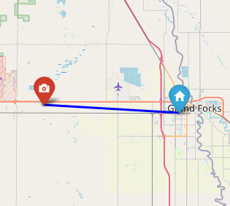
Personal Testing
For personal testing we measured the shadows of various object
- Roads Signs
- Cardboard Boxes
- Shoes
Phones were used as a compass to find north and the corresponding azimuth angles
Notes:
Means percentile below 300: 96.69988213864781%
Medians percentile below 300: 97.78206364513018%
Minimums percentile below 300: 98.74638379942141%
Maximums percentile below 300: 81.58148505303761%

Slide 18
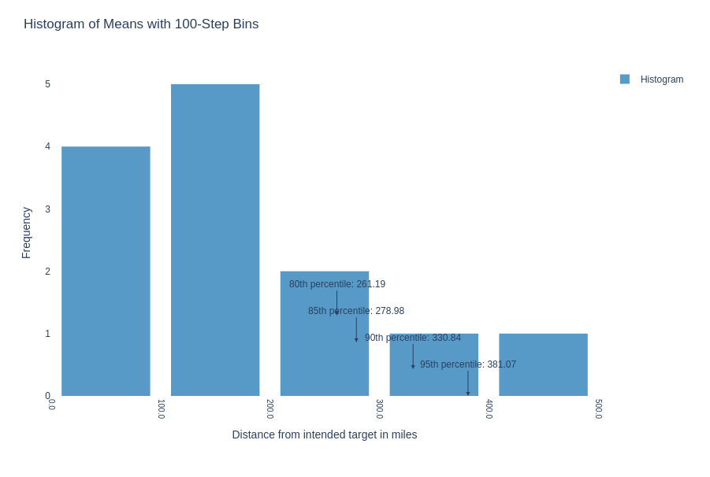
Personal Testing Results
Notes:
Means percentile below 300: 96.69988213864781%
Medians percentile below 300: 97.78206364513018%
Minimums percentile below 300: 98.74638379942141%
Maximums percentile below 300: 81.58148505303761%

Slide 19
Work To Be Done and Applications
More extensive personal testing
- More shadow measurements with different and more precise tools
- Measurements using gimble
Automated localization using gimble and sun detection
Notes:
Means percentile below 300: 96.69988213864781%
Medians percentile below 300: 97.78206364513018%
Minimums percentile below 300: 98.74638379942141%
Maximums percentile below 300: 81.58148505303761%

Slide 20
Appendix
- Supporting Math (21 - 23)
- Single Test Images (24 - 33)
- Large Test Result graphs (34 – 37)
- Personal Testing Results (38

Slide 21
Calculating Solar Declination Angle
The angular distance from the zenith of the observer at the equator and the sun at solar noon
dOmega = 2.1429 - 0.0010394594 * dElapsedJulianDays
dMeanLongitude = 4.8950630 + 0.017202791698 * dElapsedJulianDays # Radians
dMeanAnomaly = (6.2400600 + 0.0172019699 * dElapsedJulianDays)
dEclipticLongitude = dMeanLongitude + 0.03341607 * math.sin(dMeanAnomaly) + 0.00034894 * math.sin(2 * dMeanAnomaly) - 0.0001134 - 0.0000203 * math.sin(dOmega)
dEclipticObliquity = 0.4090928 - 6.2140e-9 * dElapsedJulianDays + 0.0000396 * math.cos(dOmega)
dSin_EclipticLongitude = math.sin(dEclipticLongitude)
dY = math.cos(dEclipticObliquity) * dSin_EclipticLongitude
dX = math.cos(dEclipticLongitude)
dRightAscension = math.atan2(dY, dX) if dRightAscension < 0.0: dRightAscension += (2 * math.pi)
dDeclination = math.asin(math.sin(dEclipticObliquity) * dSin_EclipticLongitude)

Slide 22
Calculating Solar Hour Angle
The angular displacement of the sun east or west of the local meridian due to rotation of the earth on its axis at 15° per hour with morning being negative and afternoon being positive
# Local Standad Time Meridian
LSTM = 15 * abs(0) # LSTM = 15 * UTC Difference which is zero if given UTC Time
# Equation of time
B = math.radians((360/365) * (day_of_year - 81))
EoT = 9.87*math.sin(2*B) - 7.53*math.cos(B) - 1.5*math.sin(B)
# Time Correction Factor
TC = 4 * (longitude - LSTM) + EoT
# Local Solar Time
LST = ((60 * datetime.hour) + datetime.minute + TC) / 60
# Hour Angle
hour_angle = math.radians(15 * (LST - 12))

Slide 23
Calculating Solar Alt, and Azm Angles
altitude_angle = math.asin(math.sin(latitude) * math.sin(declination_angle) +
math.cos(latitude) * math.cos(declination_angle) *
math.cos(hour_angle))
azimuth_angle = math.atan2(-math.cos(declination_angle) * math.sin(hour_angle),
math.cos(latitude) * math.sin(declination_angle) -
math.sin(latitude) * math.cos(declination_angle) *
math.cos(hour_angle))
altitude_deg = math.degrees(altitude_angle)
azimuth_deg = math.degrees(azimuth_angle)

Slide 24
Results 1
Targeting Bismark, ND

Slide 25
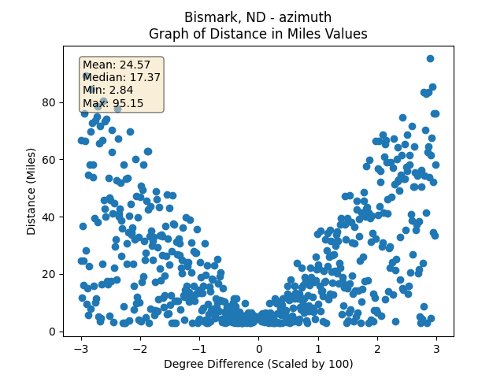
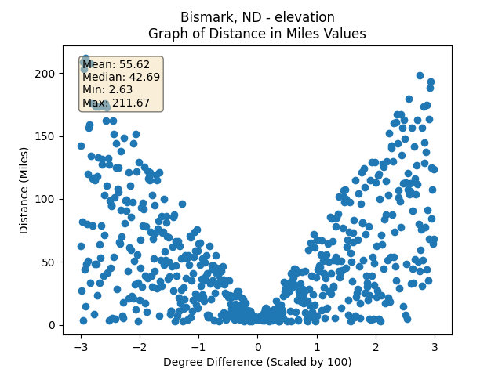
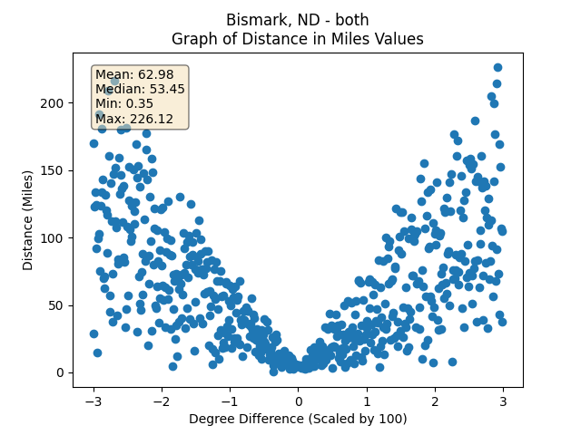
Results 1 Stats
Targeting Bismark, ND

Slide 26
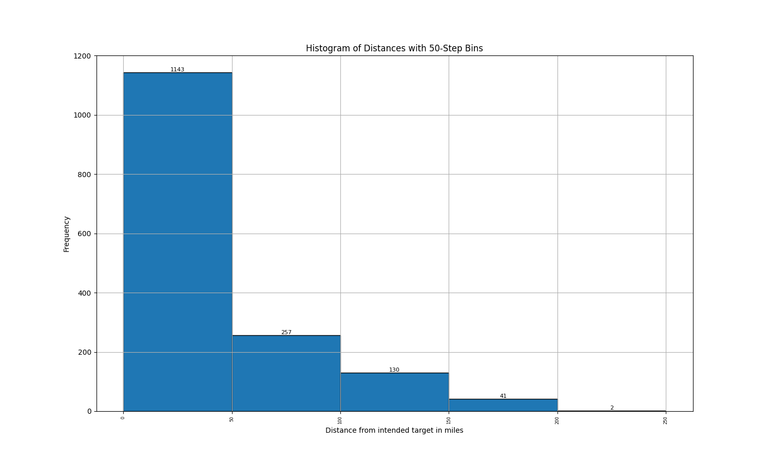
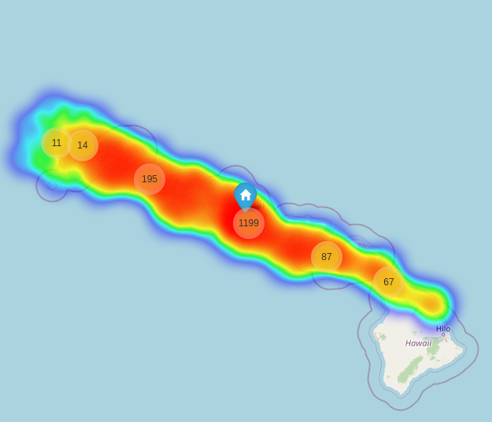
Results 2
Targeting Honolulu, HI

Slide 27
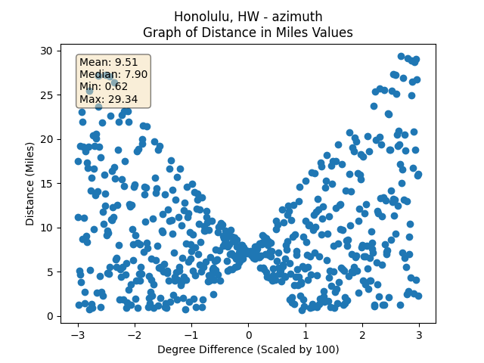
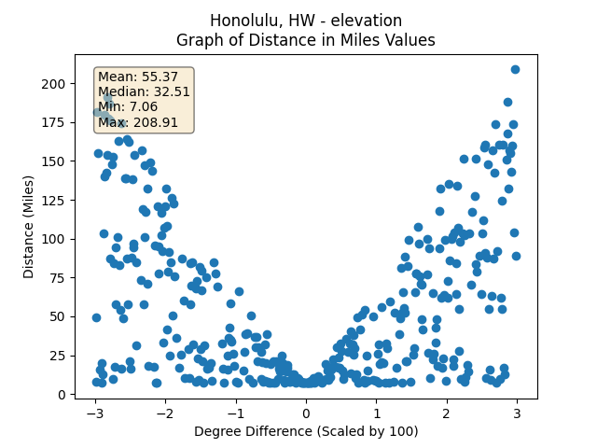
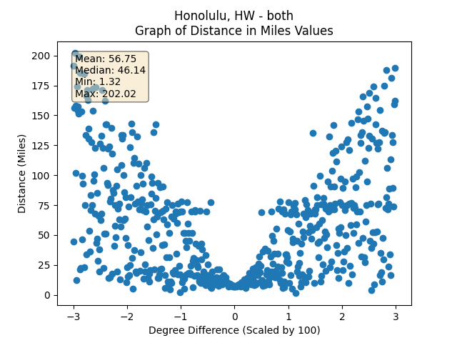
Results 1 Stats
Targeting Honolulu, HI

Slide 28
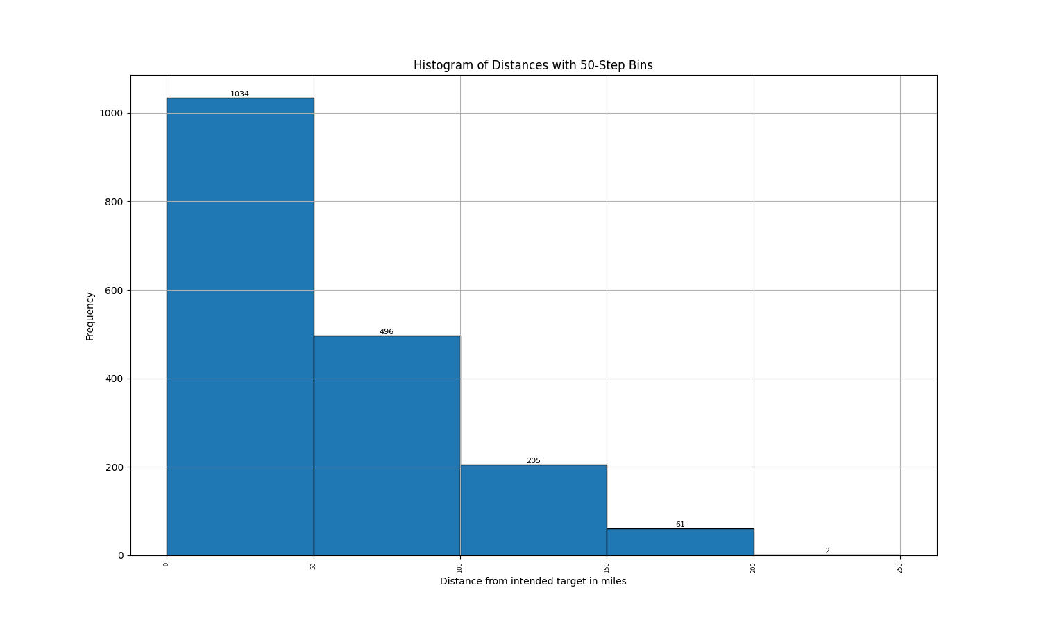
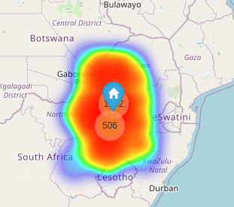
Results 3
Targeting Johannesberg, South Africa

Slide 29
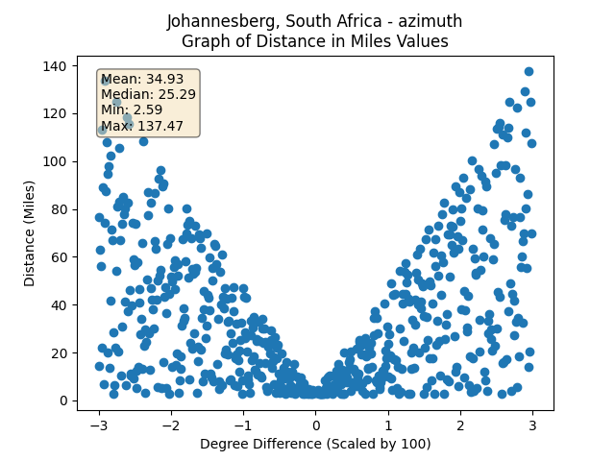
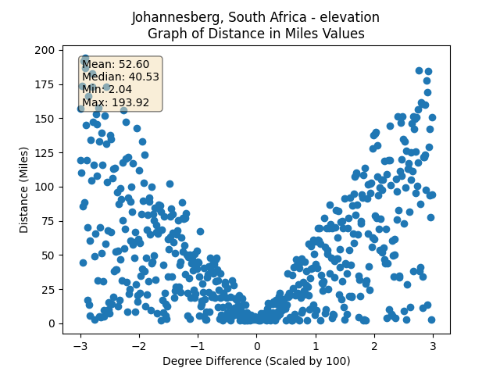
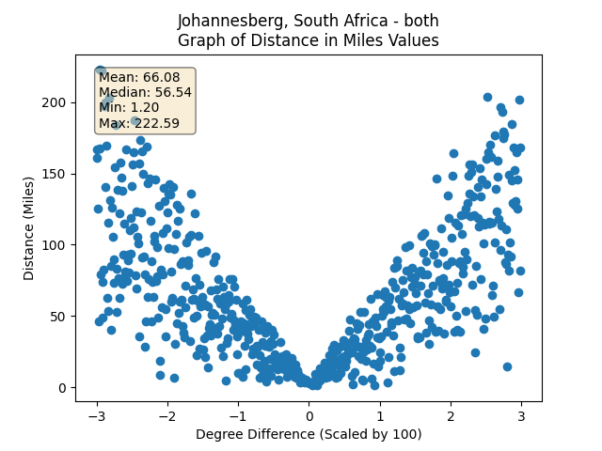
Results 1 Stats
Targeting Johannesberg, South Africa

Slide 30
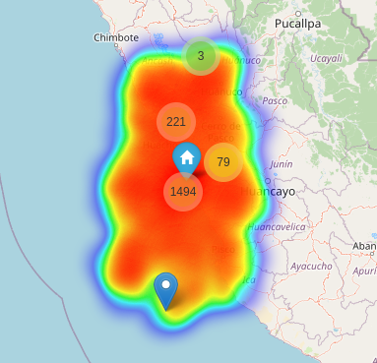
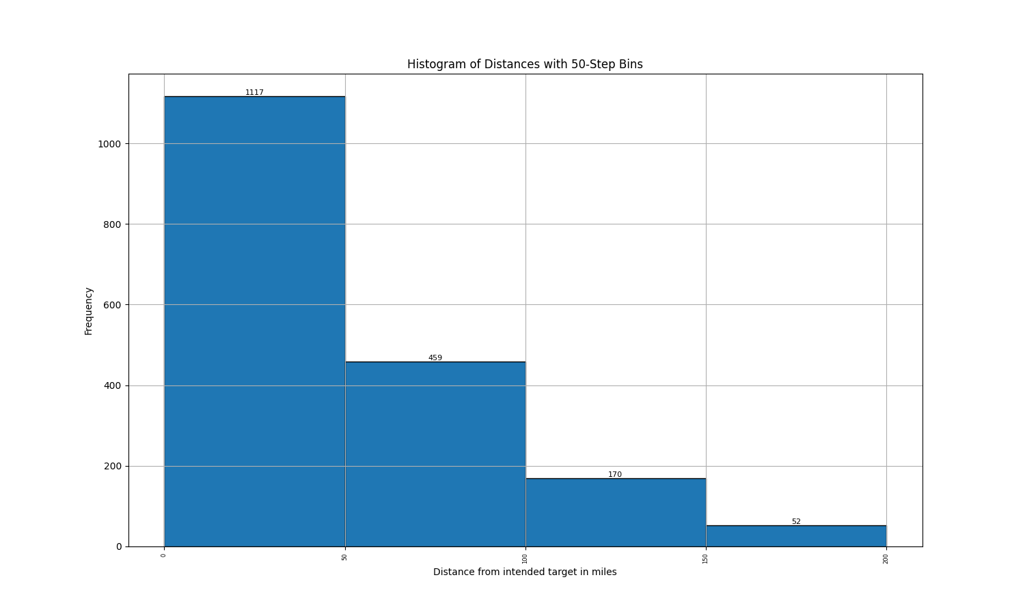
Results 4
Targeting Lima, Peru

Slide 31
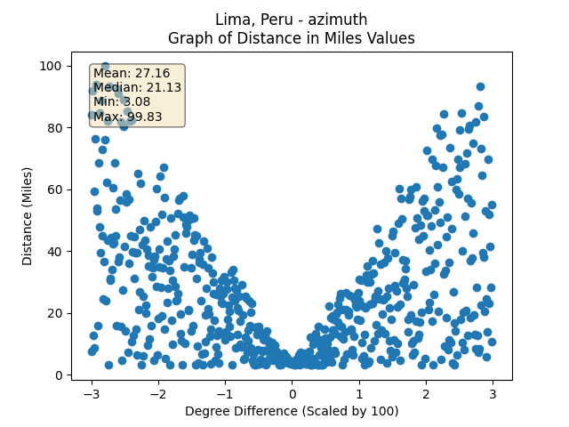
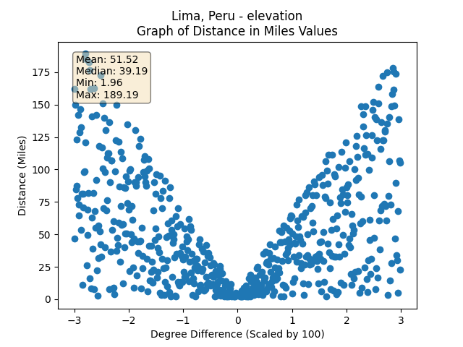
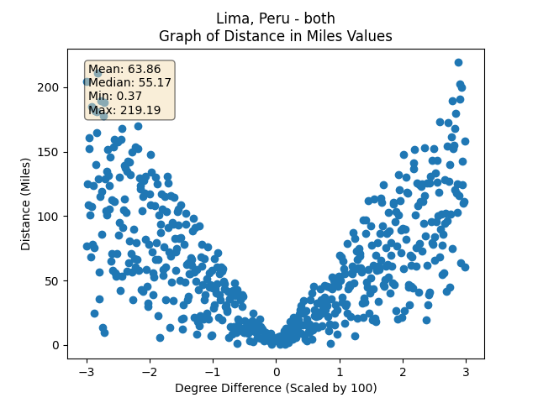
Results 1 Stats
Targeting Lima, Peru

Slide 32
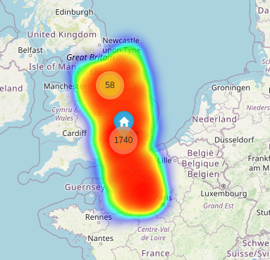
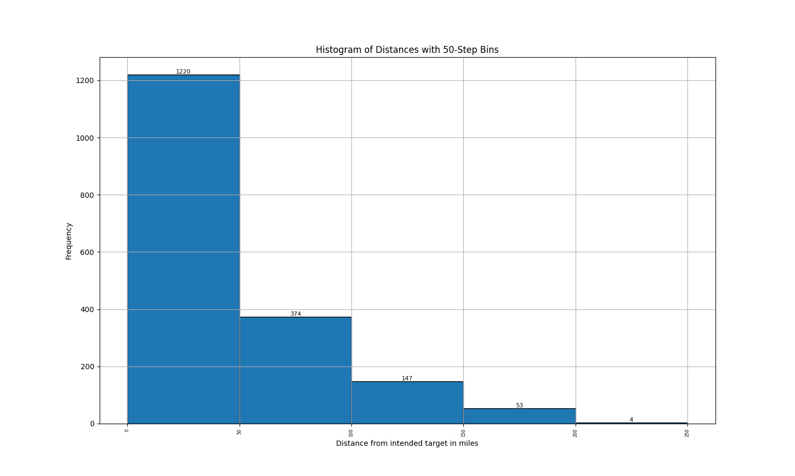
Results 5
Targeting London, England

Slide 33
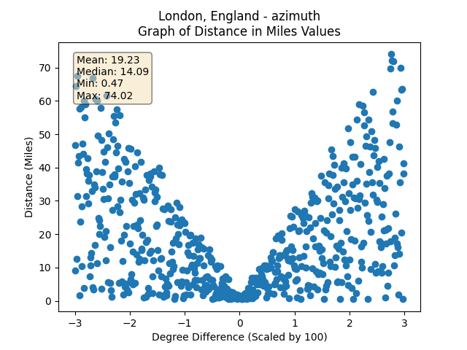
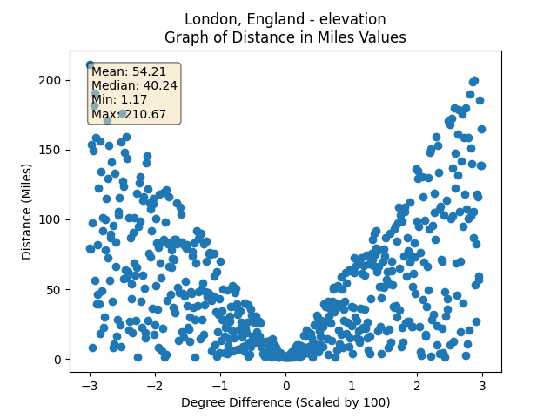
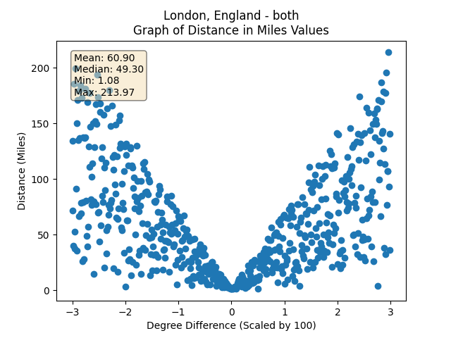
Results 1 Stats
Targeting London, England

Slide 34
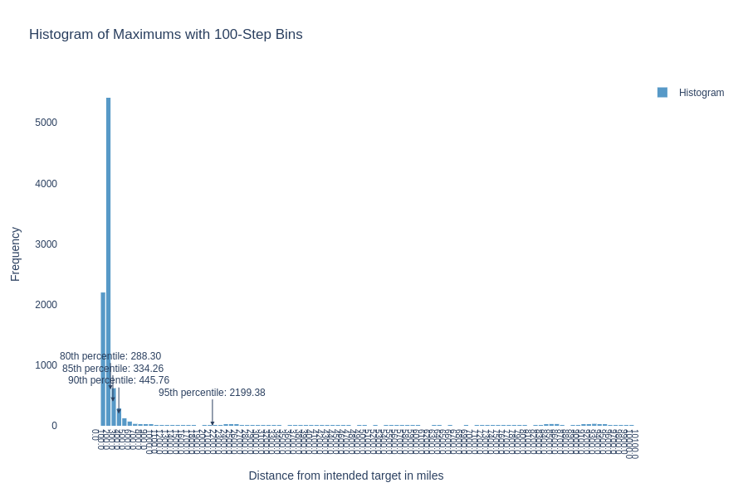

Slide 35
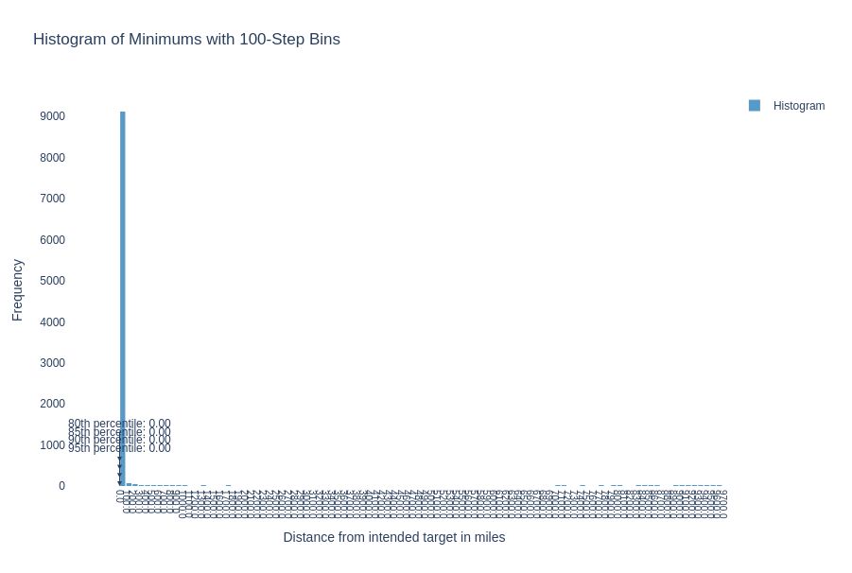

Slide 36


Slide 37
