Slide 1
Review of: “Genome-wide transcriptional analysis of T cell activation reveals differential gene expression associated with psoriasis”
Sam Brown, Wayne Kunze, Caleb Perry
EECS 6690, Spring 2018

Slide 2
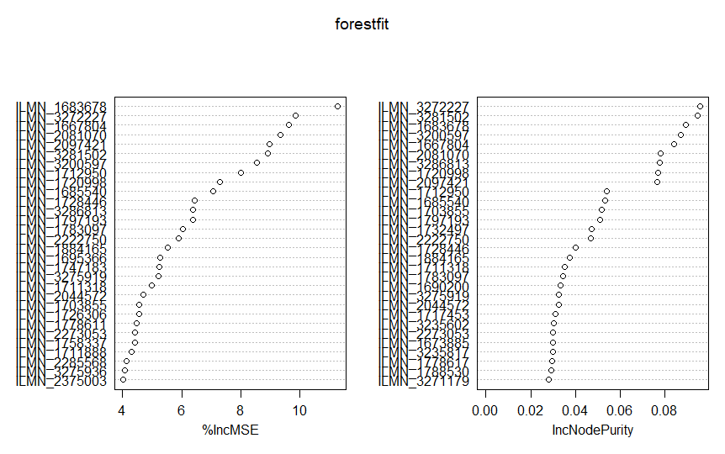
Random Forests
Implementation:
Computationally intensive – initial development required several hours to run
Large number of factors (more than 48000) requires factor reduction (not reducing factors crashes RStudio)
We subdivided the factors into “factor subsets” to identify “more important” factors that then competed to “most important factors”
2 | EECS 6690

Slide 3
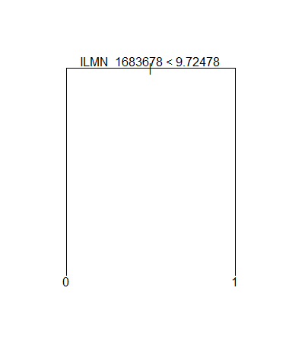
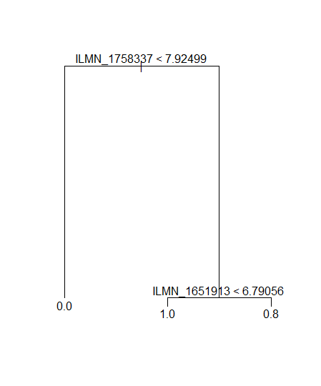
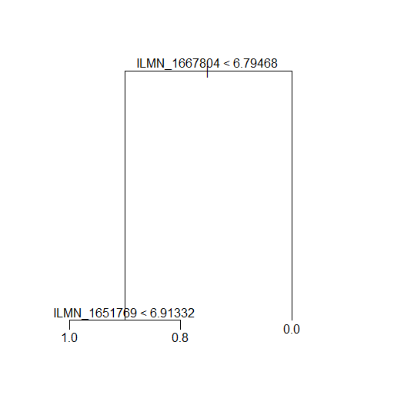
Random Forests
Results:
Very limited overlap between Random Forest analysis and other methods
ILMN_1683678 (“SPATS2L”) is identified as “most important” factor (single factor with 100% predictive accuracy)
Other trees use two factors for 96% accuracy
3 | EECS 6690

Slide 4
References
1. Palau, Julia, Ferrandiz, Puig, Fonseca, Fernadez, Lopez-Lasanta, Tortose, Marsal. "Genome-wide transcriptional analysis of T cell activation reveals differential gene expression associated with psoriasis." BMC Genomics (2013): 14:825
2. James, Witten, Hastie, Tibshirani. An Introduction to Statistical Learning with Applications in R. New York, NY: Springer, 2013. Ebook.
3. Hastie, Tibshirani, Friedman. The Elements of Statistical Learning. New York, NY: Springer, 2009. Ebook.
4 | EECS 6690

Slide 5

Questions/Comments?
5 | EECS 6690

