Slide 1


Spring Boot Thymeleaf
with JDBC

Slide 2
Spring Model-View-Controller (MVC) framework
The Spring Model-View-Controller (MVC) framework is a powerful and flexible way to build web applications. It follows the MVC design pattern, which separates the application into three main components: the Model, the View, and the Controller. This separation helps manage the complexity of application development by promoting clean, modular, and maintainable code.

Slide 3
Model
The Model represents the application's data and business logic. It is responsible for retrieving data from the database, processing it, and updating the database as needed. In Spring MVC, the Model is often composed of plain old Java objects (POJOs), which are simple Java classes that encapsulate the data and business logic.

Slide 4
View
The View is responsible for displaying the data to the user. It generates the user interface (UI) and presents the data from the Model in a human-readable format. In Spring MVC, the View can be implemented using various technologies such as JSP (JavaServer Pages), Thymeleaf, or FreeMarker. The View is usually defined in HTML or XHTML, and it can include elements like forms, tables, and other UI components.

Slide 5
Controller
The Controller acts as an intermediary between the Model and the View. It processes user input, handles requests, and directs the flow of data between the Model and the View. In Spring MVC, the Controller is typically a Java class annotated with @Controller or @RestController. It contains methods annotated with @RequestMapping, @GetMapping, @PostMapping, etc., which define the request handling logic.

Slide 6
Thymeleaf
Thymeleaf's Expression Language (EL) is a powerful feature that allows you to embed dynamic content in your HTML templates. It helps bind data from your application's backend to the frontend views1.
Here are the main types of expressions used in Thymeleaf:

Slide 7

Thymeleaf's Variable Expressions
Variable expressions are used to access variables from the model. They are enclosed in ${...}. This expression injects the value of product.name into the <span> element.
For example:

Slide 8
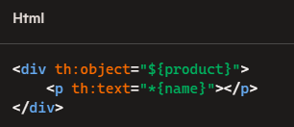
Thymeleaf Selection Expressions
Selection expressions are used to access properties of an object that has been selected using th:object. They are enclosed in *{...}. This expression accesses the name property of the product object.
For example:

Slide 9

Thymeleaf Message Expressions
They are enclosed in #{...}. This expression retrieves a localized message based on the key welcome from a properties file.
For example:

Slide 10

Thymeleaf Link Expressions
Link expressions are used to create URLs. They are enclosed in @{...}. This expression generates a URL to the /products endpoint.
For example:

Slide 11

Thymeleaf Fragment Expressions
Fragment expressions are used to include reusable fragments of HTML. They are enclosed in ~{...}. This expression includes the content of the header fragment . This expression generates a URL to the /products endpoint.
For example:

Slide 12
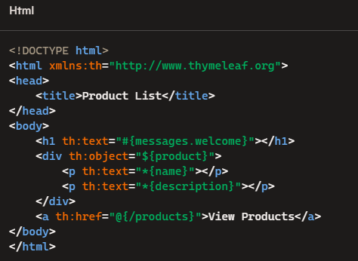
Thymeleaf Example
In this example, the template displays a welcome message, product details, and a link to the product list. Here's a complete example of a Thymeleaf template using these expressions:

Slide 13
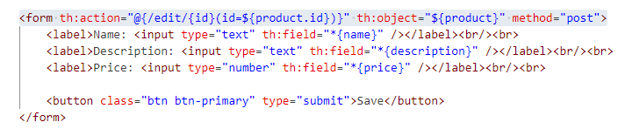
Thymeleaf Form
The provided code snippet is an HTML form element that uses Thymeleaf, a popular Java template engine, to dynamically generate the form's action URL and bind the form to a product object. Let's break down the key components:
Form Tag: The <form> tag defines an HTML form that will be used to submit data to the server. The method="post" attribute specifies that the form will use the HTTP POST method to send data.
Thymeleaf Action Attribute: The th:action attribute is a Thymeleaf-specific attribute used to dynamically set the form's action URL. The value @{/edit/{id}(id=${product.id})} indicates that the form will submit to the /edit/{id} endpoint, where {id} is a placeholder for the product's ID. The expression id=${product.id} dynamically inserts the product's ID into the URL, ensuring that the form submits to the correct endpoint for the specific product being edited.
Thymeleaf Object Attribute: The th:object="${product}" attribute binds the form to a product object. This means that the form fields will be populated with the properties of the product object, and when the form is submitted, the data will be mapped back to this object.
Overall, this code snippet is part of a web application that allows users to edit product details. By using Thymeleaf, the form is dynamically generated with the correct action URL and bound to the appropriate product object, facilitating seamless data binding and submission.

Slide 14
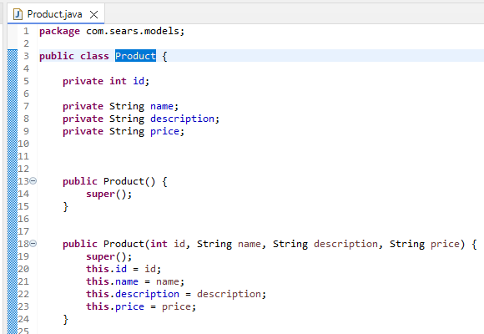
POJO and Product Class
We start with a Plain Old Java Object (POJO) for Product with four attributes: an integer id, name, description, and price. The Product class includes a constructor and the necessary getters and setters.

Slide 15
References
https://www.baeldung.com/java-thymeleaf-expression-types

