Slide 1

Neural Collaborative Filtering for a Music Recommendation System
Bratislav Petkovic – M.S. Data Analytics 2023

Slide 2
Problem and Hypothesis
Recommendation engines have been essential to the success of digital platforms Alibaba, Amazon, Netflix, and Spotify, according to their founders and CEOs. For companies such as these, recommendation engines aren’t merely marketing or sales tools but drivers of insight, innovation, and engagement … they amplify customer lifetime value. Computing compelling recommendations profitably reshapes human behavior. (MIT Sloan, 2020)
Problem: How can a Neural Collaborative Filtering model be used to create a music recommendation system?
Hypothesis:
H₀ : An NCF music recommendation system cannot be designed with an accuracy of 90% or higher.
H₁ : An NCF music recommendation system can be designed with an accuracy of 90% or higher.

Slide 3
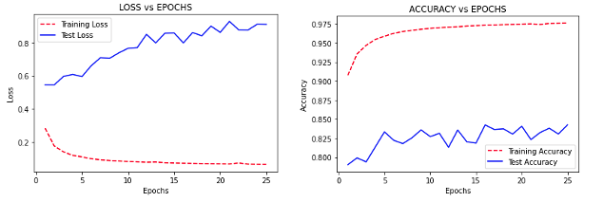
Data Analysis
The dataset was comprised of real Spotify users and was publicly published on Kaggle. The dataset contains anonymized users and the songs and artists that they have liked.
One artist was left out of the training data for each user and placed into the test data.
An NCF model is constructed and fitted using various architectural and training parameters. After numerous iterations of training and re-designing an optimal model was identified.
The final model was evaluated by
Assessing model generalizability by examining train and test accuracies.
Generating and testing the relevance of recommendations through exploratory data analysis.

Slide 4
Outline of the Study’s Findings
The NCF model reaches a test recall accuracy of 85% which did not meet the threshold for rejecting the null hypothesis.
The success of the model can be attributed to its architecture – while General Matrix Factorization is able to learn the linear relationship between users and items, the Multilayer Perceptron inferred the non-linear relationships.
Through careful analysis of the effects of batch size, learning rate and number of epochs on the model’s test accuracy, generalization error was minimized.
The exploratory data analysis reveals that the model performance does not decrease when the input size varies – the recommendation accuracy was comparable for users with different pool sizes of liked artists.

Slide 5
Limitations
The major limitation of the study was that the accuracy was 5 % lower than necessary to reject the null hypothesis.
Fitting the model and generating predictions was computationally expensive - training the model for 8 epochs lasted 2 hours while generating predictions for each user lasted 1 hour and 40 minutes.
Increasing the neural network size by adding more layers or units did not seem to improve performance and only made the model more complex, requiring more computation.

Slide 6
Proposed Actions
Feature Engineering via Natural Language Processing – many artists were expressed in multiple formats which increased item dimensionality. An NLP to decrease the number of items has the potential to improve the NCF model.
Combining the NCF model with another classification model which would have music metadata – genre, danceability, language, style.
Using a larger dataset with more records would allow the model to gain a deeper understanding of the complex listening behavior of humans.

Slide 7
Benefits of the Study
The NCF structure is thoroughly examined for a recommendation system and its advantages, limitations and next steps are identified.
Since the model gave relevant results for 85% of users it could be deployed as a beta feature on the music platform to help current users discover new artists. If the model’s performance was continuously monitored in a production environment it could give more insight into future enhancements.

