Slide 1
PySimpleGUI
By: B. R. Pawan Kumar

Slide 2
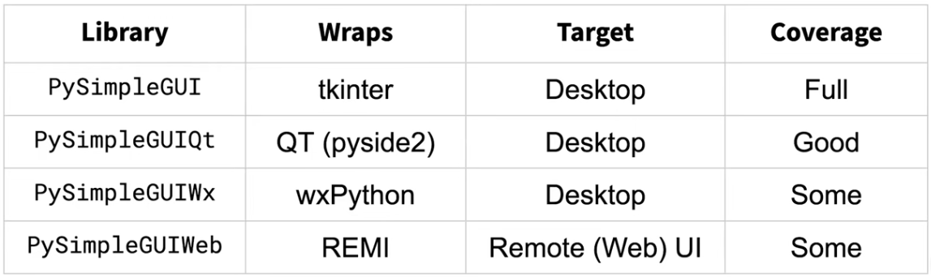
What Is PySimpleGUI ?
PySimpleGUI is a Python package that enables Python programmers of all levels to create GUIs. You specify your GUI window using a "layout" which contains widgets (they're called "Elements" in PySimpleGUI). Your layout is used to create a window using one of the 4 supported frameworks to display and interact with your window. Supported frameworks include tkinter, Qt, WxPython, or Remi. The term "wrapper" is sometimes used for these kinds of packages.

Slide 3
PySimpleGUI Hardware and Software supported
Hardware
PC's, Desktop, Laptops
Macs of all types
Raspberry Pi
Android devices like phones and tablets
Virtual machine online (no hardware) - repl.it
OS
Windows 7, 8, 10
Linux on PC - Tested on several distributions
Linux on Raspberry Pi
Linux on Android - Can use either Termux or PyDroid3
Mac OS
It can run on Python 2.7 and above and all versions of Python 3

Slide 4
PySimpleGUI Installation
The most common and easy method is via Pip install: Console Command is as: pip install PySimpleGUI
The GitHub Link for PySimpleGUI is as: https://github.com/PySimpleGUI/PySimpleGUI

Slide 5
PySimpleGUI Themes
Themes are used for designing Beautiful windows. It gives the user a choice to showcase his creativity on the GUI with colors.
Black | DarkBlue12 | DarkBrown | DarkGrey | DarkPurple6 | DarkTeal6 | LightBlue2 | LightBrown4 | LightGreen6 | Material1
BlueMono | DarkBlue13 | DarkBrown1 | DarkGrey1 | DarkRed | DarkTeal7 | LightBlue3 | LightBrown5 | LightGreen7 | Material2
BluePurple | DarkBlue14 | DarkBrown2 | DarkGrey2 | DarkRed1 | DarkTeal8 | LightBlue4 | LightBrown6 | LightGreen8 | NeutralBlue
BrightColors | DarkBlue15 | DarkBrown3 | DarkGrey3 | DarkRed2 | DarkTeal9 | LightBlue5 | LightBrown7 | LightGreen9 | Purple
BrownBlue | DarkBlue16 | DarkBrown4 | DarkGrey4 | DarkTanBlue | Default | LightBlue6 | LightBrown8 | LightGrey | Reddit
Dark | DarkBlue17 | DarkBrown5 | DarkGrey5 | DarkTeal | Default1 | LightBlue7 | LightBrown9 | LightGrey1 | Reds
Dark2 | DarkBlue2 | DarkBrown6 | DarkGrey6 | DarkTeal1 | DefaultNoMoreNagging | LightBrown | LightGray1 | LightGrey2 | SandyBeach
DarkAmber | DarkBlue3 | DarkGreen | DarkGrey7 | DarkTeal10 | Green | LightBrown1 | LightGreen | LightGrey3 | SystemDefault
DarkBlack | DarkBlue4 | DarkGreen1 | DarkPurple | DarkTeal11 | GreenMono | LightBrown10 | LightGreen1 | LightGrey4 | SystemDefault1
DarkBlack1 | DarkBlue5 | DarkGreen2 | DarkPurple1 | DarkTeal12 | GreenTan | LightBrown11 | LightGreen10 | LightGrey5 | SystemDefaultForReal
DarkBlue | DarkBlue6 | DarkGreen3 | DarkPurple2 | DarkTeal2 | HotDogStand | LightBrown12 | LightGreen2 | LightGrey6 | Tan
DarkBlue1 | DarkBlue7 | DarkGreen4 | DarkPurple3 | DarkTeal3 | Kayak | LightBrown13 | LightGreen3 | LightPurple | TanBlue
DarkBlue10 | DarkBlue8 | DarkGreen5 | DarkPurple4 | DarkTeal4 | LightBlue | LightBrown2 | LightGreen4 | LightTeal | TealMono
DarkBlue11 | DarkBlue9 | DarkGreen6 | DarkPurple5 | DarkTeal5 | LightBlue1 | LightBrown3 | LightGreen5 | LightYellow | Topanga

Slide 6
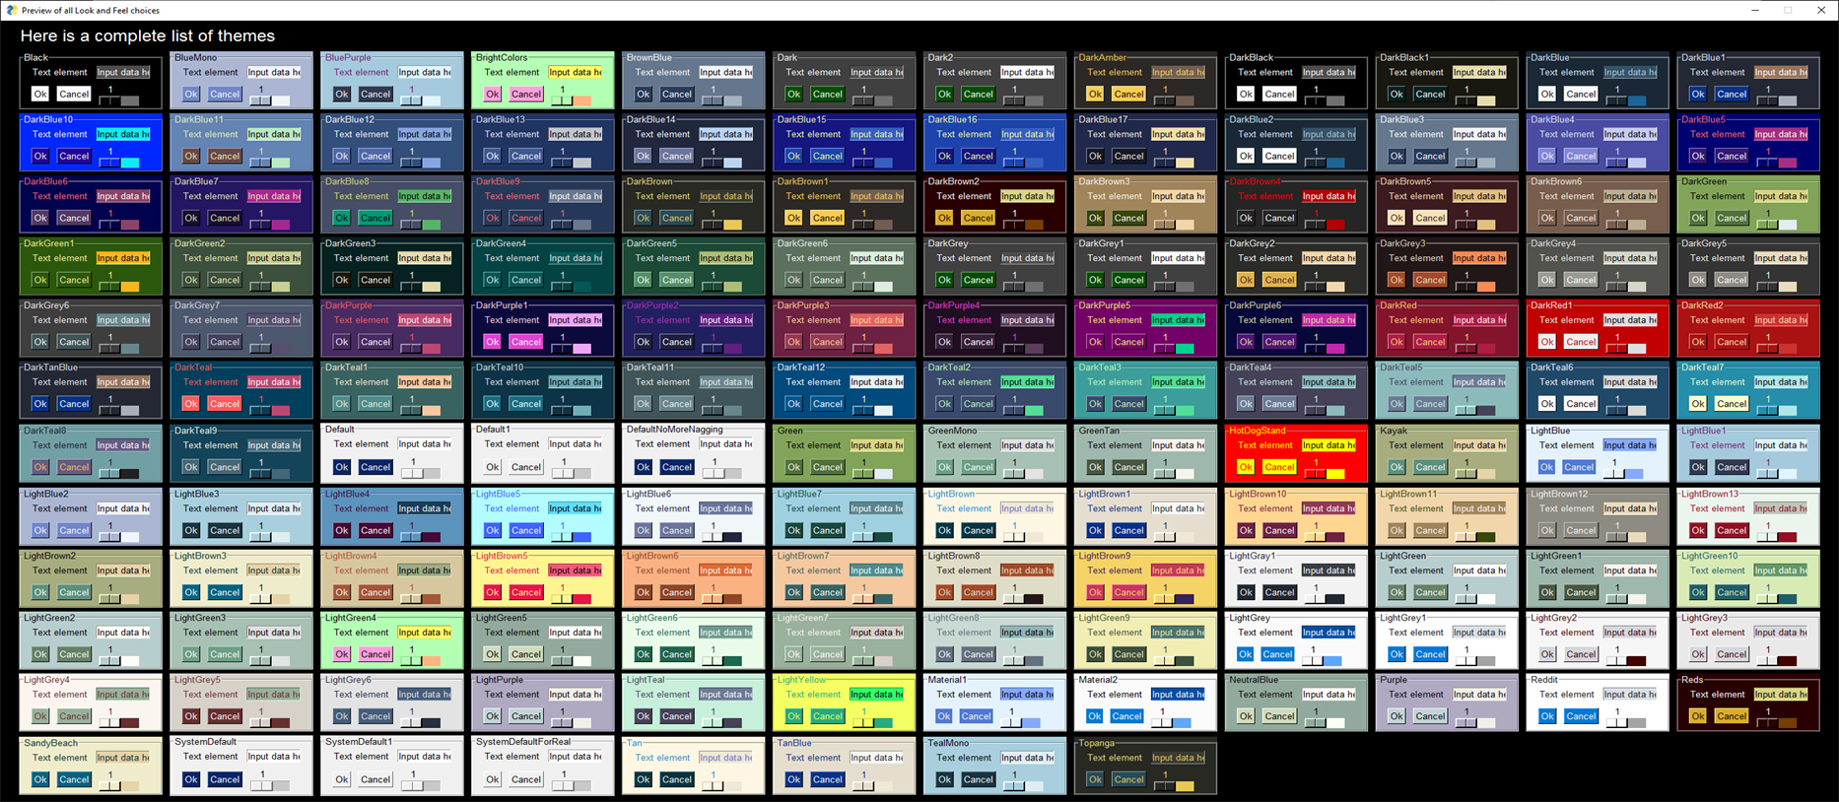
PySimpleGUI Themes

Slide 7
Basic Elements of PySimpleGUI
The two main basic elements of PySimpleGUI are as:
Window: This is the main screen that shows on the screen and is the base UI. All the other components are hosted within the window.
Elements: The widgets like buttons, test box and file managers are known as ELEMENTS (put in capital letters). These are the components we interact with and are the ones that generate the events.

Slide 8
Containers in PySimpleGUI
The containers in PySimpleGUI help to align and arrange the components in the window.
There can be containers within containers as well to better arrange the components.
The container elements are as:
PySimpleGui.Column
PySimpleGUI.Frame
PySimpleGUI.Tab
PySimpleGUI.TabGroup

Slide 9
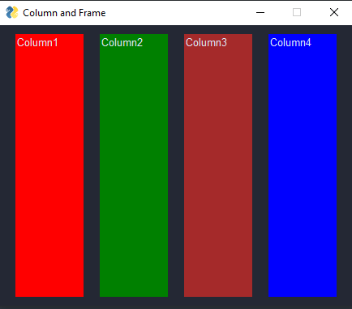
Containers in PySimpleGUI : Column Element
The layout can be created as you have already created layout in the first PySimpleGUI Tutorial. Other attributes of Column element are –
background_color – String, to set the background color of the column
size-(Integer,Integer), is the size of the columns defined as pair of values representing width and height of the column.
pad– Integer, is the padding space you can specify of a specific column with respect to other elements.
scrollable– Boolean, set it true if you wish to add a scroll bar to the columns. Use it if the columns may get bigger content than its defined size.
key/K -String, the key assigned to combo element to identify this column in the values list returned by the window read() method.
Justification- String, defines how the column will be justified in the window. All the columns in one row will have the same justification.
element_Justification- String, defines how the elements in the columns will be justified. Allowed values are ‘left’, ‘right’ and ‘center’
grab –Boolean- defines whether you can grab the column with mouse and move to another location
expand_x, expand_y Boolean, Boolean – can be set to True if you want the column to grow horizontally and vertically when its contents exceed the original size of the column.

Slide 10
Containers in PySimpleGUI : Frame Element
A frame is a container element that contains other PySimpleGUI elements. The frame groups the elements such that they can be relocated as one unit. Elements in different frames belong to their respective frames.
Title – String, is the text that you want to show so that a user knows about the context of the elements placed on a frame.
Layout – List, is the list of lists that defines the elements and their attributes. The other attributes that you define to set the appearance and working of a frame. You can use an existing layout to define the elements of the frame.
title_color – String, to set the color of the title text
title_location - ENUM, is used to set the location of Title text. The allowed values are defined by using string of 1 or 2 characters from the combination of e, s, n and w (east, south, north and west). Allowed values are e, en, es, n, ne, nw, s, se, sw, w, wn, or ws
background_color – String, to set the background color of the frame
border_width- Integer, to set the width of the border in pixels.
size- (Integer,Integer), is the size of the columns defined as pair of values representing width and height of the column.
Pad – Integer – is the padding space you can specify for a frame with respect to other elements/frames.
font – String, to set the font family of the text
key/K - String, the key assigned to frame element to identify this frame in the values list returned by the window read() method.
element_Justification - String, defines how the elements in the frame will be justified. Allowed values are ‘left’, ‘right’ and ‘center’
visible - Boolean, to set the visibility of the frame at the runtime. If visible is False, all the elements placed in the frames will also be not visible.
tooltip - String, the small text that appears when the user rests mouse cursor on the frame.

Slide 11
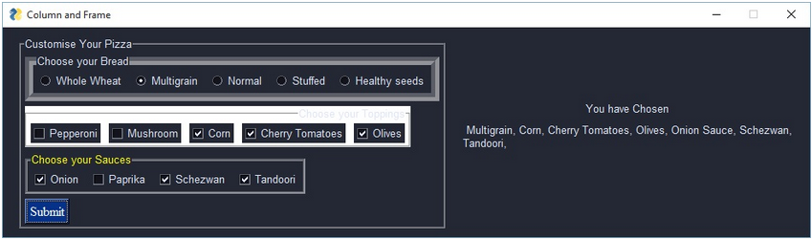
Containers in PySimpleGUI : Frame Element

Slide 12
Containers in PySimpleGUI : Tab Element
Tab Element is a container element which uses a string as its tab title and a layout to fill with the input elements like Text, Input, Check Boxes, Radio Buttons and so on. It does not have individual existence in a Python GUI interface.
Title – String, is the text of the tab that you wish to assign, reflecting the purpose of the elements of the container tab
Layout -- List of elements, is the list of elements defined to create the interface required to get the input from user
background_color – String, set a color name from the allowed Python colors to paint the color to the title of the Tab
Font – String, set the font family for the text on a specific tab
Disabled -- Boolean, set the value to enable or disable the tab so that you can allow the user to interact or not in the specific tab
Key/K – String, is the key by which a specific tab will be identified in the code, like it can be used to disable or enable it
Tooltip -- String, is the text you wish the user to read in form of a tooltip appearing with a resting mouse arrow
Visible – Boolean, to make a tab visible or invisible for the user
Element_justification – String, set to “left”,”right” or “center” to justify the elements in the tab

Slide 13
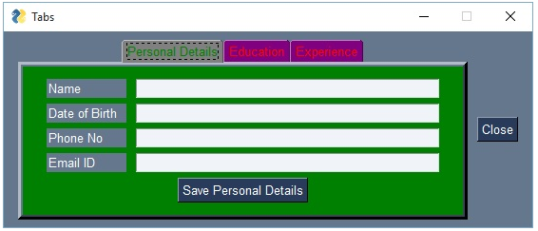
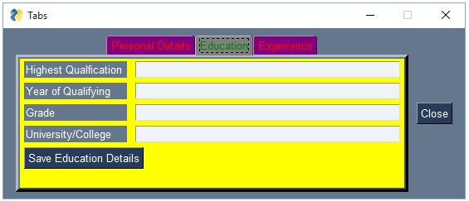
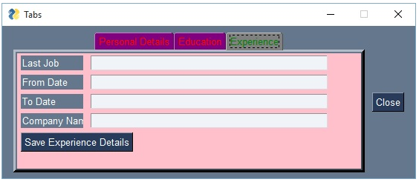
Containers in PySimpleGUI : Tab Element

Slide 14
My GitHub Link
My GitHub Link will provide the code for all of the Sample Apps discussed and a few More for your Reference.
GitHub Link: https://github.com/brpawankumariyengar-python/PySimpleGUI__Tutorial

