Slide 1
The impact of fossil data on the power of estimates under state-dependent diversification models
Bruno do Rosario Petrucci
EEOB 565 – Final project

Slide 2
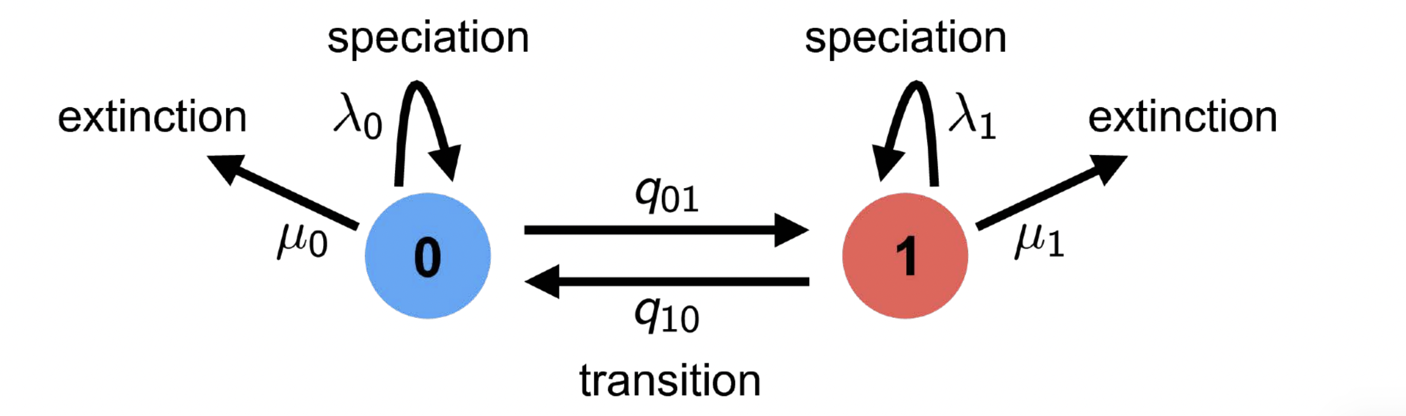
Background
Binary state speciation and extinction (BiSSE) is a model for inference of trait-dependent diversification rates
https://revbayes.github.io/tutorials/sse/bisse-intro.html

Slide 3
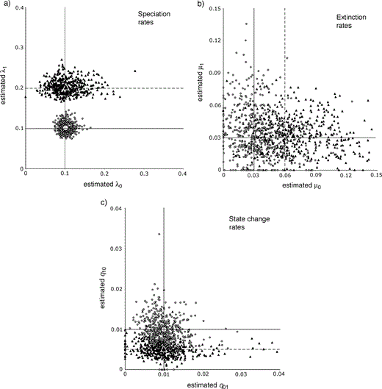
Background
Tests on simulated data show the model’s power is pretty low when estimating extinction and transition rates
Maddison et al 2007 (Fig. 4, adapted)

Slide 4
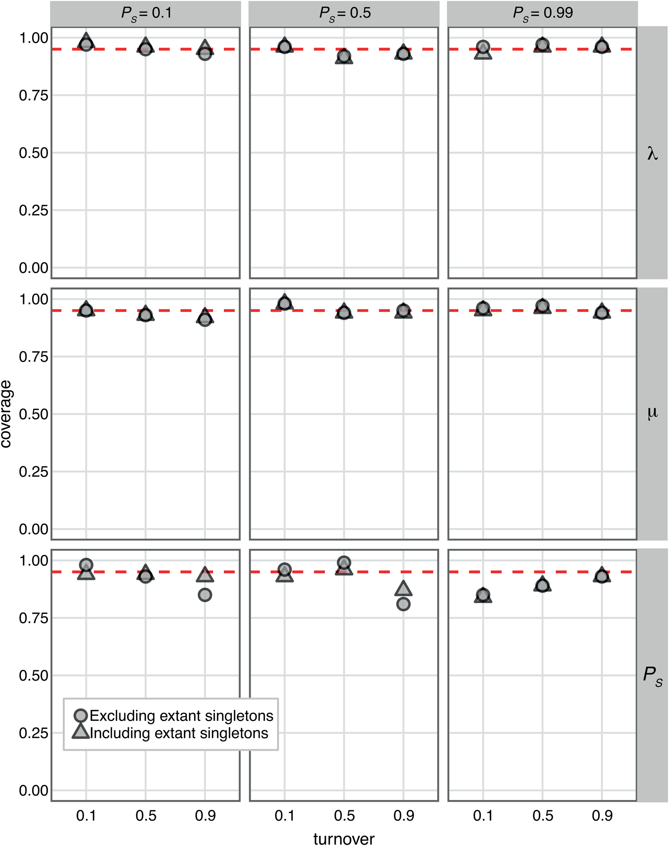
Background
Fossilized birth-death (FBD) models have higher power in estimating extinction rates
Warnock et al 2020 (Fig. 3)

Slide 5
Plan
Simulate data following BiSSE, including fossil samples
Run a BiSSE analysis with an FBD tree
Hypothesis: BiSSE will have more power to estimate extinction rates when including fossil samples

Slide 6
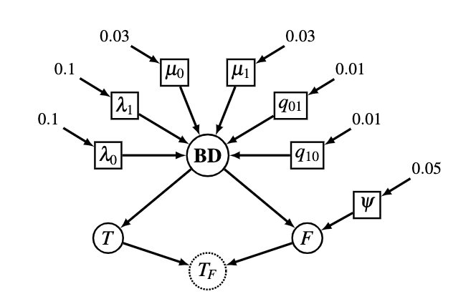
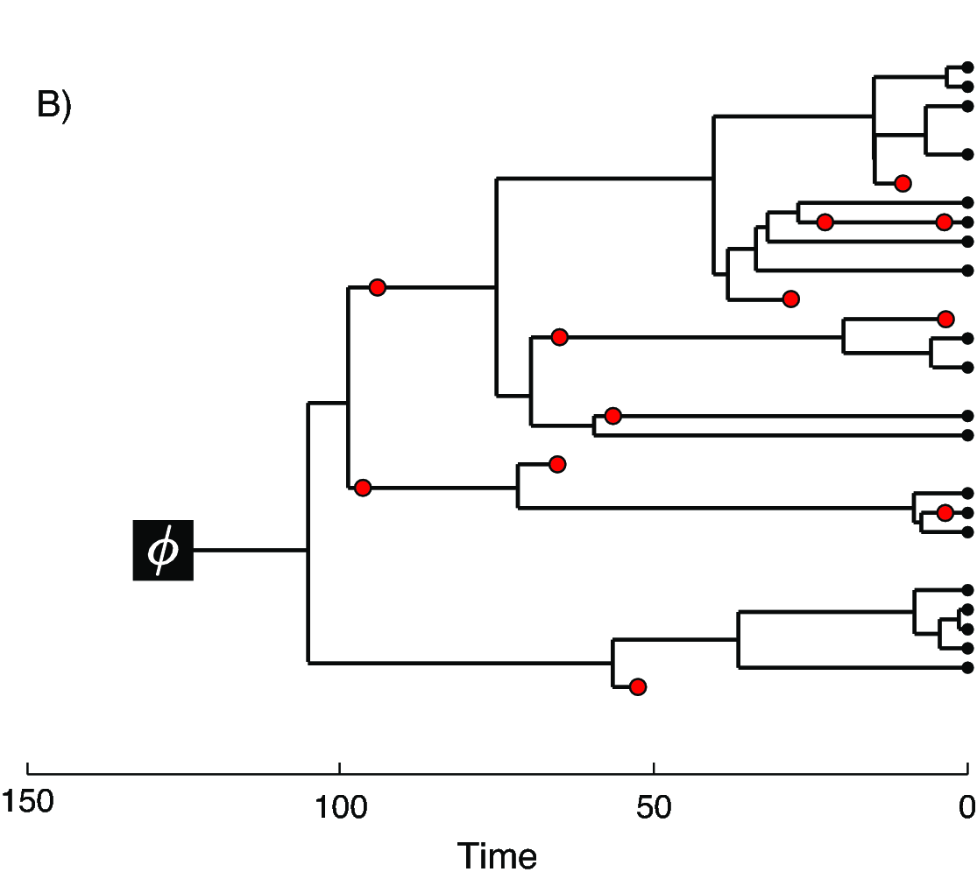
Simulation (paleobuddy)
0.06
0.2
0.005
Scenario 4: low q10
Scenario 2: high lambda1
Scenario 3: high mu0
Scenario 1: base
Bounds: >25% of extinct species sampled; at least 10% of taxa with each trait

Slide 7
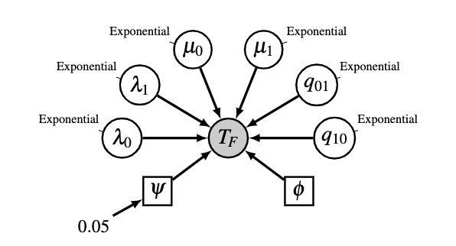
Analysis (RevBayes)
Prior means equal true values
Root age fixed since tree is fixed
100 trees for each of the 4 scenarios

Slide 8
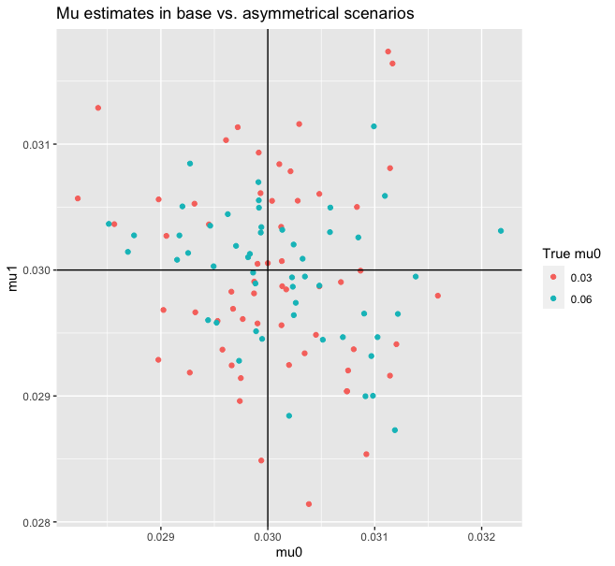
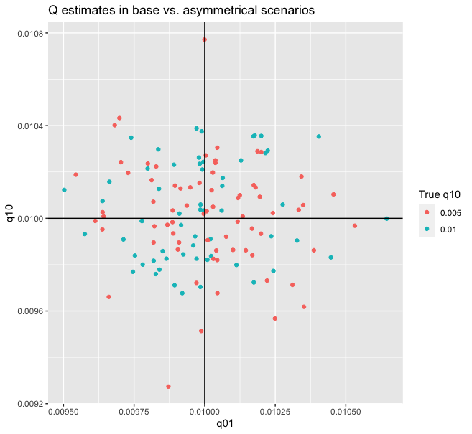
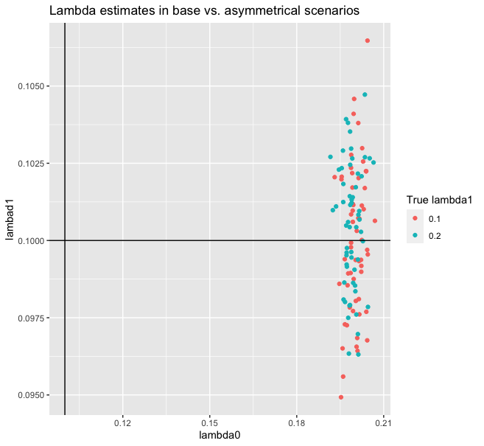
Results

Slide 9
Future directions
Investigate likelihood issue in RevBayes
Fit more models (e.g. let fossil sampling vary)
Test other SSE models

Slide 10
References
Höhna, S., Freyman, W., Goldberg, E., Background on state-dependent diversification rate estimation, https://revbayes.github.io/tutorials/sse/bisse-intro.html
Maddison, W. P., Midford, P. E., Otto, S. P., Estimating a Binary Character's Effect on Speciation and Extinction, Sys. Bio. (2007)
Warnock, R. C. M., Heath, T. A., Stadler, T., Assessing the impact of incomplete species sampling on estimates of speciation and extinction rates, Paleobiology (2020)

Slide 11

Thank you!

