Slide 1
Accuracy of extinction rate estimates using state-dependent diversification models with fossil data
Bruno do Rosario Petrucci
Ecology and Evolutionary Biology – Iowa State University

Slide 2
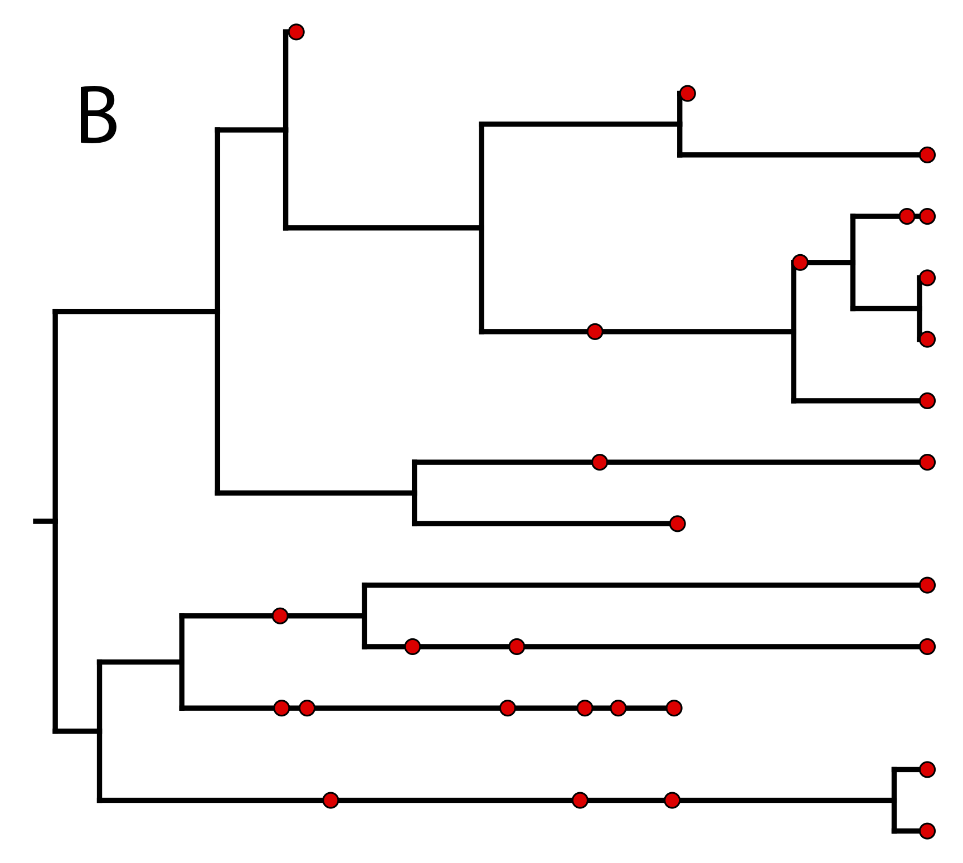
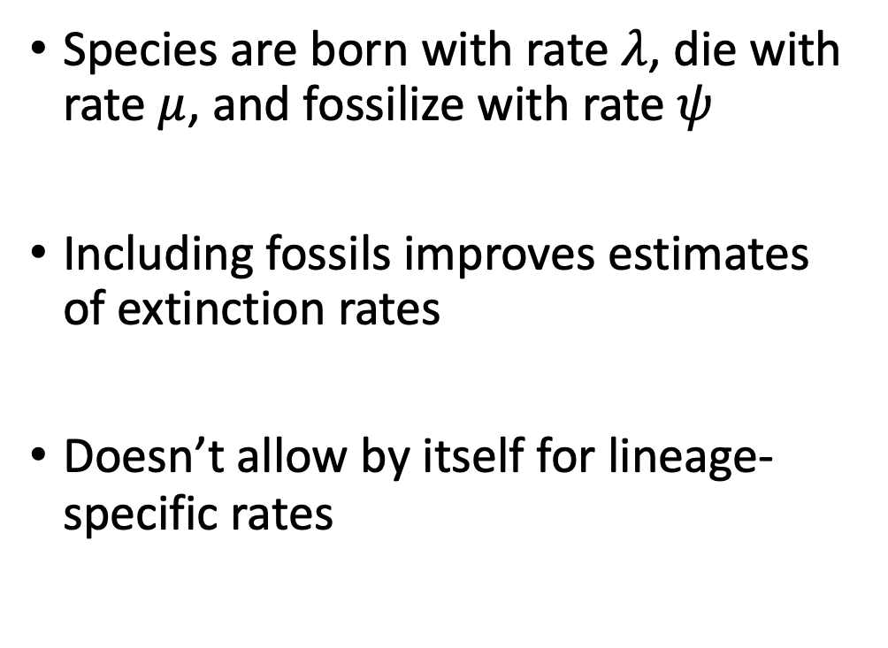
Background: (fossilized) birth-death models
Species are born with rate $λ$, die with rate $μ$, and fossilize with rate $ψ$
Including fossils improves estimates of extinction rates
Doesn’t allow by itself for lineage-specific rates
https://revbayes.github.io/tutorials/fbd/

Slide 3
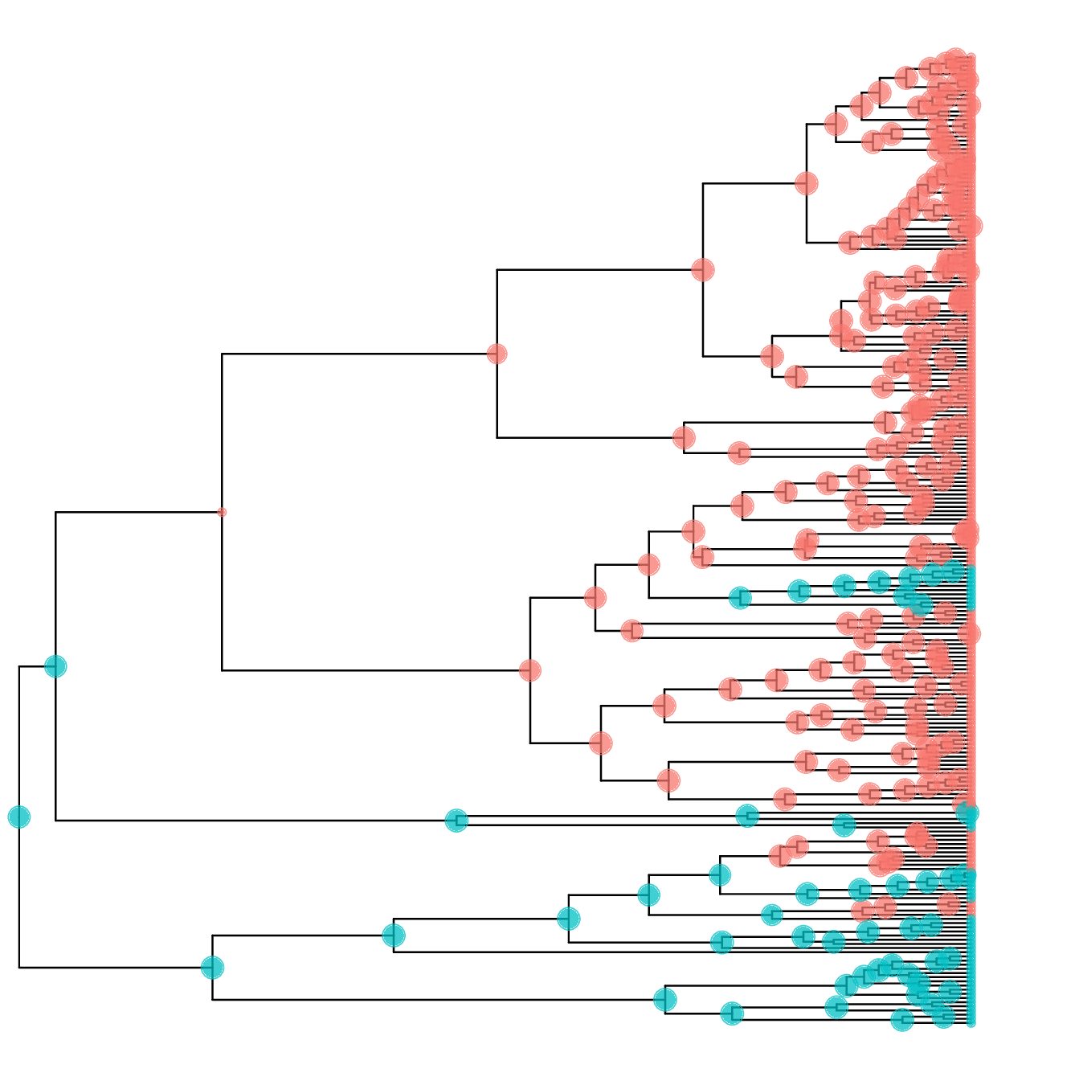
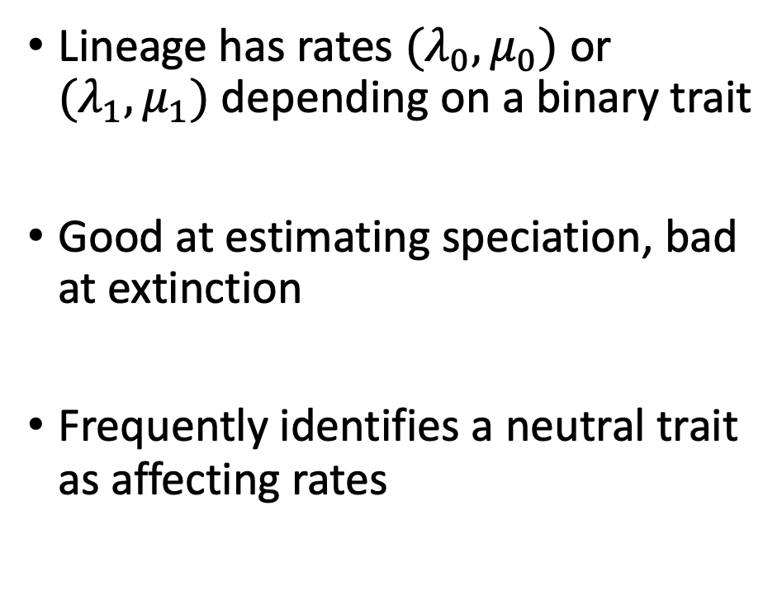
Background: state-dependent diversification
Lineage has rates ${(λ}_{0}, μ_{0})$ or ${(λ}_{1}, μ_{1})$ depending on a binary trait
Good at estimating speciation, bad at extinction
Frequently identifies a neutral trait as affecting rates
https://revbayes.github.io/tutorials/sse/bisse-intro
Notes:
There have been extensions to include the possibility of multiple traits, or hidden traits, or quantitative traits
This presentation will deal only with BiSSE but in the future this work could be extended to other models

Slide 4
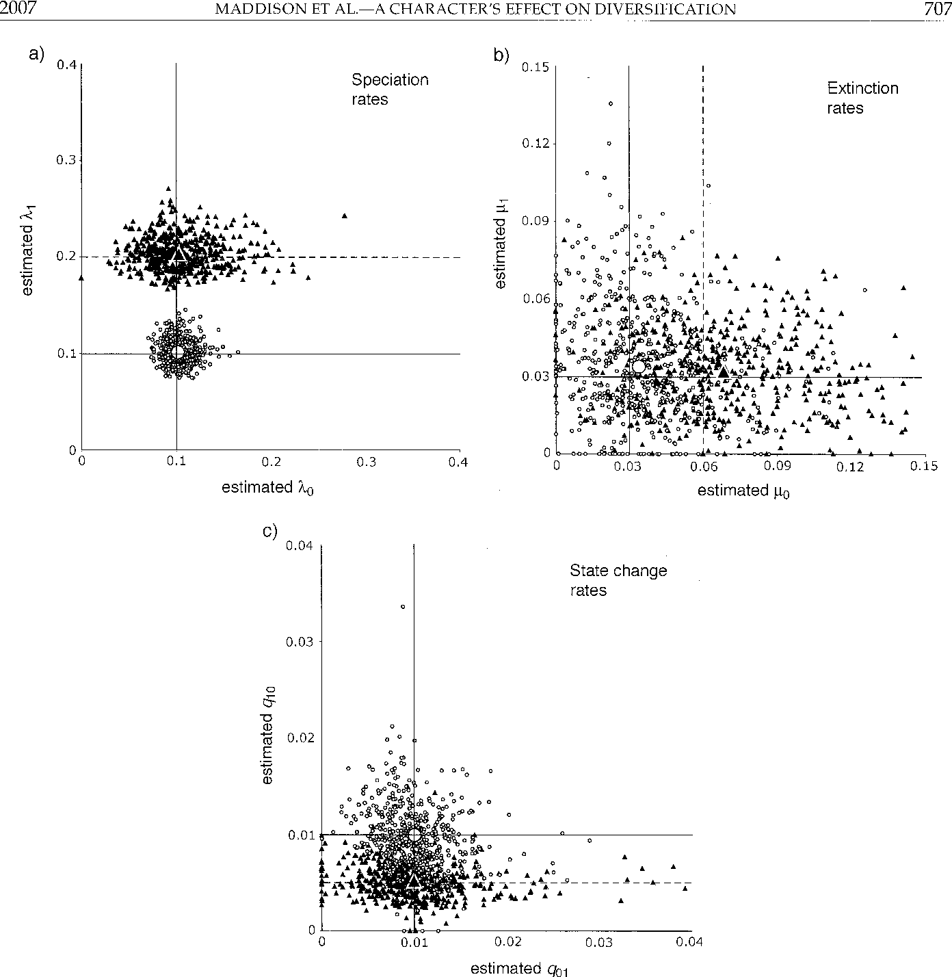
Research questions: for BiSSE, does fossil data…
…improve extinction rate estimates?
…lower the rate of false positives?
Figure 4b in Maddison 2007
Notes:
Same tests as in Maddison 2007 for accuracy for better comparison

Slide 5
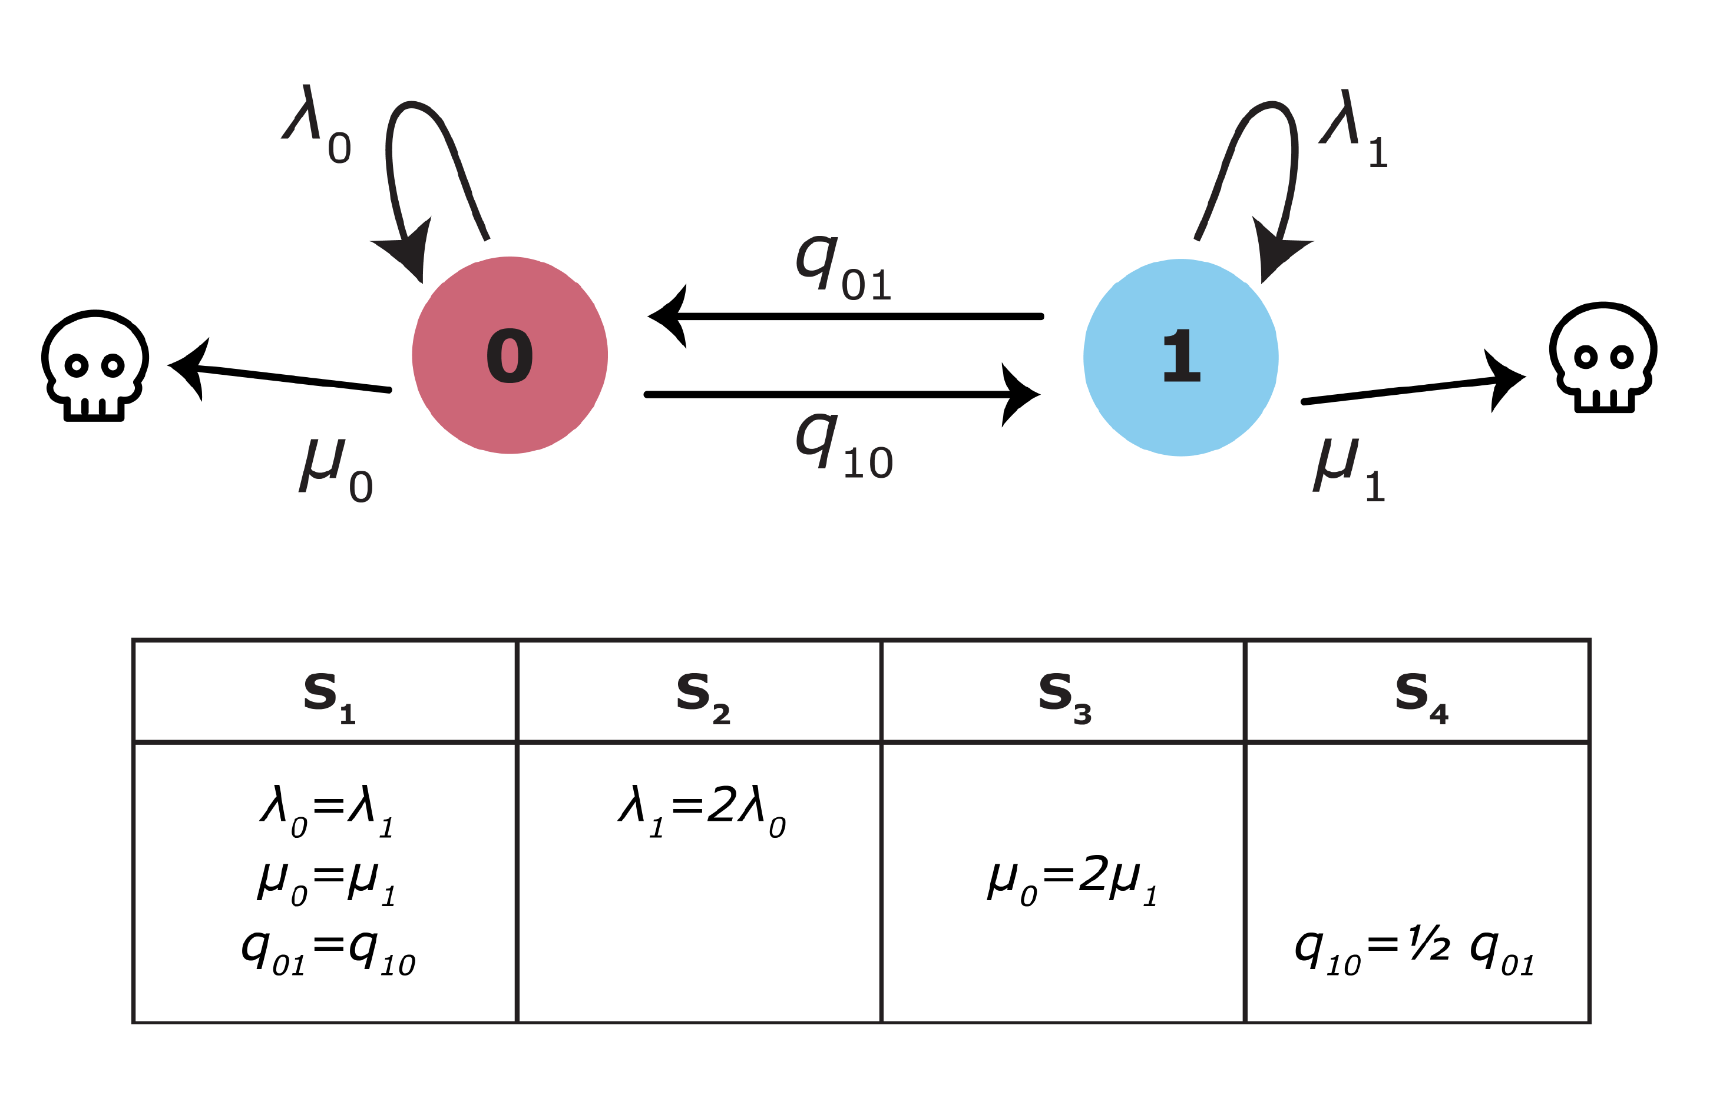
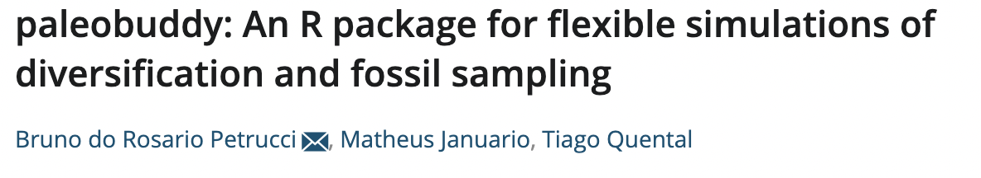
Simulation
100 trees, 100 extant tips each
Keep track of which fossils are sampled ancestors and which are tips
Notes:
Scenarios are the same as in the original Maddison 2007 paper
To compare with false positives in Rabosky & Goldberg 2015, just simulate neutral traits at different transition rates

Slide 6

Analysis
3 models (fbd, bisse, fbd+bisse)
4 scenarios (S1-S4)
3 fossil sampling values (0.01-0.05-0.1)
4 types of traits (real, neutral low-mid-high transition rates)
76 combinations, 100 reps each
Notes:
Not all parameter combinations need to be considered, e.g. fossil sampling doesn’t matter for bisse, or traits for fbd
100k gens, record every 100, 25% burnin, convergence looked pretty good (all under 200 ESS on coda were above 200 on Tracer)

Slide 7
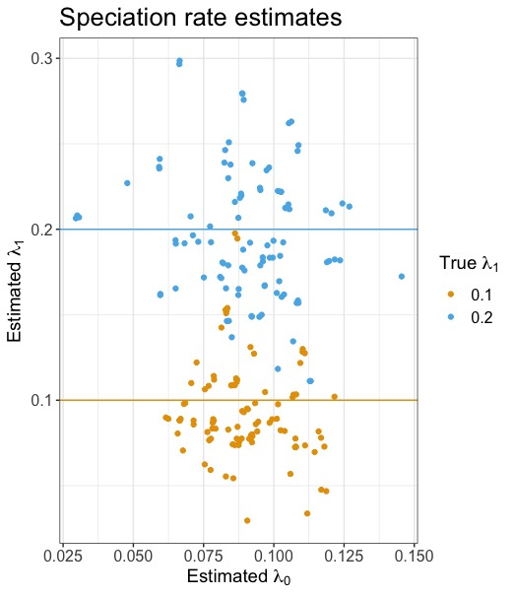
Results: replicating Maddison (2017)

Slide 8
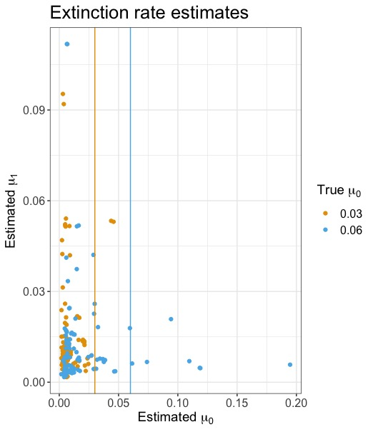
Results: replicating Maddison (2017)

Slide 9
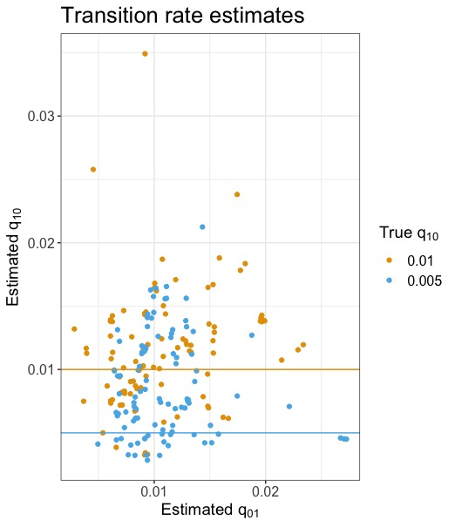
Results: replicating Maddison (2017)

Slide 10
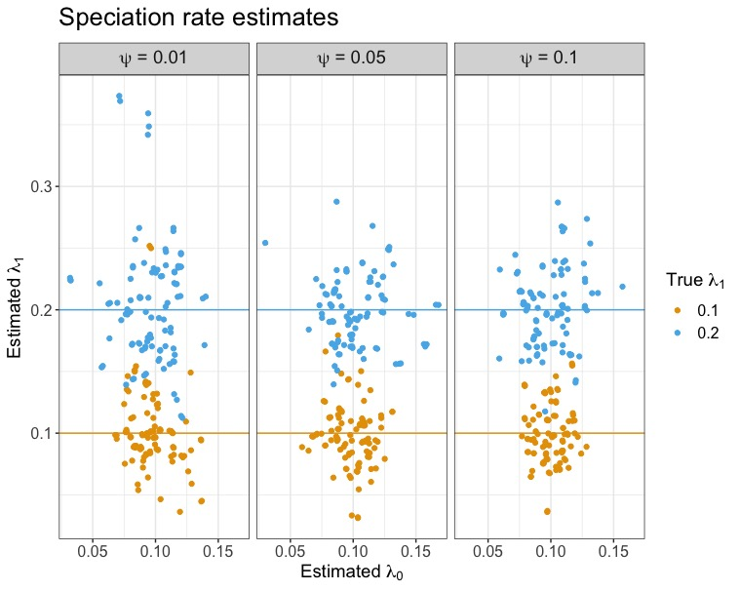
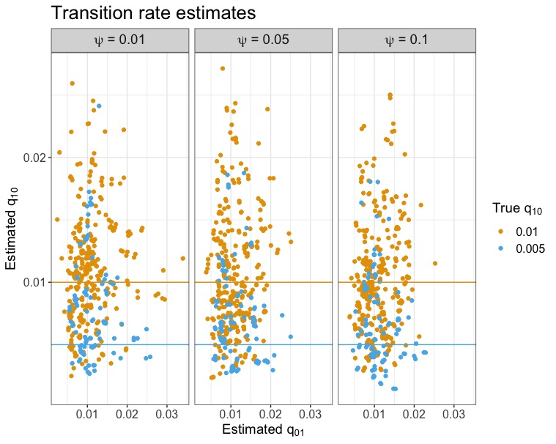
Results: adding fossils

Slide 11
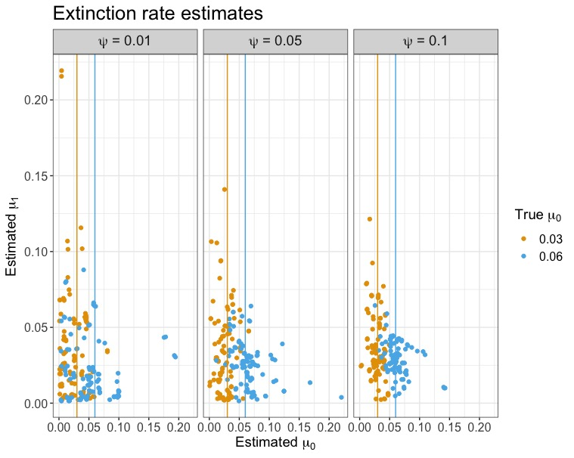
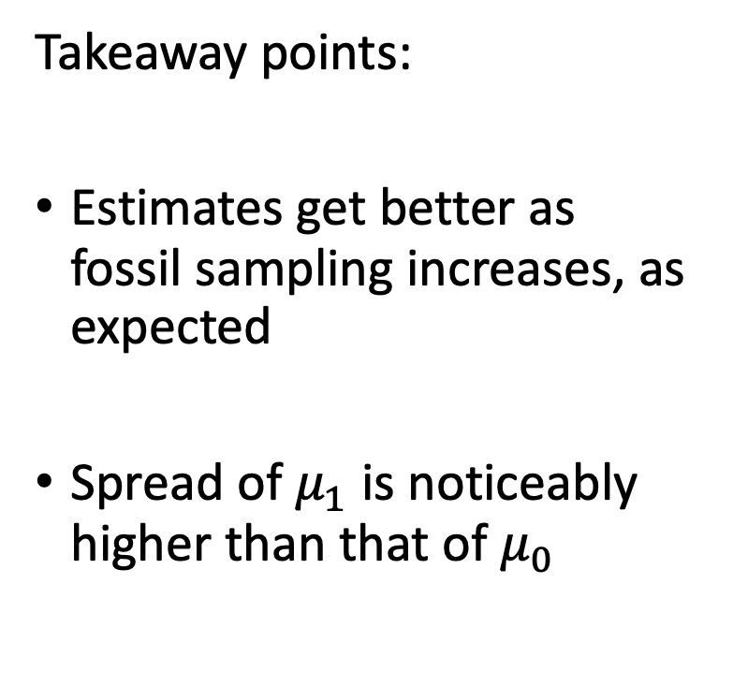
Results: adding fossils
Takeaway points:
Estimates get better as fossil sampling increases, as expected
Spread of $μ_{1}$ is noticeably higher than that of $μ_{0}$
Notes:
There is clear clustering, and it would probably get better with bigger trees
Still the clusters are clearly really close, might have to do with how extinction’s really low but still, problem with identifiability (see next slides)
Spread probably because 0 is ancestral to the whole clade and q is low

Slide 12
Results: replicating Rabosky & Goldberg (2015)
Talk to tracy about weird pattern: more sampling = more concentration on 0 for no shifts, high q neutral traits (bottom row of figures). Weird, it should be more likely to be spread out since there shouldn’t be a difference (maybe because it’s underestimating the q, so it overestimates speciation for the more common trait, which is 0 just cause it starts there)

Slide 13
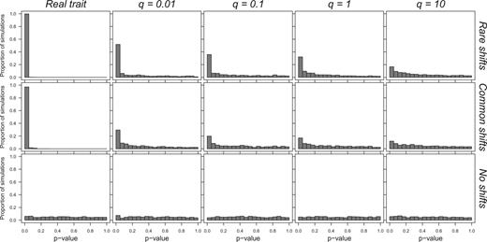
Results: replicating Rabosky & Goldberg (2015)
q = 0.01
q = 0.1

Slide 14
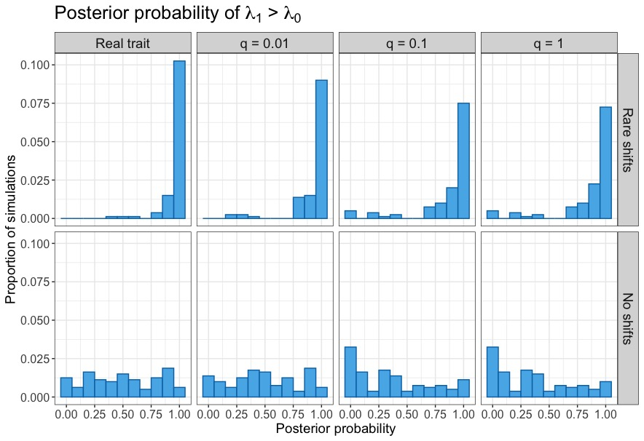
Results: replicating Rabosky & Goldberg (2015)

Slide 15
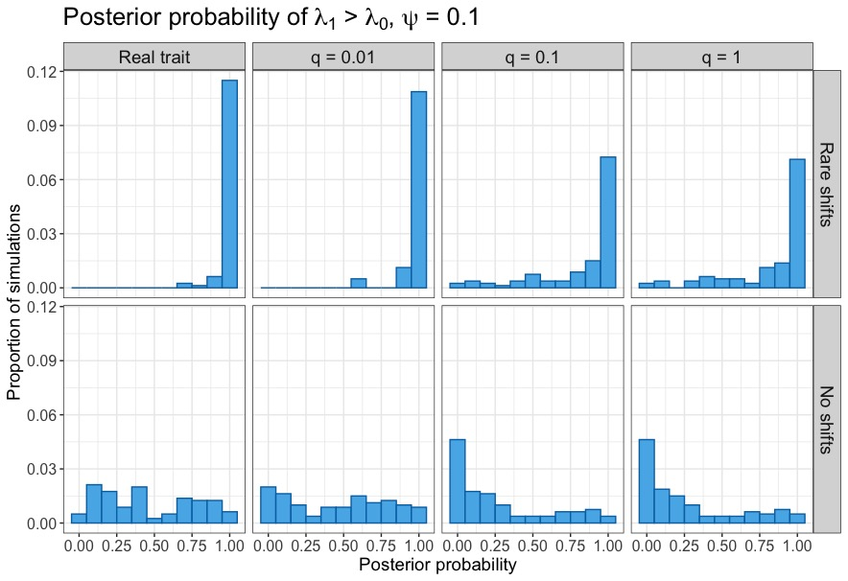
Results: adding fossils

Slide 16
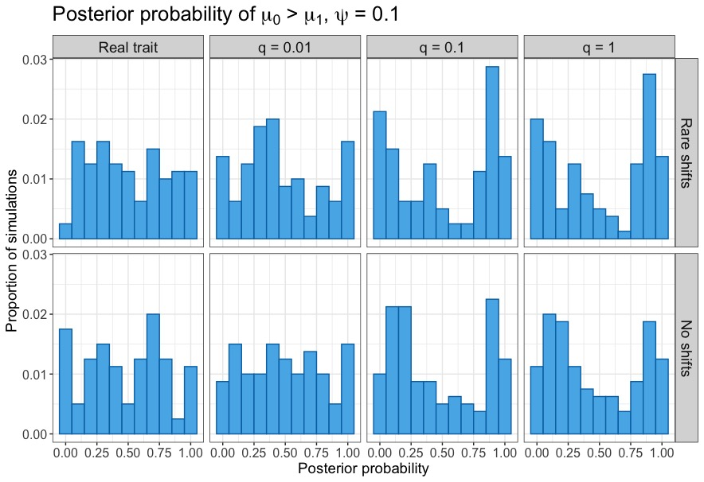
Results: adding fossils

Slide 17
Conclusions
Adding fossil data allows for more accurate extinction estimates, but does not affect the false positive rates
Extinction estimates show large variance for the least common trait
Accuracy increases with increasing fossil sampling, as expected

Slide 18
Future work
Consider bigger (and possibly more) trees for better precision
Test how these results change with different proportions of sampled ancestors to fossil tips (re: Beaulieu & O’Meara 2022)
Investigate variance of extinction estimates, e.g. by increasing real trait transition rates
Extend this entire pipeline to test HiSSE (currently running)

Slide 19
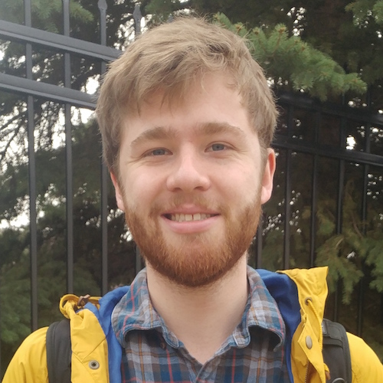

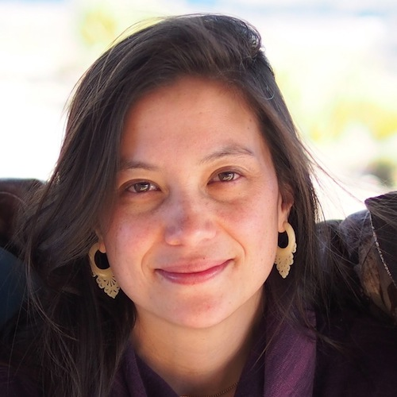



Thank you!
The Heath lab at ISU
PhD committee:
Prof. Dean Adams
Prof. Haldre Rogers
Prof. Jeanne Serb
Prof. Graham Slater
Other collaborators:
Dr. Joëlle Barido-Sottani
Dr. Walker Pett
Dr. Jordan Satler
Prof. Tiago Quental
Matheus Januário

Slide 20
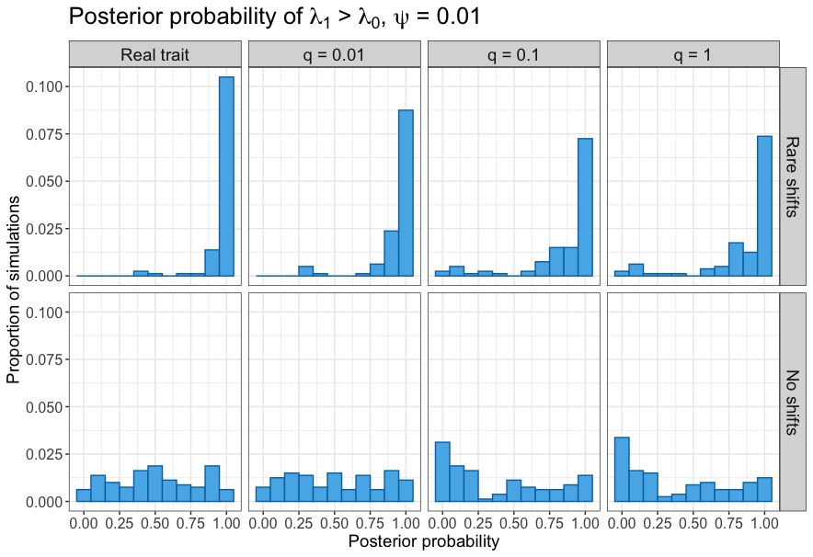

Slide 21
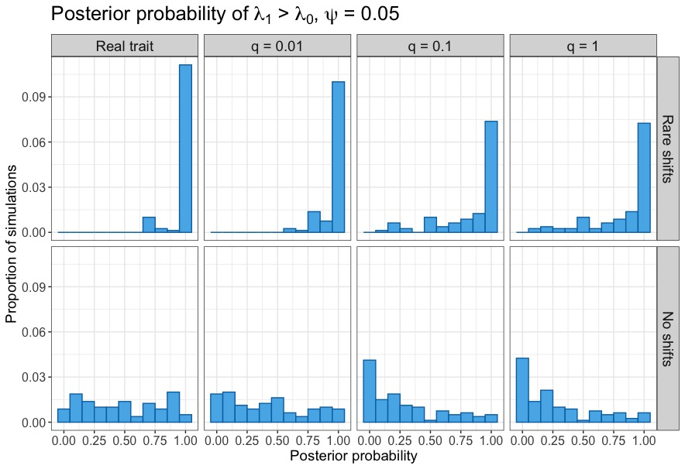

Slide 22
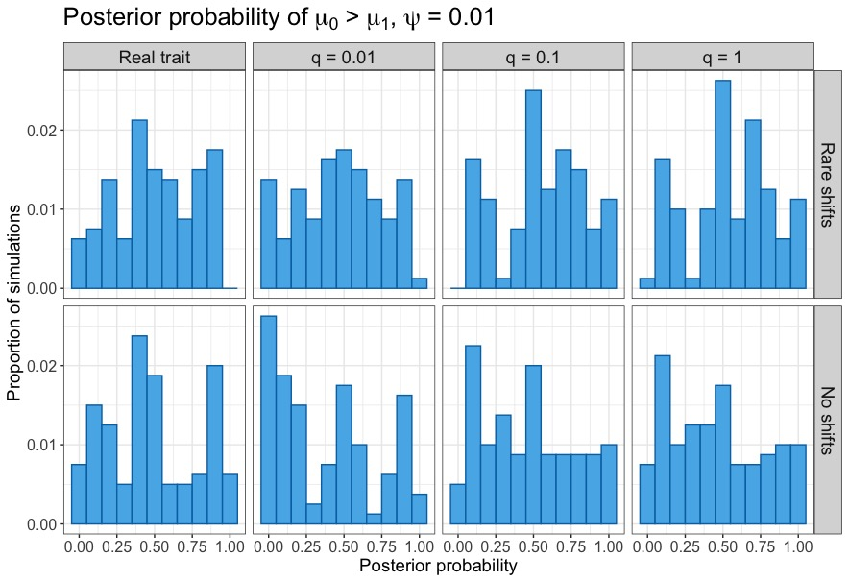

Slide 23
