Slide 1
STOCK PRICE PREDICTION USING LSTM AND GRU
By
BHAGYASHREE PUJARI
USN : 231VMTHR0202

Slide 2
CONTENT
Introduction
Significance Of Stock Market Prediction
Objectives
Literature Review
Methodology
Working Of Lstm Model
Data Analysis And Interpretation
Coding used
Conclusion
Future Scope
References

Slide 3
INTRODUCTION
The stock market is complex, influenced by economic indicators, news, and investor emotions, causing unpredictability.
Machine learning advances enable better analysis and forecasting of stock market trends and behaviors.
This study develops a robust model using historical data and feature selection for accurate stock prediction.
Evaluating model accuracy with metrics ensures dependable forecasting, benefiting investors, brokers, and financial strategies.
Data collection, preprocessing, and selecting relevant features are critical for effective machine learning model building.
Training models with algorithms like regression, SVM, and neural networks optimizes predictions on stock performance.
Continuous model refinement through new data and feedback improves prediction accuracy and real-time stock market forecasts.

Slide 4
SIGNIFICANCE OF STOCK MARKET PREDICTION
Machine learning helps investors make informed decisions using historical stock data.
Risk management improves by adjusting portfolios according to predicted market trends.
Algorithmic trading automates transactions using machine learning-based trading strategies.
Regression models forecast stock prices by analyzing past financial performance.
Time series methods like ARIMA and LSTM capture temporal stock patterns.
Sentiment analysis evaluates news and social media to gauge market mood.
Data cleaning, feature engineering, and evaluation metrics improve model accuracy.

Slide 5
OBJECTIVES
Develop a deep learning model utilizing LSTM and GRU networks to efficiently forecast stock prices by learning from past market data and detecting intricate patterns in price movements.
Implement time series cross-validation to evaluate the model performance on various time segments, with a focus on ensuring the stability and ability of the model to generalize to unknown data.
Assess the accuracy and reliability of the model’s stock price predictions by calculating MSE, RMSE, and MAE, ensuring the model's effectiveness in forecasting and minimizing errors.
Integrate risk management strategies such as stop-loss limits to prevent large financial losses and portfolio diversification to distribute risk, minimizing potential negative impacts from incorrect stock price predictions and enhancing decision-making in volatile market conditions.

Slide 6
LITERATURE REVIEW
REVIEW OF LITERATURE
Study Stock Market
Using Machine Learning
Prediction
Literature Map

Slide 7
LITERATURE REVIEW
Sr. No. | Authors name with year of publication | Methodology name (Algorithm) | Performance parameters | Pros | Cons
1 | Lokesh Chouhan, Navanshu Agarwal (2018) | Regression and LSTM | Improvement in prediction accuracy | Use of Regression and LSTM on Yahoo finance dataset; factors like open, close, low, high, volume considered | No specific cons mentioned
2 | V Kranthi Sai Reddy (2018) | Support Vector Machine (SVM) | Accurate prediction for large and small capitalizations; daily and minute frequencies | Uses ML approach trained on available stocks data; uses Python; combines technical, fundamental, and time series analysis | No specific cons mentioned

Slide 8
LITERATURE REVIEW
Sr. No. | Authors name with year of publication | Methodology name (Algorithm) | Performance parameters | Pros | Cons
3 | Mehak Usmani, Syed Hasan Adil, Kamran Raza Iqra (2016) | Single Layer Perceptron (SLP), Multi-Layer Perceptron (MLP), Radial Basis Function (RBF), Support Vector Machine (SVM) | MLP performed best; oil rate highly relevant | Multiple ML techniques compared; integrates old statistical methods and multiple attributes including news and social media | No specific cons mentioned
4 | Shunrong Shen, Haomiao Jiang, Tongda Zhang (2015) | Support Vector Machine (SVM), reinforcement learning, regression algorithms | Prediction accuracy: NASDAQ 74.4%, S&P500 76%, DJIA 77.6% | Combines global stock market temporal correlation; simple trading model; applies multiple algorithms | No specific cons mentioned

Slide 9
LITERATURE REVIEW
Sr. No. | Authors name with year of publication | Methodology name (Algorithm) | Performance parameters | Pros | Cons
5 | Hiransha Ma, Gopalakrishnan E. Ab, Vijay Krishna Menonab, Soman K.P (2018) | Deep learning architectures: MLP, RNN, LSTM, CNN | Outperformed ARIMA; effective for NSE and NYSE | Neural networks outperform linear models; shared dynamics between NSE and NYSE exploited | No specific cons mentioned
6 | M Umer Ghania, M Awaisa, Muhammad Muzammu (2019) | Linear Regression (LR), Three month Moving Average (3MMA), Exponential Smoothing (ES), Time Series Forecasting using MS Excel | Accurate trend prediction | Use of multiple ML algorithms and statistical tools; focus on non-linear signal prediction with AI | No specific cons mentioned

Slide 10
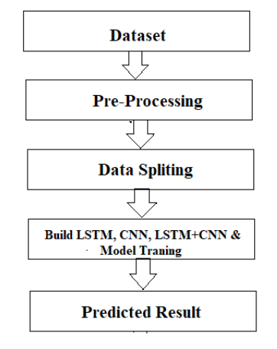
METHODOLOGY
LSTM addresses long-term dependencies for accurate stock market predictions.
CNN extracts visual features, enhancing prediction through layered processing.
Hybrid LSTM-CNN combines sequential and spatial features for better accuracy.
Jupyter provides interactive, collaborative environment ideal for machine learning.
Python libraries like Pandas, Scikit-learn, TensorFlow enable robust modeling.
Proposed Workflow

Slide 11
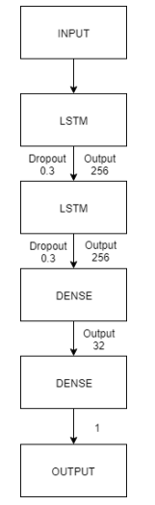
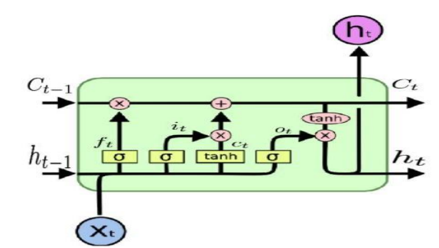
METHODOLOGY
LSTM Architecture
LSTM layers

Slide 12
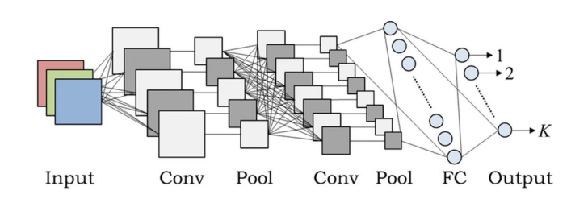
METHODOLOGY
CNN Architecture

Slide 13
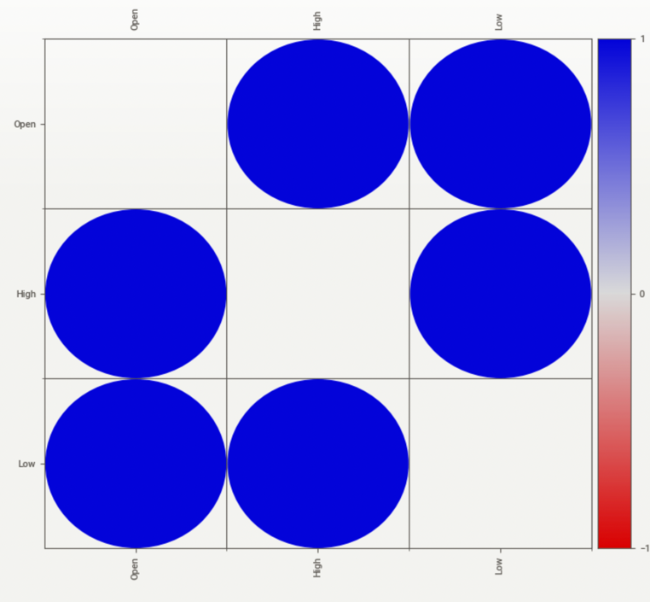
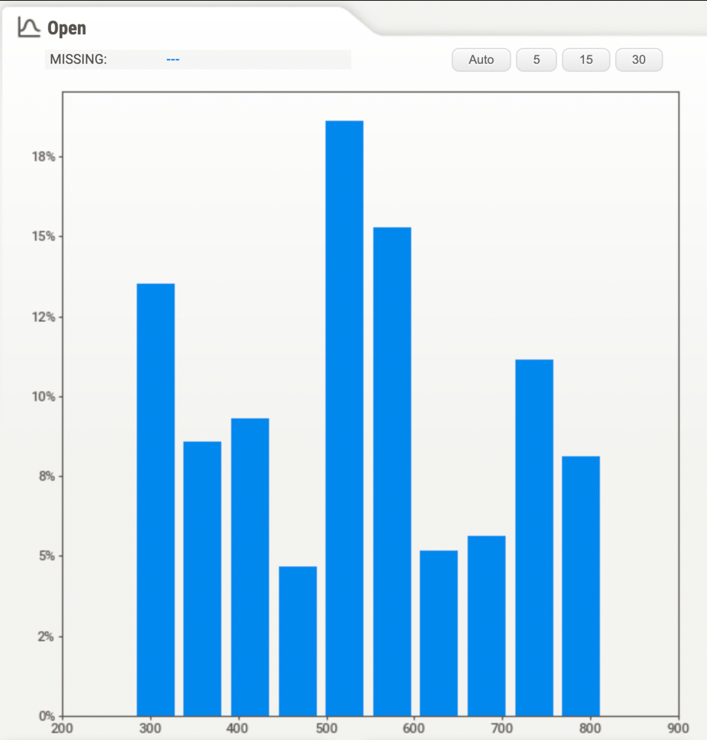
DATA ANALYSIS AND INTERPRETATION
The image is a blue bubble correlation matrix showing strong positive relationships among Open, High, and Low variables.
The bar chart shows percentage distribution of "Open" values, peaking near 500 and varying across range.

Slide 14
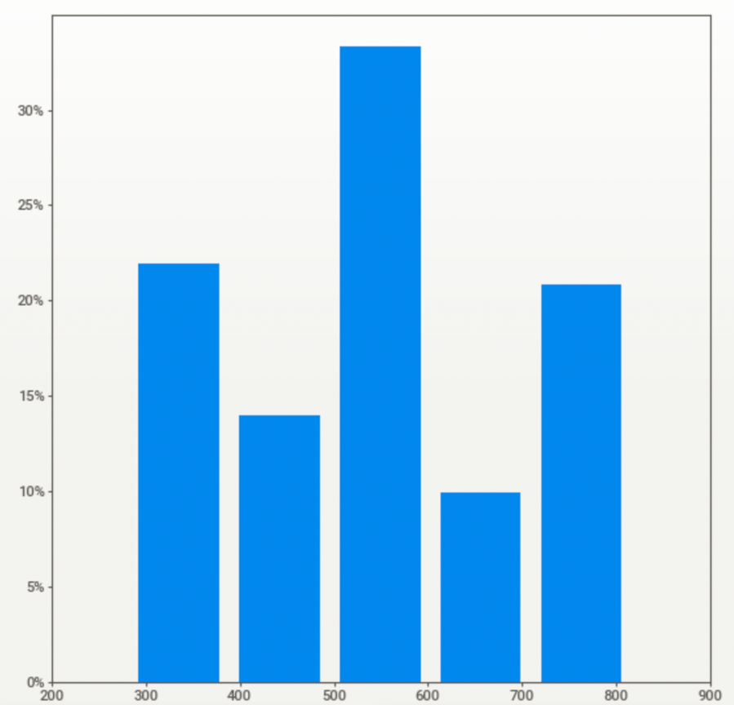
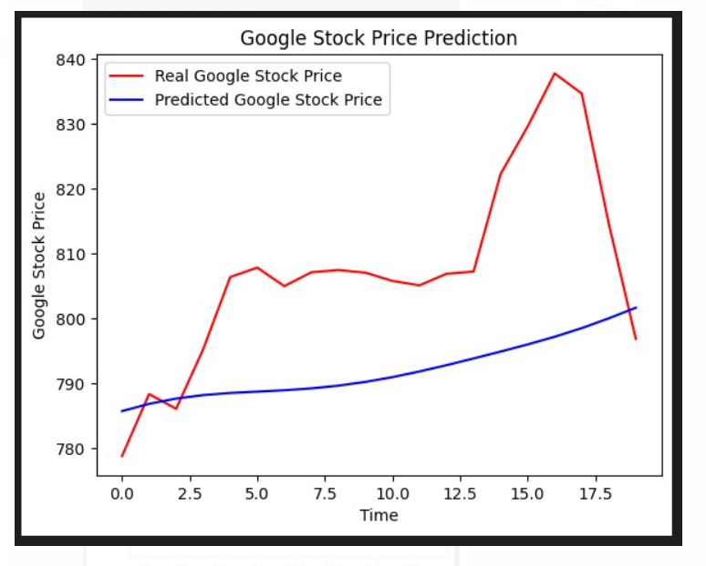
DATA ANALYSIS AND INTERPRETATION
The bar chart shows varying percentage values for different categories on the x-axis from 300 to 800.
The graph shows predicted Google stock prices consistently lower and smoother than the volatile real prices.

Slide 15
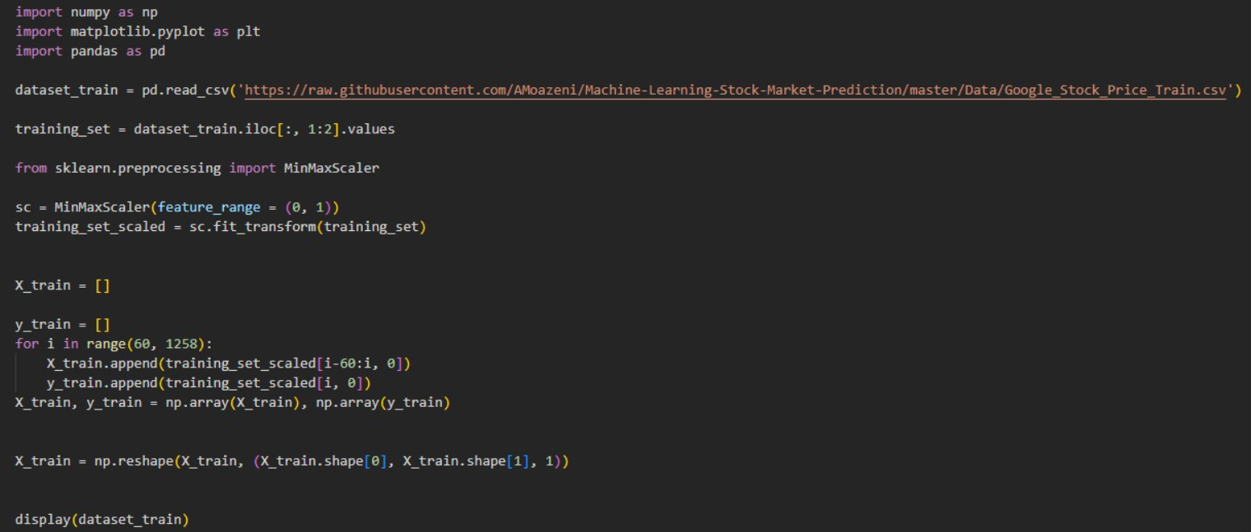
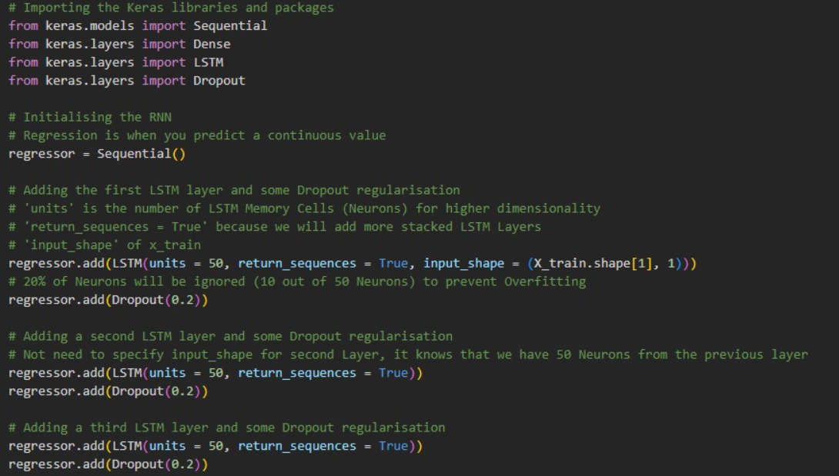
CODING USED
The code loads stock price data, scales it, and prepares sequences for training a machine learning model on time series data.
This code initializes a Sequential RNN with three LSTM layers, each having 50 units and dropout regularization to prevent overfitting.

Slide 16
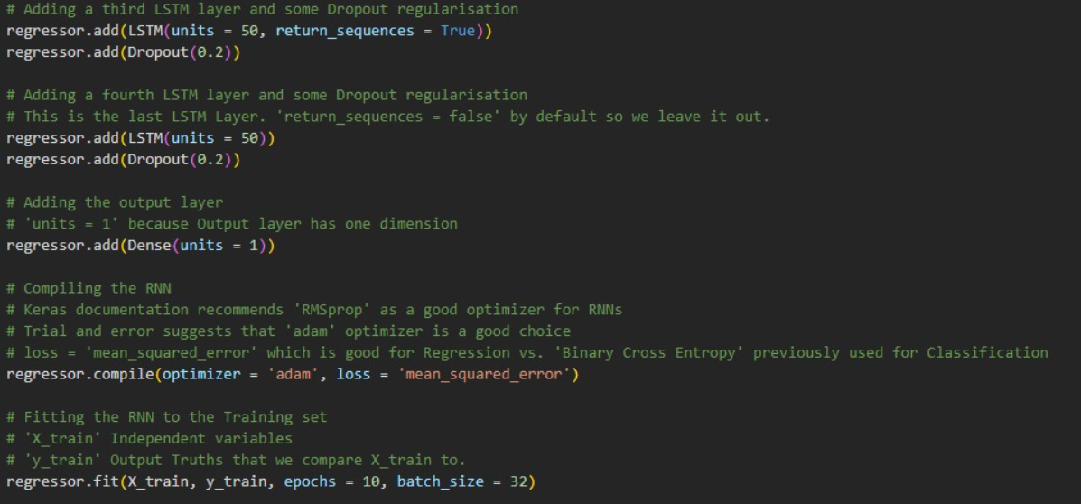
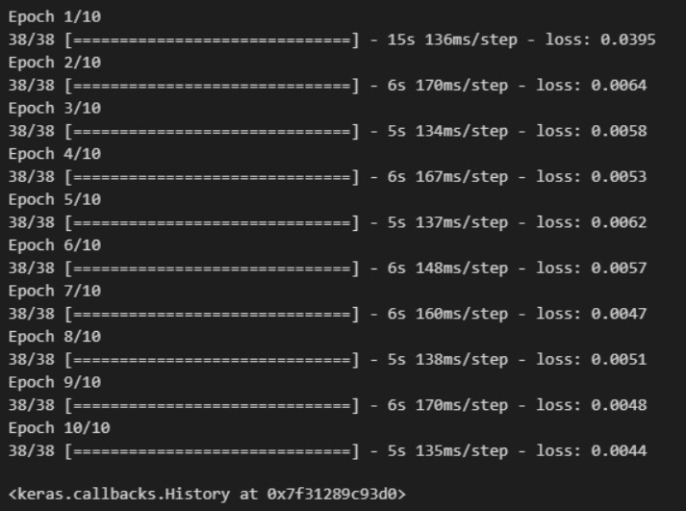
CODING USED
The code adds LSTM and Dropout layers to an RNN, compiles it with Adam optimizer, mean squared error loss, and trains on data.
The figure shows a Keras model training log with decreasing loss over 10 epochs, indicating effective learning.

Slide 17
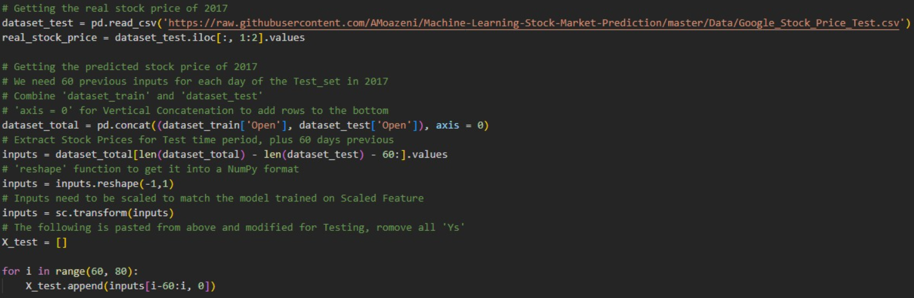
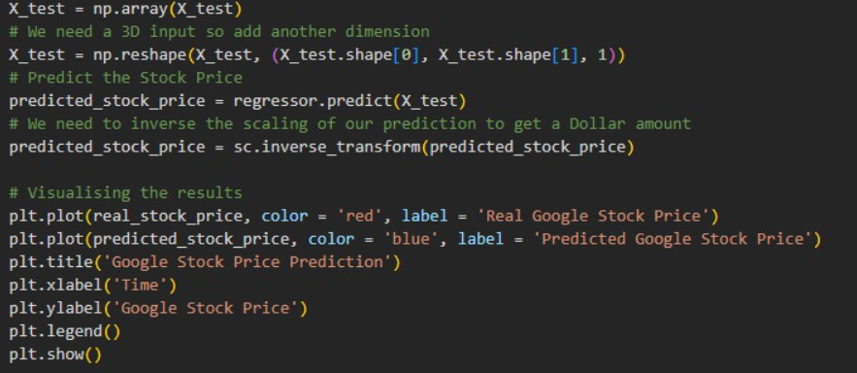
CODING USED
The code loads real stock prices, combines datasets, reshapes and scales inputs, then prepares test data for stock price prediction.
This code snippet reshapes test data, predicts stock prices, reverses scaling, and plots actual vs. predicted Google stock prices using Matplotlib.

Slide 18
CONCLUSION
Machine learning predicts stock market performance using artificial intelligence techniques.
Stock market affected by dynamic economic, social, and political factors.
Algorithms identify patterns, trends to forecast future stock prices accurately.
Models include regression, time series, neural networks, and deep learning.
Predictions aid finance in portfolio optimization, risk management, and trading.
Accuracy depends on data quality, features, algorithm complexity, and volatility.

Slide 19
FUTURE SCOPE
Stock market prediction with machine learning is rapidly evolving and promising.
Improved algorithms will enhance prediction accuracy over time significantly.
Integrating diverse data like news and social media boosts prediction quality.
Developing models capturing non-linear financial relationships is crucial.
Deep learning techniques show growing potential in stock market forecasting.
Future advancements promise more precise, reliable stock market predictions.

Slide 20
REFERENCES
[1] T. Z. Shunrong Shen, Haomiao Jiang, “Successful user experience: Strategies and roadmaps,” Success. User Exp. Strateg. Roadmaps, pp. 1–344, 2015, doi: 10.1016/c2013-0-19353-1.
[2] M. Hiransha, E. A. Gopalakrishnan, V. K. Menon, and K. P. Soman, “NSE Stock Market Prediction Using Deep-Learning Models,” Procedia Comput. Sci., vol. 132, no. Iccids, pp. 1351–1362, 2018, doi: 10.1016/j.procs.2018.05.050.
[3] A. I. Al-Alawi and Y. A. Alaali, “Stock Market Prediction using Machine Learning Techniques: Literature Review Analysis,” 2023 Int. Conf. Cyber Manag. Eng. CyMaEn 2023, no. January 2023, pp. 153–157, 2023, doi: 10.1109/CyMaEn57228.2023.10050933.
[4] J. Hota, S. Chakravarty, B. K. Paikaray, and H. Bhoyar, “Stock Market Prediction Using Machine Learning Techniques,” CEUR Workshop Proc., vol. 3283, pp. 163–171, 2021, doi: 10.32628/cseit1952296.
[5] P. Sidhu, H. Aggarwal, and M. Lal, “Stock Market Prediction using LSTM,” vol. 10, no. 3, pp. 20–30, 2021, doi: 10.4108/eai.27-2-2020.2303545.

