Slide 1
Introduction to Object Oriented Programming
- Dr. (Prof.) NEELESH S. UPADHYE
Slides prepared by Puneet (Link)

Slide 2
Lecture 1: Foundations of Python Programming and Tools for Object-Oriented Development

Slide 3
Section 1: Introduction to Tools – Jupyter Notebook and Google Colab

Slide 4
Introduction To Course
Welcome to Python Programming
Tool Covered:
Local setup for Jupyter Notebook
Cloud-based for Google Colab
Python coding basics and exception handling

Slide 5
What is Jupyter Notebook?
A web-based environment for writing and running the python code.
It supports interactive code, visualizations, and markdown text.
It is extremely helpful for learning, data science, and machine learning projects.

Slide 6
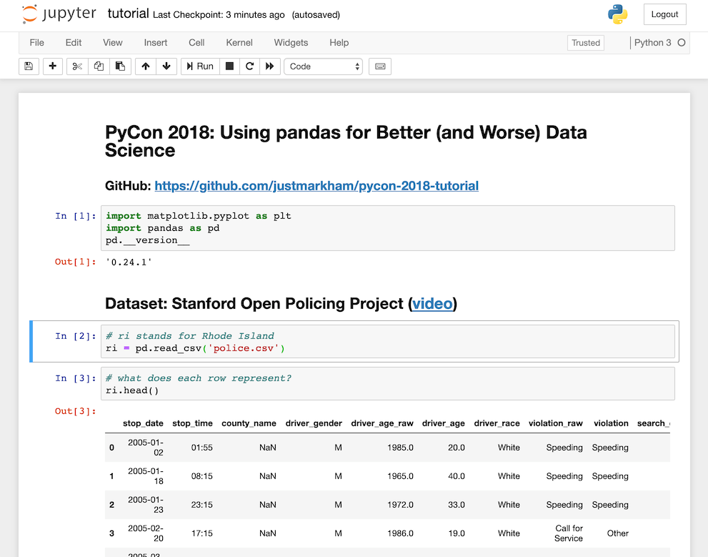
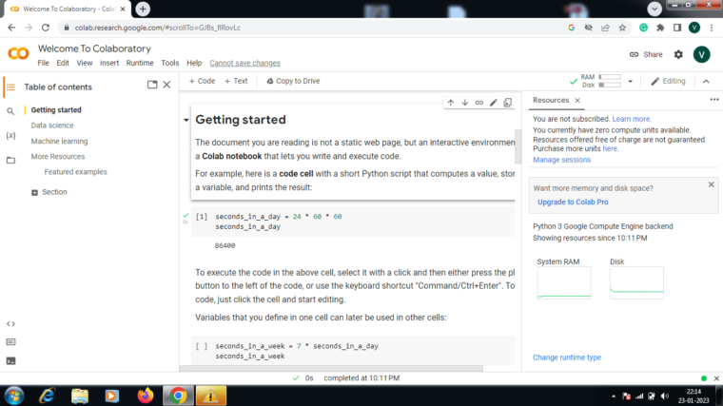
Jupyter vs Google Colab
Code cells vs markdown cells
Toolbar: Run, Stop, Restart Kernel
Saving notebooks (.ipynb files)
Google’s free Jupyter Notebook service. No local setup needed.
GPU support for heavy compute.
Saved in the drive automatically.

Slide 7
Section 2: Python Basics and First Code

Slide 8
Python Basic Syntax
Open a code cell, type
``` print(“Hello, World!”) ```
Run the cell to see the output.
Note: Case sensitive, i.e. Print and print are not the same.
Indentation is crucial in Python (using a tab or 4 spaces)
A comment starts with a # symbol.

Slide 9
Variables in Python
Variables acts as containers to store the data values.
In Python, unlike languages like Java or C, there is no such command to declare a variable.
The variables are created on the fly.
``` name = “Alice” age = 28 ```
Dynamic Typing – Easily change the type of the variable after they are set.
Casting – If you want specify the type of the variable, just mention it.

Slide 10
Data Types in Python
Categories | Built-In Data Type
Text Type | str
Numeric Type | int, float, complex
Mapping Type | dict
Sequence Type | list, tuple, range
Set Type | set, frozenset
Boolean Type | bool
Binary Type | bytes, bytearray, memoryview
None Type | NoneType
To know the type of the variable, just use type() function.

Slide 11
Input and Output
input() takes the input from the user.
Example: ``` name = input(“Enter your name: ”) print(f”Hello {name}”)
Note: The input function always returns a string value. If we need to use the variable in some different data type, use Casting.

Slide 12
Section 3: Python Recap Part 1

Slide 13
Operators
Type | Operators
Arithmetic | +, -, *, /, %, **, //
Assignment | =, +=, -=, /=, %=, //=, **=, &=, |=, ^=, >>=, <<=, :=
Comparison | ==, !=, >, <, >=, <=
Logical | and, or, not
Identity | is, is not
Membership | in, not in
Bitwise | &, |, ^, ~, <<, >>

Slide 14
Conditional Statements
The conditional statements in python uses if, else, and elif structure.
Example: ``` if age >= 18: print(“Adult”) else: print(“Minor”) ```
Note: The if statement used without indentation raises error.

Slide 15
Loops: for and while
For loop is used to iterate over a known sequence (it could be list, dictionary, set of numbers, or string).
It works as an iterator method as found in other OOPs languages.
Example: ``` cars = [“BMW”, “Audi”, “Truck”] for x in cars: print(x) ```
The while loops executes the sequence of actions as long as the primary condition is true. Used when the end of the sequence is not known.
Example: ``` while i < 5: print(i) I = I + 1 ```
If not mentioned, the while loop might enter into an infinite loop.

Slide 16
Section 4: Python Recap Part 2

Slide 17
Functions in Python
They are blocks of reusable code. It runs only when it is called.
We can pass the data into a function, as the parameters of the function.
It can return the data as a result.
Defined using the def keyword.
Example: ``` def greet(name): print(f”Hello, {name}”) greet(“Class”) ```

Slide 18
Arguments and Return Values
Information can be passed into a function via arguments.
They are specified within the function in parentheses.
The function returns the values, that means, the result of the function can be then stored in a variable and used later.
Example: ``` def add(a, b): return (a+b) x = add(514, 713) print(x) ```

Slide 19
Lists in Python
Store multiple values in a single variable. They can be of different data types.
They are ordered, changeable, mutable, and allow duplicate values.
Note: There are some list methods which might change the order of the list, but in general, the order of the list does not change.
Example: ``` mylist = [“Bottle”, “Ball”, 3, True] print(mylist[0]) ```

Slide 20
Basic List Operations
append() – The element added to the list, gets to the end of the list.
remove() – Removes the first occurrence of the element in the list.
sort() – Sorts the list, in-place.
len() – Returns the total number of items present in the list.
Example: ``` cars.append(“Mini Cooper”) cars.sort() cars.remove(“BMW”) cars.len() ```

Slide 21
Section 5: Python Recap Part 3

Slide 22
Strings in Python
In short, the strings are immutable sequence of characters.
They are defined using single quotes (‘ ‘) or double quotes (“ “).
You can easily display the string literal using the print() function.
Multiline strings are defined using the three quotes (“””) or (‘’’).
There are several methods on strings, to make our task easier.
Example: ``` print(“PYTHON”.lower()) ```
Link - https://www.w3schools.com/python/python_ref_string.asp

Slide 23
Dictionary in Python
Dictionary stores the data in the form of key: value pairs. Remember, the key must be unique.
It is a collection which is ordered, changeable, and immutable.
The items of the dictionary can be referred by using the key name.
After Python version 3.7, the dictionaries are unordered.
Example: ``` info = {“name”: “John”, “age”: 28, “city”: “Delhi”} print(info[“city”]) ```
Learners are advised to explore more useful dictionary functions.

Slide 24
Section 6: Exception Handling

Slide 25
What is an Exception?
When an error occurs in the code, as known as Exception in Python, in such cases, Python interpreter normally stops and generates an error message.
Example: ``` x = 314 print(x[0]) ```
These exceptions are handled using the try-except statements.
Once the try block raises an error, the except block gets executed. Without the try block, the program crashes and raises error.

Slide 26
How to Handle Exceptions?
We use try, except blocks.
Example: ``` try: x = input(“Enter a number: “) x = int(x) print(10/x) except ZeroDivisionError: print(“Cannot divide by zero.”) ```
A neat way to handle errors. The try block allows you to test the block of code for errors. The except blocks handles the error.

Slide 27
Multiple Except Blocks
It is possible to define as many exception blocks you want, every except block will be handling a special kind of error.
Example: ``` try: x = int(input(“Enter a number: “)) print(10/x) except ZeroDivisionError: print(“Cannot divide by zero.”) except ValueError: print(“Please check your input again.”) ```

Slide 28
Finally Block
The finally block will execute the piece of code, regardless of the result you received from try and except blocks.
Example: ``` try: x = int(input(“Enter a number: “)) print(10/x) except ZeroDivisionError: print(“Cannot divide by zero.”) finally: print(5+2) print(“This piece of code is over.”) ```

Slide 29
Raising Exceptions
As a developer, you might choose to throw an exception when a certain condition occurs.
To throw or raise an error, we can use the raise keyword.
Example: ``` x = 1 if x > 0: raise Exception(“For this program, no numbers > 0 are allowed.”) ```

Slide 30
Exercises
Write a program to:
Accept a number from the user.
Check if it’s even or odd.
Print appropriate message.
[Optional]: For this question, consider 0 as neither odd nor even, how to handle that?
Create a function to calculate the factorial of a number.
Create a simple calculator based program to perform arithmetic operations. Use exception handling to manage invalid number inputs, unsupported operators, and division by zero.

