Slide 1
Introduction to Object Oriented Programming
- Dr. (Prof.) NEELESH S. UPADHYE
Slides prepared by Puneet (Link)

Slide 2
Lecture 2: Object-Oriented Programming in Python: Classes, Objects, and Algorithmic Efficiency

Slide 3
Lecture Overview
Classes
Objects
Timing the Code
Why Efficiency Matters?
Introduction to Algorithms
Few Implementation Examples in Python

Slide 4
Introduction to Object Oriented Programming (OOPs)
Refers to syntax or group of languages that uses objects in programming.
Aim: Binds together the data and the functions that operate on them, making sure no other part of the code can access the data except the function.
Pros: Modularity, Scalability, Reusability
Example: A house blueprint can be thought as a class through which many different houses can be built (objects). Each house will have some common features like (rooms, kitchen, etc) but some houses might have special functionalities (automatic doors, voice-enabled lighting system). Different houses can be built from one house blueprint with unique features and specific functions.

Slide 5
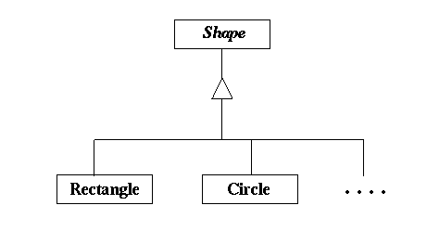
Classes and Objects in Python
Class is like a user-defined data type. It has members and functions. It is like a blueprint of an object.
Object is a basic unit of OOP and represents real-life entities.
Example: Shape is a class, while particular polygons like Rectangle, Circle, Triangle all can be classified as Shapes. Further, they might have attributes like perimeter, area, length, etc. depending on the shape.

Slide 6
How to Define a Class?
We define a Class using the class keyword.
We can further, create objects (instances) of a class.
Example: ``` class Dog: def __init__(self, name): self.name = name def bark(self) print(f”{self.name} says Woof!”) my_dog = Dog(“Rocky”) my_dog.bark() ```

Slide 7
__init__ Method and self Keyword
__init__ method acts as an initializer for the objects in the class. The other name for this method is constructor. In some languages like Java and C++, it is a default constructor. It other words, this method has some statements or instructions that are executed at the time of Object creation.
In Python language, self keyword stands for the convention to refer to the current instance of a class within its methods. In other words, it helps to differentiate between local variables inside a method and those belonging to the instance.
Example: ``` class Student: def __init__(self, name, age): self.name = name self.age = age ```

Slide 8
Attributes and Methods
Attributes are variables or data members associated with a class or object that represents its properties or state.
Eg. In a car class, color, model, year are the attributes.
Functions are defined within a class that perform actions on that particular object.
Eg. In a car class, functions/methods could be start_engine(), brake(), etc.
Example: ``` class Car: def __init__(self, make, model): self.make = make self.model = model def drive(self): print(f”The {self.make} {self.model} is driving.”)

Slide 9
Encapsulation in Python
It refers to creating a bundle of the data and associated methods that will operate on this data, stay within a class.
It kinds of provide a restrictive access to direct modification of data.
Example: ``` class Account: def __init__(self, balance): self.__balance = balance def get_balance(self): return self.__balance ```
Explore about modifiers: public, protected (_), private (__)

Slide 10
Eg. Implementing a Bank Account Class
``` class BankAccount: def __init__(self, balance=0): self.balance = balance def deposit(self, amount): self.balance = self.balance + amount def withdraw(self, amount): if amount <= self.balance: self.balance = self.balance – amount else: print(“Insufficient funds.”) def get_balance(self): return self.balance ```

Slide 11
Exercises on Classes and Objects
Create a car class with following methods: start(), stop(), and drive().
Create a book class with following attributes: title and author, and method: read()

Slide 12
Python Code Execution Flow
Unlike languages like Java, etc, the python language works on the principle of line-by-line execution method.
Other, important feature to remember is when a function is called, it acts like a call stack. Stack is a data structure that is last in first out. So, basically it manages and tracks active function calls during the execution of the program. Whenever, a new function is called, a new frame gets pushed into the stack.
Scope of the variable determines the where in the program, the variable is accessible. While the lifetime of the variable defines how long a variable exists in the memory, before it is cleaned.

Slide 13
Debugging Techniques
The best practice is to use logging and debugging statements in python. Why? Because the language itself works on line-by-line execution.
Introducing another tool: Python Debugger (pdb)
Example: ``` import pdb def add(a, b): pdb.set_trace() return a+b ```

Slide 14
Measuring Execution Time of the Program
While now there are several advanced methods and libraries to track the amount of time taken by execution of the program.
In this course, we will be using classical time module.
We capture the start and end time using single line methods. The elapsed time can be then calculated using start and end time. ``` import time start = time.time() # Insert your code here, you wish to calculate the time for. end = time.time() print(“Execution Time: “, end – start) ```

Slide 15
Eg. Efficiency in Sorting Algorithms
Now, in the next slide we will take example of two sorting algorithms – Bubble sort and in-built sort method in python.
In this example, we will generate a list of 1000 random numbers. Apply both bubble sort (simple but an inefficient way) and built-in sorting algorithm (uses Timsort, a efficient sorting algorithm).
As seen earlier, use the time module to calculate the elapsed time.
Post results, discuss the impact of algorithm choice on performance.

Slide 16
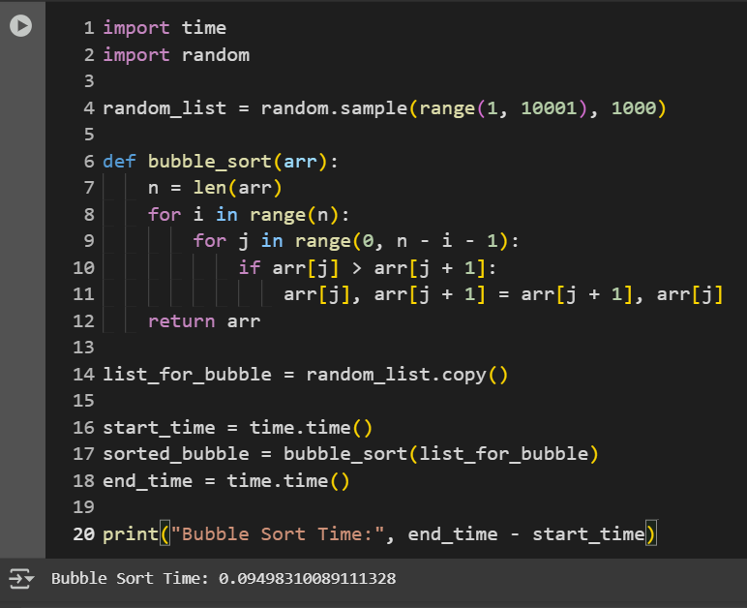

Slide 17
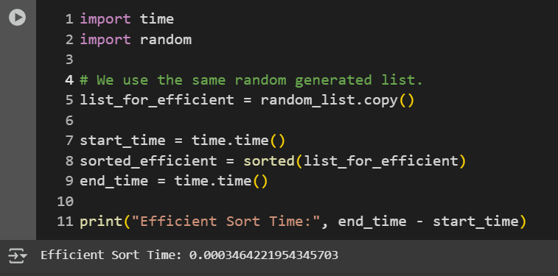

Slide 18
Creating a Countdown Application
``` import time def countdown(t): while t: mins, secs = divmod(t, 60) timeformat = '{:02d}:{:02d}'.format(mins, secs) print(timeformat, end = ‘\r’) time.sleep(1) t -= 1 print(‘Timer Completed!’) ```
Can we build the countdown application using some other technique?

Slide 19
Understanding the Big-O Notation
The Big-O Notation is a method or tool to calculate or describe the time and space complexity of algorithms.
It provides with the upper limit of the time taken by the algorithm based on the size of the input. To calculate the upper limit, we generally consider the worst-case scenario of the algorithm in interest.
Important point to note is it describes the asymptomatic behaviour (order of growth of time and space wrt input size) of the function, but does not provide with a exact value.
Big-O Cheat Sheet added as the reference.

Slide 20
Comparing Algorithm Efficiencies
Linear Search: Scans every element of the list one-by-one until it finds the target or hits the end. It does not require the data to be sorted beforehand.
O(n) time complexity, no specific data requirement, simple implementation, poor for large datasets, O(1) iterative space complexity, works on small and unsorted datasets.
Binary Search: It works only on the sorted lists. It divides the search interval in half iteratively, comparing the middle element with the target and every time discards the remaining other half of the elements.
O(log n) time complexity (how?), works only on sorted but can handle large datasets, bit complex implementation, Space complexity: O(1) iteratively, O(log n) recursively.

Slide 21
Code Implementation
def linear_search(arr, target):
for i, value in enumerate(arr):
if value == target:
return i
return -1
def binary_search(arr, target):
left, right = 0, len(arr) - 1
while left <= right:
mid = (left + right) // 2
if arr[mid] == target:
return mid
elif arr[mid] < target:
left = mid + 1
else:
right = mid - 1
return -1

Slide 22
Timing Multiple Functions
It is important to note that a same function can be implemented in several ways.
You can try different methods including the time module method to measure and compare their execution times.
Discuss and Explore:
Difference between the recursive and iterative function to enumerate the Fibonacci sequence.
Can students implement these two functions?
[Optional]: Any other data structure can be used here to implement Fibonacci function, which is also at the same time more efficient than the previous methods?

Slide 23
What is Python Profiling?
It helps to optimize your python code in a all-efficient manner.
It works to identify the performance bottlenecks in the code sections that are generally found to consume unproportionate amount of time or space resources.
In Python, we generally have two widely used profiling tools: - cProfile and line_profiler.
They both are unique in their methods of profiling, but in the end they provide a comprehensive profiling workflow, from high-level function analysis to detailed line-by-line inspections.

Slide 24
Profiling Tool: cProfile
cProfile is a python’s built-in code profiler. It collects and depicts how often and for how long each function in the program is being executed. Provides a comprehensive overview of your code’s performance at the function level.
```{bash} # Consider my_script.py has your code or function. python –m cProfile my_script.py ```
```{python} import cProfile cProfile.run(‘my_function()’) # Code is in my_function() ```

Slide 25
Profiling Tool: line_profiler
As the name suggests, line_profiler tool provides a detailed timing and performance for each individual line within a specified function. It allows you to pinpoint and understand the exact operations which are consuming more resources.
Download it using – pip install line_profiler
```{python} from line_profiler import profile @profile def my_function(): ```
Or use bash script – python –m kernprof –l –v my_script.py

Slide 26
Comparing Data Structures
Features | List | Set | Dictionary
Order | Ordered | Unordered | Unordered (now)
Duplicates | Allowed | Not Allowed | Key unique, value can repeat.
Lookup Time | O(n) | O(1) avg. case | O(1) avg. case
Insertion Time | O(1) amortized | O(1) avg. case | O(1) avg. case
Deletion Time | O(n) | O(1) avg. case | O(1) avg. case
Index Access | O(1) | Not supported | Not supported
Memory Usage | Low | Higher than list. | Similar to set.
Use case | Ordered collection, indexing. | Unique elements, fast check on membership. | Key-value mapping, fast lookup by keys.

Slide 27
Understanding Space Complexity
Type | Time | Space | Use Case
Recursion | Often slow (function call overhead) | Higher (stack growth) | Tree traversals, divide and conquer
Iteration | Faster (no function call) | Lower (fixed memory) | Large datasets, memory constraint systems.
Example: Factorials
# Recursive (O(n) space)
def factorial(n):
return 1 if n <= 1 else n * factorial(n-1)
# Iterative (O(1) space)
def factorial(n):
result = 1
for i in range(1, n+1):
result *= i
return result

Slide 28
Generators for Memory Efficiency
Generators: They are special kind of iterators in Python that allow the values to be produced slowly (one at a time) instead of returning all the values at one time.
yield: The yield keyword helps to create these generators. It is particularly useful in handling very large datasets. It will allow the iteration without storing the entire big chunk of sequence in the memory.
``` def generate_numbers(n): for i in range(n): yield I ```

Slide 29
Exercises
What is the time complexity of binary search?
Which data structure offers the fastest lookup time?
Try to build a stopwatch application within Colab with start, stop, and reset functionalities. Use time module to track time. Use class-based methodology to implement the function.
Measure time taken to sort n-element list: n= 10, 50, 100, 500, 1000.
Implement a person class and a subclass student. Use the attributes and methods of your choice! (show creativity)
What are the different performance metrics of list vs set operations?

Slide 30
References
Big O Cheat Sheet - https://www.bigocheatsheet.com/

