Slide 1
Introduction to Object Oriented Programming
- Dr. (Prof.) NEELESH S. UPADHYE
Slides prepared by Puneet (Link)

Slide 2
Lecture 4: Comprehensive Study of Sorting Algorithms: Concepts, Implementation and Analysis

Slide 3
Lecture Overview
Selection Sort
Insertion Sort
Merge Sort
Analysis of Sorting Algorithms
Python Implementation of Sorting Algorithms

Slide 4
Introduction
Sorting algorithms play a vital role in computer science, they help in arranging the data in a specified manner (it could be either in ascending or descending).
It helps in efficient searching methods (basics of which we have already covered earlier). We have seen in the case of binary search performs the searching algorithm very efficiently. The only constraint for binary search is that the data should be sorted.
It also helps in improved data representation.
In this module, we will explore different search methodologies like merge, insertion, selection, quick, etc and also discuss their performance analysis.

Slide 5
Importance of Sorting
There are multiple benefits of sorting, few of them are –
Enabling efficient searching in the case of binary search.
Data normalization and organization. The sorted data is always easier to interpret, visualize, and analyse. It helps in identifying trends and patterns.
In many algorithms, it boosts the efficiency by performing operations like merging, joining, and filtering based on conditions.
Most important, sorting acts as the building block for many fundamental problems of computer science. It provides indirect solution to problems like query optimization, finding closest pair of points in KNN, and finding solutions for convex hull algorithms.

Slide 6
Selection Sort: Overview
The selection sort is considered as one of the most introductory and simple search algorithm. Though it is comparison based, it is still a in-place algorithm. Therefore, efficient for small datasets and does not require extra space.
It divides the array into sorted and unsorted portion. As the algorithm progresses, the sorted side keeps getting bigger.
In each iteration, it picks up the minimum element from the unsorted portion and keeps it at the beginning. Basically, in each iteration, the smallest element in the unsorted section gets swapped with the first unsorted element. Therefore, in place algorithm.

Slide 7
Selection Sort: Algorithm Steps
Initialize the sorted boundary: Generally, here we start with the first element. The sorted part is initially empty, while the unsorted part is the entire array.
Find the minimum: From 0 to n-1, find the smallest element.
Swap elements: Pick the smallest element and swap its position with the first element (or 0th) of the unsorted part.
Advance the boundary: Slowly move the boundary of the sorted part one by one. The unsorted data shrinks.
Repeat: We continue this process, until the entire array is sorted (the total number of comparison iterations are n-1).

Slide 8
Selection Sort: Code Example
``` arr = [64, 15, 12, 22, 11] for i in range(len(arr)): mini = i for j in range(i+1, len(arr)): if arr[mini] > arr[j]: mini = j arr[i], arr[mini] = arr[mini], arr[i] ```

Slide 9
Selection Sort: Analysis
The algorithm in general is not considered as stable, as the relative order of the equal elements might change.
The selection sort always scans the unsorted region for either minimum or maximum value, regardless of the input order.
It has fewer swaps than some algorithms but has the same asymptomatic time.
Space Complexity: O(1); in-place sort, no extra memory required.
Time Complexity: O(n^2) for all best, worst, and average cases.
Inefficient for large datasets due to quadratic time complexity. Fine for small or nearly sorted datasets.

Slide 10
Insertion Sort: Overview
Insertion sort is a simple yet important type of sorting algorithm. It builds the final sorted array one element at a time. It replicates the method how you play the cards in hands. We always insert the new card in our hand by placing it at the right position in the already sorted deck of cards in hand.
Because of its adaptive nature, the total number of shifts required are less. Very useful in the cases of real-time data, where we need to keep the sorted array while we continue to receive the new elements.
Again, more of a in-place algorithm, therefore, requires only a constant amount of extra memory space. Ideal for already sorted algorithms.

Slide 11
Insertion Sort: Algorithm Steps
Initialize: We assume that first element is already sorted.
Iteration: From the second to the last element:
Take the current element as the key.
We compare the key with other elements in the sorted portion (that is towards the left).
All the elements that are greater than key, we move them one position towards the right to create a space (for 1 element).
We place the key in the correct sorted position.
Repeat: Continue the process until all the elements have been processed.

Slide 12
Insertion Sort: Code Example
``` arr = [64, 15, 12, 22, 11] for i in range(1, len(arr): key = arr[i] j = i-1 while j >= 0 and key < arr[j]: arr[j+1] = arr[j] j -= 1 arr[j+1] = key ```
The outer loops starts with the second element. Inner loop shifts the elements towards the right. Key is then placed at correct position.

Slide 13
Insertion Sort: Analysis
The insertion sort is a more stable sorting algorithm as it maintains the relative order of equal elements, which is essential for applications that requires sorting records on multiple tables.
Space Complexity: O(1); in-place, requires constant extra space.
Again not suitable for large datasets due to quadratic time complexity. Acts as the building block in more advanced hybrid algorithms. It is often used as the final block in Timsort or Introsort.
Time Complexity: Best Case - O(n), Average & Worst Case – O(n^2)
For arrays of small size, insertion sort outperforms quick sort due to lower overhead.

Slide 14
Merge Sort: Overview
It is a classical example of divide-and-conquer strategy. It recursively divides the input array into smaller sub-arrays. Sorts each sub-array recursively and join them to produce a sorted output.
Due to the predictable, O(n log n) space complexity. It is highly efficient for sorting large datasets.
It is a very ideal sorting algorithm, specially used for linked list and external sorting implementations (specifically sorts data that can not easily fit into RAM).
The merge step of this sorting algorithm is the crucial part and therefore, has to be implemented efficiently using appropriate data structures.

Slide 15
Merge Sort: Algorithm Steps
Divide: Find the midpoint of the array. Split the array into two halves.
Recursion: Apply recursive operation to each sub array until the base (size=1) is reached.
Merge: From the base, start combining the sorted subarrays back into a single array. Thus, reducing the number of sub arrays created. We can use few temporary array or pointers to efficiently merge the elements in the same order.
In the algorithm, the recursion allows the each subarray to be sorted before getting merged. The merge step is often the bottleneck, as it maintains the overall order and stability of the sort.

Slide 16
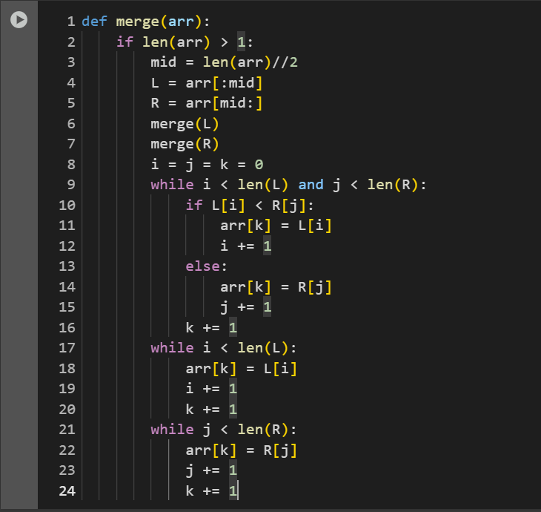
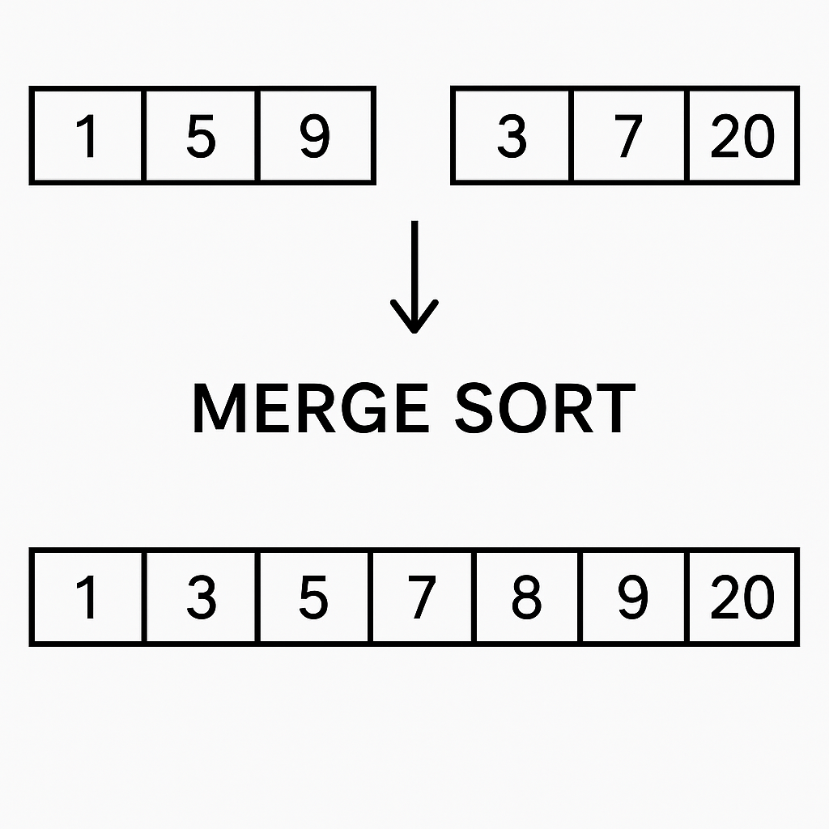
Merge Sort: Code Example

Slide 17
Merge Sort: Analysis
It is a stable sorting algorithm, thus, crucial in multi-level sorting.
Requires O(n) auxiliary space that is required for temporary arrays during the merge process. Not an in place sorting algorithm.
Performs extremely well on large datasets and linked lists.
The new property introduced by merge sort is parallelization, as the divide-and-conquer steps can be distributed to multiple processors. Later, they can give the individual outputs that can be merged.
Time Complexity: Best, Worst, and Average Case: O(n log n). The array is always divided in halves (therefore, log n). At each level, all the n elements are sorted before moving to the merge step.

Slide 18
Comparative Analysis
Feature | Merge Sort | Insertion Sort | Selection Sort
Best Time | O(n log n) | O(n) | O(n²)
Average Time | O(n log n) | O(n²) | O(n²)
Worst Time | O(n log n) | O(n²) | O(n²)
Space Complexity | O(n) | O(1) | O(1)
Stability | Stable | Stable | Not Stable
Adaptive? | No | Yes | No
In-place? | No | Yes | Yes
Usage | Large data, external sorting | Small or nearly sorted data | Simple, small datasets
Implementation | Moderate/High | Simple | Simple

Slide 19
Search Algorithms
We have already studied – Linear and Binary Search algorithms in the previous lectures.
In this lecture, we will see the implementation of those algorithms.
Further, we will now implement 3 sorting algorithms with these two searching algorithms.
We will be using time module to calculate their performance.

Slide 20
Implementation of Linear Search
``` for i in range(len(arr)): if arr[i] == x: return i ```
Time Complexity: O(n)

Slide 21
Implementation of Binary Search
``` def binary(arr, x): low, high = 0, len(arr) – 1 while low <= high: mid = (low + high)//2 if arr[mid] == x: return mid elif arr[mid] < x: low = mid + 1 else: high = mid – 1 return -1 ```
Time Complexity: O(log n)

Slide 22
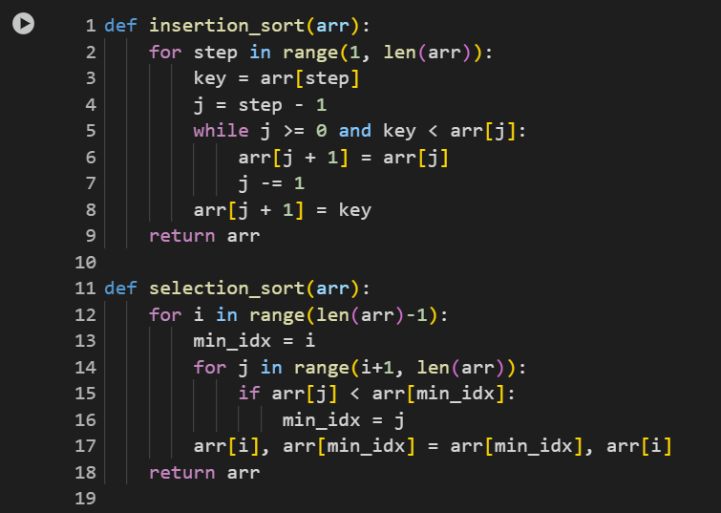
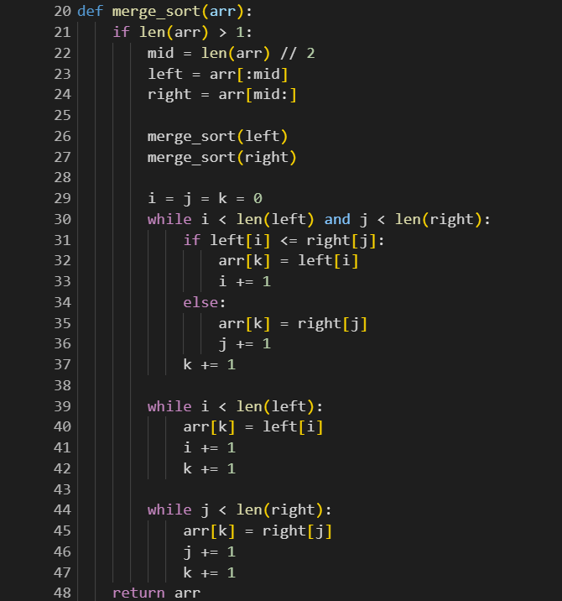
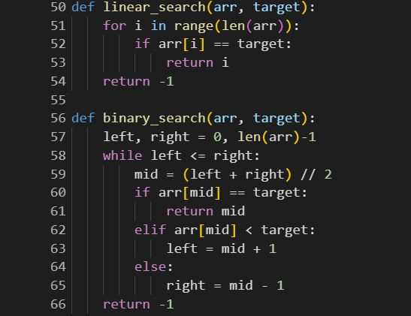

Slide 23
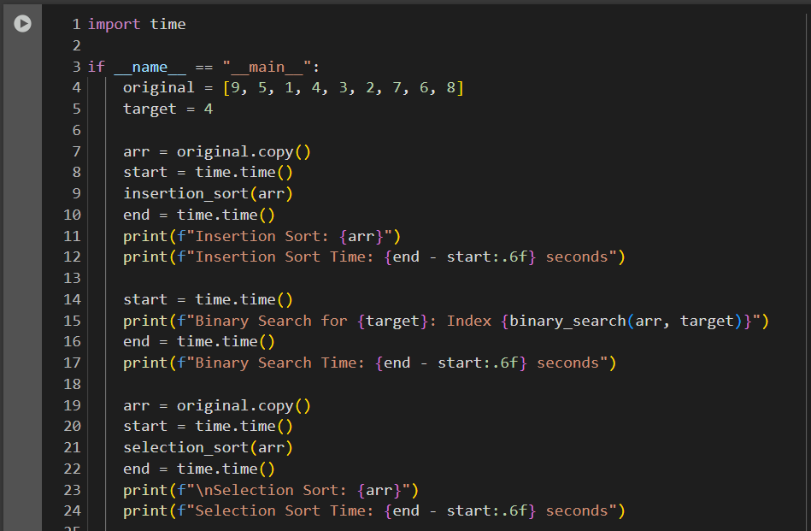
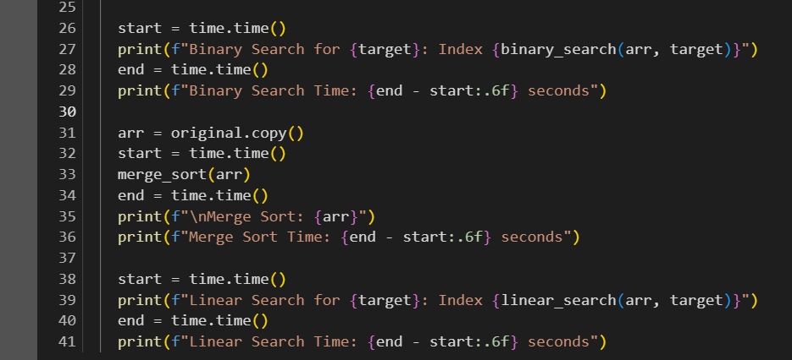
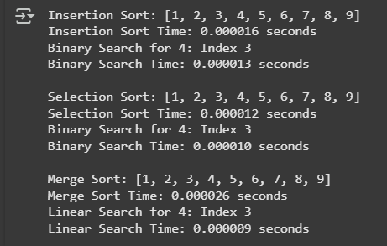

Slide 24
Introduction to Quick Sort
``` def quick(arr): if len(arr) <= 1: return arr else: j = arr[0] k = [x for x in arr[1:] if x <= j] l = [x for x in arr[1:] if x > j] return quick(k) + j + quick(l) ```
A divide-and-conquer strategy sorting algorithm. We choose the pivot element and partition the array based on it. Average time complexity: O(n log n). Not stable. Why?

Slide 25
Exercises
Given a list of 2^n elements that are arranged in this way (1, 1000, 2, 999, 3, 998…), how you can analyse the behaviour of the merge sort? What is the exact number of comparisons made in merging at each level? Derive a tight bound on the total number of comparisons made by Merge Sort on this input.
Standard merge sort uses O(n) extra space during the merging operation. Implement an in-place merge version of Merge Sort. What will be the complexity of the modified merge operation?
Design a hybrid sorting algorithm that switches between Insertion Sort and Merge Sort depending on the size of the sub-array. What threshold size kkk would be optimal for switching from Merge Sort to Insertion Sort (derive or estimate)?

Slide 26
Exercises (contd.)
Prove that selection sort always performs exactly (n(n-1))/2 comparisons regardless of the input. Design a variant of Selection Sort that can minimize comparisons when duplicates are heavily present.
How you can improve the Insertion Sort using Binary Search to find the correct insertion point? What is the new time complexity in terms of comparisons?

