Slide 1
Object Oriented Programming
Dr. Neelesh S. Upadhye
Slides are prepared by Puneet

Slide 2
Lecture 7: Merge & Quicksort, Timsort Idea
References
Core Text
Goodrich, Tamassia & Goldwasser, Data Structures and Algorithms in Python
Other References
Jon Kleinberg & Éva Tardos, Algorithm Design
Sanjoy Dasgupta, Christos Papadimitriou & Umesh Vazirani, Algorithms
Luciano Ramalho, Fluent Python
Steve Freeman & Nat Pryce, Growing Object-Oriented Software, Guided by Tests

Slide 3
Sorting Problem Recap
Sorting is the process of arranging elements in a defined order, commonly ascending or descending.
Input: We provide a list of n comparable elements.
Output: A defined permutation of input such that the array is for i < j, array[i] <= array[j].
Sorting is essential for efficient searching, data analysis, compression, and visualization.
For comparison-based sorting, lower bound is Ω(n log n) in worst case (proved via decision tree argument). The goal is to match this lower bound while continuing to optimize the space and practical efficiencies.

Slide 4
Merge Sort - Concepts
Type: Divide and Conquer
Steps:
Divide the unsorted list into two roughly equal halves.
Recursively sort each half using merge sort.
Merge the two sorted halves into one final sorted list.
Always divides the input completely before beginning any merge operation.
Time complexity: O(n log n) in every case.
Advantages:
Highly predictable performance, stable sort
Excellent choice for linked lists and external sorting scenarios

Slide 5
Merge Operation and Internal Mechanics
Merging is the operation that combines two sorted sequences into a single sorted sequence.
Use two pointers to scan both arrays simultaneously.
At each step, move the smaller element to the output.
When one input is exhausted, append the remainder of the other.
Complexity
Time: O(n), where n is total length of two sequences
Space: O(n) auxiliary memory for standard array implementation
Code Implementation Notes – The key to its performance is the efficient linear-time merge step. You can choose to implement it iteratively or recursively.

Slide 6
Merge Sort – Complexity and Behaviour
Time Complexity
(T(n) = 2T(n/2) + Θ(n))
Solve to T(n) = Θ(n log n) (via Master Theorem)
Space Complexity
O(n) additional memory for temporary arrays.
For linked lists, can be done in O(1) extra space.
Stability – Yes, equal elements retain original relative positions.
Use Case - External sorting where input doesn't fit into RAM.
Disadvantage – Primary concern for not in-place for arrays. Another concern is memory overhead.

Slide 7
Merge Sort – Design Considerations
Best for –
Very large datasets (especially on disk)
Linked lists due to pointer manipulation
Parallelism –
Merge sort’s divide stage is highly parallelizable
Merge sort variants –
Bottom-up merge sort (iterative implementation)
Natural merge sort (detects existing runs)
Weakness – Space overhead in array-based implementation, not ideal for small datasets due to function call overhead.

Slide 8
Quick Sort – Concepts
Type: Divide and Conquer
Steps:
Choose a pivot element from the array.
Partition array into two sub-arrays:
Elements ≤ pivot
Elements > pivot
Recursively apply Quicksort on sub-arrays
Key Features:
In-place sort, not stable by default.
Sensitive to pivot choice, fastest general-purpose sort in practice.

Slide 9
Quick Sort Partitioning Schemes
Two Common Schemes:
Lomuto Partition: Simple, but less efficient (more swaps)
Hoare Partition: Fewer swaps, more efficient
Pivot Selection Strategies:
First element, last element, random element.
Median-of-three: Median of first, middle, last → improves balance
Goal of Partition: Minimize unbalanced splits to avoid O(n²) worst case.
Randomized Quicksort: Choose pivot randomly → Expected time O(n log n) with high probability.

Slide 10
Quick Sort Analysis
Best Case: Balanced partition → T(n) = 2T(n/2) + Θ(n) ⇒ O(n log n)
Average Case: Random inputs → O(n log n) expected
Worst Case: Highly unbalanced (e.g., already sorted) → O(n²)
Space:
In-place sorting.
Recursion stack: O(log n) expected, O(n) worst
How to optimize?
Tail-call elimination.
Switch to insertion sort for small partitions

Slide 11
Quick Sort Practical Use Cases
Real-world efficiency
Excellent cache performance due to in-place nature.
Fewer data movements than merge sort.
Standard library implementations
JavaScript, C++ STL (IntroSort hybrid), etc.
How to improve it further?
Hybrid with insertion sort for small arrays (typically ≤ 16 elements).
Avoid recursion depth using explicit stack or tail-call removal.
Limitation: Unstable sort, not suitable if stability is needed.

Slide 12
Timsort Motivation
Real-world input often has pre-existing order:
Partially sorted arrays
Repeating patterns or runs
Merge sort is stable and consistent, but not adaptive.
Quicksort is fast but unstable and non-adaptive.
Timsort:
Designed to handle real-world data efficiently.
Adaptive, stable, hybrid sort.
Offers O(n) performance on nearly sorted data.
Widely accepted in Python and Java implementation.

Slide 13
Timsort Hybrid Strategy
It combines Insertion Sort for small or nearly sorted segments and Merge Sort for merging sorted segments (runs).
Key Features:
Identifies natural runs (monotonic subarrays).
Extends short runs to a minimum size using insertion sort.
Efficient merging with stack of runs obeying specific invariants.
It speeds up merging when one run dominates. Next, uses exponential search to skip comparisons.
Complexity:
Worst-case: O(n log n)
Best-case: O(n)
Space: O(n) auxiliary memory

Slide 14
Summary
Merge Sort
Predictable O(n log n) time
Stable, good for linked lists and external data
Quick Sort
Generally fastest in practice, in-place, but not stable.
Sensitive to pivot; average O(n log n), worst O(n²)
Timsort
Hybrid, adaptive, stable.
Exploits structure in real-world data.
Chosen for many production-grade language libraries.
Disclaimer – For course use only; do not redistribute.

Slide 15
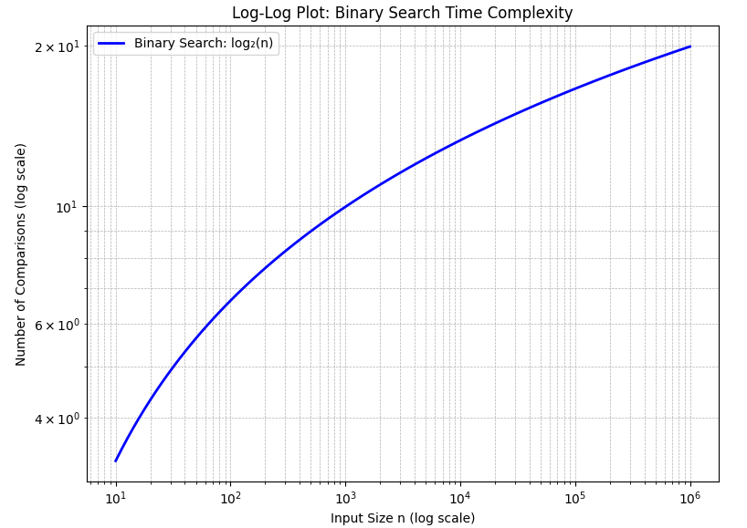
Additional Information (Log-Log Plot)

