Slide 1
Introduction to Object Oriented Programming
- Dr. (Prof.) NEELESH S. UPADHYE
Slides prepared by Puneet (Link)

Slide 2
Lecture 3: Advanced Time Complexity Analysis: Master Theorem and Beyond

Slide 3
Lecture Overview
Introducing Algorithm Analysis
Orders of Growth
Time Complexity Calculation Techniques
Search Algorithms
Related Advanced Topics

Slide 4
Why Analyse Algorithms?
Predict the scalability for large inputs to compute efficiency.
Comparing efficiency between them to identify the optimal solutions for the same problem.
Guiding algorithmic design by checking the trade-off between time or space complexity.
There are three types of analysis types –
Worst case – Requires maximum resources (pessimistic)
Best case – Requires minimum resources
Average case – Expected required resources on typical usage.

Slide 5
Running Time vs Actual Time
Running time refers to the number of total operations (primitive) performed.
Actual time refers to real-world seconds influenced by hardware, compiler, and code logic.
Asymptomatic analysis helps to shift the focus towards how running time scales with input size.
Running Time
Counts steps per operations.
Expressed as functions like O(n) or O (n log n)
Independent of hardware
Actual Execution Time
Measured in sec/millisecond.
Depends on – CPU, PL efficiency, compiler optimization, OS and background process.

Slide 6
Asymptomatic Analysis
As discussed, the task of the asymptomatic analysis is to turn the shift towards calculating the running time scaling wrt input size.
The analysis eliminates the constants/lower-order terms. Eg. it treats 15n + 40 as O (n).
Helps to identify better algorithms regardless of implementation.
The focus is on calculating the growth patterns –
Complexity | Input Size Changes from 10 to 100
O(n) | 10x longer
O(n^2) | 100x longer
O(2^n) | (2^90)x longer

Slide 7
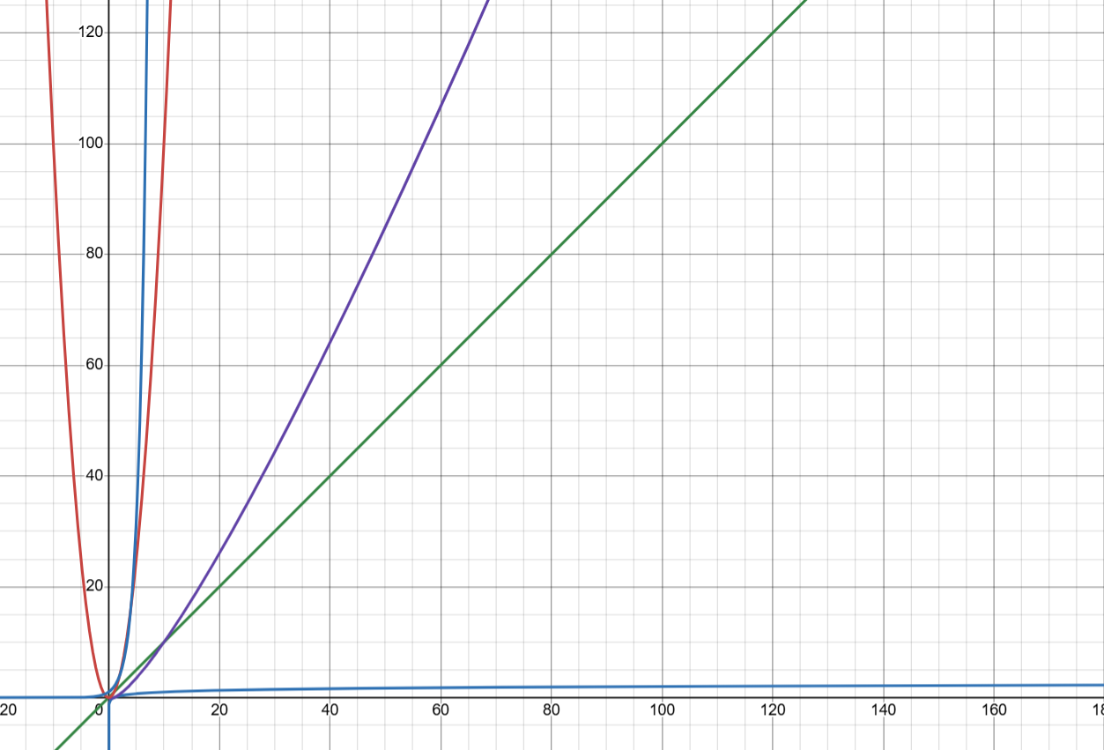
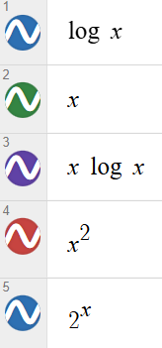
Growth Functions

Slide 8
Big O Notation
Definition: f(n) = O(g(n)) iff ∃ constants c > 0, n₀ > 0 such that f(n) ≤ c·g(n) ∀ n ≥ n₀.
The focus is to calculate the asymptomatic upper bound (that will be the worst case growth rate as n tends to infinity.
To simply –
We drop the constant terms. 5n² ≡ n²
We ignore all the lower order terms. 3n² + 7n + 20 → O(n²).
Example –
f(n) = 4n log n + 10n → O(n log n)

Slide 9
Big O Notation (contd.)
Complexity Hierarchy –
Practical problems –
Time vs space complexity (eg. Hash tables use extra tables to speed up the process.). Constants matter for a very small n. ((10^6)n vs 0.01n^2)
We are not quantifying hardware or optimization effects.
Optimal | O(1) | Constant
Efficient | O(log n) | Binary Search
Linear | O(n) | Simple Iteration
Log-linear | O(n log n) | Merge Sort
Quadratic | O(n^2) | Bubble Sort
Exponential | O(2^n) | Brute force TSP

Slide 10
Some Other Asymptomatic Notations
Big Omega (Ω) – It represents the lower bound of the algorithm runtime. It grows at least as fast as a particular function.
Big Theta (Θ) – It explains the tight bound, including both upper and lower limits. The algorithm grows exactly equal to big theta asymptomatically (neither faster nor slower).
Little-o – It shows the upper bound but not tight. Eg. 2n = o(n^2) as 2n grows more slower than n^2.
Little-ω (ω) – It represents a strict lower bound. If it is given that f(n) = ω(g(n)), it means that f(n) grows strictly faster than g(n).

Slide 11
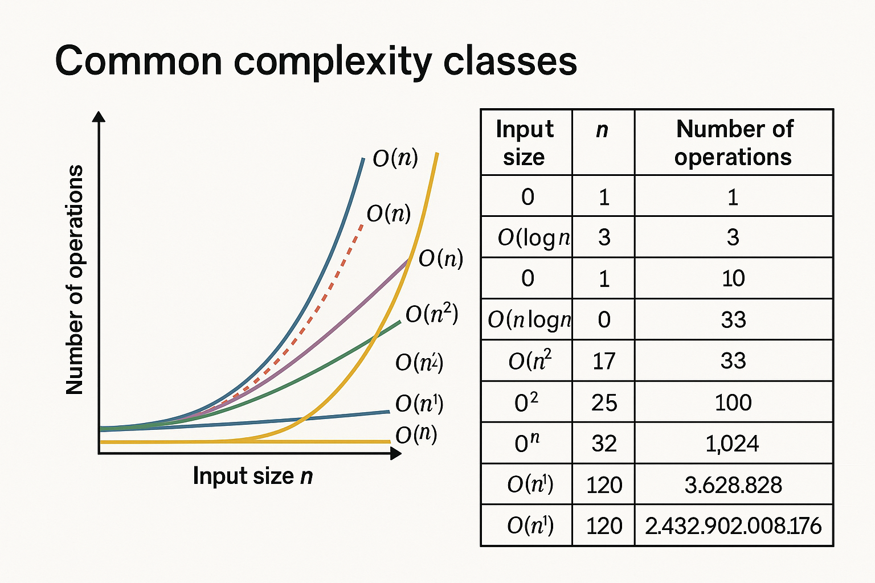
Comparing Orders of Magnitude

Slide 12
Example Analysis 1: Simple Loop
``` for i in range(n): print(i) ```
Time complexity: O(n)
One operation per iteration. Similarly, nested loops multiply their complexities. Therefore, the runtime of the program increases proportionately to the input size.
Each loop iteration also does a constant-time action (printing it), so the total cost still remains proportional to the number of iterations.

Slide 13
Example Analysis 2: Nested Loop
``` for i in range(n): for j in range(n): print(i, j) ```
Time complexity: O(n^2)
Total operations: n*n
Nested loops does the multiplication of the number of operations that leads to its quadratic growth. Each iteration of the outer loop also triggers the full iteration of the inner loop.
Nested loops are the classical case of polynomial time complexity.

Slide 14
Example Analysis 3: Log loop
``` i = 1 while i < n: print(i) i *=2 ```
Time complexity: O(log n)
Explanation: On each iteration, the i doubles. Obviously, the loop covers i to n in far less steps. After k iterations, i = 2^k. The loop will continue as long as 2^k < n. Thus, k < log(2) n. Thus, any loop where variable increases or decreases by a constant factor per iteration will have a logarithmic efficiency.

Slide 15
Example Analysis 4: Linearithmic
``` for i in range(n): j = 1 while j < n: print(i, j) j *= 2 ```
The outer loop runs n times, which contributes as O(n). The inner while loop, the j doubles every iteration until j >= n. So the total number of iterations will be log(2) n. The total time complexity of the algorithm will be – T (n) = O(n) * O(log n) = O(n log n).

Slide 16
Example Analysis 5: Constant Time
``` print(“Hello”) print(2 + 3) a = 2 print(a) ```
Such statement or expressions take constant time during the implementation of the logic.
Therefore, the time complexity would be: O(1).
When, such statements are added to loops or complex algorithms, they do not add any complexity in the existing algorithm.

Slide 17
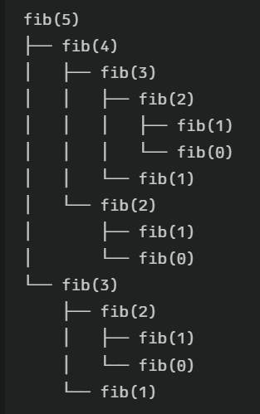
Recursive Time Complexity
Fibonacci example: ``` def fib(n): if n <= 1: return n return fib(n-1) + fib(n-2) ```
This generates recurrence relation – T(n) = T(n-1) + T(n-2) + O(1)
We follow a recursive tree structure. Eg. n = 5.
Thus, there will be total 2^n calls.
T(n) ~ 2*T(n-1) = O(n^2)

Slide 18
Overview of Searching Problem
It is a fundamental computational challenge where a given set of items the goal is to locate a specific target value. At its core, the problem lies in the domain of a broader class of search problems. We can think of this as a binary relation: for a object x (list), find y (index of target) such that specified relations holds.
Input | Generally, list of items, and a target value.
Output | If found, return the index of target, else, -1.
State Space | All possible positions of the list.
Goal Test | Does the current item is equal to the target.
Strategy | Systematic exploration in the search space.
Evaluation Metric | Completeness, time/space complexity, optimal or not.

Slide 19
Linear Search
``` def linear(arr, x): for i in range((len(arr)): if arr[i] == x: return i return -1 ```
It has a simple implementation. Works on unsorted data. Gives best performance for small and unsorted datasets.
Time complexity: Best – O(1), Average and Worst – O(n)
Space complexity: O(1)

Slide 20
Binary Search Implementation
``` def binary(arr, x): low = 0 high = len(arr) – 1 while low <= high: mid = (low + high)//2 # Why //? if arr[mid] ==x: return mid elif arr[mid] < x: low = mid + 1 else: high = mid – 1 return -1 ```

Slide 21
Binary Search Explanation
Binary Search is a classical example of divide and conquer algorithm. It works efficiently by splitting the problem in half at each step. It locates the target value in a sorted array, it divides the search interval in half iteratively. At each step, it compares the target value to the middle element and then eliminates the remaining half of the elements.
Essential Requirement: Array must be sorted.
It is much faster for sorted large datasets. The total number of comparisons grows slowly as the n increases.
Case | Time Complexity | Space Complexity
Best | O(1) | O(1) (iterative)
Average | O(log n) | O(1) (iterative)
Worst | O(log n) | O(1) (iterative), O(log n) (recursive)

Slide 22
Brief Overview of BST (Binary Search Tree)
BST is a binary tree where each nodes’ left child will contain values less than the node, and higher values will be in the right child.
For searching, we can locate the value by recursively comparing the nodes values and then traversing either left or right sub-trees. We can add a new value by finding the leaf position again based on comparison. While deleting a node, we have to handle three cases separately – no child, one child, or two children.
The application of the BSTs are majorly efficient in lookup tables, dynamic sets, and priority queues implementation.

Slide 23
Real-World Applications of Searching
Lookup in the large database.
Word search in a linguistic dictionary.
Key-value pair search in a python dictionary and other related applications.
Indexing
All of it depends on choosing the right algorithm for the given problem statement. It depends on various factors like – input size, frequency of search problems, data mutable/immutable, space vs time trade-off dependent on the algorithm implementation.

Slide 24
Amortized Analysis
Amortized analysis calculates the average cost of the operation over a sequence, even if the individual operations are expensive.
Dynamic Array Behaviour: It starts with a fixed capacity. When it gets full a new array of double the size of elements gets created.
Amortized Cost: n simple iterations with n cost, copying during resize as per the sequence < 2n. Total cost is 3(O(1)).
Doubling leads to geometric growth. It ensures that the copying cost forms a convergent geometric series, limiting the cost to O(n).
Thus, by resizing strategy like doubling and amortized analysis, the dynamic arrays has efficient average performance even though the array itself has costly operations.

Slide 25
Master Theorem
The Master Theorem provides a framework that helps to determine the asymptomatic time complexity of the divide-and-conquer algorithm. The recurrences are shown in the form of – T(n)=aT(n/b)+f(n) where, a >= 1, b > 1, and f(n) are the cost of operations that are non-recursive.
This theorem compare the equation f(n) to n^(log⁡(b)a), to classify the solutions into three distinct cases (discussed in the next slide).

Slide 26
Concepts of Master Theorem
Critical Exponent: log(b) a helps to determine the dominant relationship between splitting/combining costs and the recurrence relation.
Regularity Condition: It helps to establish the geometric decay in the third case of Master Theorem.
Limitations: It cannot be applied to non-divide-and-conquer relationships. (Eg. T(n) = T(n-1) + f(n).
The Master Theorem helps to simplify in the analysis of algorithms like matrix multiplication, merge sort, binary search, etc.

Slide 27
Example:
Merge Sort Recurrence – T(n) = 2T (n/2) + O(n) a = 2, b = 2, log(b)a = 1, f(n) = O(n). Therefore, f(n) = Θ (n^(log(b)a))
Thus, the time complexity of merge sort is: Θ(n log n).

Slide 28
Revision: Space Complexity
It refers to the space used by the algorithm which itself is the function of input size.
``` def sum(arr): total = 0 for x in arr: total += x return total ```
Time Complexity: O(n)
Space Complexity: O(1)

Slide 29
Exercises
What is the time complexity of binary search?
Given an algorithm, find its complexity – ``` for i in range(n): for j in range(n): for k in range(10): print(i, j, k) ```
Given an algorithm, find its complexity – ``` def foo(n): if n==0: return mystery(n//2) ```

Slide 30
Exercise (contd.)
Let T(n) = 2T(n/2) + n/log n. Verify if or not we can find the complexity of T(n) using master theorem or not.
Let T(n) = T(⌊n/2⌋) + T(⌈n/2⌉) + n. Derive the tight Θ bound for T(n). How will you solve it using recurrence tree or expansion.
Find the time complexity of T(n) = 3T(n/4) + n log n (Use: Master Th.)
Two algorithms are given as follows –
A: T(n) = 4T(n/2) + n
B: T(n) = 2T(n/4) + n^2
For large n, which algorithm is asymptomatically faster? Justify your answer with the proof derived from master theorem.

