Slide 1
Shipping Delays
IST 718
Jogesh K Pugazhendhi
Myles Wentworth
Brandon Reyes
Leonidas Garcia

Slide 2
Overview
Supply chain logistics creates lots of data. There is collaboration between various departments in the logistics department to coordinate and ship products ordered by customers.
There are various systems that are used in this process that create details of a shipment and monitor the shipment at various times until it is delivered to the customer.

Slide 3
Data
Shipping data from Logistics system: The data is extracted from a logistics system for a period of 5 years from Jan 2015 to June 2021 with almost half a million transactions.
Some variables include:
from_location_zipcode
to _location_Zipcode
miles driven
cost of shipping
dispatch date
delivered date, etc.
The dataset has two dimensions (from_zipcode & to_zipcode) the rest are all shipping transaction metrics.
Total number of attributes: 19

Slide 4
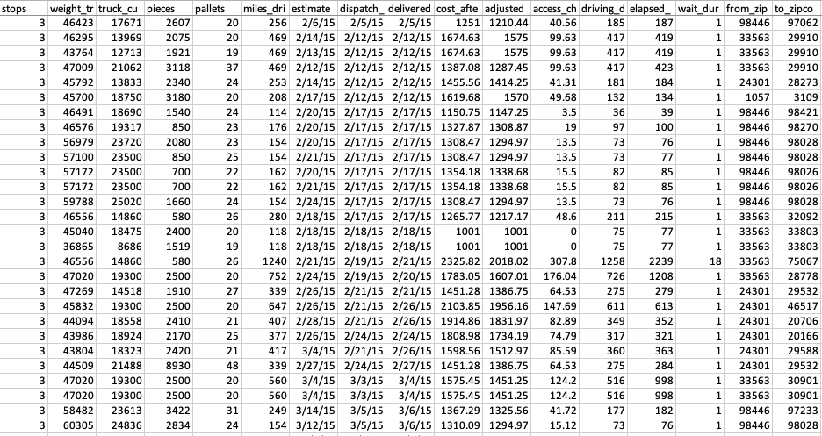

Slide 5
Additional Data
There will be additional variables derived from our dataset to know:
number of days between estimated ship date and actual ship date
time it took to deliver dispatch date and delivered date
distance between from and to_zipcode (to understand the actual miles driven and if this distance value affects any of the other metrics)
Average Crude Prices: Since logistics have a direct relation to crude oil prices, the data for average crude prices by month/year will be joined to the logistics dataset on the shipping date to understand if there has been a linear progression between oil prices and cost of shipment
Season: This dataset will benefit from having day to day weather information for all zip codes. Since historical weather data by zip code was difficult to obtain, seasons of the year will be added based on the month of shipping
Inflation Rate: Adding inflation data by year and month from 2015 to 2021 to understand if the inflation rate has any effect in any of the other metrics

Slide 6
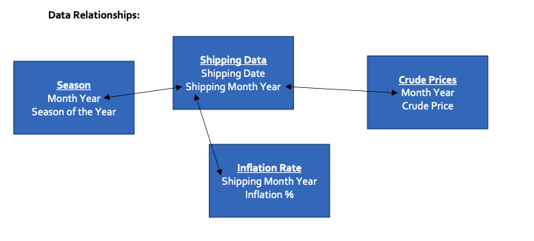

Slide 7
Problems attempting to solve
Was there any delay in shipping for certain transactions? If so, what factors might have contributed to delay in shipping so we can prevent delays in the future?
Predict number of delay days for a shipment
Predict cost of shipment based on historical data

Slide 8
Were there shipping delays?
Majority of shipments are on time (89.3%)
Of those delayed, most are by one day (7.8%)
Occasional delays of 2-5 days (2.8%)
Very rare delays of > 5 days (0.1%)

Slide 9
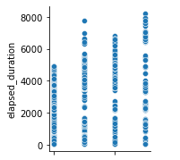
If delayed, why?
Possible factors?
Number of stops
Truck Weight
Number of Pallets
Duration of Shipment
Days Delayed

Slide 10
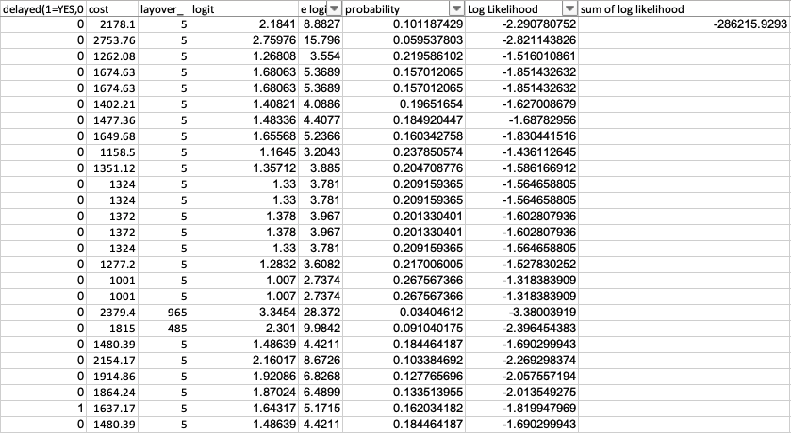


Attempt at Logistic Regression for predicting delays
P(delayed=1)=(e(28.94870145+100*52687.0902+10*7285.602768))/(1+e28.94870145+100*52687.0902+10*7285.602768))

Slide 11
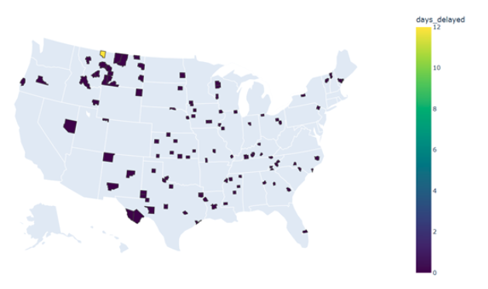
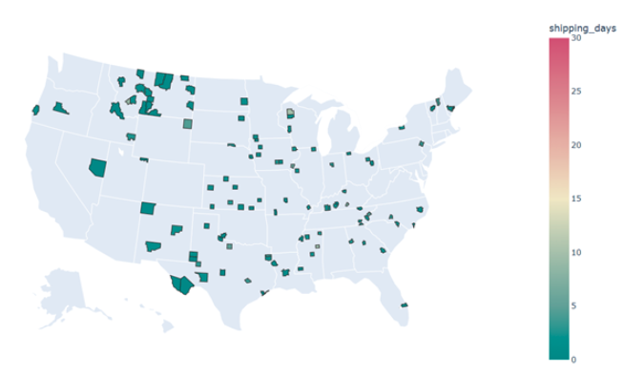
Trends and observations
Delay Days by Zip Code
vs
Average Shipping Days by Zip Code
Notes:
Pretty much the same everywhere for days delayed except for a a small area in Montana near the Canadian border, and for shipping days we do also see uniformity aside from an area in Wisconsin, Mississippi and again in Montana

Slide 12
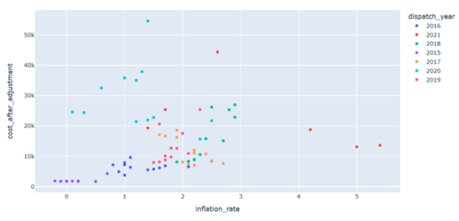
Inflation vs Cost
Notes:
This shows the relationship between cost and inflation rate, which doesn’t give us any visible correlation although it is interesting to note that for 2020, even though the inflation rate was near the average for all years, it showed a much higher cost than the all the others. Covid may have very well been the culprit here. Less people available to work or willing to work, so companies probably needed to give out incentives so they wont go out of business.

Slide 13
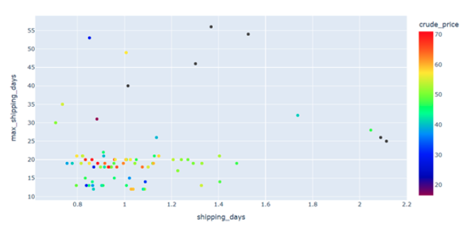
Shipping Days vs Maximum Shipping Days Vs Crude Price
Notes:
How do crude prices affect shipping days? Again no real trend here. As crude prices went up, the amount of days it took to ship either decreased or hovered around the same for other crude price rates. We see ship days increase when the crude prices decrease.

Slide 14
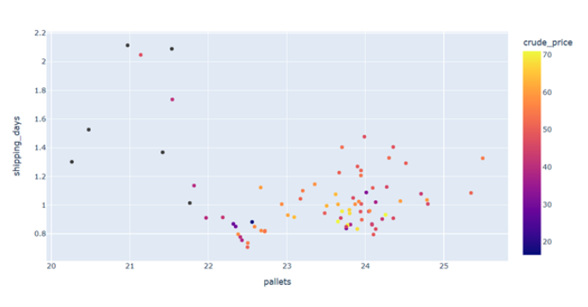
Number of Pallets vs Shipping days Vs Crude Price
Notes:
So how do the number of pallets relate to days it takes to ship and the crude prices? Well we see a cloud around 23-25 pallets and 0-1.5 days of shipping. Although the crude prices are high, they stay within 0-1.5 days for maximum amount of pallets. We see some cases of shipping days rising when crude prices drop, the number of pallets also drops for these cases so that was quite interesting. Let’s take a look at the trend of crude prices over the years

Slide 15
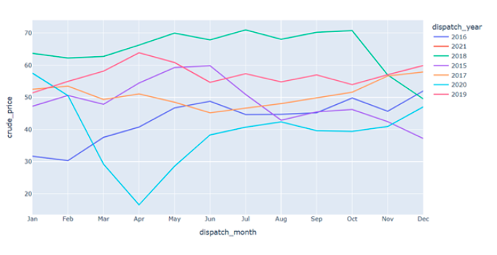
Crude Prices Trend
Notes:
We see a rise in crude prices for 2015, a dip in 2016, a small rise in 2017, 2018 started as the all the time high for the past 6 years, but fell below 2019’s top of the year start, the biggest change we see is in 2020, which makes sense because of covid-19. Now let’s see what the rend has been for shipping days throughout the years

Slide 16
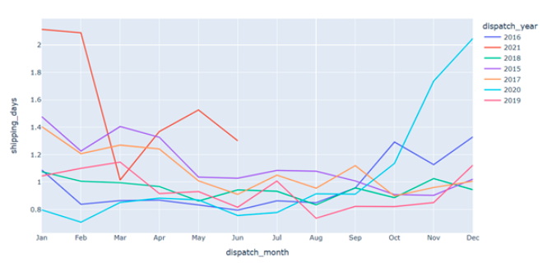
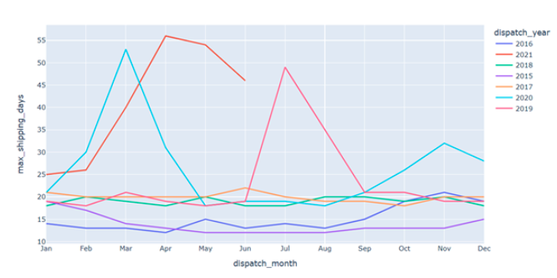
Shipping Days Trend
Notes:
All kind of hover around the same amount of ship days throughout the years, staying between 0-1.5 days, with the exception of the end of 2020 taking a leap up to 2 days. We have limited data for 2021, but we can see it started of above 2 days and has since dipped into the average of the past 5 years. What trend does the cost follow throughout the years?

Slide 17
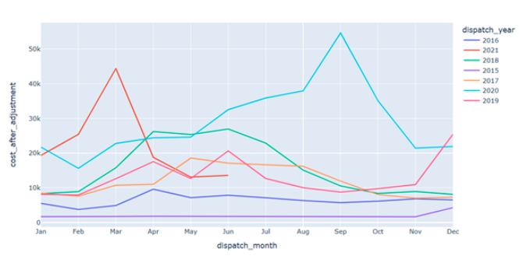
Cost Trend
Notes:
Again, not too much happening here except for 2020 which we already expect. Let’s take a close look at 2020 and see what all these metrics look like stacked on one another

Slide 18
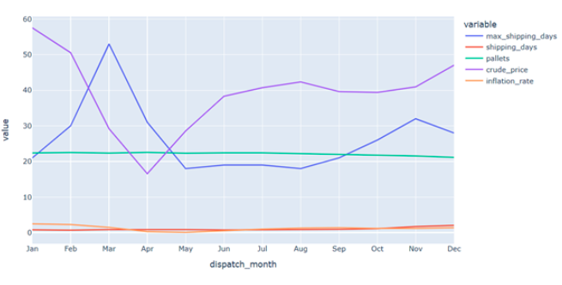
Comparing metrics for 2020
Notes:
Shipping days, inflation rate, and pallets, stayed pretty constant throughout the year, but we saw an inverse relationship between crude prices and maximum amount of shipping days, which leads us to believe crude prices definitely affect how long orders take to ship. Now Jogesh will take it away with our time series analysis

Slide 19
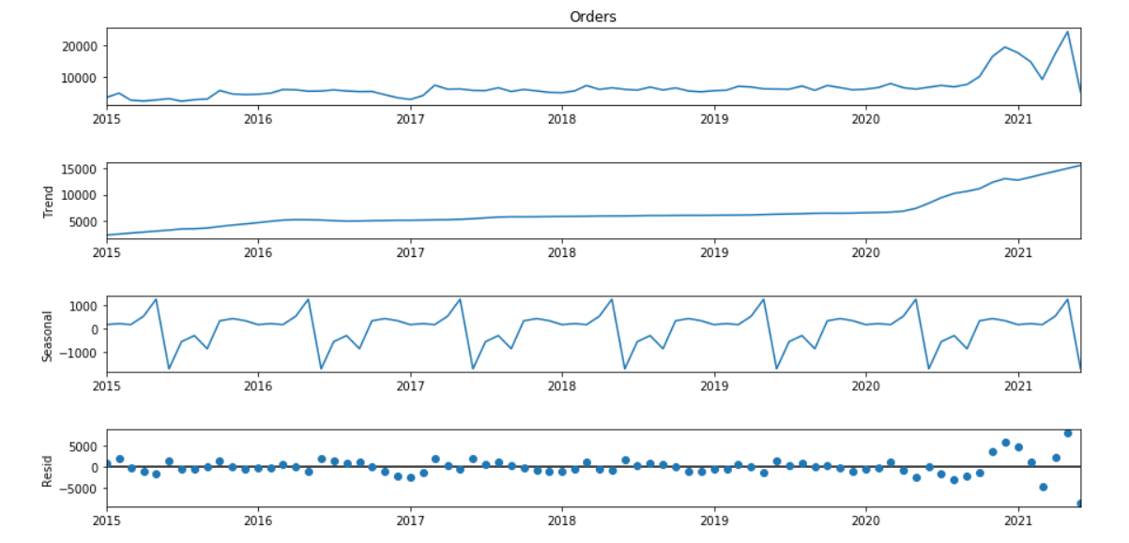
Time Series Model – Predicting Number of Loads per month (Seasonal Decompose)

Slide 20
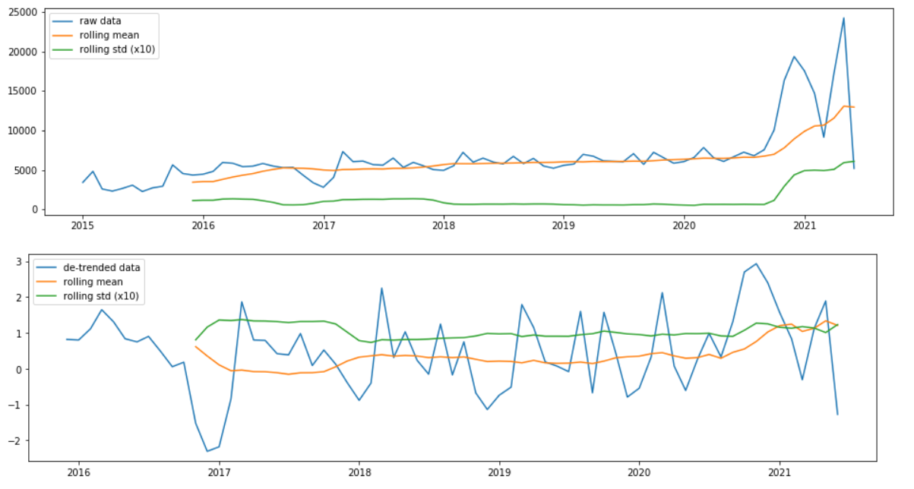
Loads per month (ADF Test)

Slide 21
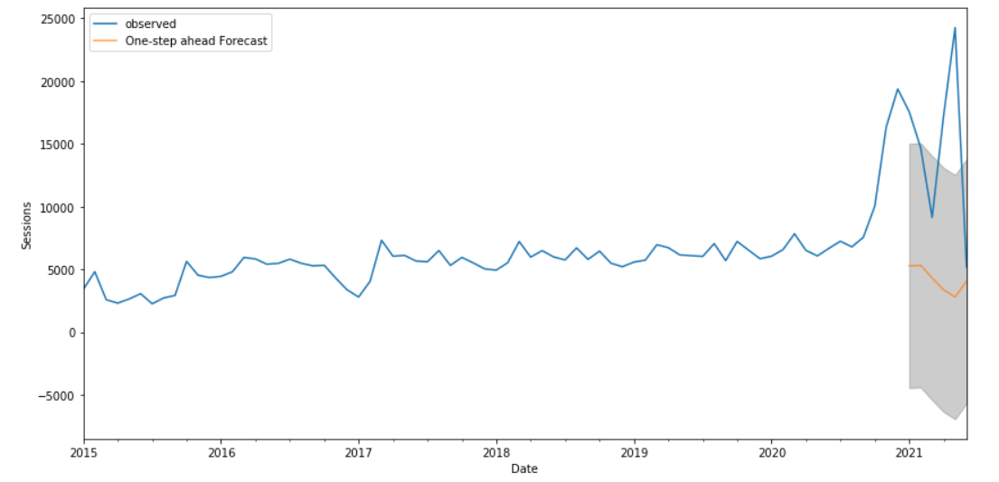
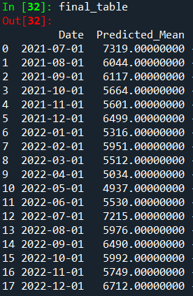
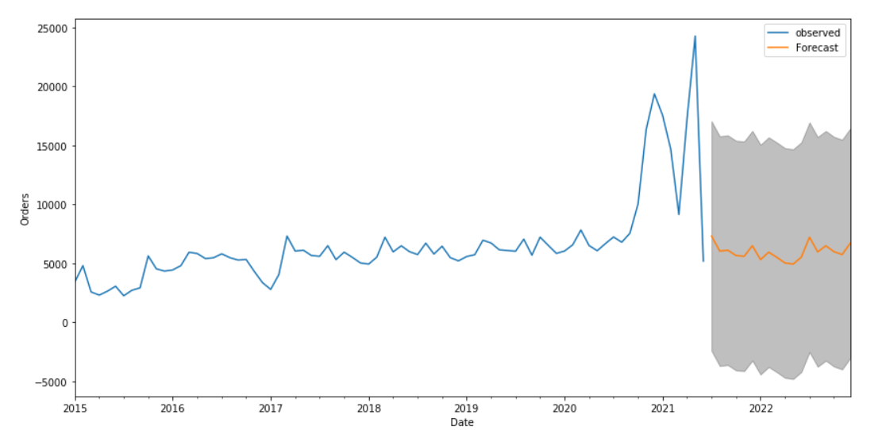
Loads per month (Compare Train Vs Test and Forecast)

Slide 22
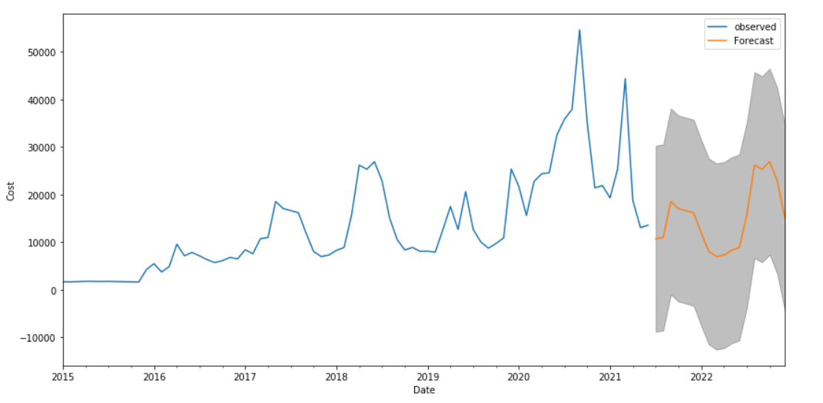
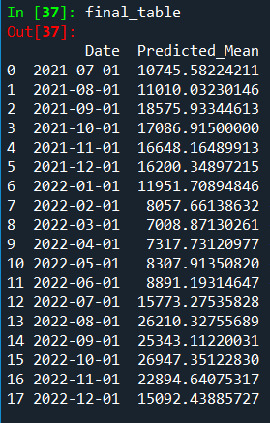
Cost Prediction

