Slide 1
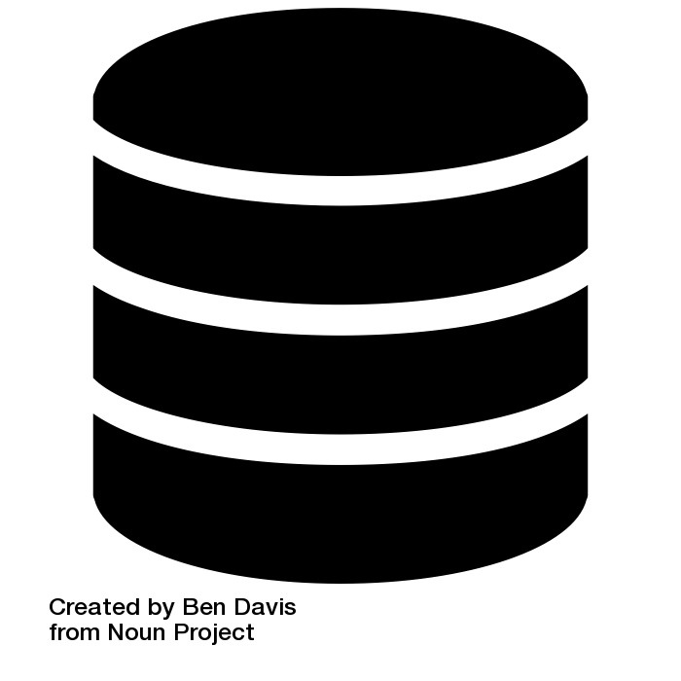




Dear Data, tell me a story …
by Rachel Brabender and Oliver Clasen
Welcome to the world of data. Nowadays, modern computer systems (e.g. your mobile phone, car and small robots) are collecting tons of data on what is happening in their environment. Such data provides much information about the people and their passions. Companies have already realized the power of such data by analyzing them. Now we want to explain to you how this data can tell a story.
Let’s think of a handsome example.
You are a passionate
diy enthusiast
and in need of a grinding machine for your homemade table project. Recently, you have noticed that not far away from your place, there is a rental store where you could probably borrow it for a few hours.
Since the rental store has to be aware of which of his inventories are currently lended, they save all necessary information in a database.
Perhaps, you can imagine how much data is generated if you consider the amount of inventories the store or even the business chain may offer. This data is saved in very big information systems and waits to be used. Potential application scenarios are analyzing all rentals, on which inventories are from high demand, so that the store can be retrofitted onto the popular ones. As a result, this could improve the image of the store because of the higher availability of popular machines and enhances the customer satisfaction.
Before digging deeper into the usage of such data, let’s have a look on the rental workflow. It could look like this:
When the customer creates a rental order involving the several inventories, it is also considered as the starting point of the rental.
Based on all recently created rental orders, the store will create invoices.
The customer must pay his open invoices.
The store receive your payment, and will confirm the invoice, and
will confirm the rental order.
Now the customer can lend his requested inventories,
or probably cancel an inventory from his rental order.
If the customer has picked up all requested inventories, he will return them at a later point in time.
When the inventories are returned, the store will inspect them, since they might have suffered from damage.
In the case of a damage, the store will create a new invoice,
which the customer has to pay,
so that the store can confirm it.

Slide 2


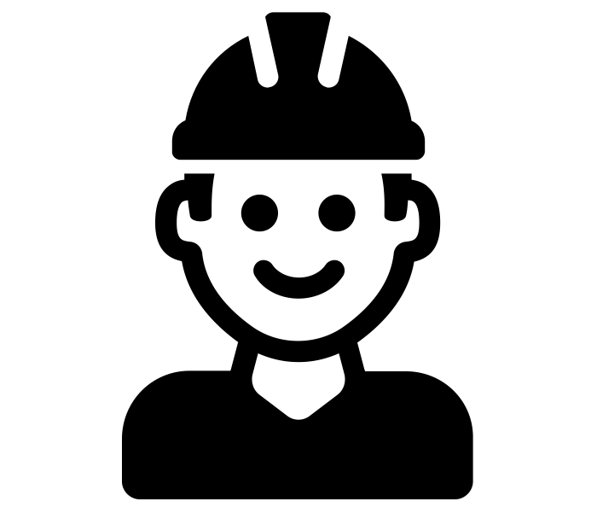
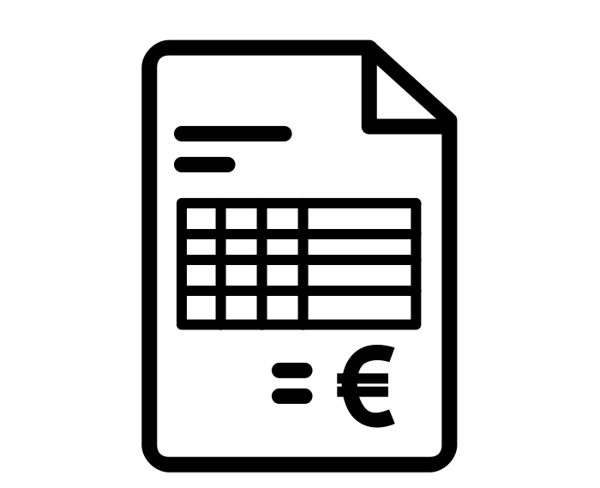
Cancel Inventory
OR
END
Create Rental
Pay Invoice
Confirm Rental
OR
Create Invoice
Return Invoice
OR
Create INVOICE
Confirm Invoice
Lend Inventory
Return Inventory
Inspect Inventory
Pay Invoice
A well-organized store is aware of the customers rental requests for specific inventories, and knows in which step of the rental process the customer currently is. Therefore, we store such information about performed activities in form of adding or updating information related to an object (e.g. rental, inventory, invoice, customer, staff or inspection) in the database.
When thinking about the process, please be aware of the following restrictions:
Each of these actvities do not involve all objects at the same time. As for example, create rental and pay invoice doesn’t involve a staff member and inspect inventory doesn’t consider the customer and is performed by a staff member.
Be aware that a rental can involve more than one inventory at the same time. An invoice is always created for one rental.
You can deal with multiple rentals (in form of picking them up all together from the store) and multiple invoices (in form of paying them all together) at the same time. The store e.g. creates invoices for all created rentals, confirms all received payments/rentals and inspect multiple inventories of the different rentals at the same time.
Customer
Rental
inventory
Inspection
Staff
Invoice
As you can see, the rental procedure is far more complex than it seemed in the beginning. Furthermore, inventories are not only just rented or not, they might be already requested by a customer, so that we could not reserve or hand it out to someone else for the moment. A common technique for structuring the information is to create an own table within the database for each object type of that process. The complex dependencies between our objects (a customer creates a rental which involves multiple inventories, and the store creates an invoice for each rental) is also visible in our database. For realizing such dependencies, we make a reference within an inventory entry to the belonging rental. The disadvantage is that information, such as about the customers, rental requests and related invoices, is distributed over different database tables.
2

Slide 3

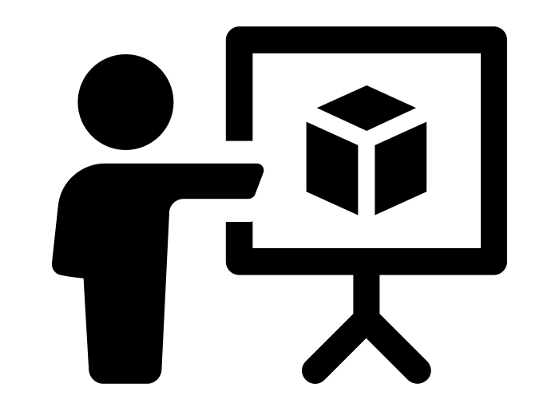

Today, one of the biggest challenge when describing a process flow is that one object can be involved in different activities and one activity can include several objects.
How could we get an idea of the procedure for a rental, an inventory, a staff member, the customer or even of the invoices?
A baseline approach for deriving a process flow from a database is to consider the perspectives of the object types. Therefore, we collect all activities for an object from the considered type, where it is involved and sort the activities by their timestamp.
Inspired by that approach, we thought on how the process flow would look, if we consider multiple object types at the same time instead of one. Thereby, you could easily derive where two objects are interacting with one another. Here, you would collect all activities, where both objects are involved at the same time.
So smart these ideas may appear,
they also bring problems with them.
And here, we realize, that there will be no perspective, which comprises all activities since not all objects are always included within the performance of an activitiy at the same time. It only gives the possibility to understand how these objects behave. But there is no perspective which comprises all activities. Considering multiple object types at the same time, it visualizes the interactions between the object types and thereby generates a specific view on the process. Here, it helps to understand the complex dependencies between the objects.
As you remember, multiple different objects may be involved in the same activity. When collecting the activities for each object instance, there will be some activities which will appear more than once for each object instance and are separately saved (this behavior is called convergence). As an example, I have two rental orders, and the store sends for both rentals the invoices at the same time. So both rentals are passing that activity together, but this information isn’t easily to access anymore in the end. Furthermore, if our rental involves multiple inventories, we can probably detect, that the inventories are returned one by one. The occurrence of the same activity instance within the same procedure is called divergence. If you have only a little knowledge about the procedures within a company, this might be confusing.
3

Slide 4



Event ID 234
Event ID 298
Event ID 398
Convergence = the same performed activity appears in different object type perspectives
Rental 108
Create Rental
Create Invoice
Confirm Invoice
Rental 111
Create Rental
Create Invoice
Confirm Invoice
Event ID 238
Event ID 298
Event ID 401
Divergence = the same activity type appears multiple times in the same object type perspective
Rental 103
Lend Inventory
Return Inventory
Return Inventory
Event ID 5500
Event ID 5548
Event ID 5586
When you decide to visualize the perspectives of the object types, you will never be able to recover the complete procedure as we have discussed earlier. The moment you choose a perspective (object type) you have already accepted, that you will lose information about the other involved objects which can’t be solved. That's why people are trying to create approaches to easily visualize such complex behavior of objects while to minimize convergence and divergence problems as much as possible.
We are within a conflict between completeness and clearness.
As you can see, the world of data is very deep and complex. But there are many ways to bring structure into it e.g by modelling and analyzing the renting procedures. Here, each object tells a different story.
End.
All icons are from https://thenounproject.com/
4

