Slide 1
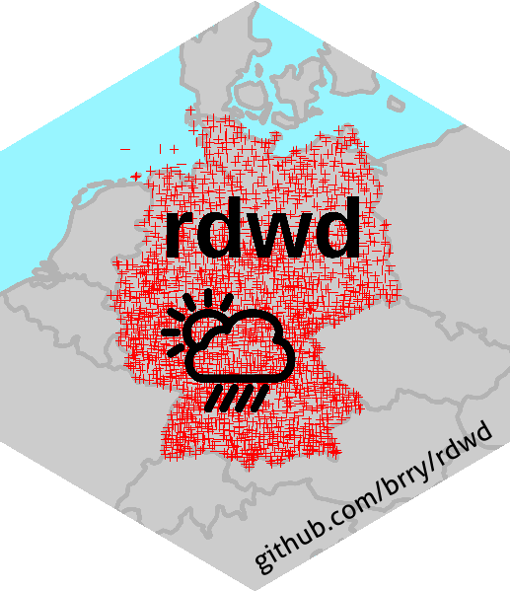
rdwd: R interface to German weather service (DWD) data
github.com/brry/rdwd
ON CRAN
select, download + read data
time series from meteorological stations
raster data from radar + interpolation

Slide 2
rdwd: handle German weather data with R
find, select, download + read data from the German weather service DWD
vectorized, progress bars, no re-downloads
index of files + meta data
observational time series from 6k meteorological recording stations (2.5k active)
-> rain, temperature, wind, sunshine, pressure, cloudiness, humidity, snow, ...
gridded raster data from radar + interpolation
european data stock slowly growing
ON CRAN
github.com/brry/rdwd

