Slide 1

Facebook’s Prophet Library

Slide 2
Let’s learn about Facebook’s Prophet Forecasting library, specifically designed to forecast the business data sets that are common at Facebook. (e.g. Daily, Minute, large data sets)

Slide 3
Make sure to check out the full paper explaining how Prophet works!
It’s a short read (~25 pages) and explains clearly how Prophet operates internally.
Forecasting at Scale by Sean Taylor and Benjamin Letham

Slide 4
Keep in mind this library is not meant to be “better” than any of the ARIMA methods we saw before, it is just an alternative for you to explore.

Slide 5
At its core, the Prophet procedure is an additive regression model with four main components:
A piecewise linear or logistic growth curve trend. Prophet automatically detects changes in trends by selecting changepoints from the data.

Slide 6
At its core, the Prophet procedure is an additive regression model with four main components:
A yearly seasonal component modeled using Fourier series.

Slide 7
At its core, the Prophet procedure is an additive regression model with four main components:
A weekly seasonal component using dummy variables.

Slide 8
At its core, the Prophet procedure is an additive regression model with four main components:
A user-provided list of important holidays.

Slide 9
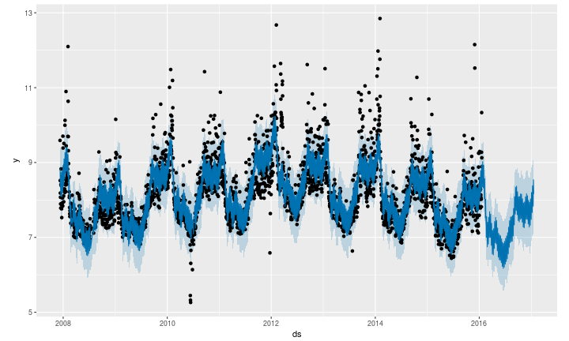
Prophet only requires a few lines of code to produce its forecast results:

Slide 10
Let’s being to explore how we can use Python with the Prophet library!
Make sure to read the installation instructions in the first notebook carefully!

Slide 11
Prophet
Forecast Evaluations

Slide 12
Prophet
Trend Changes

Slide 13
Prophet
Changing Seasonality

