Slide 1
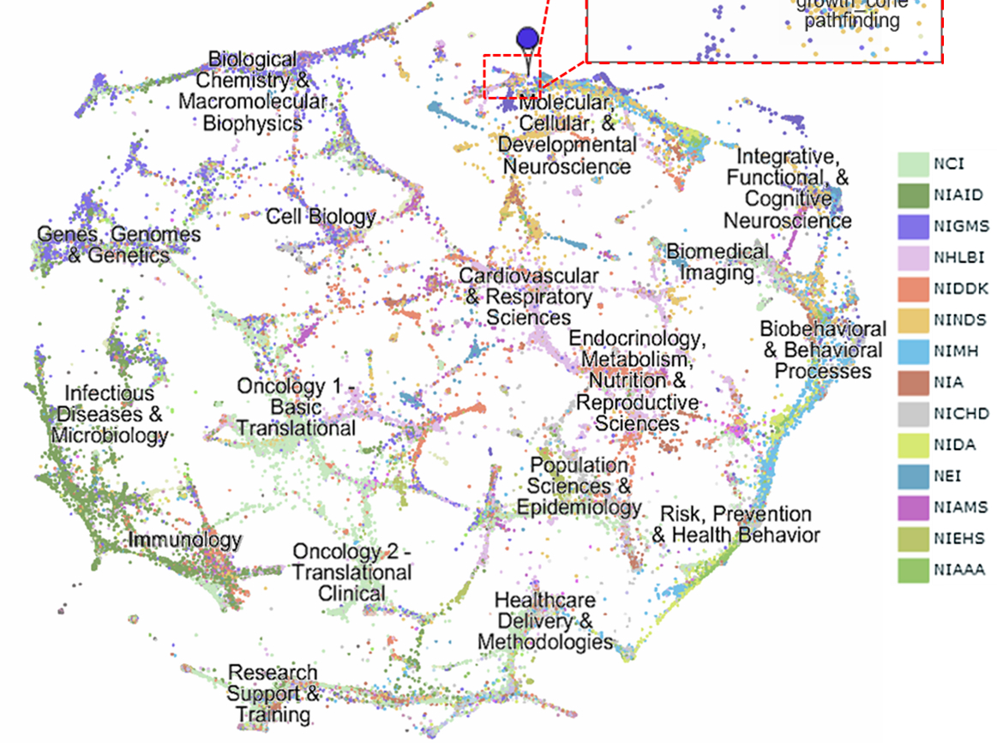

Visualization tool depicting
topical analysis on presidential
documents
By: Chetan Mishra and Sugandha Agrawal

Slide 2
Why should we make this tool?
How did the focus of Bush and Clinton administrations change over time?
How would we find this out without the tool…
Maybe Google? When googling “Clinton administration important events”, one gets 1,420,000 results in 0.41 seconds. Yikes!
Search engine is powerful but something is missing…
SEARCHING AND EXPLORING DOCUMENTS BASED ON THEMES THAT RUN THROUGH THEM

Slide 3
Background
We used data from Office of the federal register
Each document contains the papers and speeches of the President of the United States that were issued by the Office of the Press Secretary during the specified time period.
probabilistic topic modeling - a suite of algorithms that aim to discover and annotate large archives of documents with thematic information.
Topic modeling algorithms
statistical methods to discover themes that, how those themes are connected to each other, how they change over time.
do not require any prior annotations or labeling of the documents—the topics emerge from the analysis of the original texts.

Slide 4
Latent Dirichlet Allocation
Formally define a topic to be a distribution over a fixed vocabulary.
for example the genetics topic has words about genetics with high probability
We assume that these topics are specified before any data has been generated
Now for each document in the collection, we generate the words in a two-stage process.
Step 1: Randomly choose a distribution over topics.
Step 2: For each word in the document (a) Randomly choose a topic from the distribution over topics in step #1. (b) Randomly choose a word from the corresponding distribution over the vocabulary.
This statistical model reflects the intuition that documents exhibit multiple topics. Each document exhibits the topics with different proportion (step #1)

Slide 5
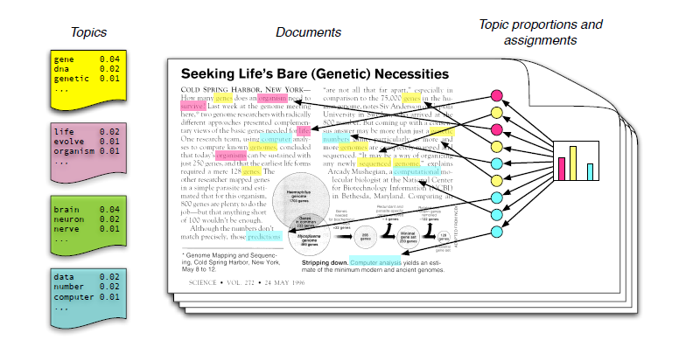
The GENERATIVE process described through an image

Slide 6
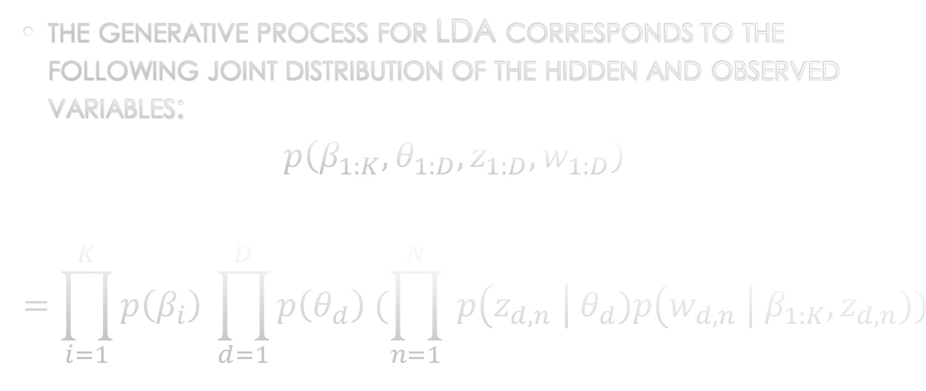
Some dreaded math…
the generative process for LDA corresponds to the following joint distribution of the hidden and observed variables:
$$p\left(β_{1:K}, θ_{1:D}, z_{1:D}, w_{1:D}\right)$$
$$=\prod_{i=1}^{K}{p\left(β_{i}\right) \prod_{d=1}^{D}{p\left(θ_{d}\right) (\prod_{n=1}^{N}{ p\left(z_{d,n} \right| θ_{d})p\left(w_{d,n} \right| β_{1:K}, z_{d,n}))}}}$$

Slide 7
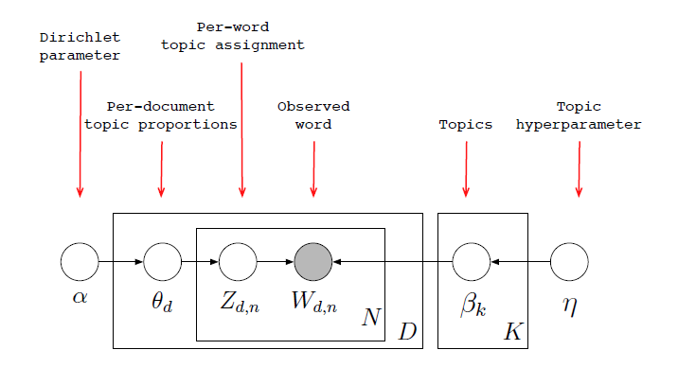
Image to help with the Dreaded math…

Slide 8
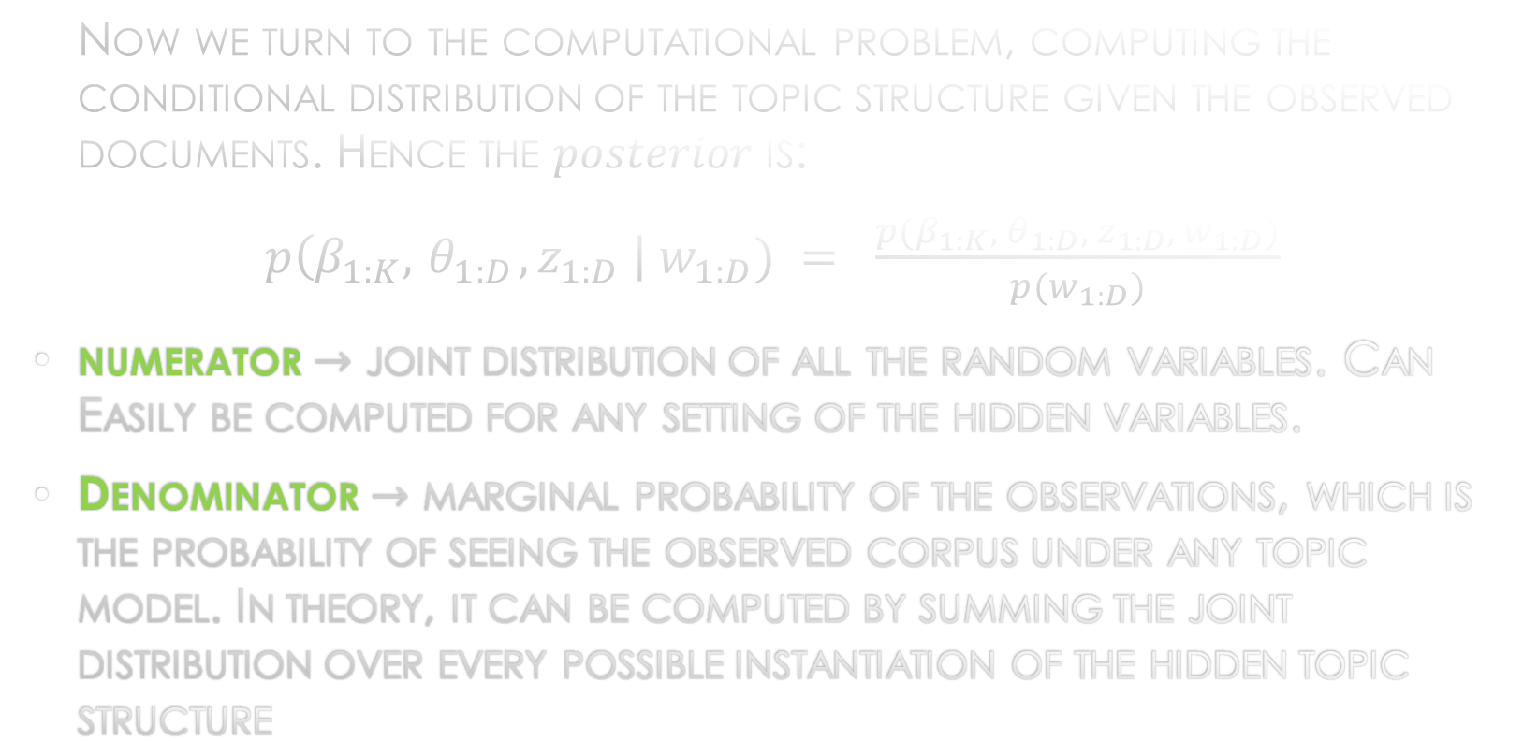
Some more dreaded math…
Now we turn to the computational problem, computing the conditional distribution of the topic structure given the observed documents. Hence the $posterior$ is:
$p\left(β_{1:K}, { θ}_{1:D}, z_{1:D} \right| w_{1:D}) = \frac{{p(β}_{1:K}, { θ}_{1:D}, z_{1:D}, w_{1:D})}{p(w_{1:D})}$
numerator $→$ joint distribution of all the random variables. Can Easily be computed for any setting of the hidden variables.
Denominator $→$ marginal probability of the observations, which is the probability of seeing the observed corpus under any topic model. In theory, it can be computed by summing the joint distribution over every possible instantiation of the hidden topic structure

Slide 9

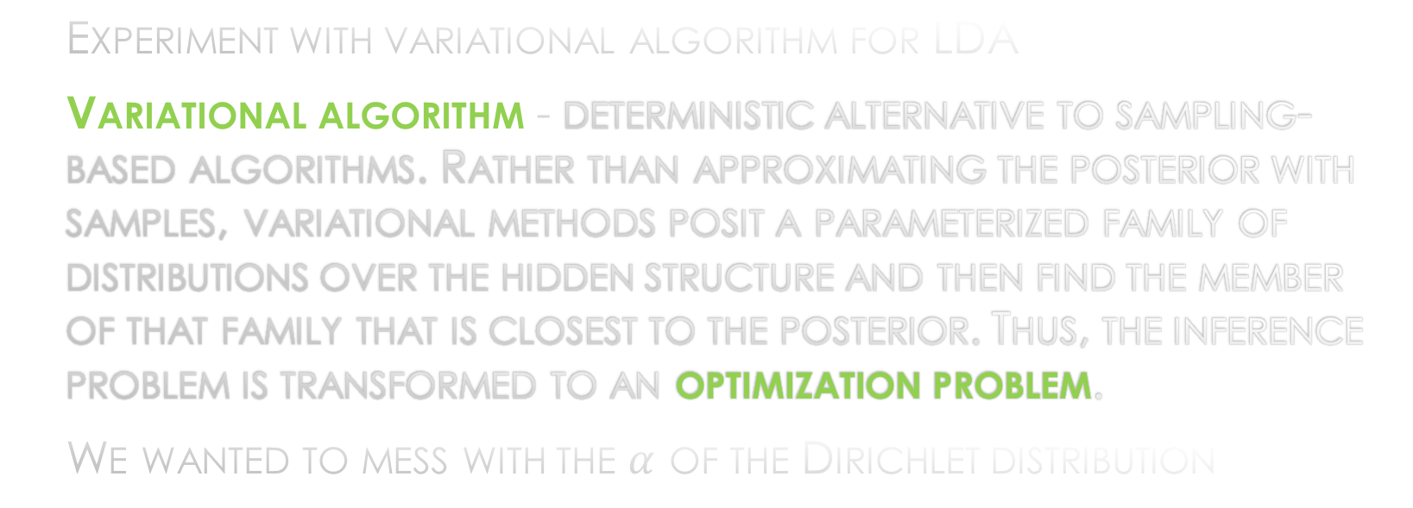
Our quest
Experiment with variational algorithm for LDA
Variational algorithm - deterministic alternative to sampling-based algorithms. Rather than approximating the posterior with samples, variational methods posit a parameterized family of distributions over the hidden structure and then find the member of that family that is closest to the posterior. Thus, the inference problem is transformed to an optimization problem.
We wanted to mess with the $α$ of the Dirichlet distribution

Slide 10
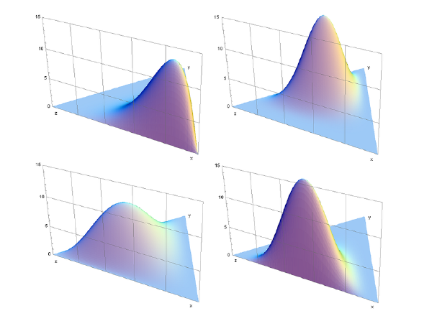
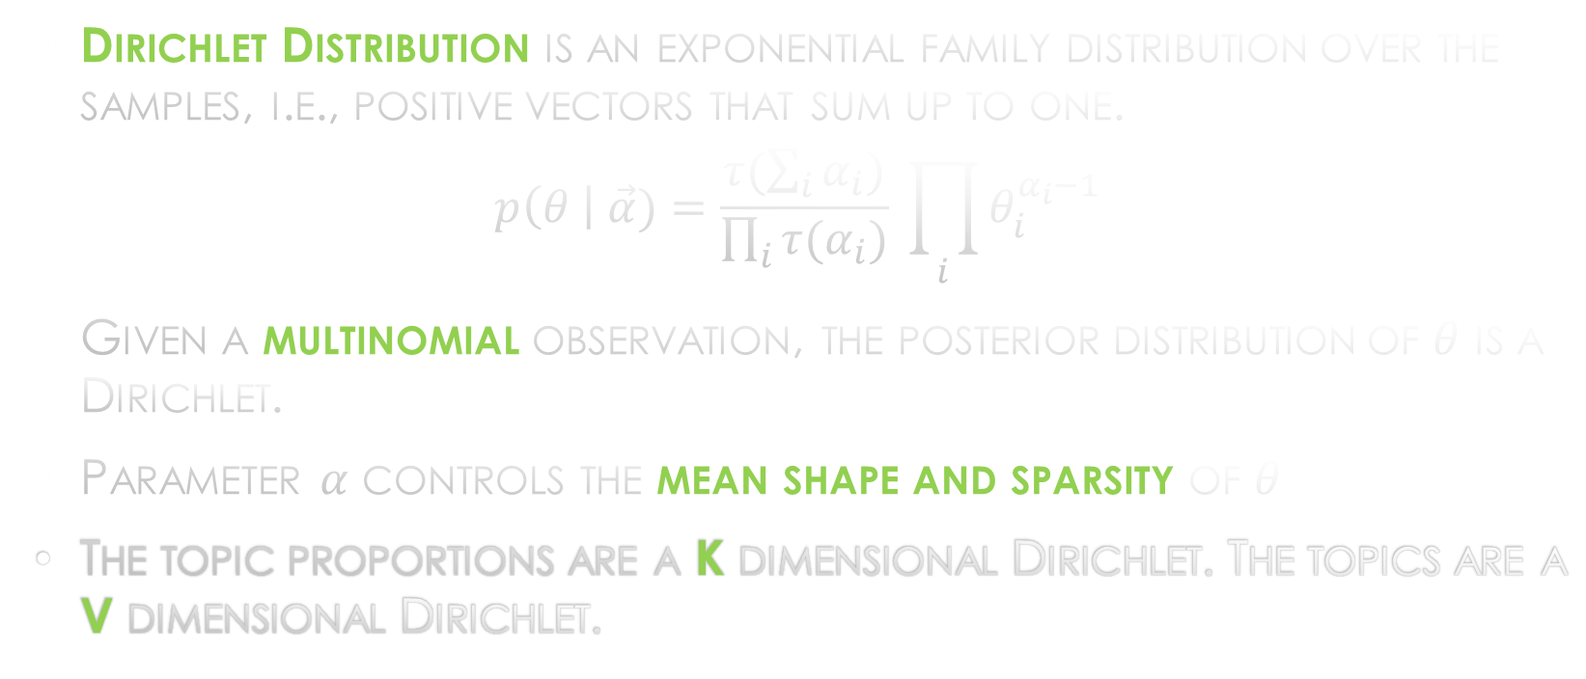
Dirichlet Distribution
Dirichlet Distribution is an exponential family distribution over the samples, i.e., positive vectors that sum up to one.
$$p\left(θ \right| \vec{α})=\frac{τ(\sum_{i}{α_{i})}}{\prod_{i}{τ(α_{i})}} \prod_{i}{θ_{i}^{α_{i}−1}}$$
Given a multinomial observation, the posterior distribution of $θ$ is a Dirichlet.
Parameter $α$ controls the mean shape and sparsity of $θ$
The topic proportions are a K dimensional Dirichlet. The topics are a V dimensional Dirichlet.

Slide 11
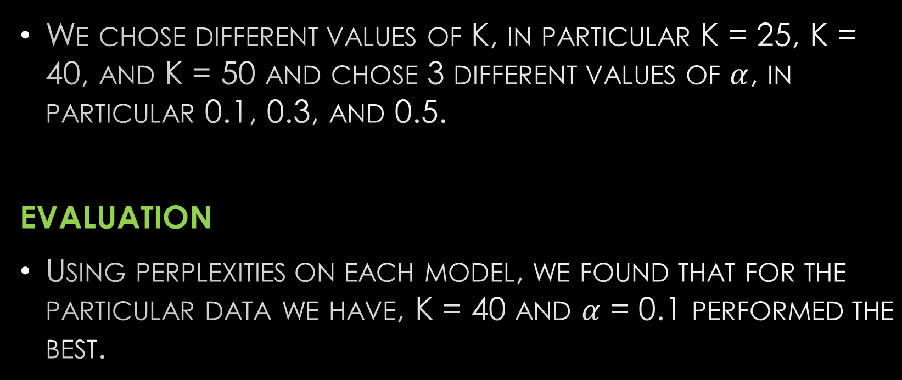
Our work
We chose different values of K, in particular K = 25, K = 40, and K = 50 and chose 3 different values of $α$, in particular 0.1, 0.3, and 0.5.
EVALUATION
Using perplexities on each model, we found that for the particular data we have, K = 40 and $α$ = 0.1 performed the best.

Slide 12
Ideas for further improvement/Future direction of Topic modeling
Explore state-of the art methods, raw and not yet fully developed, deep evaluation methods.
Model checking problem
Moreover, the hidden topic proportions implicitly connect each document to the other documents (by considering a distance measure between topic proportions). How can we best display these connections? What is an effective interface to the whole corpus and its inferred topic structure?

Slide 13


