Slide 1
Content-based
Query Auto-completion
Jason Ye

Slide 2
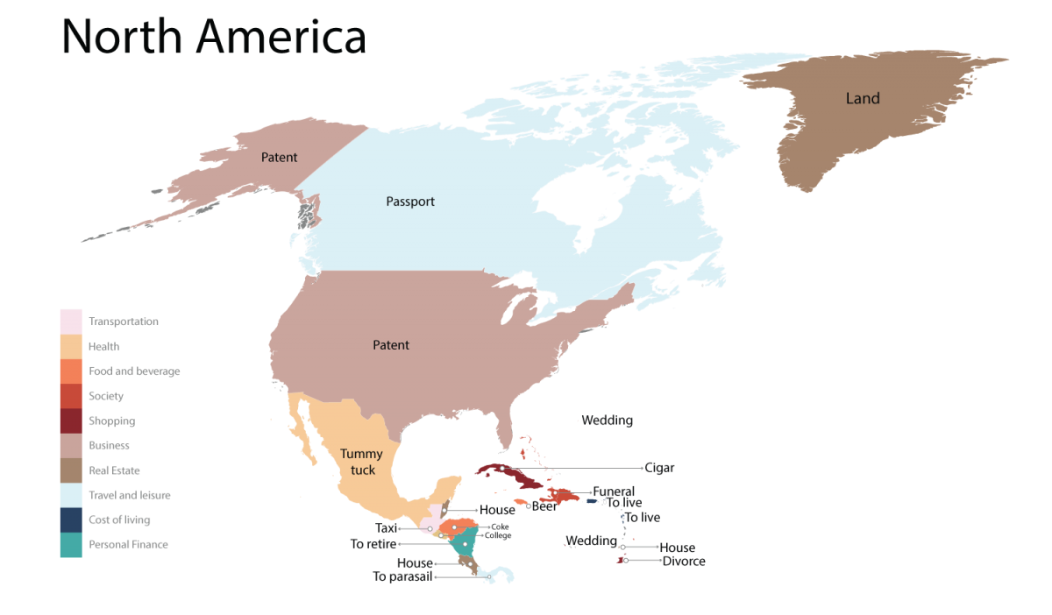
How much does * cost in [country]?
http://www.businessinsider.com/google-cost-searches-2015-4?utm_content=bufferb4577&utm_medium=social&utm_source=facebook.com&utm_campaign=buffer

Slide 3
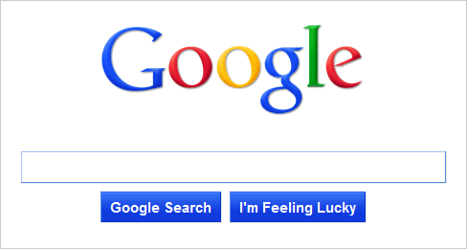

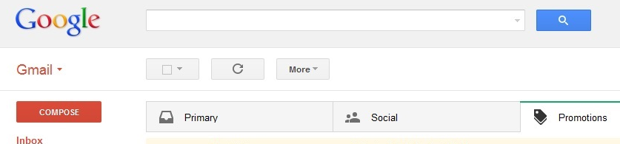

Slide 4
What data do you collect?
Crowdsourcing
Large search engines (Google)
Personal log
Facebook
Web content
Yelp

Slide 5
Project Goals
Isolate QAC to content-based data
Explore “assumptions” on content retrieval
Evaluate the effectiveness of content-driven QAC

Slide 6
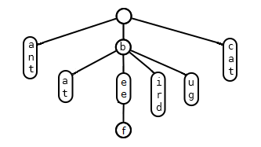
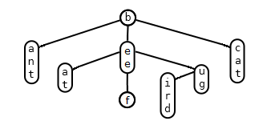
Tries and Ternary Search Trees
k pointers for alphabet size k
Lookup time: O(L)
Only 3 pointers
Lookup time: O(L*log(k))

Slide 7
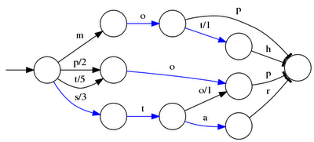
Finite State Transducer
SortedMap
Less memory

Slide 8
Lucene
Analyzer
String
Tokenizer
Filter 1
Filter 2
...
Token
Token
Token
Token

Slide 9
Content Processing
Explored:
N-grams
Feature selection
Stemming vs non-stemming
Stop-word removal (?)
Apriori algorithm

Slide 10
Apriori algorithm
Association rule learning
If “A” and “B” are seen, how likely will “C” follow?
Set a “support threshold” - 2
Review 1: {spacious, comfort}
Review 2: {spacious, comfort, window}
Review 3: {spacious, expensive}
Review 4: {window}
Word | Count
spacious | 3
comfort | 2
window | 2
expensive | 1
Word | Count
spacious AND comfort | 2
spacious AND window | 0
comfort AND window | 1

Slide 11
Demo!
Trigram QAC on Yelp Reviews

Slide 12
Evaluation
User evaluation: “eye test”
Trigrams: “readability”
Apriori: “informative”
Future implementation:
Synonym mapping

Slide 13
Conclusion
Cons
NOT a good idea to build a QAC only on content
Not flexible, does not utilize user requirements
Unlikely query formats
Pros
Context heavy websites: digital science libraries
Can lead to more accurate search results

Slide 14
Thank you!

