Slide 1
Text Categorization
Hongning Wang
CS@UVa

Slide 2
Today’s lecture
Bayes decision theory
Supervised text categorization
General steps for text categorization
Feature selection methods
Evaluation metrics

Slide 3
Text mining in general
Access
Serve for IR applications
Sub-area of DM research
Mining
Filter
information
Discover knowledge
Add
Structure/Annotations
Based on NLP/ML techniques
Organization

Slide 4
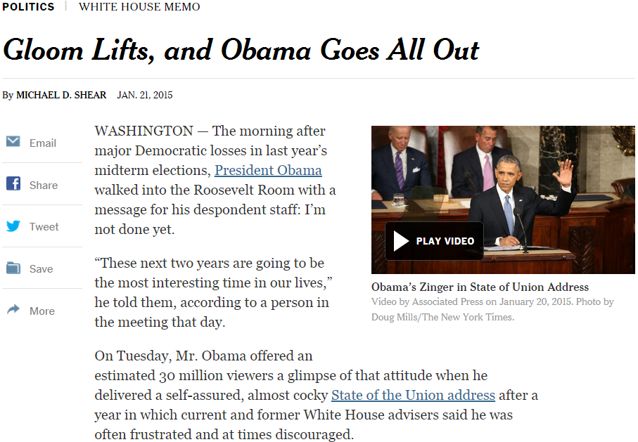
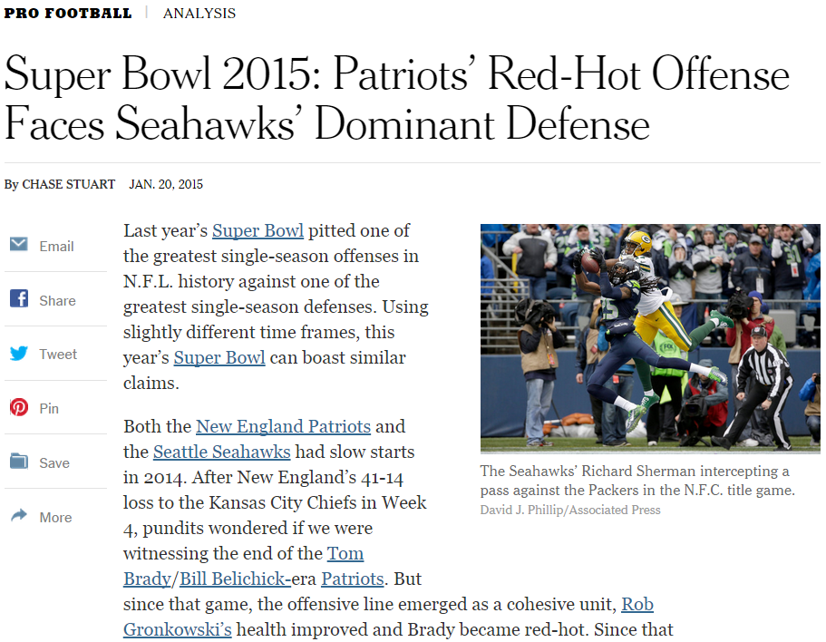
Applications of text categorization
Automatically classify politic news from sports news
political
sports

Slide 5
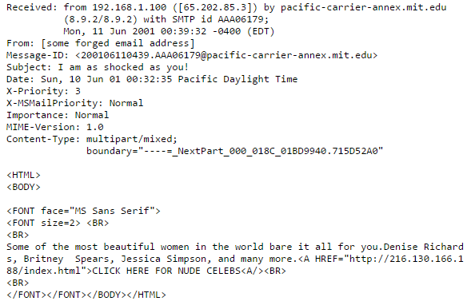
Applications of text categorization
Recognizing spam emails
Spam=True/False

Slide 6

Applications of text categorization
Sentiment analysis

Slide 7
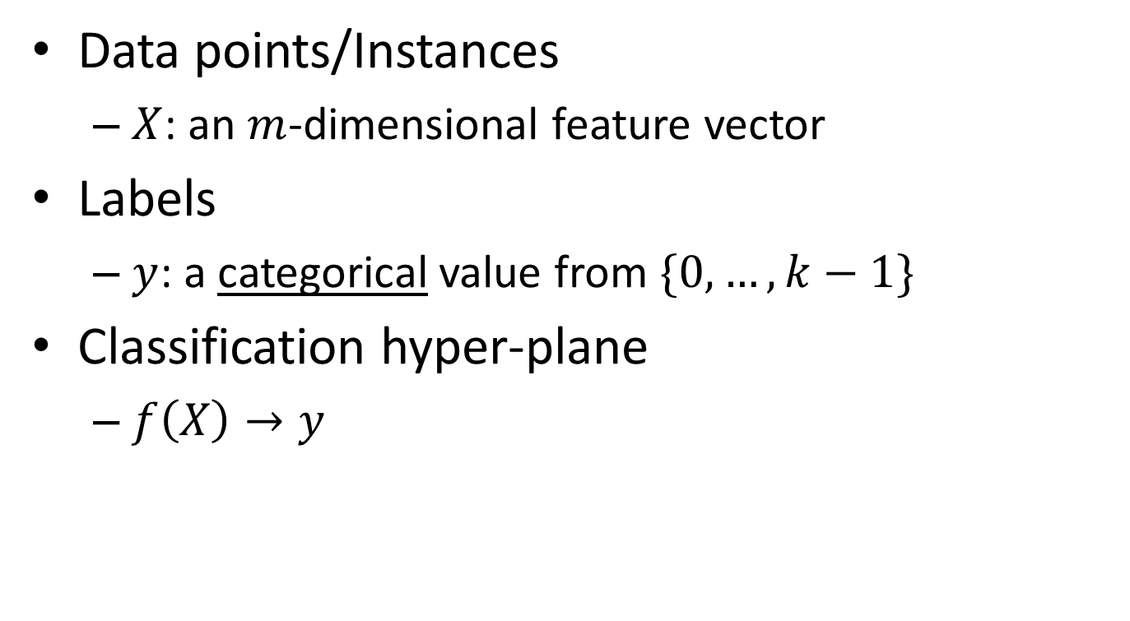
Basic notions about categorization
Data points/Instances
$X$: an $m$-dimensional feature vector
Labels
$y$: a categorical value from $\{0,…,k−1\}$
Classification hyper-plane
$f\left(X\right)→y$
vector space representation
Key question: how to find such a mapping?

Slide 8
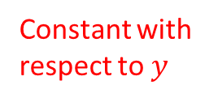
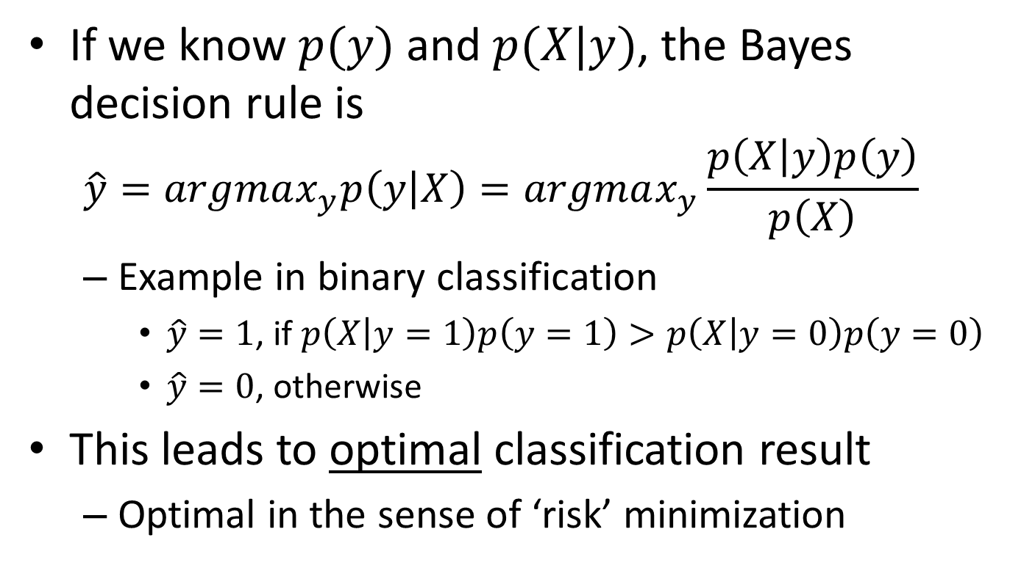
Bayes decision theory
If we know $p(y)$ and $p(X|y)$, the Bayes decision rule is
$$\hat{y}=argmax_{y}p\left(y | X\right)=argmax_{y}\frac{p\left(X | y\right)p\left(y\right)}{p\left(X\right)}$$
Example in binary classification
$\hat{y}=1$, if $p\left(X | y=1\right)p\left(y=1\right)>p\left(X | y=0\right)p\left(y=0\right)$
$\hat{y}=0$, otherwise
This leads to optimal classification result
Optimal in the sense of ‘risk’ minimization
Constant with respect to $y$

Slide 9
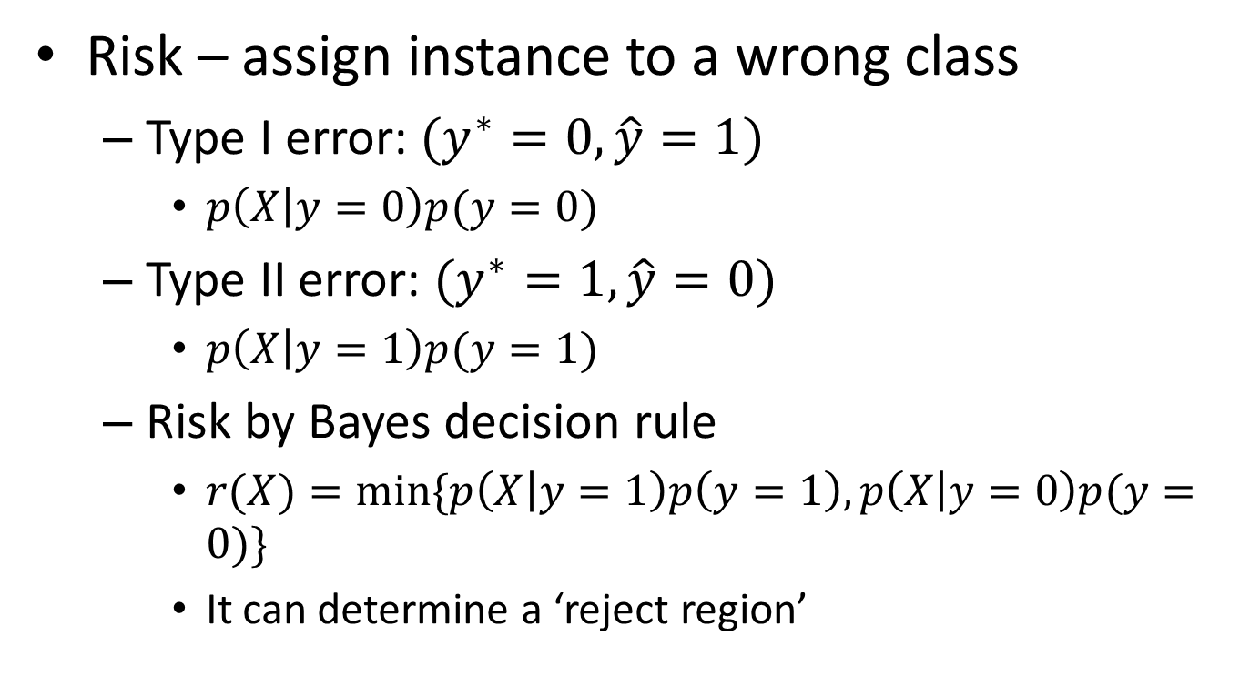
Bayes risk
Risk – assign instance to a wrong class
Type I error: $(y^{∗}=0, \hat{y}=1)$
$p\left(X | y=0\right)p(y=0)$
Type II error: $(y^{∗}=1, \hat{y}=0)$
$p\left(X | y=1\right)p(y=1)$
Risk by Bayes decision rule
$r(X)=min⁡\{p\left(X | y=1\right)p\left(y=1\right), p\left(X | y=0\right)p(y=0)\}$
It can determine a ‘reject region’
False positive
False negative

Slide 10






Bayes risk
Risk – assign instance to a wrong class
Bayes decision boundary
$$p(X,y)$$
$$\hat{y}=0$$
$$\hat{y}=1$$
$$p\left(X | y=0\right)p(y=0)$$
$$p\left(X | y=1\right)p(y=1)$$
$$X$$
False negative
False positive

Slide 11
Bayes risk
Risk – assign instance to a wrong class
$$p(X,y)$$
$$\hat{y}=0$$
$$\hat{y}=1$$
$$p\left(X | y=0\right)p(y=0)$$
$$p\left(X | y=1\right)p(y=1)$$
Increased error
$$X$$
False negative
False positive

Slide 12
Bayes risk
Risk – assign instance to a wrong class
*Optimal Bayes decision boundary
$$p(X,y)$$
$$\hat{y}=0$$
$$\hat{y}=1$$
$$p\left(X | y=0\right)p(y=0)$$
$$p\left(X | y=1\right)p(y=1)$$
$$X$$
False negative
False positive

Slide 13
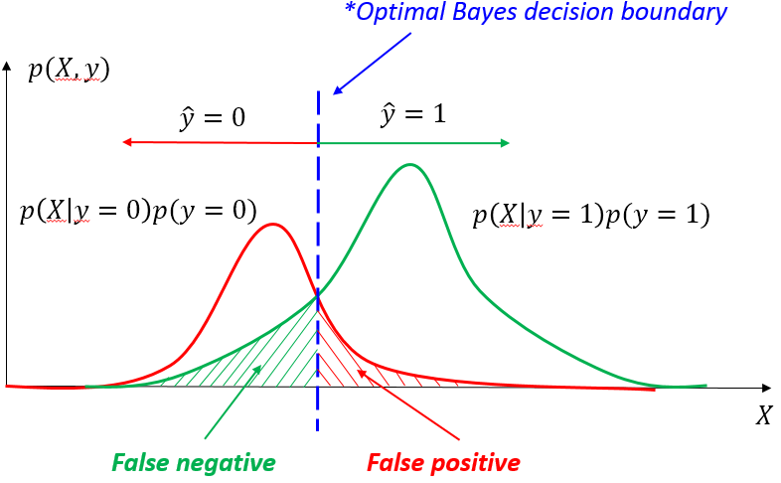
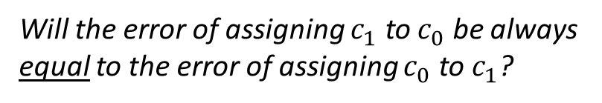




Bayes risk
Expected risk
$E\left[r\left(x\right)\right]=\int_{x}{p\left(x\right)r\left(x\right)dx}$
$$=\int_{x}{p\left(x\right)min⁡\{p\left(x | y=1\right)p\left(y=1\right), p\left(x | y=0\right)p(y=0)\}\text{dx} }$$
$$=p\left(y=1\right)\int_{R_{0}}{p(x)p\left(x|y=1\right)dx}+p\left(y=0\right)\int_{R_{1}}{p(x)p\left(x|y=0\right)dx}$$
Region where we assign $x$ to class 0
Region where we assign $x$ to class 1
Will the error of assigning $c_{1}$ to $c_{0}$ be always equal to the error of assigning $c_{0}$ to $c_{1}$?

Slide 14
Recap: IBM translation models
A generative model based on noisy channel framework
Generate the translation sentence e with regard to the given sentence f by a stochastic process
Generate the length of f
Generate the alignment of e to the target sentence f
Generate the words of f
$$Eng^{∗}=argmax_{Eng}p\left(Fre | Eng\right)p(Eng)$$

Slide 15
Recap: IBM translation models
Translation model with word alignment
$p\left(Fre | Eng\right)=\sum_{a∈A(Eng,Fre)}{p(Fre,a|Eng)}$
Generate the words of f with respect to alignment $a$
marginalize over all possible alignments $a$
$$p\left(f,a | e\right)=p(m|e)\prod_{j=1}^{m}{p\left(a_{j} | a_{1..j−1},f_{1,..j−1},m,e\right)p(f_{j}|a_{1..j},f_{1,..j−1},m,e)}$$
Length of target sentence f
Word alignment $a_{j}$
Translation of $f_{j}$

Slide 16

Recap: decoding process in Model 1
$$p\left(e | f\right)=1e^{−55}$$
For a particular English sentence $e = e_{1}..e_{n}$ of length $n$
$$p(e)$$
0 | 1 | 2 | 3 | 4 | 5
NULL | John | flies | across | the | river
Search through all English sentences
1. Choose a length $m$ for the target sentence (e.g m = 8)
1 | 2 | 3 | 4 | 5 | 6 | 7 | 8
? | ? | ? | ? | ? | ? | ? | ?
Search through all possible alignments
$$p\left(m | e\right)=ε$$
2. Choose an alignment $a= a_{1}…a_{m}$for the source sentence
Order of action
$$p\left(a | e\right)=\frac{1}{n}$$
Target Position | 1 | 2 | 3 | 4 | 5 | 6 | 7 | 8
Source Position | 1 | 2 | 4 | 5 | 5 | 2 | 0 | 3
$$\prod_{j=1}^{m}{p(f_{j}|e_{a_{j}})}$$
3. Translate each source word $e_{a_{j}}$into the target language
English | John | flies | the | river | river | flies | NULL | across
Alignment | 1 | 2 | 4 | 5 | 5 | 2 | 0 | 3
Encoded | Jean | a | traversé | le | lac | à | la | nage
Receiver

Slide 17
Recap: decoding process in Model 1
$$p\left(e | f\right)=1e^{−15}$$
For a particular English sentence $e = e_{1}..e_{n}$ of length $n$
0 | 1 | 2 | 3 | 4 | 5
NULL | John | swam | across | the | lake
Search through all English sentences
$$p(e)$$
1. Choose a length $m$ for the target sentence (e.g m = 8)
1 | 2 | 3 | 4 | 5 | 6 | 7 | 8
? | ? | ? | ? | ? | ? | ? | ?
Search through all possible alignments
$$p\left(m | e\right)=ε$$
Order of action
2. Choose an alignment $a= a_{1}…a_{m}$for the source sentence
$$p\left(a | e\right)=\frac{1}{n}$$
Target Position | 1 | 2 | 3 | 4 | 5 | 6 | 7 | 8
Source Position | 1 | 3 | 3 | 4 | 5 | 0 | 0 | 2
$$\prod_{j=1}^{m}{p(f_{j}|e_{a_{j}})}$$
3. Translate each source word $e_{a_{j}}$into the target language
English | John | across | across | the | lake | NULL | NULL | swam
Alignment | 1 | 3 | 3 | 4 | 5 | 0 | 0 | 2
Encoded | Jean | a | traversé | le | lac | à | la | nage
Receiver

Slide 18
Recap: Bayes decision theory
If we know $p(y)$ and $p(X|y)$, the Bayes decision rule is
$$\hat{y}=argmax_{y}p\left(y | X\right)=argmax_{y}\frac{p\left(X | y\right)p\left(y\right)}{p\left(X\right)}$$
Example in binary classification
$\hat{y}=1$, if $p\left(X | y=1\right)p\left(y=1\right)>p\left(X | y=0\right)p\left(y=0\right)$
$\hat{y}=0$, otherwise
This leads to optimal classification result
Optimal in the sense of ‘risk’ minimization
Constant with respect to $y$

Slide 19
Recap: Bayes risk
Risk – assign instance to a wrong class
Bayes decision boundary
$$p(X,y)$$
$$\hat{y}=0$$
$$\hat{y}=1$$
$$p\left(X | y=0\right)p(y=0)$$
$$p\left(X | y=1\right)p(y=1)$$
$$X$$
False negative
False positive

Slide 20
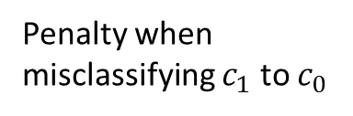
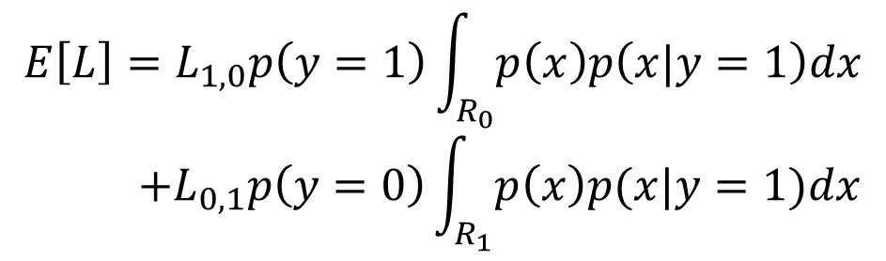


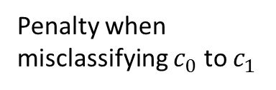
Loss function
Will this still be optimal?
The penalty we will pay when misclassifying instances
Goal of classification in general
Minimize loss
Region where we assign $x$ to class 0
$$E\left[L\right]=L_{1,0}p\left(y=1\right)\int_{R_{0}}{p\left(x\right)p\left(x|y=1\right)dx}$$
$$+L_{0,1}p\left(y=0\right)\int_{R_{1}}{p\left(x\right)p(x|y=1)dx}$$
Penalty when misclassifying $c_{1}$ to $c_{0}$
Region where we assign $x$ to class 1
Penalty when misclassifying $c_{0}$ to $c_{1}$

Slide 21




Supervised text categorization
Supervised learning
Estimate a model/method from labeled data
It can then be used to determine the labels of the unobserved samples
Training
Testing
Sports
Business
Education
Science
Sports
Business
Education
Classifier
$f\left(x,θ\right)→y$
…
…
$${\left\{\left(x_{i},y_{i}\right)\right\}}_{i=1}^{n}$$
$${\left\{\left(x_{i}, ?\right)\right\}}_{i=1}^{m}$$
$${\left\{\left(x_{i},\hat{y_{i}}\right)\right\}}_{i=1}^{m}$$

Slide 22
Type of classification methods
Model-less
Instance based classifiers
Use observation directly
E.g., kNN
Key: assuming similar items have similar class labels!
Training
Testing
Sports
Business
Education
Science
Sports
Business
Education
Instance lookup
Classifier
$f\left(x,θ\right)→y$
…
…
$${\left\{\left(x_{i},y_{i}\right)\right\}}_{i=1}^{n}$$
$${\left\{\left(x_{i}, ?\right)\right\}}_{i=1}^{m}$$
$${\left\{\left(x_{i},\hat{y_{i}}\right)\right\}}_{i=1}^{m}$$

Slide 23




Type of classification methods
Model-based
Generative models
Modeling joint probability of $p(x,y)$
E.g., Naïve Bayes
Discriminative models
Directly estimate a decision rule/boundary
E.g., SVM
Key: i.i.d. assumption!
Training
Testing
Sports
Business
Education
Science
Sports
Business
Education
Classifier
$f\left(x,θ\right)→y$
…
…
$${\left\{\left(x_{i},y_{i}\right)\right\}}_{i=1}^{n}$$
$${\left\{\left(x_{i}, ?\right)\right\}}_{i=1}^{m}$$
$${\left\{\left(x_{i},\hat{y_{i}}\right)\right\}}_{i=1}^{m}$$

Slide 24
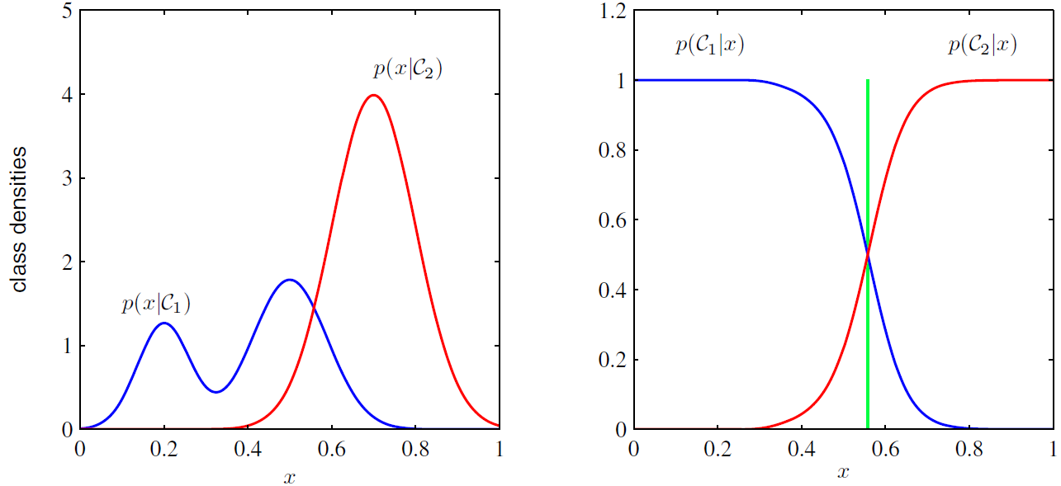
Generative V.S. discriminative models
Binary classification as an example
Generative Model’s view
Discriminative Model’s view

Slide 25
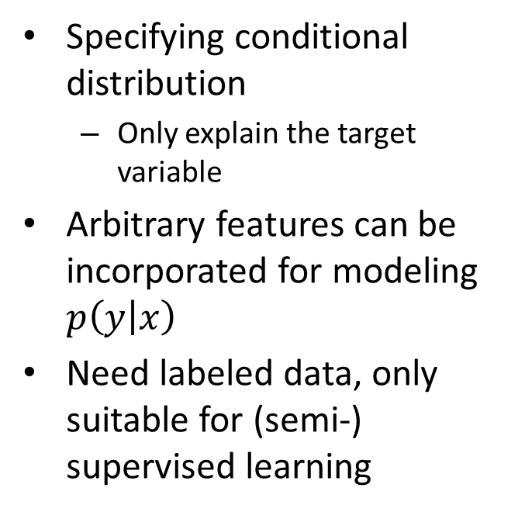
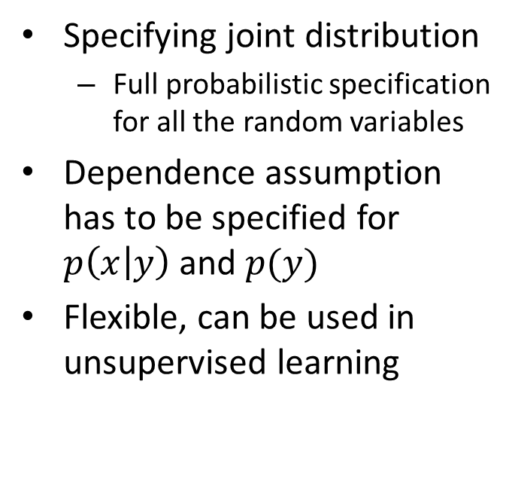
Generative V.S. discriminative models
Generative
Discriminative
Specifying joint distribution
Full probabilistic specification for all the random variables
Dependence assumption has to be specified for $p\left(x | y\right)$ and $p(y)$
Flexible, can be used in unsupervised learning
Specifying conditional distribution
Only explain the target variable
Arbitrary features can be incorporated for modeling $p\left(y | x\right)$
Need labeled data, only suitable for (semi-) supervised learning

Slide 26
General steps for text categorization
Feature construction and selection
Model specification
Model estimation and selection
Evaluation
Political News
Sports News
Entertainment News

Slide 27

General steps for text categorization
Feature construction and selection
Model specification
Model estimation and selection
Evaluation
Political News
Sports News
Entertainment News
Consider:
1.1 How to represent the text documents?
1.2 Do we need all those features?

Slide 28
Feature construction for text categorization
Vector space representation
Standard procedure in document representation
Features
N-gram, POS tags, named entities, topics
Feature value
Binary (presence/absence)
TF-IDF (many variants)

Slide 29
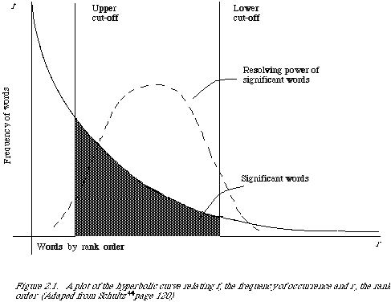
Recall MP1
How many unigram+bigram are there in our controlled vocabulary?
130K on Yelp_small
How many review documents do we have there for training?
629K Yelp_small
Very sparse feature representation!

Slide 30
Feature selection for text categorization
Select the most informative features for model training
Reduce noise in feature representation
Improve final classification performance
Improve training/testing efficiency
Less time complexity
Fewer training data

Slide 31
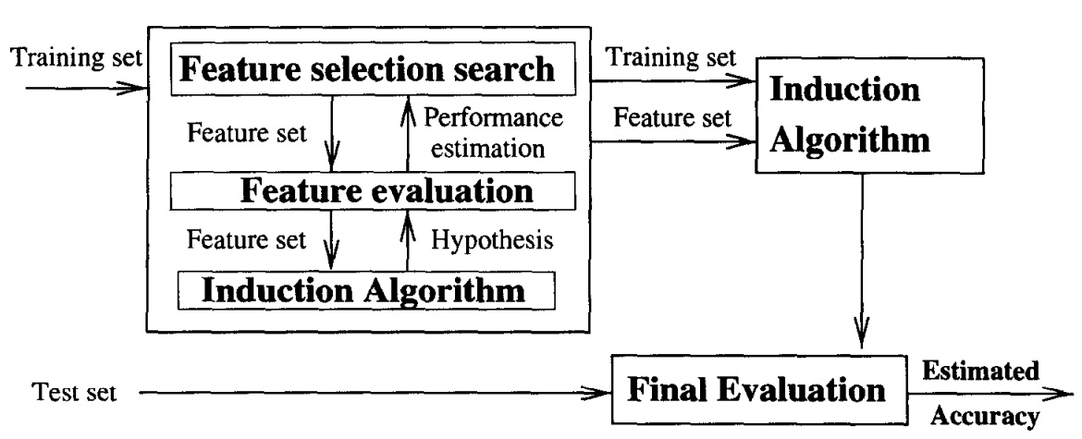
Feature selection methods
Wrapper method
Find the best subset of features for a particular classification method
the same classifier
R. Kohavi, G.H. John/Artijicial Intelligence 97 (1997) 273-324

Slide 32
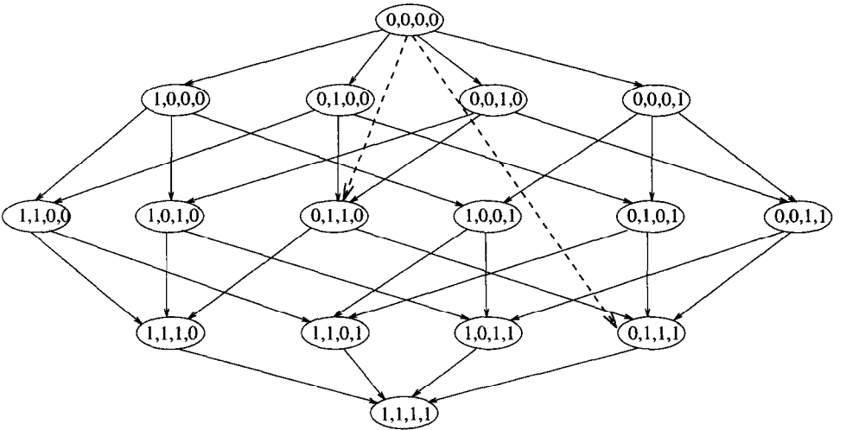
Feature selection methods
Wrapper method
Search in the whole space of feature groups
Sequential forward selection or genetic search to speed up the search
R. Kohavi, G.H. John/Artijicial Intelligence 97 (1997) 273-324

Slide 33
Feature selection methods
Wrapper method
Consider all possible dependencies among the features
Impractical for text categorization
Cannot deal with large feature set
A NP-complete problem
No direct relation between feature subset selection and evaluation

Slide 34

Feature selection methods
Filter method
Evaluate the features independently from the classifier and other features
No indication of a classifier’s performance on the selected features
No dependency among the features
Feasible for very large feature set
Usually used as a preprocessing step
R. Kohavi, G.H. John/Artijicial Intelligence 97 (1997) 273-324

Slide 35
Feature scoring metrics
Document frequency
Rare words: non-influential for global prediction, reduce vocabulary size
remove head words
remove rare words

Slide 36
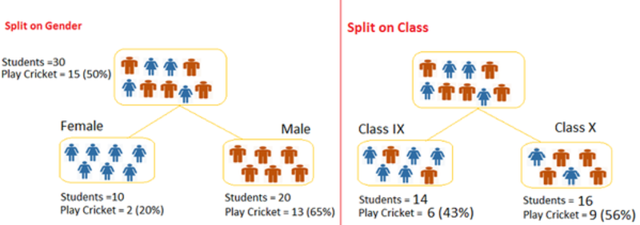
Feature scoring metrics
Information gain
Decrease in entropy of categorical prediction when the feature is present v.s. absent
class uncertainty decreases
class uncertainty intact

Slide 37
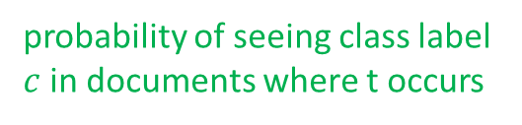
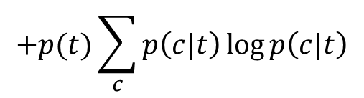
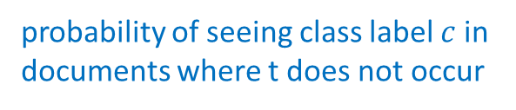
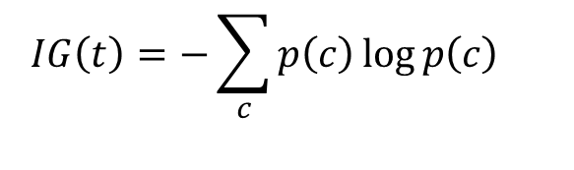
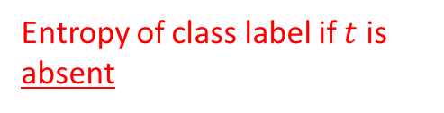
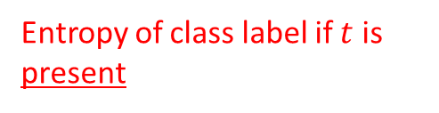
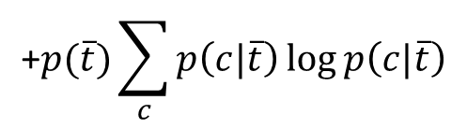
Feature scoring metrics
Information gain
Decrease in entropy of categorical prediction when the feature is present or absent
$$IG\left(t\right)=−\sum_{c}{p\left(c\right)\log{p\left(c\right)}}$$
Entropy of class label along
$$+p(t)\sum_{c}{p\left(c|t\right)\log{p\left(c|t\right)}}$$
Entropy of class label if $t$ is present
$$\text{+}p(\overline{t})\sum_{c}{p\left(c|\overline{t}\right)\log{p\left(c|\overline{t}\right)}}$$
Entropy of class label if $t$ is absent
probability of seeing class label $c$ in documents where t occurs
probability of seeing class label $c$ in documents where t does not occur

Slide 38

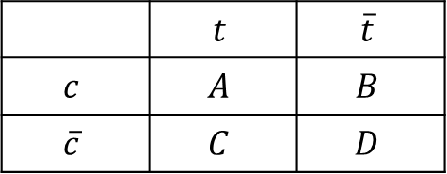

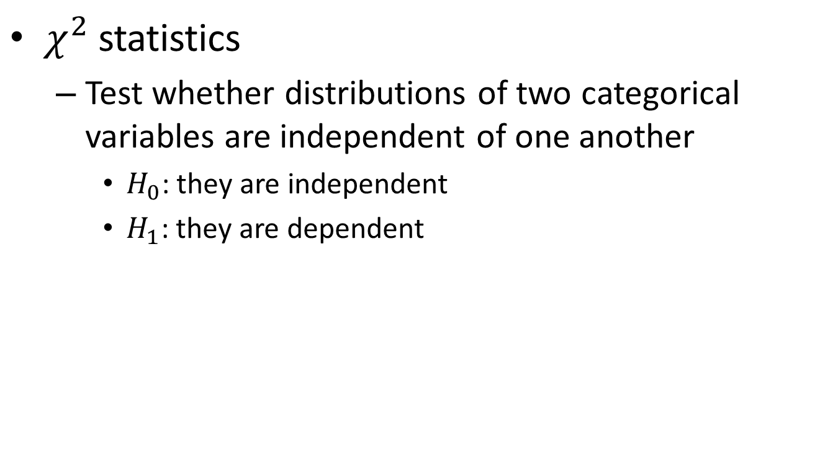



Feature scoring metrics
$χ^{2}$ statistics
Test whether distributions of two categorical variables are independent of one another
$H_{0}$: they are independent
$H_{1}$: they are dependent
 | $$t$$ | $$\overline{t}$$
$$c$$ | $$A$$ | $$B$$
$$\overline{c}$$ | $$C$$ | $$D$$
$$χ^{2}\left(t,c\right)=\frac{(A+B+C+D){\left(AD−BC\right)}^{2}}{(A+C)(B+D)(A+B)(C+D)}$$
$$DF(t)$$
$$N−DF(t)$$
$$\#Pos doc$$
$$\#Neg doc$$

Slide 39
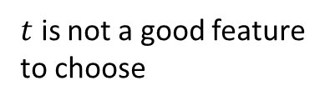
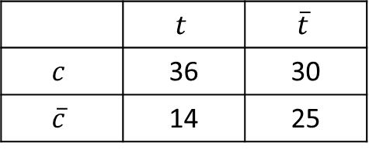

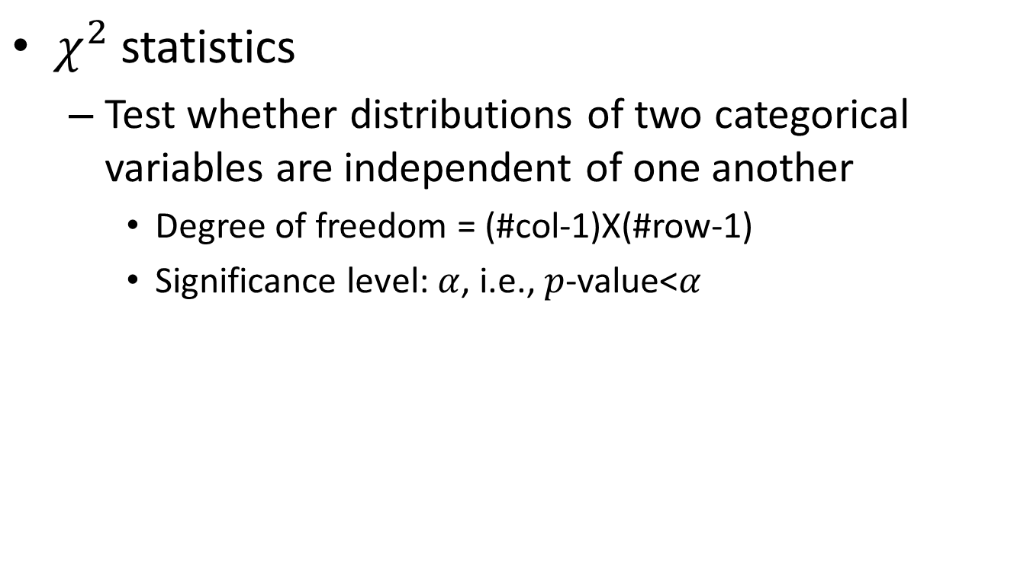
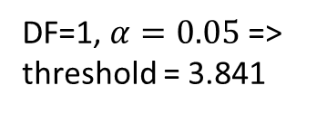
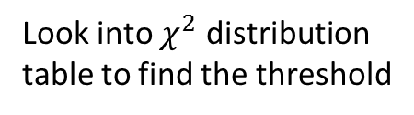

Feature scoring metrics
$χ^{2}$ statistics
Test whether distributions of two categorical variables are independent of one another
Degree of freedom = (#col-1)X(#row-1)
Significance level: $α$, i.e., $p$-value<$α$
Look into $χ^{2}$ distribution table to find the threshold
 | $$t$$ | $$\overline{t}$$
$$c$$ | 36 | 30
$$\overline{c}$$ | 14 | 25
DF=1, $α=0.05$ => threshold = 3.841
We cannot reject $H_{0}$
$$χ^{2}\left(t,c\right)=\frac{105{\left(36×25−14×30\right)}^{2}}{50×55×66×39}=3.418$$
$t$ is not a good feature to choose

Slide 40
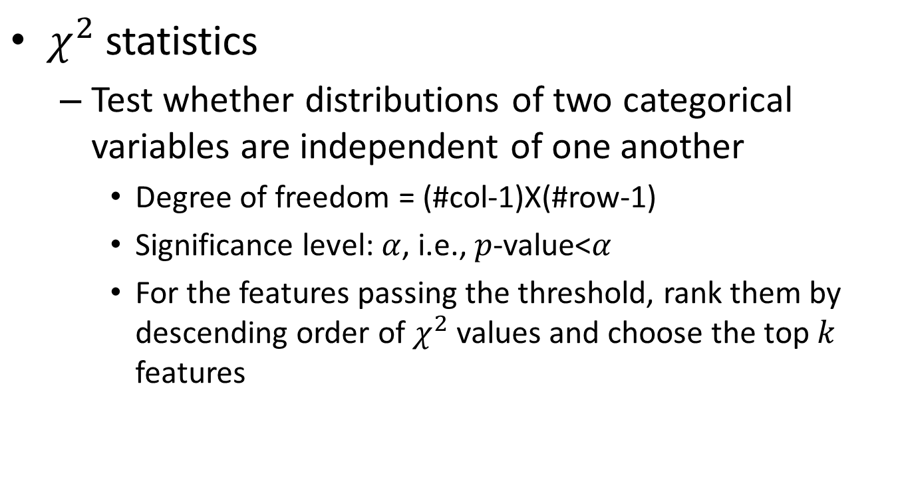
Feature scoring metrics
$χ^{2}$ statistics
Test whether distributions of two categorical variables are independent of one another
Degree of freedom = (#col-1)X(#row-1)
Significance level: $α$, i.e., $p$-value<$α$
For the features passing the threshold, rank them by descending order of $χ^{2}$ values and choose the top $k$ features

Slide 41
Recap: general steps for text categorization
Feature construction and selection
Model specification
Model estimation and selection
Evaluation
Political News
Sports News
Entertainment News

Slide 42
Recap: feature selection methods
Wrapper method
Find the best subset of features for a particular classification method
the same classifier
R. Kohavi, G.H. John/Artijicial Intelligence 97 (1997) 273-324

Slide 43
Recap: feature selection methods
Filter method
Evaluate the features independently from the classifier and other features
No indication of a classifier’s performance on the selected features
No dependency among the features
R. Kohavi, G.H. John/Artijicial Intelligence 97 (1997) 273-324

Slide 44
Recap: feature scoring metrics
Document frequency
Rare words: non-influential for global prediction, reduce vocabulary size
remove head words
remove rare words

Slide 45
Recap: feature scoring metrics
Information gain
Decrease in entropy of categorical prediction when the feature is present or absent
$$IG\left(t\right)=−\sum_{c}{p\left(c\right)\log{p\left(c\right)}}$$
Entropy of class label along
$$+p(t)\sum_{c}{p\left(c|t\right)\log{p\left(c|t\right)}}$$
Entropy of class label if $t$ is present
$$\text{+}p(\overline{t})\sum_{c}{p\left(c|\overline{t}\right)\log{p\left(c|\overline{t}\right)}}$$
Entropy of class label if $t$ is absent
probability of seeing class label $c$ in documents where t occurs
probability of seeing class label $c$ in documents where t does not occur

Slide 46
Recap: feature scoring metrics
$χ^{2}$ statistics
Test whether distributions of two categorical variables are independent of one another
Degree of freedom = (#col-1)X(#row-1)
Significance level: $α$, i.e., $p$-value<$α$
Look into $χ^{2}$ distribution table to find the threshold
 | $$t$$ | $$\overline{t}$$
$$c$$ | 36 | 30
$$\overline{c}$$ | 14 | 25
DF=1, $α=0.05$ => threshold = 3.841
We cannot reject $H_{0}$
$$χ^{2}\left(t,c\right)=\frac{105{\left(36×25−14×30\right)}^{2}}{50×55×66×39}=3.418$$
$t$ is not a good feature to choose

Slide 47
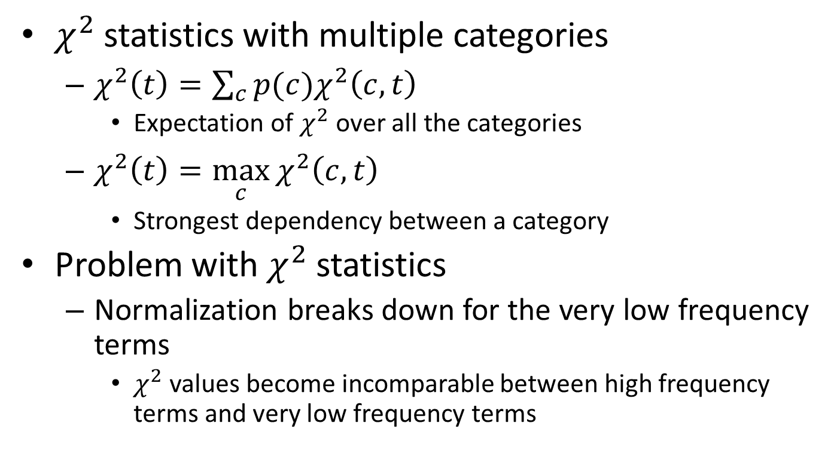
Feature scoring metrics
$χ^{2}$ statistics with multiple categories
$χ^{2}\left(t\right)=\sum_{c}{p(c)χ^{2}\left(c,t\right)}$
Expectation of $χ^{2}$ over all the categories
$χ^{2}\left(t\right)=\max_{c}{χ^{2}\left(c,t\right)}$
Strongest dependency between a category
Problem with $χ^{2}$ statistics
Normalization breaks down for the very low frequency terms
$χ^{2}$ values become incomparable between high frequency terms and very low frequency terms
Distribution assumption becomes inappropriate in this test

Slide 48
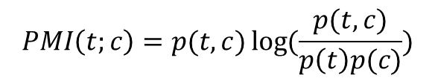
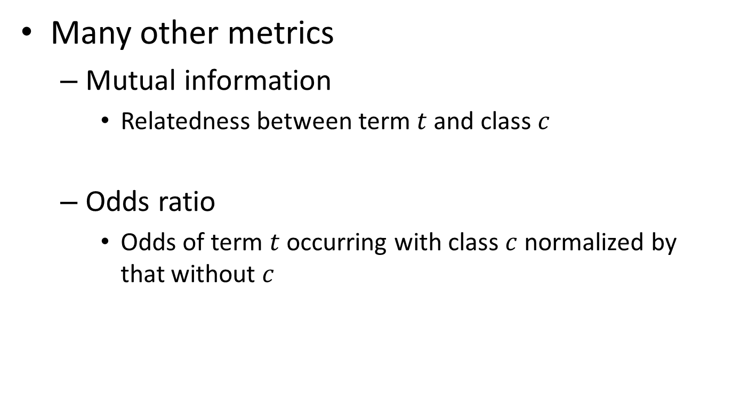
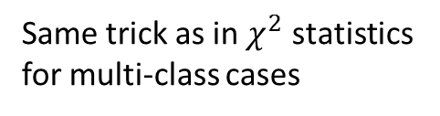
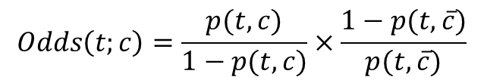
Feature scoring metrics
Many other metrics
Mutual information
Relatedness between term $t$ and class $c$
Odds ratio
Odds of term $t$ occurring with class $c$ normalized by that without $c$
Same trick as in $χ^{2}$ statistics for multi-class cases
$$PMI\left(t;c\right)=p(t,c)\log{(\frac{p(t,c)}{p\left(t\right)p(c)})}$$
$$Odds\left(t;c\right)=\frac{p(t,c)}{1−p(t,c)}×\frac{1−p(t,\overline{c})}{p(t,\overline{c})}$$

Slide 49
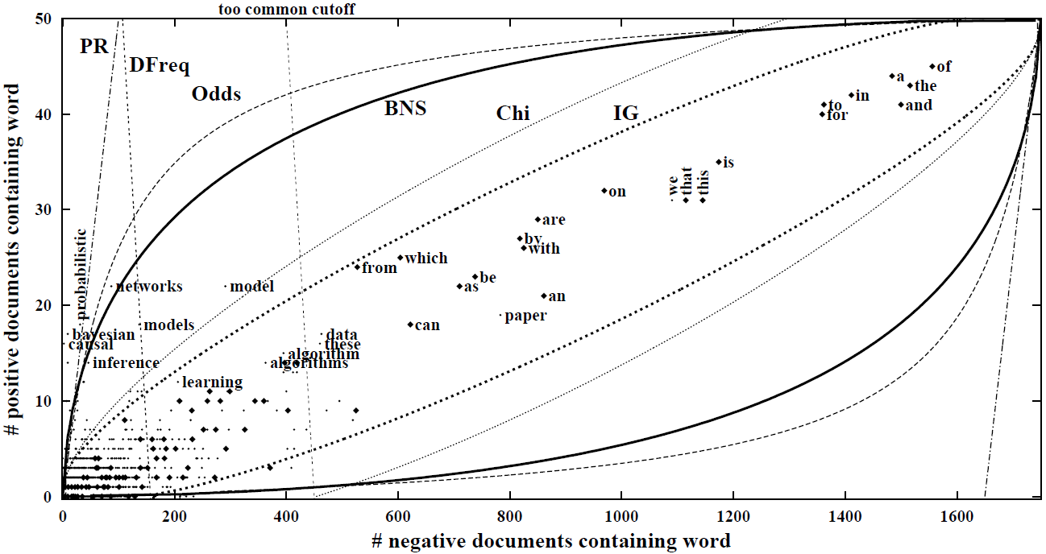
A graphical analysis of feature selection
Isoclines for each feature scoring metric
Machine learning papers v.s. other CS papers
Stopword removal
Zoom in
Forman, G. (2003). An extensive empirical study of feature selection metrics for text classification. JMLR, 3, 1289-1305.

Slide 50
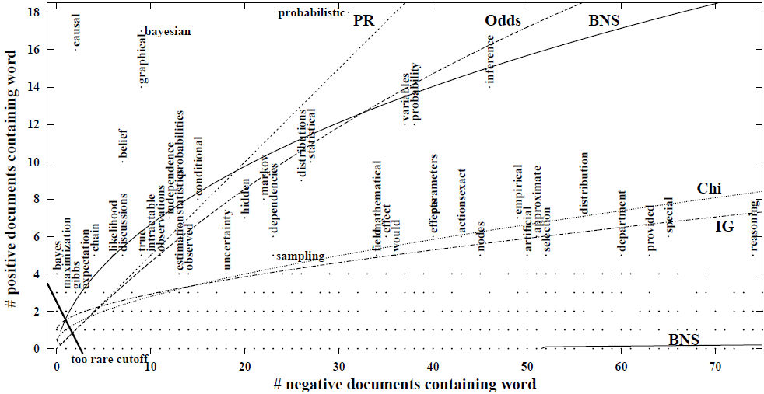
A graphical analysis of feature selection
Isoclines for each feature scoring metric
Machine learning papers v.s. other CS papers
Forman, G. (2003). An extensive empirical study of feature selection metrics for text classification. JMLR, 3, 1289-1305.

Slide 51
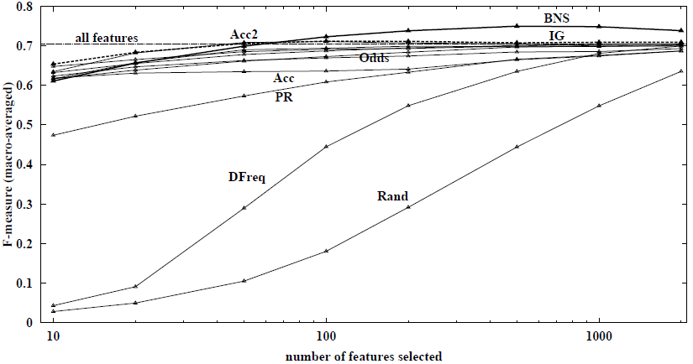
Effectiveness of feature selection methods
On a multi-class classification data set
229 documents, 19 classes
Binary feature, SVM classifier
Forman, G. (2003). An extensive empirical study of feature selection metrics for text classification. JMLR, 3, 1289-1305.

Slide 52
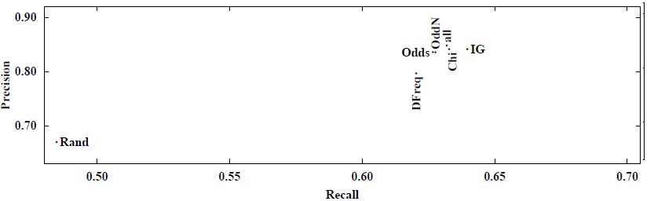
Effectiveness of feature selection methods
On a multi-class classification data set
229 documents, 19 classes
Binary feature, SVM classifier
Forman, G. (2003). An extensive empirical study of feature selection metrics for text classification. JMLR, 3, 1289-1305.

Slide 53
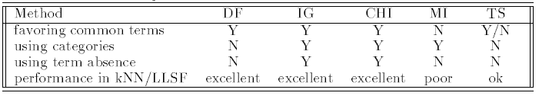
Empirical analysis of feature selection methods
Text corpus
Reuters-22173
13272 documents, 92 classes, 16039 unique words
OHSUMED
3981 documents, 14321 classes, 72076 unique words
Classifier: kNN and LLSF

Slide 54
General steps for text categorization
Feature construction and selection
Model specification
Model estimation and selection
Evaluation
Political News
Sports News
Entertainment News
Consider:
2.1 What is the unique property of this problem?
2.2 What type of classifier we should use?

Slide 55
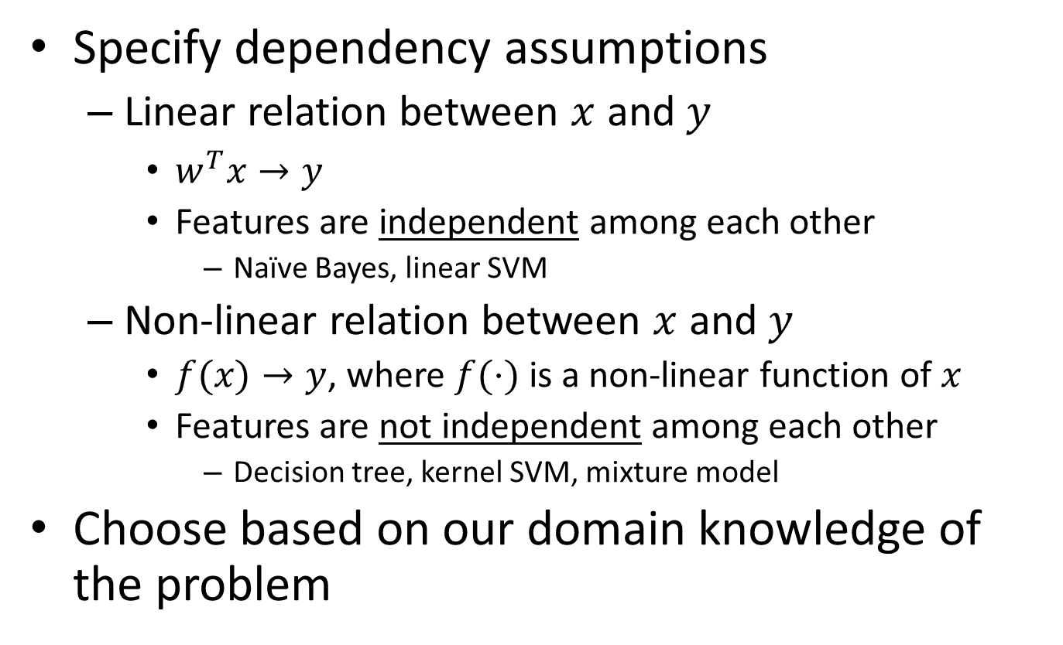
Model specification
Specify dependency assumptions
Linear relation between $x$ and $y$
$w^{T}x→y$
Features are independent among each other
Naïve Bayes, linear SVM
Non-linear relation between $x$ and $y$
$f(x)→y$, where $f(⋅)$ is a non-linear function of $x$
Features are not independent among each other
Decision tree, kernel SVM, mixture model
Choose based on our domain knowledge of the problem
We will discuss these choices later

Slide 56
General steps for text categorization
Feature construction and selection
Model specification
Model estimation and selection
Evaluation
Political News
Sports News
Entertainment News
Consider:
3.1 How to estimate the parameters in the selected model?
3.2 How to control the complexity of the estimated model?

Slide 57
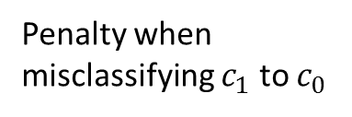


Model estimation and selection
General philosophy
Loss minimization
$$E\left[L\right]=L_{1,0}p\left(y=1\right)\int_{R_{0}}{p\left(x\right)dx}+L_{0,1}p\left(y=0\right)\int_{R_{1}}{p\left(x\right)dx}$$
Penalty when misclassifying $c_{1}$ to $c_{0}$
Penalty when misclassifying $c_{0}$ to $c_{1}$
Empirically estimated from training set
Empirical loss!
Key assumption: Independent and Identically Distributed!

Slide 58

Empirical loss minimization
Overfitting
Good empirical loss, terrible generalization loss
High model complexity -> prune to overfit noise
Over-complicated dependency assumption: polynomial
Underlying dependency: linear relation

Slide 59

Generalization loss minimization
Avoid overfitting
Measure model complexity as well
Model selection and regularization
Error
Error on testing set
Error on training set
Model complexity

Slide 60
Generalization loss minimization
Cross validation
Avoid noise in train/test separation
k-fold cross-validation
Partition all training data into k equal size disjoint subsets;
Leave one subset for validation and the other k-1 for training;
Repeat step (2) k times with each of the k subsets used exactly once as the validation data.

Slide 61

Generalization loss minimization
Cross validation
Avoid noise in train/test separation
k-fold cross-validation

Slide 62
Generalization loss minimization
Cross validation
Avoid noise in train/test separation
k-fold cross-validation
Choose the model (among different models or same model with different settings) that has the best average performance on the validation sets
Some statistical test is needed to decide if one model is significantly better than another
Will cover it shortly

Slide 63
General steps for text categorization
Feature construction and selection
Model specification
Model estimation and selection
Evaluation
Political News
Sports News
Entertainment News
Consider:
4.1 How to judge the quality of learned model?
4.2 How can you further improve the performance?

Slide 64

Classification evaluation
Accuracy
Percentage of correct prediction over all predictions, i.e., $p\left(y^{∗}=y\right)$
Limitation
Highly skewed class distribution
$p\left(y^{∗}=1\right)=0.99$
Trivial solution: all testing cases are positive
Classifiers’ capability is only differentiated by 1% testing cases

Slide 65




Evaluation of binary classification
Precision
Fraction of predicted positive documents that are indeed positive, i.e., $p(y^{∗}=1|y=1)$
Recall
Fraction of positive documents that are predicted to be positive, i.e., $p(y=1|y^{∗}=1)$
 | $$y^{∗}=1$$ | $$y^{∗}=0$$
$$y=1$$ | true positive (TP) | false positive (FP)
$$y=0$$ | false negative (FN) | true negative (TN)
Precision=
$$\frac{TP}{TP+FP}$$
Recall=
$$\frac{TP}{TP+FN}$$

Slide 66




Evaluation of binary classification
*Optimal Bayes decision boundary
$$p(X,y)$$
$$\hat{y}=0$$
$$\hat{y}=1$$
$$p\left(X | y=0\right)p(y=0)$$
$$p\left(X | y=1\right)p(y=1)$$
True negative
True positive
$$X$$
False negative
False positive

Slide 67

Precision and recall trade off
Precision decreases as the number of documents predicted to be positive increases (unless in perfect classification), while recall keeps increasing
These two metrics emphasize different perspectives of a classifier
Precision: prefers a classifier to recognize fewer documents, but highly accurate
Recall: prefers a classifier to recognize more documents

Slide 68



Summarizing precision and recall
With a single value
In order to compare different classifiers
F-measure: weighted harmonic mean of precision and recall, $α$ balances the trade-off
Why harmonic mean?
Classifier1: P:0.53, R:0.36
Classifier2: P:0.01, R:0.99
$$F=\frac{1}{α\frac{1}{P}+\left(1−α\right)\frac{1}{R}}$$
$$\left(F_{1}=\frac{2}{\frac{1}{P}+\frac{1}{R}} \right)$$
Equal weight between precision and recall
H | A
0.429 | 0.445
0.019 | 0.500

Slide 69
Summarizing precision and recall
With a curve
Order all the testing cases by the classifier’s prediction score (assuming the higher the score is, the more likely it is positive);
Scan through each testing case: treat all cases above it as positive (including itself), below it as negative; compute precision and recall;
Plot precision and recall computed for each testing case in step (2).

Slide 70

Summarizing precision and recall
With a curve
A.k.a., precision-recall curve
Area Under Curve (AUC)
Under each recall level, we prefer a higher precision

Slide 71


Multi-class categorization
Confusion matrix
A generalized contingency table for precision and recall

Slide 72
Statistical significance tests
How confident you are that an observed difference doesn’t simply result from the train/test separation you chose?
Fold
Classifier 1
Classifier 2
1
2
3
4
5
0.20
0.21
0.22
0.19
0.18
0.18
0.19
0.21
0.20
0.37
Average
0.20
0.23

Slide 73
Background knowledge
p-value in statistic test is the probability of obtaining data as extreme as was observed, if the null hypothesis were true (e.g., if observation is totally random)
If p-value is smaller than the chosen significance level (α), we reject the null hypothesis (e.g., observation is not random)
We seek to reject the null hypothesis (we seek to show that the observation is not a random result), and so small p-values are good
73

Slide 74
Paired t-test
Algorithm 1
Algorithm 2
Paired t-test
Test if two sets of observations are significantly different from each other
On k-fold cross validation, different classifiers are applied onto the same train/test separation
Hypothesis: difference between two responses measured on the same statistical unit has a zero mean value
One-tail v.s. two-tail?
If you aren’t sure, use two-tail

Slide 75
Statistical significance test
Fold
Classifier A
Classifier B
paired t-test
1
2
3
4
5
0.20
0.21
0.22
0.19
0.18
0.18
0.19
0.21
0.20
0.37
+0.02
+0.02
+0.01
-0.01
-0.19
Average
0.20
0.23
p=0.4987
95% of outcomes
0

Slide 76
What you should know
Bayes decision theory
Bayes risk minimization
General steps for text categorization
Text feature construction
Feature selection methods
Model specification and estimation
Evaluation metrics

Slide 77
Today’s reading
Introduction to Information Retrieval
Chapter 13: Text classification and Naive Bayes
13.1 – Text classification problem
13.5 – Feature selection
13.6 – Evaluation of text classification

