Slide 1
Recognizing Contextual Polarity in Phrase-Level Sentiment Analysis
by Wilson, Wiebe, and Hoffmann
Presented by Daniel Brady

Slide 2
Outline
Sentiment Analysis Background
Ambiguities
Corpus Used
Agreement Study
Neutral / Polar Classifier
Polarity Classifier
Results

Slide 3
Sentiment Analysis Background
Def: “The task of identifying positive and negative opinions, emotions, and evaluations”
Most previous work is on the document level
Usually start with a lexicon of positive and negative words
“Beautiful” vs. “Horrid”
Notes:
Document level like pos/neg reviews

Slide 4
Ambiguity - Negation
Local
“Not good”
Longer distance dependent
“No one thinks that it’s good”

Slide 5
Ambiguity - Intensifiers
Negating words that intensify the meaning
“not only good but amazing”

Slide 6
Ambiguity - Word Sense
The way a word is used can change the meaning
“The Environmental Trust was...”
“He has won the people’s trust”

Slide 7
Corpus
Started with annotated Multi-perspective Question Answering (MPQA) Opinion Corpus
Already had subjective expressions labeled
A subjective expression is any word or phrase used to express an opinion, emotion, evaluation, stance, speculation
Manually annotated these subjective expressions with contextual polarity
Tagged as positive, negative, both, or neutral

Slide 8
Corpus - Examples
“Thousands of coup supporters celebrated (positive) overnight, waving flags…”
“Politicians refer to good and evil (both) only for purposes of intimidation.”
“Jerome says the hospital feels (neutral) no different than a hospital in the states”
“The criteria set by Rice are the following: the three countries in question are repressive (negative) and grave human rights violators (negative).”

Slide 9
Corpus - Size
425 Documents
8,984 Sentences
28% - no subjective expressions
25% - 1 subjective expression
47% - 2 or more subjective expressions

Slide 10
Agreement Study
Two annotators compared on 447 subjective expression labels
82% agreement, Kappa = 0.72
At least one annotator labeled “uncertain” for 18% of expressions.
90% agreement, Kappa = 0.84 when ignored
Notes:
Kappa is inter-annotator agreement. Includes chance agreement to better than raw agreement

Slide 11
Subjectivity Lexicon
Took words from various lists, and used a dictionary and thesaurus
Over 8,000 words that usually have subjective meaning
strong and weak subjectivity
Each word tagged with prior polarity
positive, negative, both, or neutral
Notes:
less than 8% marked as both or neutral. Words like feel and think. Even though they are neutral, usually indicate sentiment is being expressed

Slide 12
Inspiration
The simplest prior-polarity classifier assigns sentiment polarity purely on words’ prior polarities
On test set performed poorly, 48% accuracy
The main problem was that words with non-neutral prior polarity appeared in neutral phrases
Notes:
Example: “Happy Valley football stadium was sold out”

Slide 13
New Approach
2 step approach to polarity disambiguation
Whether or not a phrase is polar or not
Neutral / Polar classifier
Assign a contextual polarity to each polar phrase from step 1
Polarity classifier
Both classifiers use the BoosTexter AdaBoost.HM algorithm
Notes:
The main idea of boosting is to combine many simple and moderately inaccurate categorization rules into a single, highly accurate categorization rule

Slide 14
Neutral / Polar Classifier
Has 28 features
Word Features
Word context: trigram with current token in middle
Prior polarity
Modification Features
Preceded by intensifier
Sentence Features
Adverb count in sentence
Structure Features
In subject
Document Feature
Topic

Slide 15
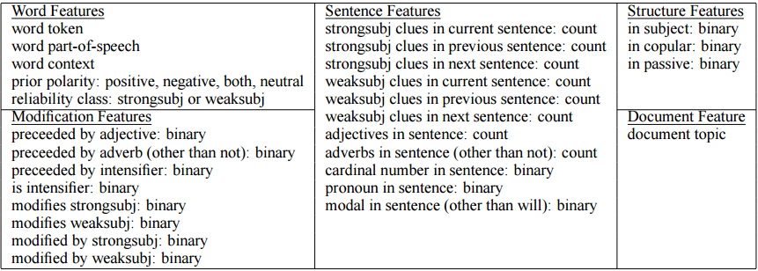
Neutral / Polar Classifier

Slide 16
Polarity Classifier
Four-way classification
positive, negative, both, or neutral
10 features
Word Features
Prior polarity
Polarity Features
Negated
Negative polarity shifter
“Lack of understanding”

Slide 17
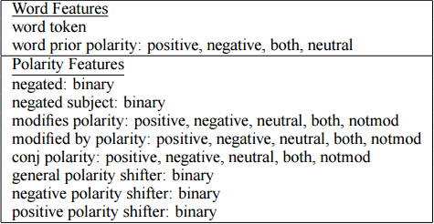
Polarity Classifier

Slide 18

Results - Neutral / Polar Classifier
10-fold cross validation used on test set
Notes:
Recall: How many positives were found out of all positives. Precision: How many found positives were actually positive

Slide 19
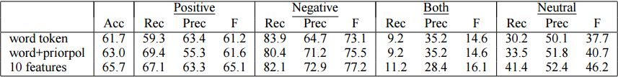
Results - Polarity Classifier
10-fold cross validation used on test set
Notes:
Recall: How many positives were found out of all positives. Precision: How many found positives were actually positive

Slide 20
Thanks for listening
Any Questions?

