Slide 1
Content-based Music Recommendation Using Hierarchical Dirichlet Process
-Xiaoqian Liu
May 2, 2015

Slide 2

When the music is over, turn out the lights.
- The Doors, “When the Music’s Over”

Slide 3
What’s the mainstream
Top Artists on “The Hot 100, Billboard Charts Archive”
BJ Thomas
Jackson 5
The Shocking Blue
Sly & The Family Stone
Simon & Garfunkel
The Beatles
The Guess Who
KC And the Sunshine Band
Rupert Holmes
Michael Jackson
Capital & Tennille
Queen
Pink Floyd
Blondie
Phil Collins
Michael Bolton
Paula Abdul
Janet Jackson
Alannah Myles
Taylor Dayne
Tommy Page
Santana
Rob Thomas
Christina Aguilera
Savage Garden
Mariah Carey
Lonestar
Destiny’s Child
Ke$ha
The Black Eyed Peas
Taio Cruz
Rihanna
B.o.B, Bruno Mars
Usher, will.i.am
Eminem
Rock
Folk
Pop
R&B
Electronic
Hip Hop
Funk
Pop
1970s
1980s
1990s
2000s
2010s
Artistic Innovations, genre diversity
Fascinating band collaboration
?

Slide 4


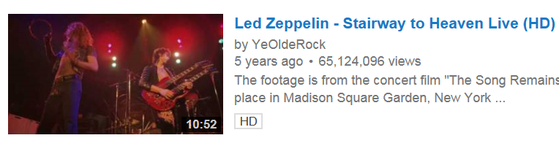
Motivation

Slide 5
Goal: Taste-making Explorer
Explore music by independent musicians and legends
Beyond users’ existing genre preferences
Taste-making (appreciate more sophisticated music)

Slide 6



Existing music recommendation systems
Content-based:
Genome Project (Pandora)
Audio Content, Metadata (Echo Nest, Spotify)
User preferences:
Collaborative Filtering (Spotify, Pandora, everywhere)
Social Network data like Twitter
Our Focus
Notes:
Approximate nearest neighbors, ensemble of latent factor models

Slide 7


Data: Web scraping and API’s
Resources:
Album reviews: Pitchfork.com
Time frame: 1960 – 2015
Focus on independent music
Genre-subcategory mapping
Labels: Last.fm
Tools:
BeautifulSoup
Last.fm API, pylast
Echo nest API, pyechonest

Slide 8
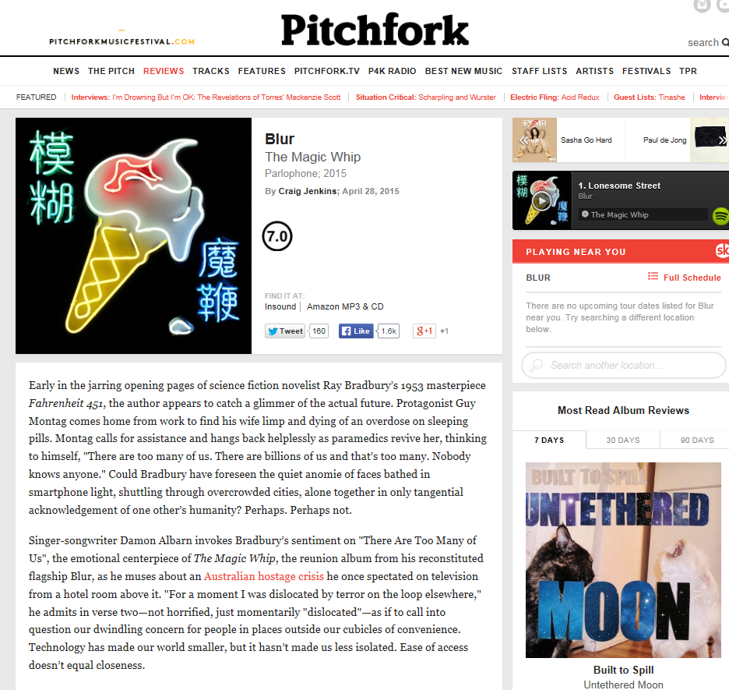
A typical review on Pitchfork
Artist
Album
Label, Issue Year
Author
Rating
Review
(Quality, stories)
Relevant stuff
(news, album, artist)

Slide 9
Pitchfork Data (w/ genre labels)
Genres | # Documents
Indie (+Alternative) | 1,003
Electronic (+Ambient) | 830
Rock | 452
Folk (Singer/Songwriter) | 340
Hip Hop | 261
Dance | 136
R & B | 122
Pop | 63
World | 56
Jazz | 26
Limitations:
After filtering out reviews without genre labels, some genres don’t have enough album reviews

Slide 10
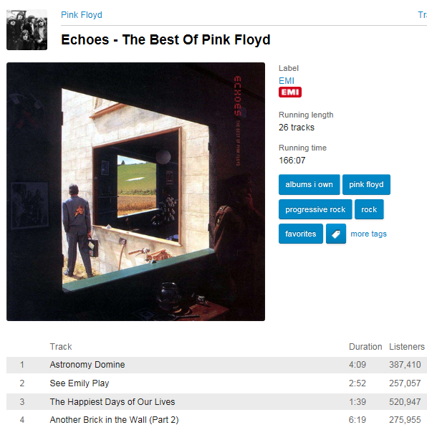
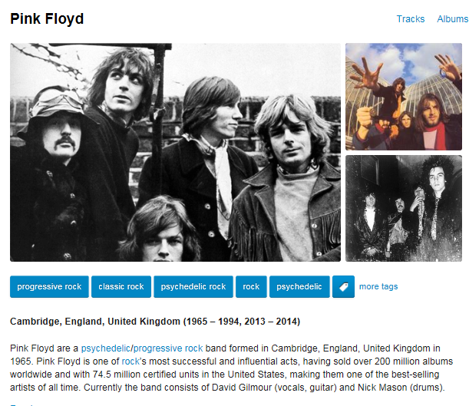
Last.fm – tags (user opinions + descriptions)
Challenges:
Varied lengths
Less popular tracks lack of tags

Slide 11
Methodology
Feature extraction:
Topic model : Hierarchical Dirichlet Process
For summarizing multiple review documents of each genre and discovering topics
10 topic models (10 genres)
Similarity measure:
Cosine similarity on topics
Recommendation Process Design
Evaluation:
User reactions (quality of recommendation)

Slide 12
Data Processing
Genre labeling: categorization based on Musicgenres.com and last.fm
Tokenization:
Stemming and stripping punctuations
Removing head words shared among documents and tail words
keeping years (which may influence the genre classification)

Slide 13
Hierarchical Dirichlet Process
Yee Whye Teh, Michael I. Jordan, Matthew J. Beal and David Blei (2006)
Nonparametric Bayesian approach, Dirichlet process to model mixed-membership data
Sharing clusters among multiple related groups
The optimal number of topics is to be inferred (different from LDA)
Applications: document clustering, genome analysis

Slide 14

Dirichlet process
A set of random measures Gj for each group j, drawn from a group-specific Dirichlet process, G~DP(α0j, G0j), with probability one
Scaling parameter α0 >0
Base probability measure G0
φk = independent r.v. distributed according to G0
δφk = atom at φk
βk = r.v, dependent on α0

Slide 15

Hierarchical Dirichlet Process
A hierarchical model for multiple Dirichlet processes
G0 is discrete
H can be either continuous or discrete
The atoms φk are shared among groups
Can be extended to multiple levels

Slide 16
Prototype: Recommendation Process
Most similar track from each genre (playlist)
3. Find the most similar song in each genre
…
2. K most similar albums in each genre
K albums
K albums
K albums
Rock
Electronic
Indie
…
HDP models
(collections of album reviews)
1. Projection onto the topic model feature space on each genre
A song
(w/ Last.fm tags)

Slide 17


A playlist example (output)
Input = Björk – Lionsong (Electronic, Alternative)
Song | Artist | Style
Blackman | Georgina Anne Muldrow | R&B
Hollow Body | Pity Sex | Indie, Alternative
It Ain’t Rocket Science | Flanger | Acid Jazz
Wonderwall | Oasis | Pop
Lina | Les Sins | Dance
Iron Galaxy | Cannibal Ox | Hip Hop
Real Cool Time | The Stooges | Rock
Azure Azure | Tim Hecker | Electronic
2020 | Suuns | Experimental
Lionsong
Björk – Vulnicura

Slide 18
Evaluation: User Reactions
From 4 kind music lovers (I know, sample size issue)
Start with songs from three different genres
Still collecting
After bootstrapping 1000 times
% | Like | Similarity
Average | 0.444 | 0.30
Std dev | 0.203 | 0.14
Confidence Interval | (0.20 , 0.75) | (0.1, 0.44)

Slide 19
Future work
Including more album reviews
Need more accurate and specific genre labeling
Solidify user evaluations by getting access user profiles and collecting more user data
Taste profiles (Echo Nest), Million Song dataset
Incorporating audio features (e.g. duration, loudness…)
Multi-armed bandit Algorithm for studying user preferences and learning curves
Collaborative Filtering
Sentiment analysis

Slide 20
Well the music is your special friend, Dance on fire as it intends, Music is your only friend, Until the end, until the end.
- The Doors, When the Music’s Over

Slide 21
References
Algorithmic Music Recommendations at Spotify, Chris Johnson, Jan 13, 2014. Retrieved from: http://www.slideshare.net/MrChrisJohnson/algorithmic-music-recommendations-at-spotify
Yee Whye Teh, Michael I. Jordan, Matthew J. Beal and David Blei (2006). Hierarchical Dirichlet Process. Retrieved from: http://www.cs.berkeley.edu/~jordan/papers/hdp.pdf
Wang, C., Paisley, J., Blei, D. (2011).Online Variational Inference for the Hierarchical Dirichlet Process. Retrieved from: http://jmlr.csail.mit.edu/proceedings/papers/v15/wang11a/wang11a.pdf

