Slide 1

Scaling Personalized Web Search
Authors: Glen Jeh , Jennfier Widom Stanford University
Written in: 2003
Cited by: 923 articles
Presented by Sugandha Agrawal

Slide 2
Topics
How PageRank works
Personal PageRank Vector (PPV)
Algorithms to scale effectively computation of PPV
Experimental results

Slide 3

Brief introduction to PageRank
At the time of its conception by Larry Page and Sergey Brin, search engines usually employed highest keyword density algorithms.
Linked web structure used to score importance of a web page
Recursive notion that important pages are those linked-to by many important pages.
Simple PageRank does not incorporate user preferences when displaying search results.

Slide 4

Brief introduction to PageRank
Random surfer model – Imagine trillions of surfers browsing web. The model finds the expected % of surfers expected to be looking at page p at any one time.
The convergence is independent of the distribution of starting points.
Reflects a “democratic” importance with no preference for any particular pages.
Hmmm…how can we incorporate user preferences??

Slide 5
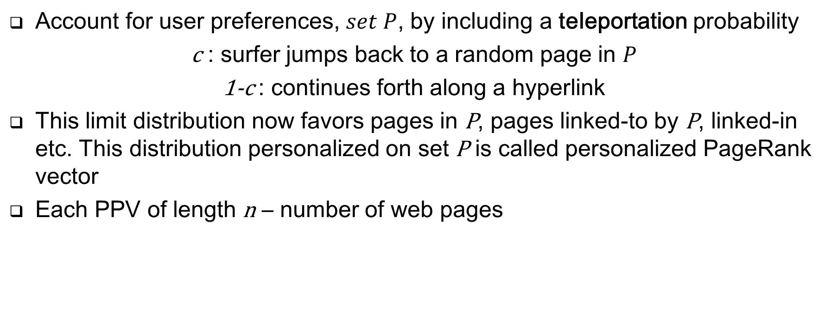
Personalized PageRank Vector (PPV)
Account for user preferences, $set P$, by including a teleportation probability
c : surfer jumps back to a random page in $P$
1-c : continues forth along a hyperlink
This limit distribution now favors pages in P, pages linked-to by P, linked-in etc. This distribution personalized on set P is called personalized PageRank vector
Each PPV of length n – number of web pages

Slide 6
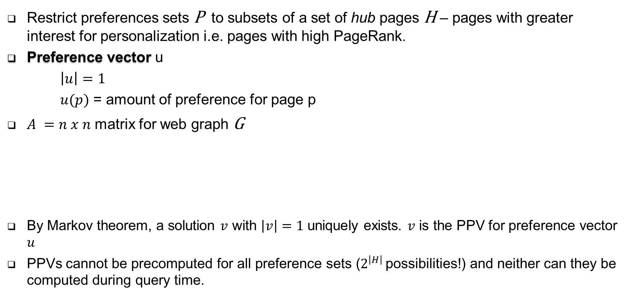

Personalized PageRank Vector (PPV)
Restrict preferences sets P to subsets of a set of hub pages H – pages with greater interest for personalization i.e. pages with high PageRank.
Preference vector u
$\left|u\right|=1$
$u(p)$ = amount of preference for page p
$A =n x n$ matrix for web graph G
By Markov theorem, a solution $v$ with $\left|v\right|=1$ uniquely exists. $v$ is the PPV for preference vector $u$
PPVs cannot be precomputed for all preference sets ($2^{\left|H\right|}$ possibilities!) and neither can they be computed during query time.
Assume every page has at least 1 out neighbor!
$$v =\left(1−c\right)Av+cu$$

Slide 7
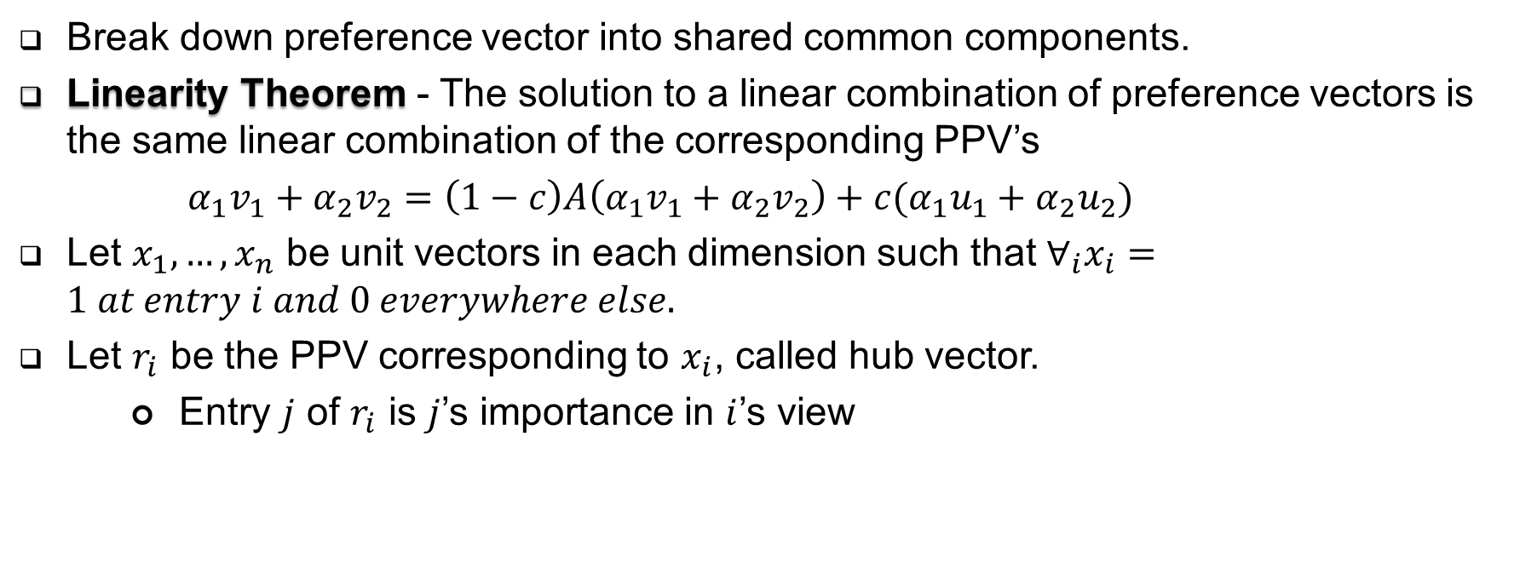
How to solve computing PPV
Break down preference vector into shared common components.
Linearity Theorem - The solution to a linear combination of preference vectors is the same linear combination of the corresponding PPV’s
$α_{1}v_{1}+α_{2}v_{2}=\left(1−c\right)A\left(α_{1}v_{1}+α_{2}v_{2}\right)+c(α_{1}u_{1}+α_{2}u_{2})$
Let $x_{1},…,x_{n}$ be unit vectors in each dimension such that $∀_{i}x_{i}=1 at entry i and 0 everywhere else.$
Let $r_{i}$ be the PPV corresponding to $x_{i}$, called hub vector.
Entry $j$ of $r_{i}$ is $j$’s importance in $i$’s view

Slide 8
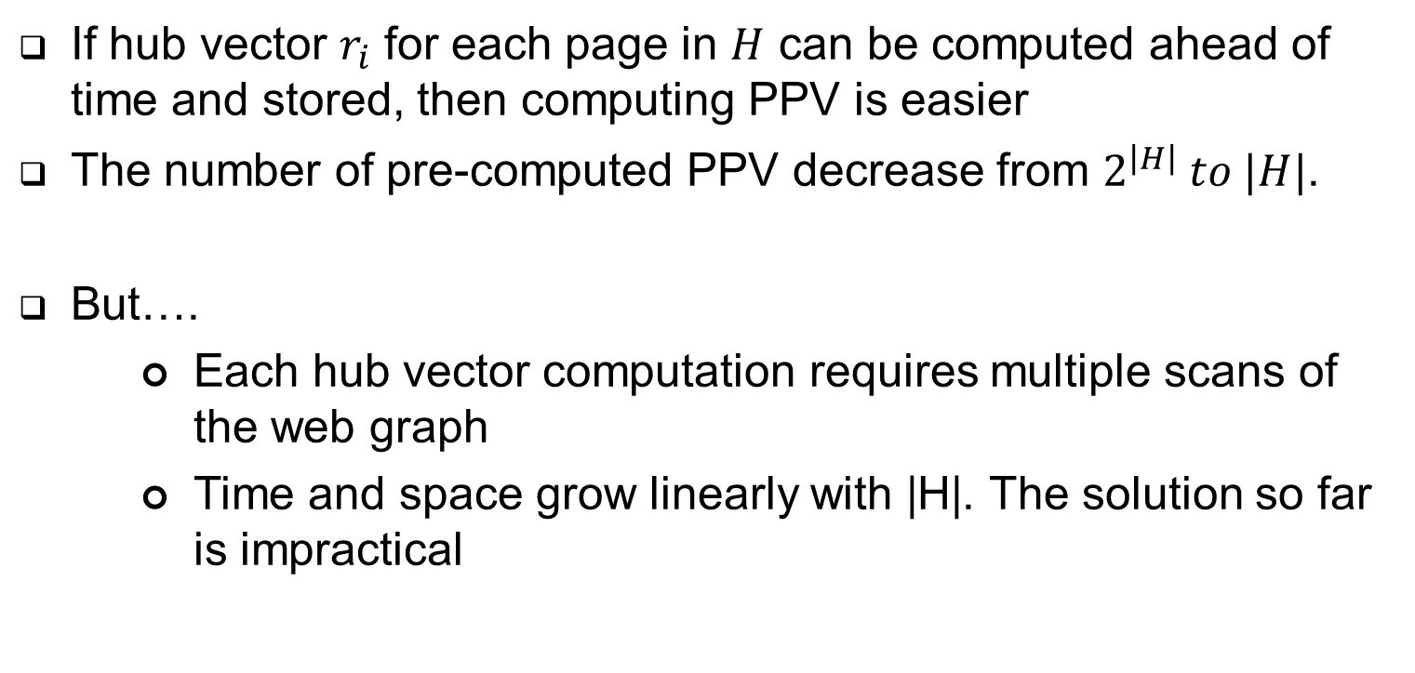
Not quite solved yet
If hub vector $r_{i}$ for each page in $H$ can be computed ahead of time and stored, then computing PPV is easier
The number of pre-computed PPV decrease from $2^{\left|H\right|} to |H|$.
But….
Each hub vector computation requires multiple scans of the web graph
Time and space grow linearly with |H|. The solution so far is impractical

Slide 9
Decomposition of hub vectors
In order to compute and store the hub vectors efficiently, we can further break them down into…
Partial vector –unique component
Hubs skeleton –encode interrelationships among hub vectors
Construct into full hub vector during query time
Saves computation time and storage due to sharing of components among hub vectors

Slide 10
Inverse P-distance
Hub vector r_{p} can be represented as inverse P-distance vector
l(t) – the number of edges in path t
P(t) – the probability of traveling on path t
We will use r_{p}(q) to denote both inverse P-distance and the personalized PageRank score.

Slide 11
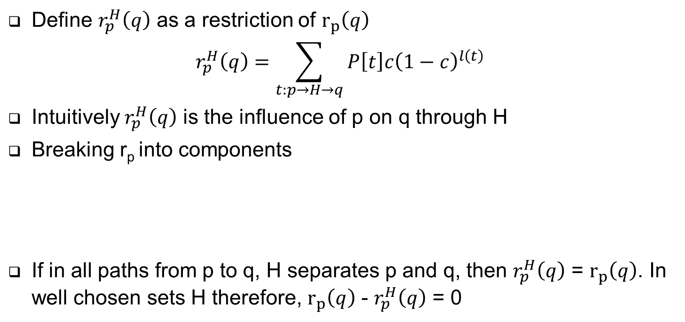
Partial Vectors
Define $r_{p}^{H}\left(q\right)$ as a restriction of $r_{p}\left(q\right)$
$$r_{p}^{H}\left(q\right)=\sum_{t:p→H→q}{P\left[t\right]c{\left(1−c\right)}^{l\left(t\right)}}$$
Intuitively $r_{p}^{H}\left(q\right)$ is the influence of p on q through H
Breaking r_{p} into components
If in all paths from p to q, H separates p and q, then $r_{p}^{H}\left(q\right)$ = $r_{p}\left(q\right)$. In well chosen sets H therefore, $r_{p}\left(q\right)$ - $r_{p}^{H}\left(q\right)$ = 0
Paths that going through some page
Partial Vector

Slide 12
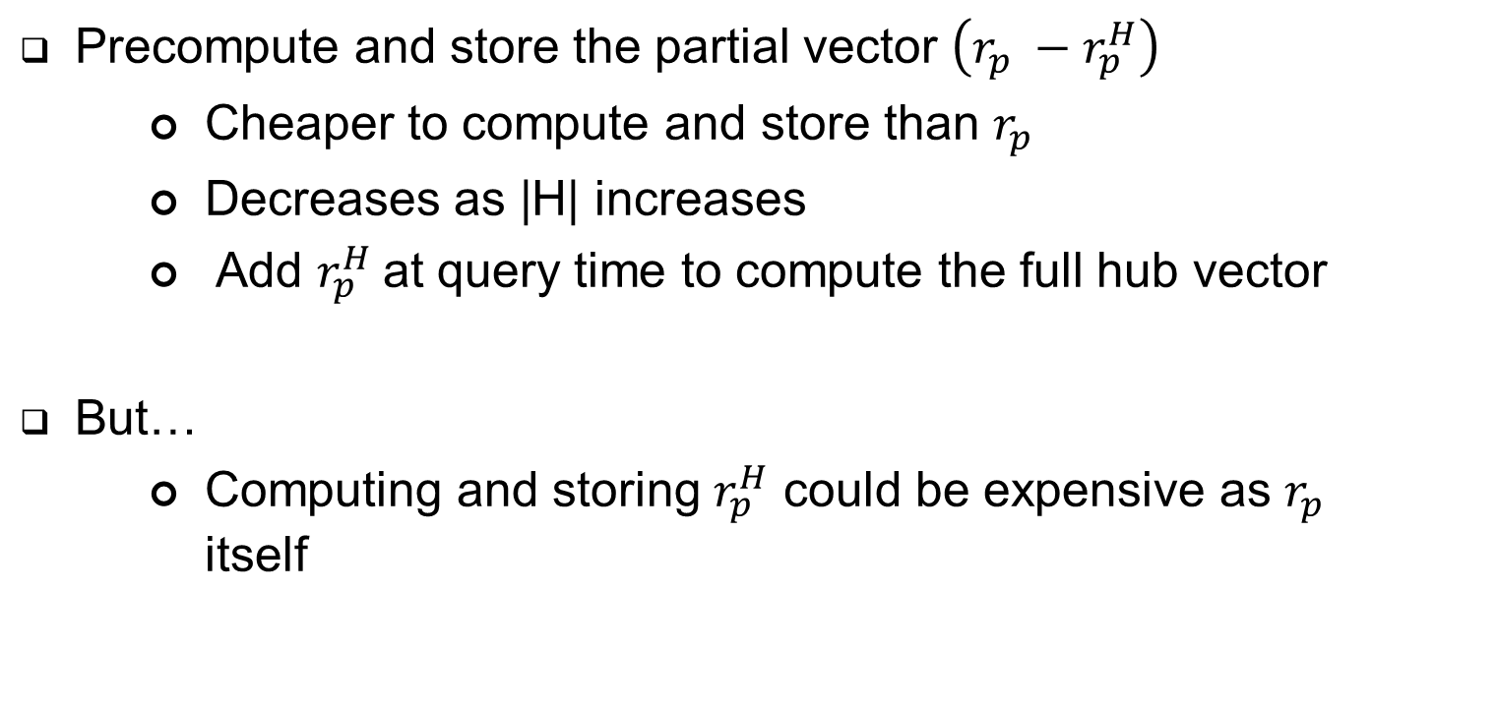
Still not good enough…
Precompute and store the partial vector $\left(r_{p} −r_{p}^{H}\right)$
Cheaper to compute and store than $r_{p}$
Decreases as |H| increases
Add $r_{p}^{H}$at query time to compute the full hub vector
But…
Computing and storing $r_{p}^{H}$ could be expensive as $r_{p}$ itself

Slide 13
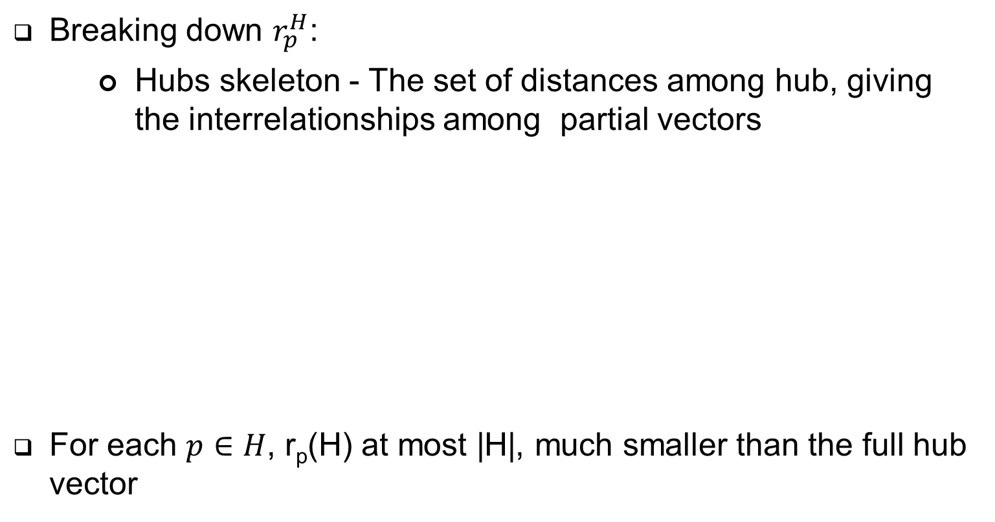
Still not good enough…
Breaking down $r_{p}^{H}$:
Hubs skeleton - The set of distances among hub, giving the interrelationships among partial vectors
For each $p∈H$, r_{p}(H) at most |H|, much smaller than the full hub vector
Hubs skeleton
Partial Vectors
Paths that go through some page
Handling the case p or q is itself in H

Slide 14
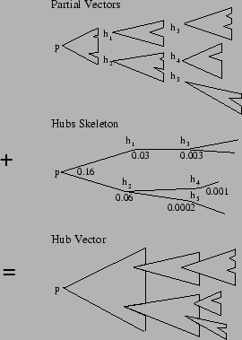
Hubs vectors = partial vectors + hubs skeleton

Slide 15

Overview of the whole process
Hubs skeleton may be deferred to query time
Given a chosen reference set $P$
Form a preference vector $u$
Calculate hub vector for each $i_{k}$
Combine the hub vectors
Pre- computed of partial vectors

Slide 16
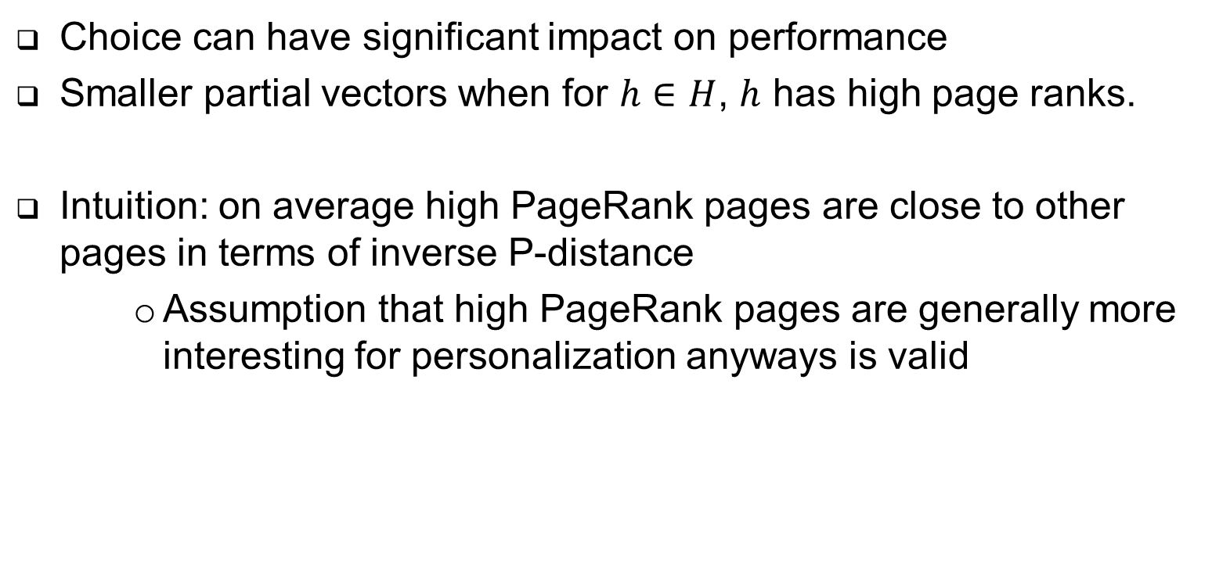
Choice of H
Choice can have significant impact on performance
Smaller partial vectors when for $h∈H$, $h$ has high page ranks.
Intuition: on average high PageRank pages are close to other pages in terms of inverse P-distance
Assumption that high PageRank pages are generally more interesting for personalization anyways is valid

Slide 17
Algorithms
Decomposition theorem
Basic dynamic programming algorithm
Partial vectors - Selective expansion algorithm
Hubs skeleton - Repeated squaring algorithm

Slide 18
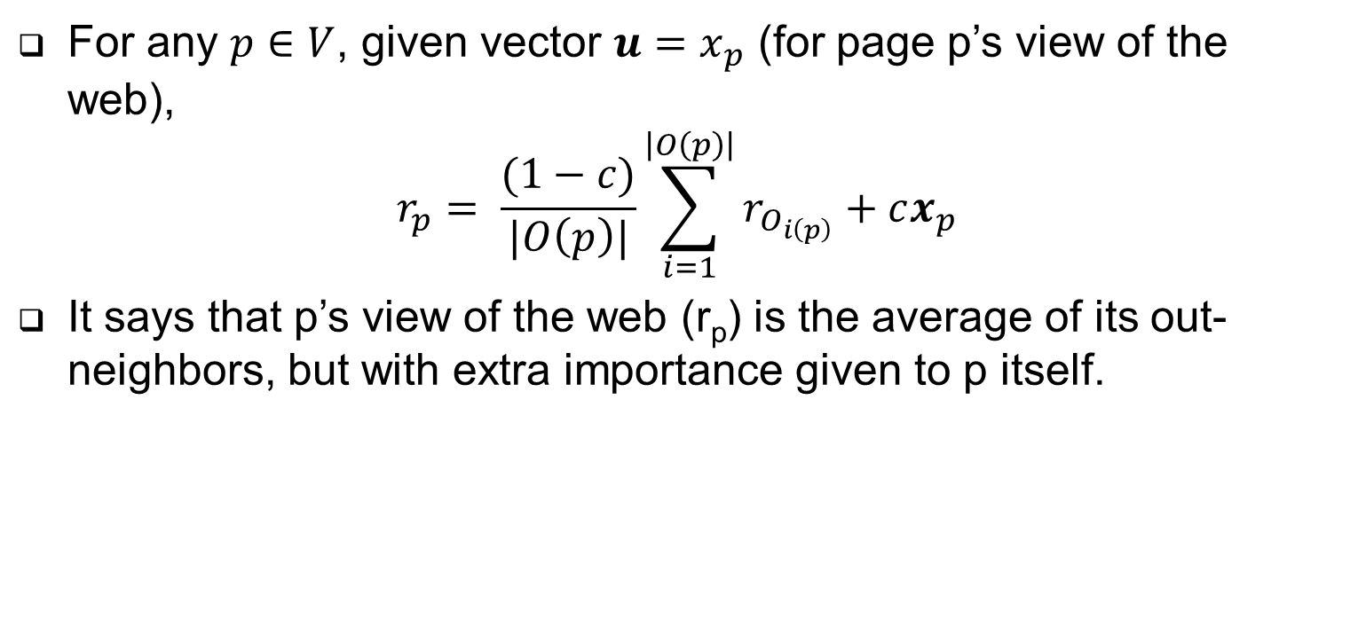
Decomposition theorem
For any $p∈V$, given vector $u=x_{p}$ (for page p’s view of the web),
$$r_{p}= \frac{(1−c)}{|O\left(p\right)|}\sum_{i=1}^{\left|O\left(p\right)\right|}{r_{O_{i\left(p\right)}}+cx_{p}}$$
It says that p’s view of the web (r_{p}) is the average of its out-neighbors, but with extra importance given to p itself.

Slide 19
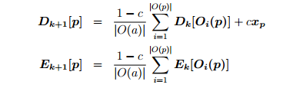
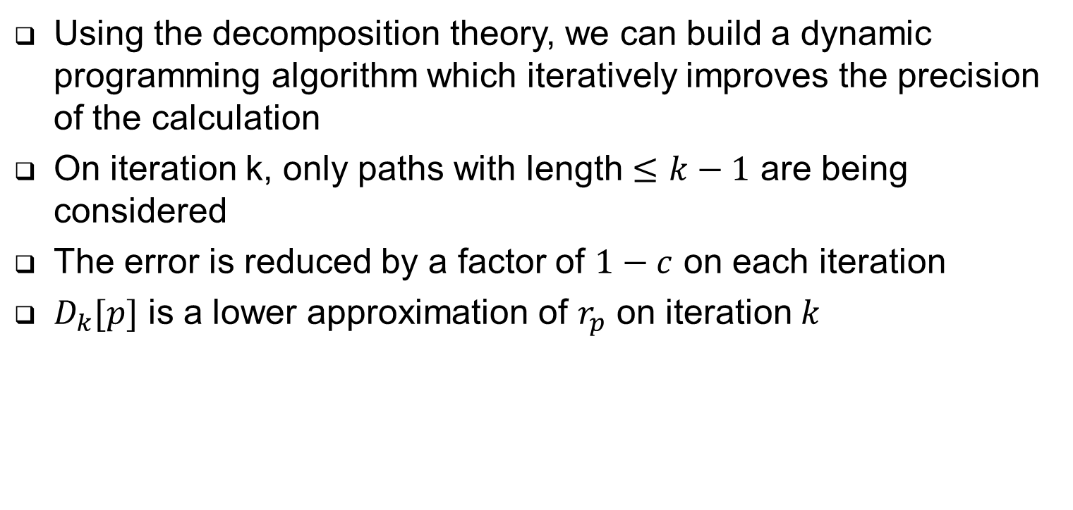
Basic Dynamic programming algorithm
Using the decomposition theory, we can build a dynamic programming algorithm which iteratively improves the precision of the calculation
On iteration k, only paths with length $≤k−1$ are being considered
The error is reduced by a factor of $1−c$ on each iteration
$D_{k}[p]$ is a lower approximation of $r_{p}$ on iteration $k$

Slide 20
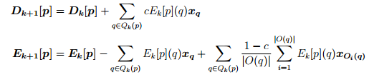
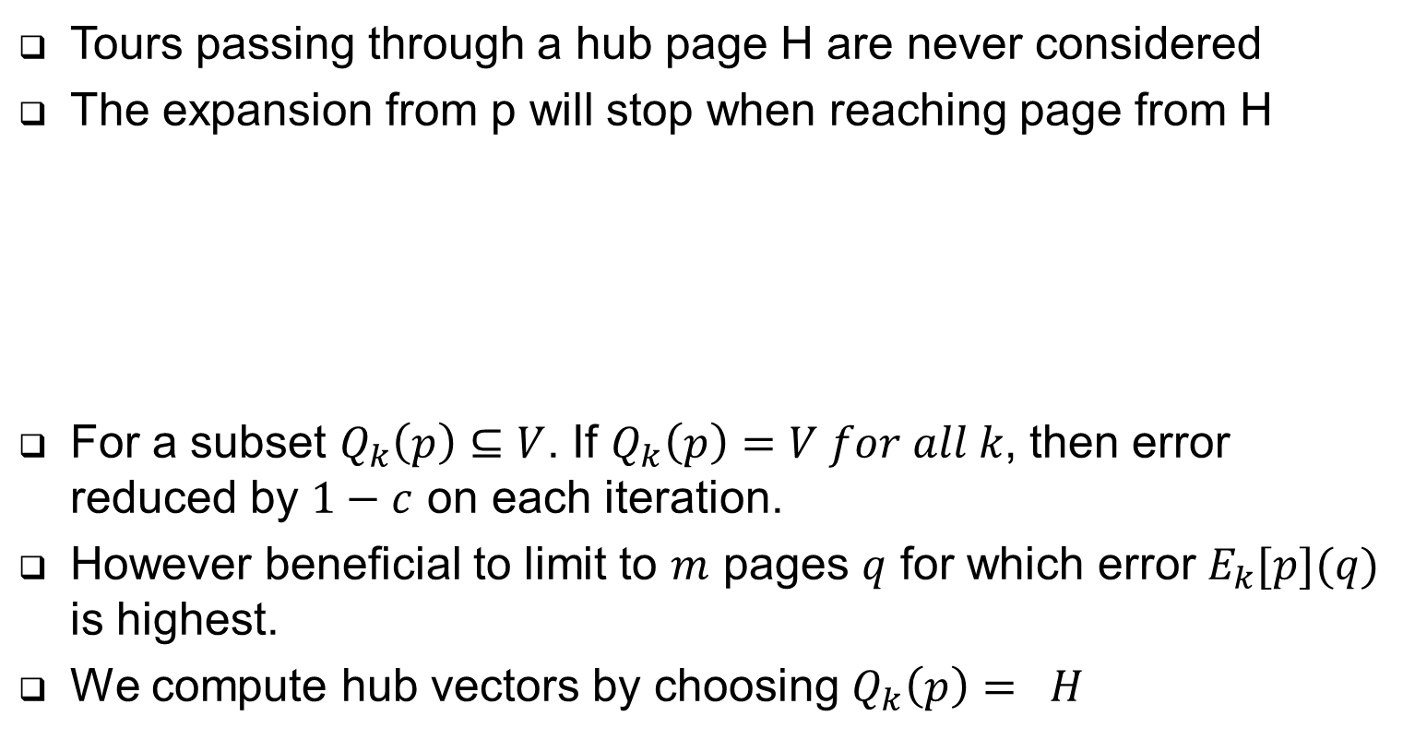
Selective Expansion Algorithm
Tours passing through a hub page H are never considered
The expansion from p will stop when reaching page from H
For a subset $Q_{k}\left(p\right)⊆V$. If $Q_{k}\left(p\right)=V for all k$, then error reduced by $1−c$ on each iteration.
However beneficial to limit to $m$ pages $q$ for which error $E_{k}[p](q)$ is highest.
We compute hub vectors by choosing $Q_{k}\left(p\right)= H$

Slide 21
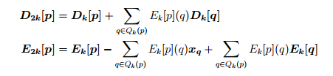

Repeated Squaring Algorithms
The error is squared on each iteration – reduces error much faster.

Slide 22
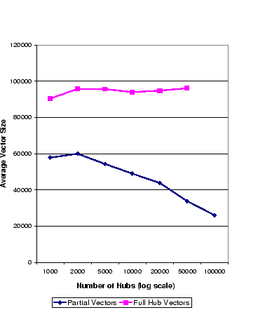
Experiments
Perform experiments using real web data from Stanford’s WebBase, containing 80 million pages after removing leaf pages
Experiments were run using a 1.4 gigahertz CPU on a machine with 3.5 gigabytes of memory
Partial vector approach is much more effective when H contains high-PageRank pages
H was taken from the top 1000 to the top 100,000 pages with the highest PageRank

Slide 23
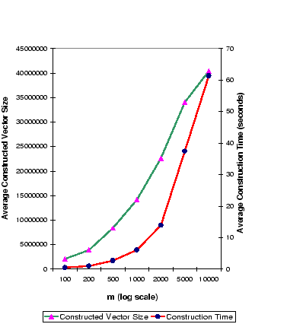
Experiments
Compute hubs skeleton for |H|=10,000
Average size is 9021 entries, much less than dimensions of full hub vectors
Instead of using the entire set rp(H), using only the highest m enteries
Hub vector containing 14 million nonzero entries can be constructed from partial vectors in 6 seconds

Slide 24

The End

