Slide 1
Topic Modeling with Network Regularization
Md Mustafizur Rahman

Slide 2
Outline
Introduction
Topic Models
Findings & Ideas
Methodologies
Experimental Analysis

Slide 3
Making sense of text
Suppose you want to learn something about a corpus that’s too big to read
need to make sense of…
Why don’t we just throw all
these documents at the
computer and see what
interesting patterns it finds?
What topics are trending today on Twitter? | half a billion tweets daily
What research topics receive grant funding (and from whom)? | 80,000 active NIH grants
What issues are considered by Congress (and which politicians are interested in which topic)? | hundreds of bills each year
Are certain topics discussed more in certain languages on Wikipedia? | Wikipedia (it’s big)

Slide 4
Preview
Topic models can help you automatically discover patterns in a corpus
unsupervised learning
Topic models automatically…
group topically-related words in “topics”
associate tokens and documents with those topics

Slide 5
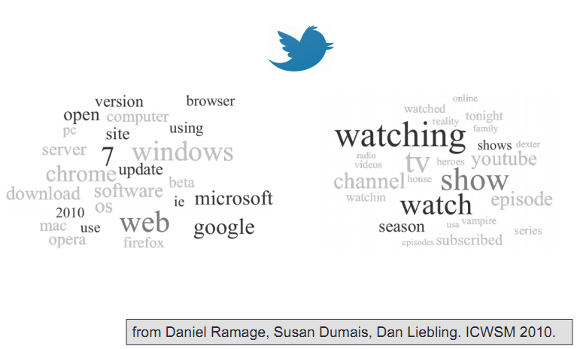
Twitter topics

Slide 6
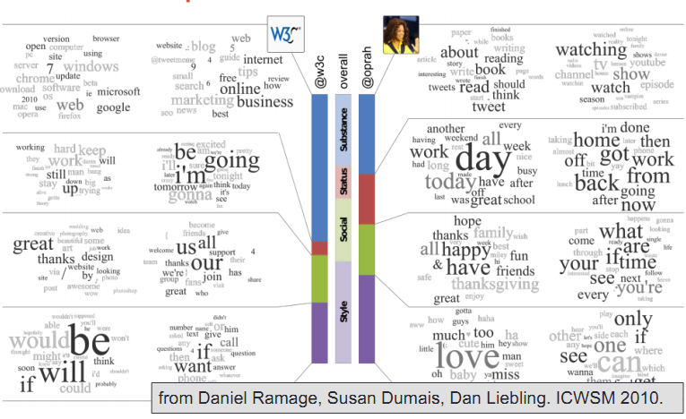
Twitter topics

Slide 7
So what is “topic”?
Loose idea: a grouping of words that are likely to appear in the same context
A hidden structure that helps determine what words are likely to appear in a corpus
e.g. if “war” and “military” appear in a document, you probably won’t be surprised to find that “troops” appears later on
why? it’s not because they’re all nouns
…though you might say they all belong to the same topic

Slide 8
You’ve seen these ideas before
Most of NLP is about inferring hidden structures that we assume are behind the observed text
parts of speech(POS), syntax trees
Hidden Markov models (HMM) for POS
the probability of the word token depends on the state
the probability of that token’s state depends on the state of the previous token (in a 1st order model)
The states are not observed, but you can infer them using the forward-backward/viterbi algorithm

Slide 9
Topic models
Take an HMM, but give every document its own transition probabilities (rather than a global parameter of the corpus)
This let’s you specify that certain topics are more common in certain documents
whereas with parts of speech, you probably assume this doesn’t depend on the specific document
We’ll also assume the hidden state of a token doesn’t actually depend on the previous tokens
“0th order”
individual documents probably don’t have enough data to estimate full transitions
plus our notion of “topic” doesn’t care about local interactions

Slide 10
Topic models
The probability of a token is the joint probability of the word and the topic label
P(word=Apple, topic=1 | θd , β1)
= P(word=Apple | topic=1, β1) P(topic=1 | θd)
each topic has
distribution , βk over words
(the emission probabilities)
global across all documents
each document has
distribution θd over topics
(the 0th order “transition” probabilities)
local to each document

Slide 11
Estimating the parameters (θ, β)
Need to estimate the parameters θ, β
want to pick parameters that maximize the likelihood of the observed data
This is easy if all the tokens were labeled with topics (observed variables)
just counting
But we don’t actually know the (hidden) topic assignments
Expectation Maximization (EM)
1. Compute the expected value of the variables, given the current model parameters
2. Pretend these expected counts are real and update the parameters based on these
now parameter estimation is back to “just counting”
3. Repeat until convergence

Slide 12
Topic Models
Probabilistic Latent Semantics Analysis (PLSA)
Latent Dirichlet Allocation(LDA)

Slide 13
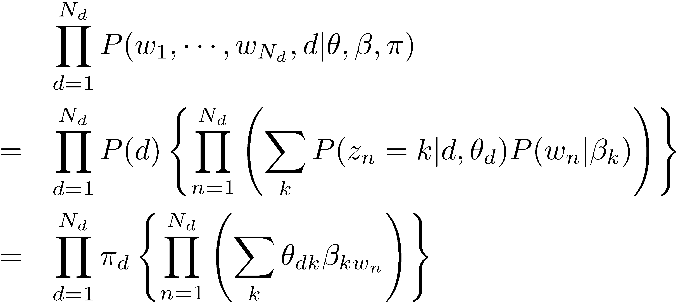
Probabilistic Latent Semantic Analysis (PLSA)
θ_{d}
d
π
Select document d ~ Mult(π)
For each position n = 1,☹, N_{d}
generate z_{n} ~ Mult( ¢ | θ_{d})
generate w_{n} ~ Mult( ¢ | β_{zn})
Topic distribution
z
w
N
M
β

Slide 14
Parameter estimation in PLSA
E-Step:
Word w in doc d is generated
from topic j
from background
Posterior: application of Bayes rule
M-Step:
Re-estimate
mixing weights
word-topic distribution
Sum over all docs
in the collection
Fractional counts contributing to
using topic j in generating d
generating w from topic j

Slide 15
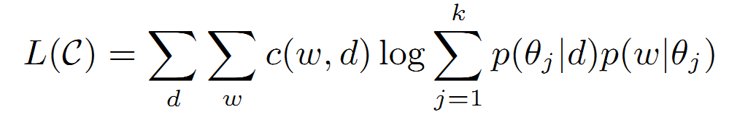
Likelihood of PLSA
θ_{d}
β
Count of word w in document d

Slide 16
Graph (Revisited)
A network associated with text collection C is a graph G = {V , E}, where V is a set of vertices and E is set of edges
Vertex v as a subset of document D_{v}
In author graph, a vertex is all the documents a author published, that is a vertex is set of documents
Edge {u , v} is a binary relation between to vertices u and v
If two authors contributes to a paper/document

Slide 17
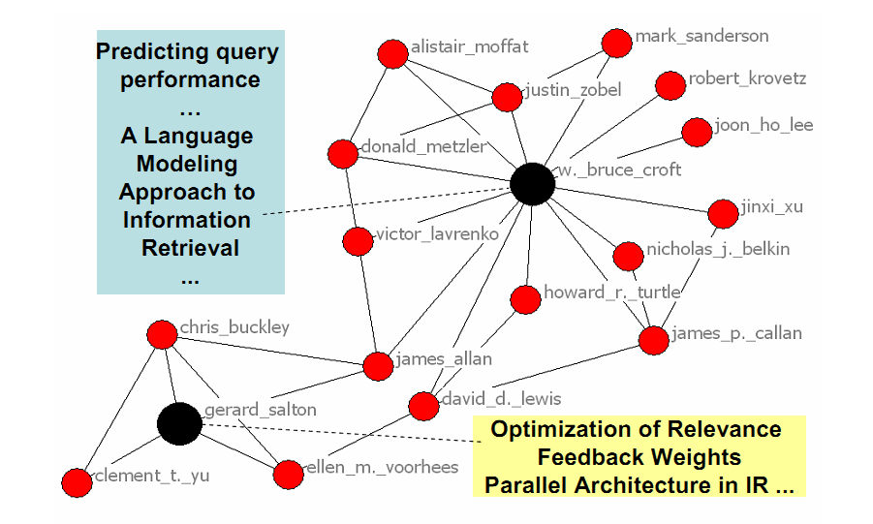
Observation
Collection of data with network structure attached
Author-topic analysis
Spatial Topic

Slide 18
Findings
In a network like author-topic graph,
Vertices which are connected to each other should have similar topic assignment
Idea
Apply some kind of regularization on the topic models
Tweak the log likelihood of the PLSA L(C)

Slide 19
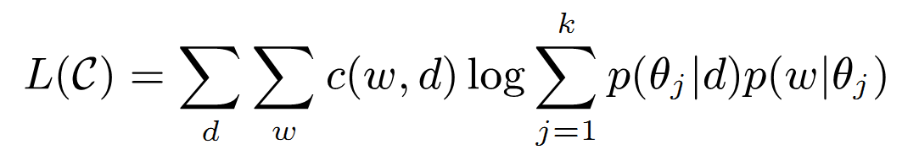
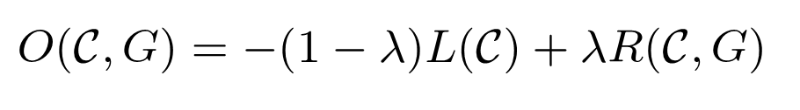
Regularized Topic Model
Likelihood L(C) from PLSA
Regularized data likelihood will be
Minimizing the O(C, G) will give us the topics that best fit the collection C

Slide 20
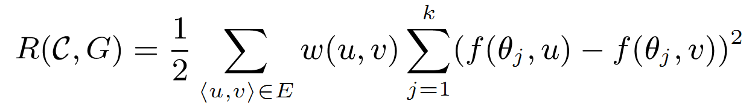
Regularized Topic Model
Regularizer
A harmonic function
Where f(θ,u) is a weighting function of topics on vertex u

Slide 21
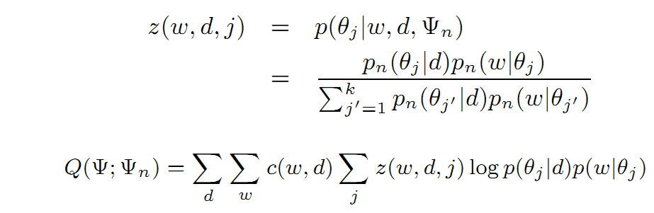
Parameter Estimation
When λ = 0, the O(C, G) boils down to L(C)
So, simply apply the parameter estimation of PLSA
E Step

Slide 22
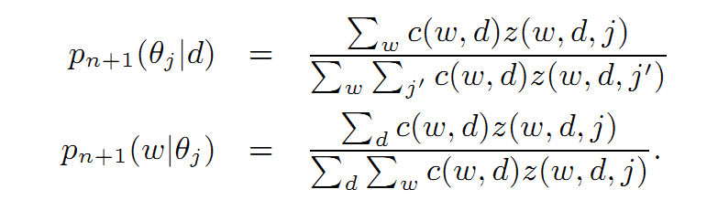
Parameter Estimation
When λ = 0, the O(C, G) boils down to L(C)
So, simply apply the parameter estimation of PLSA
M Step

Slide 23
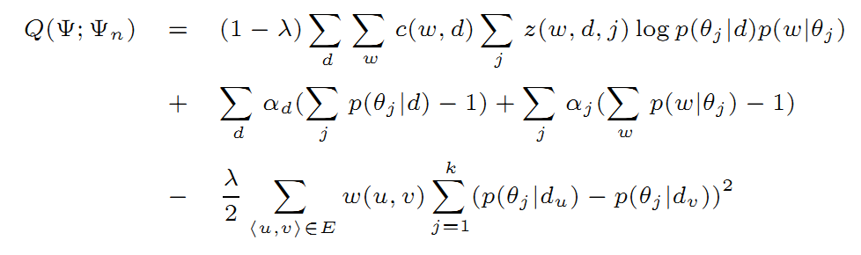
Parameter Estimation (M-Step)
When λ != 0, the complete expected data likelihood
Lagrange Multipliers

Slide 24

Parameter Estimation (M-Step)
The estimation of P(w|θ_{j}) does not rely on the regularizer
Calculation is same as when λ = 0
The estimation of P(θ_{j}|d) relies on the regularizer
Not same as when λ = 0
No closed form
Way-1: Apply Newton Raphson Method
Way-2: Solve the linear equations

Slide 25
Experimental Analysis
Two set of experiments
DBLP Author-Topic Analysis
Geographic Topic Analysis
Baseline
PLSA
DataSet
Conference proceedings from 4 conferences (WWW, SIGIR,KDD, NIPS)
Blogset from Google blog

Slide 26
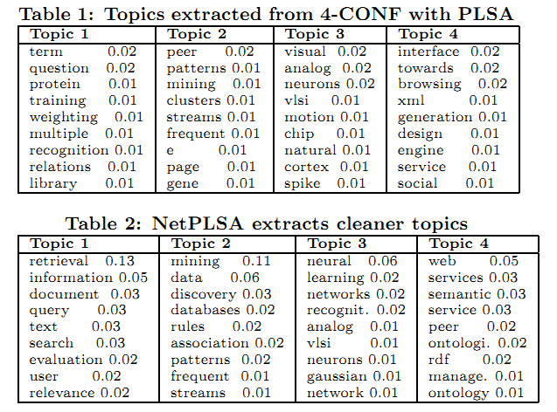
Experimental Analysis

Slide 27
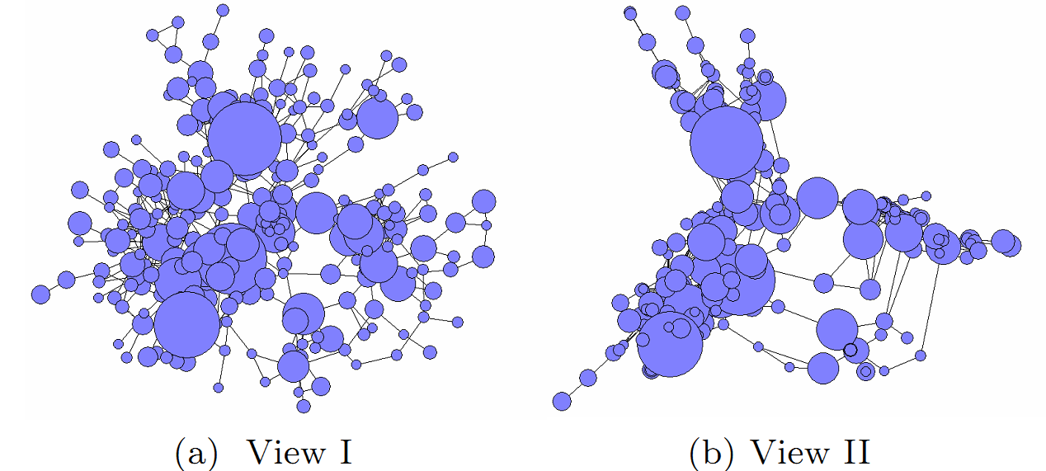
Topical Communities Analysis (Graph Methods)
Spring Embedder
Gower Metric Scaling

Slide 28
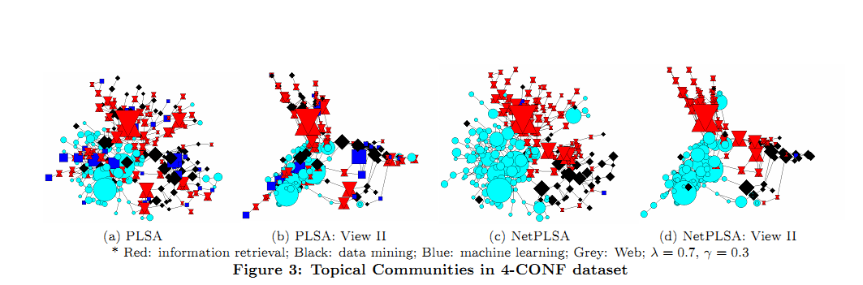
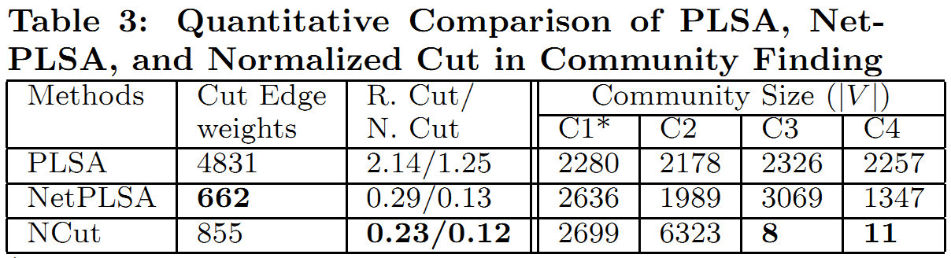
Topical Communities Analysis (Regularized PLSA)

Slide 29
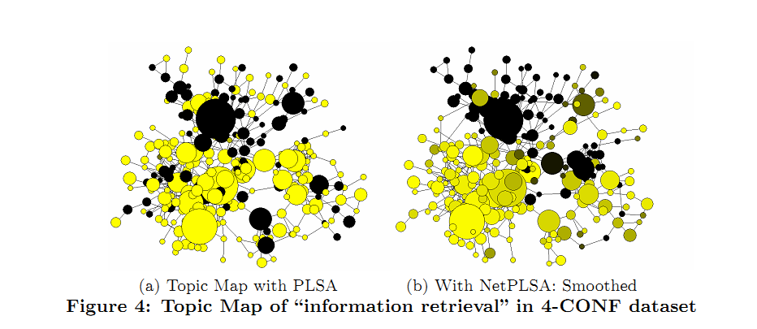
Topic Mapping

Slide 30
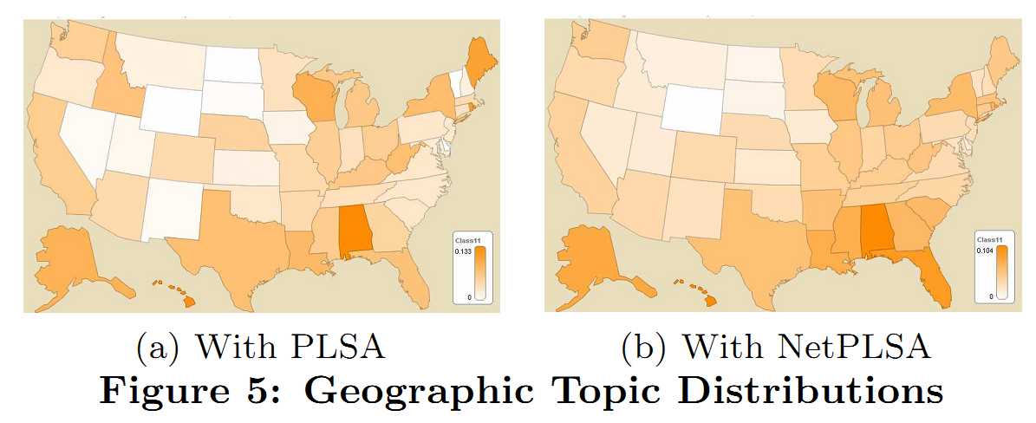
Geographical Topic Analysis

Slide 31
Conclusion
Regularize a topic modeling
Using a network structure from graph
Develop a method to solve the constrained optimization problem
Perform exhaustive analysis
Comparison against PLSA

Slide 32
Courtesy
Some of the slides in the presentation are borrowed from
Prof. Hongning Wang, University of Virginia
Prof. Michael Paul , John Hopkins University

Slide 33


