Slide 1
A Markov Random Field Model for Term Dependencies
Chetan Mishra
CS 6501 Paper Presentation
Ideas, graphs, charts, and results from paper of same name by Metzler and Croft 2005 (SIGIR)

Slide 2
Agenda
Agenda | Motivation | Background | Research Insight | Future Work | Conclusion
Motivation behind the work
Background – What is a Markov Random Field (MRF)?
Research Insight – How did the authors use MRF to model term dependencies? Results?
Future Work – If you thought this was interesting, how could you build on this?
Conclusion

Slide 3
Motivation
Agenda | Motivation | Background | Research Insight | Future Work | Conclusion
Terms are not independently distributed
A model incorporating term dependencies should outperform a model that ignores them
One problem: models incorporating term dependencies seemed no better or worse
Statistical models weren’t effectively modeling term dependencies
Why?

Slide 4
Motivation
Agenda | Motivation | Background | Research Insight | Future Work | Conclusion
Two Problems (perspective of authors):
Problem 1: Most models have taken bag of word-like approaches (which have tremendous data requirements)
Solution 1: We need a new type of model
Problem 2: Term dependency modeling (even with a reasonable model) requires a significant corpus
Solution 2: Add to research testing collections large, web-scraped corpuses

Slide 5
Background
Agenda | Motivation | Background | Research Insight | Future Work | Conclusion
What is a Markov random field (MRF) model?
Fancy name for a bidirectional graph-based model
Often used in machine learning to succinctly model joint distributions
MRF models are used in the paper to tackle the problem of document retrieval with response to a query

Slide 6
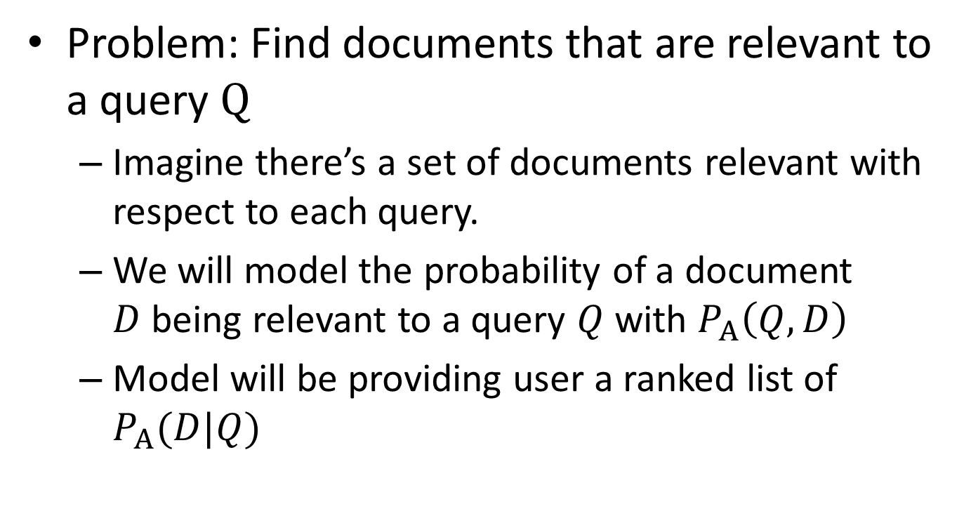
Model Overview
Agenda | Motivation | Background | Research Insight | Future Work | Conclusion
Problem: Find documents that are relevant to a query $Q$
Imagine there’s a set of documents relevant with respect to each query.
We will model the probability of a document $D$being relevant to a query $Q$ with $P_{Α}\left(Q, D\right)$
Model will be providing user a ranked list of $P_{Α}(D|Q)$

Slide 7
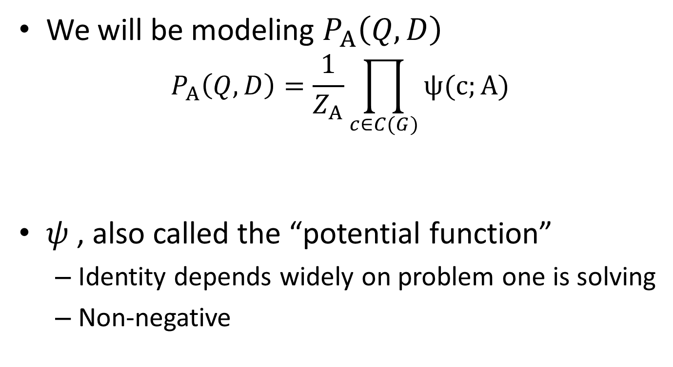
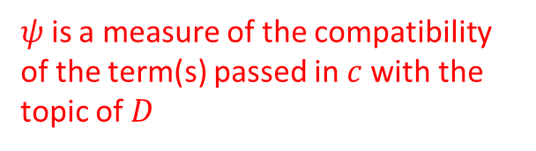
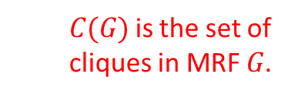
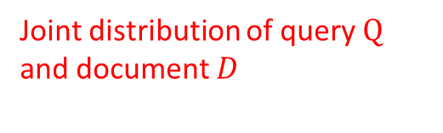
Model Overview
Agenda | Motivation | Background | Research Insight | Future Work | Conclusion
We will be modeling $P_{Α}\left(Q, D\right)$
$$P_{Α}\left(Q, D\right)=\frac{1}{Z_{Α}}\prod_{c∈C(G)}{ψ(c;Α)}$$
$ψ$ , also called the “potential function”
Identity depends widely on problem one is solving
Non-negative
Joint distribution of query $Q$ and document $D$
$ψ$ is a measure of the compatibility of the term(s) passed in $c$with the topic of $D$
$C(G)$ is the set of cliques in MRF $G$.
Notes:
REMEMBER TO MENTION Z

Slide 8
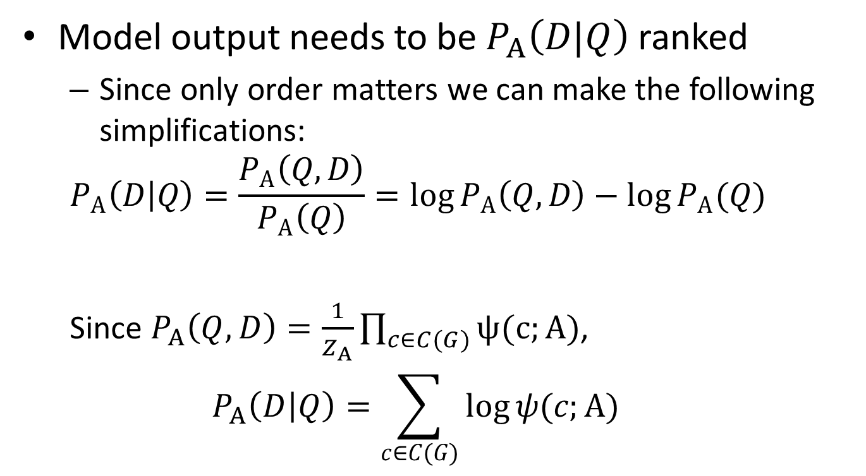
Model Overview
Agenda | Motivation | Background | Research Insight | Future Work | Conclusion
Model output needs to be $P_{Α}\left(D|Q\right)$ ranked
Since only order matters we can make the following simplifications:
$$P_{Α}\left(D | Q\right)=\frac{P_{Α}\left(Q, D\right)}{P_{Α}\left(Q\right)}=\log{P_{Α}\left(Q, D\right)−\log{P_{Α}(Q)}}$$
Since $P_{Α}\left(Q, D\right)=\frac{1}{Z_{Α}}\prod_{c∈C(G)}{ψ(c;Α)}$,
$$P_{Α}\left(D | Q\right)=\sum_{c∈C(G)}{\log{ψ(c;Α)}}$$
By the joint probability law

Slide 9
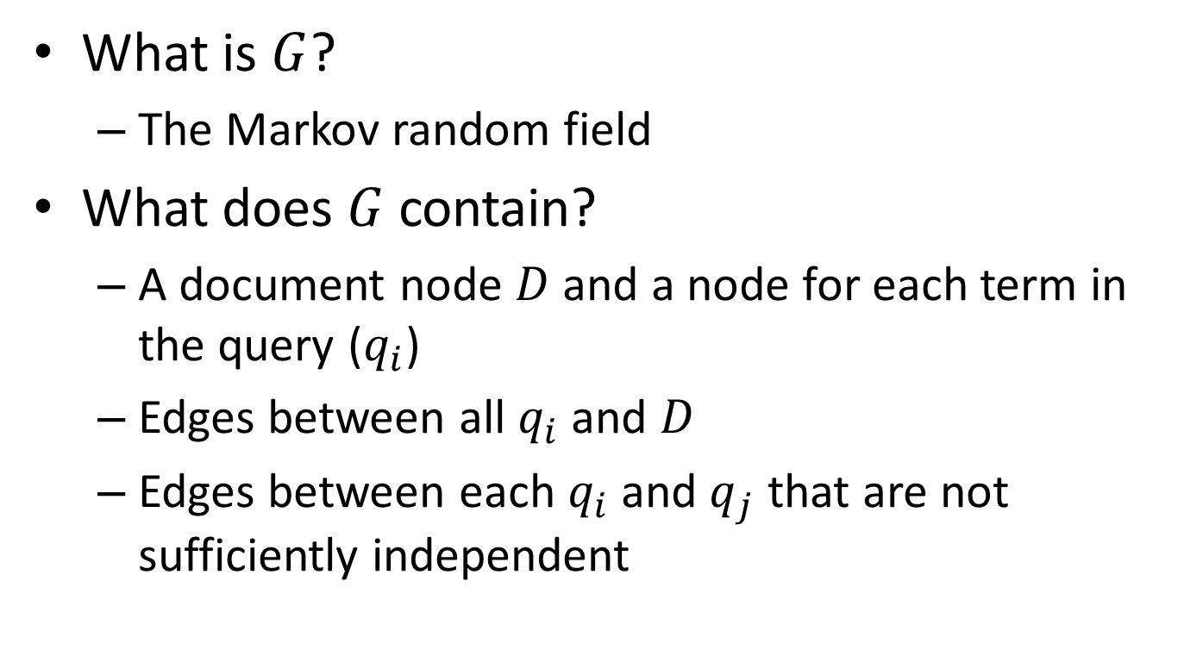
The Markov Random Field Model
Agenda | Motivation | Background | Research Insight | Future Work | Conclusion
What is $G$?
The Markov random field
What does $G$ contain?
A document node $D$and a node for each term in the query ($q_{i}$)
Edges between all $q_{i}$ and $D$
Edges between each $q_{i}$ and $q_{j}$ that are not sufficiently independent

Slide 10
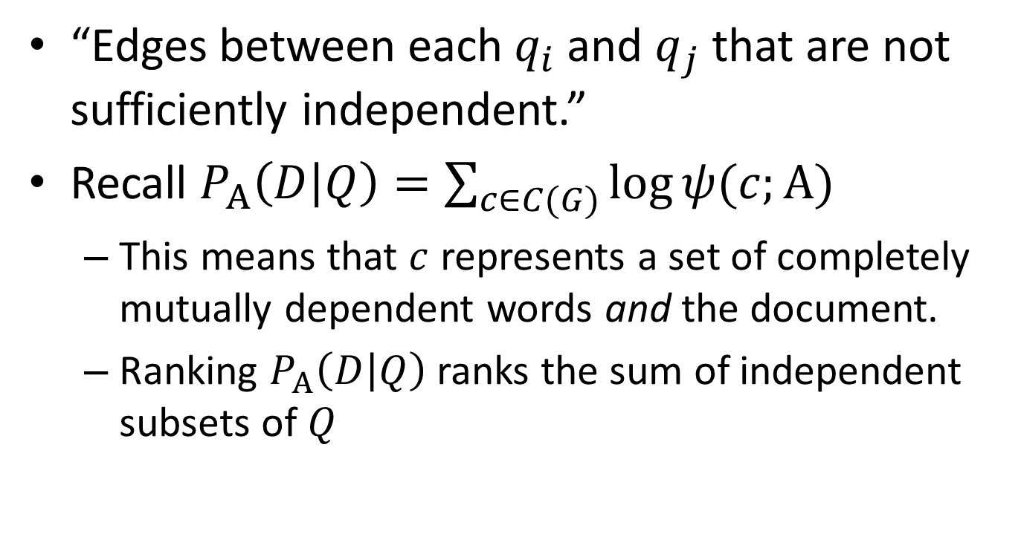
The Markov Random Field Model
Agenda | Motivation | Background | Research Insight | Future Work | Conclusion
“Edges between each $q_{i}$ and $q_{j}$ that are not sufficiently independent.”
Recall $P_{Α}\left(D | Q\right)=\sum_{c∈C(G)}{\log{ψ(c;Α)}}$
This means that $c$ represents a set of completely mutually dependent words and the document.
Ranking $P_{Α}\left(D | Q\right)$ ranks the sum of independent subsets of $Q$

Slide 11
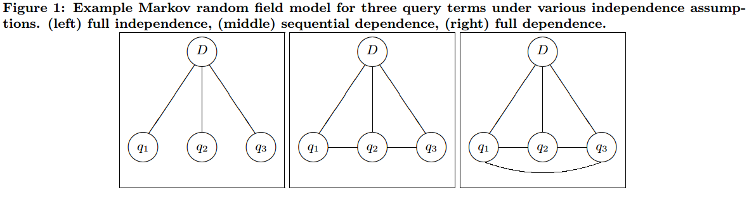
The Markov Random Field Model
Agenda | Motivation | Background | Research Insight | Future Work | Conclusion
The paper looks at the performance of three general types of dependencies:
Independence
Sequential dependence
Full dependence
Visual Depiction:
Metzler and Croft ‘05

Slide 12
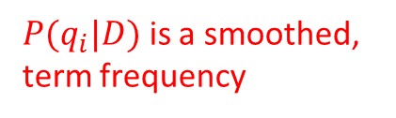
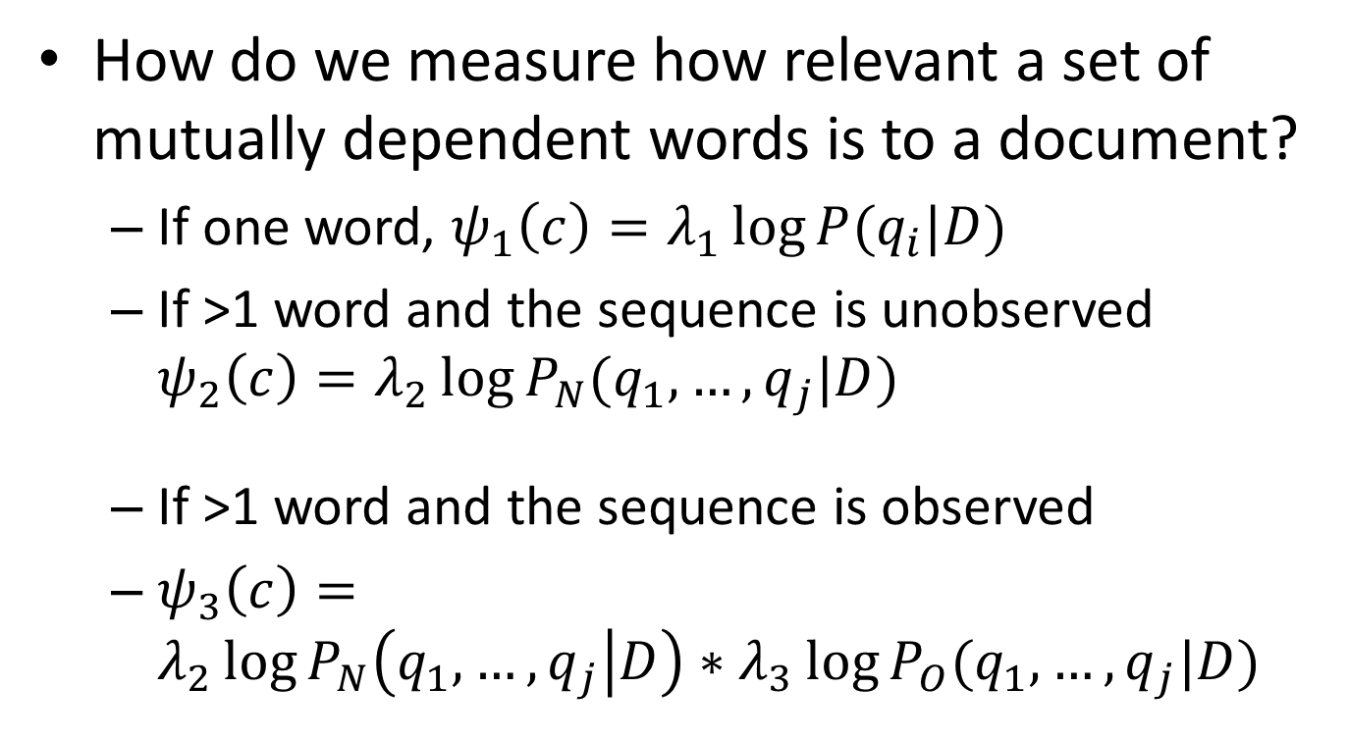
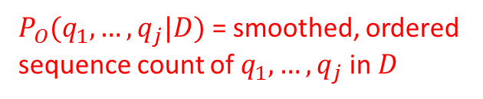

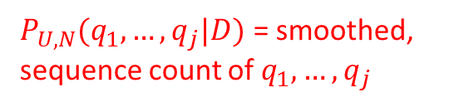
Potential Functions
Agenda | Motivation | Background | Research Insight | Future Work | Conclusion
All log scale!
How do we measure how relevant a set of mutually dependent words is to a document?
If one word, $ψ_{1}\left(c\right)=λ_{1}\log{P(q_{i}|D)}$
If >1 word and the sequence is unobserved $ψ_{2}\left(c\right)=λ_{2}\log{P_{N}(q_{1}, …, q_{j}|D)}$
If >1 word and the sequence is observed
$ψ_{3}\left(c\right)=λ_{2}\log{P_{N}\left(q_{1}, …, q_{j} | D\right)∗λ_{3}\log{P_{O}(q_{1}, …, q_{j}|D)} }$
$P(q_{i}|D)$ is a smoothed, term frequency
$P_{U,N}(q_{1}, …, q_{j}|D)$ = smoothed, sequence count of $q_{1}, …, q_{j}$
appearing unordered within $N$ extra terms
$P_{O}(q_{1}, …, q_{j}|D)$ = smoothed, ordered sequence count of $q_{1}, …, q_{j}$ in $D$

Slide 13
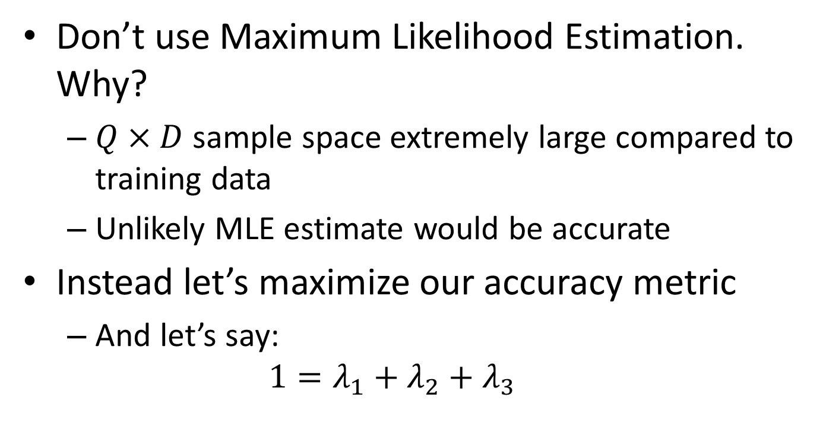
Parameter Training
Agenda | Motivation | Background | Research Insight | Future Work | Conclusion
Don’t use Maximum Likelihood Estimation. Why?
$Q×D$ sample space extremely large compared to training data
Unlikely MLE estimate would be accurate
Instead let’s maximize our accuracy metric
And let’s say:
$$1=λ_{1}+λ_{2}+λ_{3}$$

Slide 14
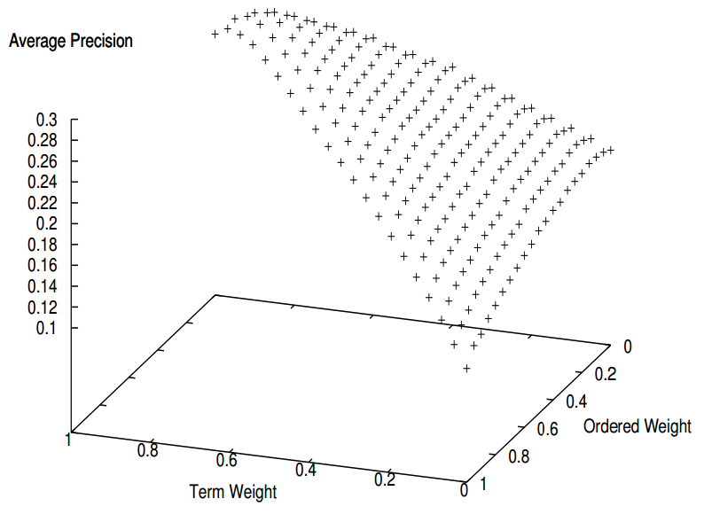
Parameter Training
Agenda | Motivation | Background | Research Insight | Future Work | Conclusion
What optimization technique do we use?
Authors found a shape common to the metric surface via parameter sweep
A hill-climbing search
should work well

Slide 15
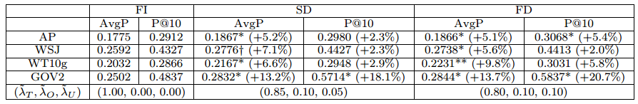
Results
Agenda | Motivation | Background | Research Insight | Future Work | Conclusion
Did MRF’s help?
I’d say so. Significant gains across data sets
Independent
Sequential Dependence
Full Dependence

Slide 16
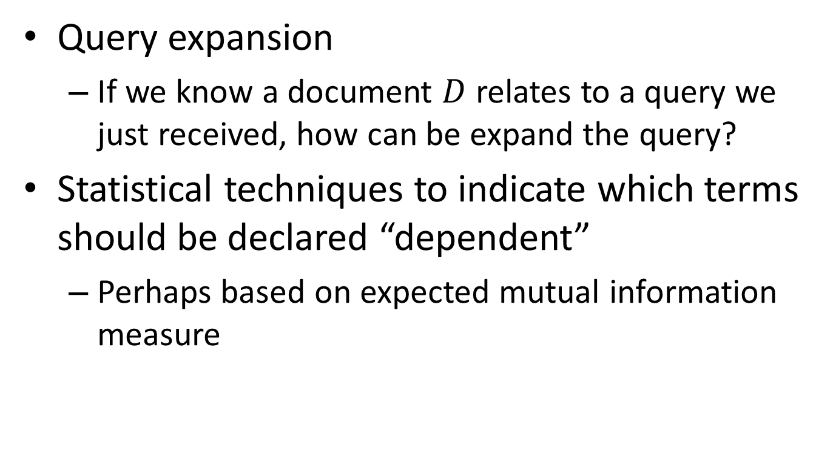
Future Work
Agenda | Motivation | Background | Research Insight | Future Work | Conclusion
Query expansion
If we know a document $D$ relates to a query we just received, how can be expand the query?
Statistical techniques to indicate which terms should be declared “dependent”
Perhaps based on expected mutual information measure

Slide 17
Conclusion
Agenda | Motivation | Background | Research Insight | Future Work | Conclusion
Motivation behind the work
Background – What is a Markov Random Field Model (MRF)?
Research Insight – How did the authors use MRF to model term dependencies? Results?
Future Work – If you thought this was interesting, how could you build on this?
Conclusion

Slide 18
Questions?

