Slide 1
Introduction to Text Mining
Hongning Wang
CS@UVa

Slide 2
What is “Text Mining”?
“Text mining, also referred to as text data mining, roughly equivalent to text analytics, refers to the process of deriving high-quality information from text.” - wikipedia
“Another way to view text data mining is as a process of exploratory data analysis that leads to heretofore unknown information, or to answers for questions for which the answer is not currently known.” - Hearst, 1999

Slide 3
Two different definitions of mining
Goal-oriented (effectiveness driven)
Any process that generates useful results that are non-obvious is called “mining”.
Keywords: “useful” + “non-obvious”
Data isn’t necessarily massive
Method-oriented (efficiency driven)
Any process that involves extracting information from massive data is called “mining”
Keywords: “massive” + “pattern”
Patterns aren’t necessarily useful

Slide 4
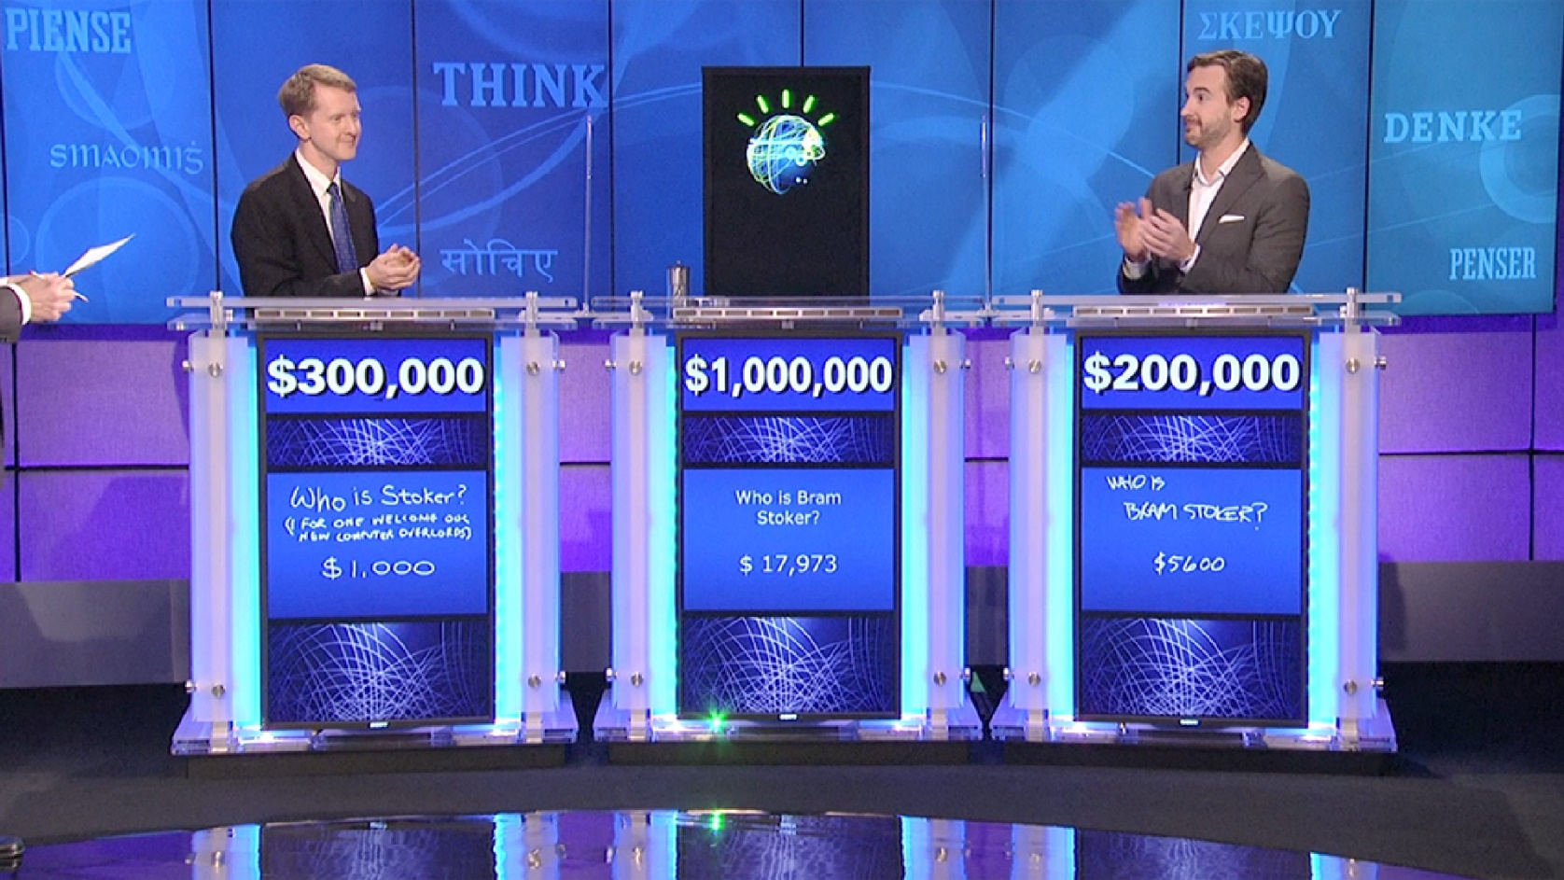
Knowledge discovery from text data
IBM’s Watson wins at Jeopardy! - 2011

Slide 5
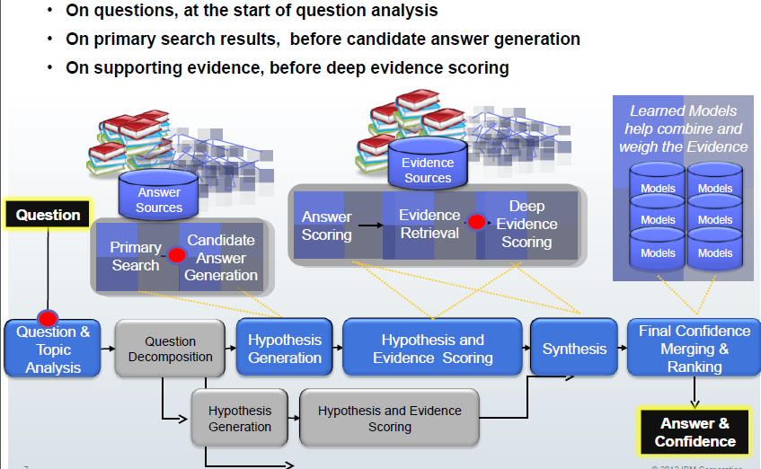
An overview of Watson

Slide 6
What is inside Watson?
“Watson had access to 200 million pages of structured and unstructured content consuming four terabytes of disk storage including the full text of Wikipedia” – PC World
“The sources of information for Watson include encyclopedias, dictionaries, thesauri, newswire articles, and literary works. Watson also used databases, taxonomies, and ontologies. Specifically, DBPedia, WordNet, and Yago were used.” – AI Magazine

Slide 7
What is inside Watson?
DeepQA system
“Watson's main innovation was not in the creation of a new algorithm for this operation but rather its ability to quickly execute hundreds of proven language analysis algorithms simultaneously to find the correct answer.” – New York Times
The DeepQA Research Team

Slide 8
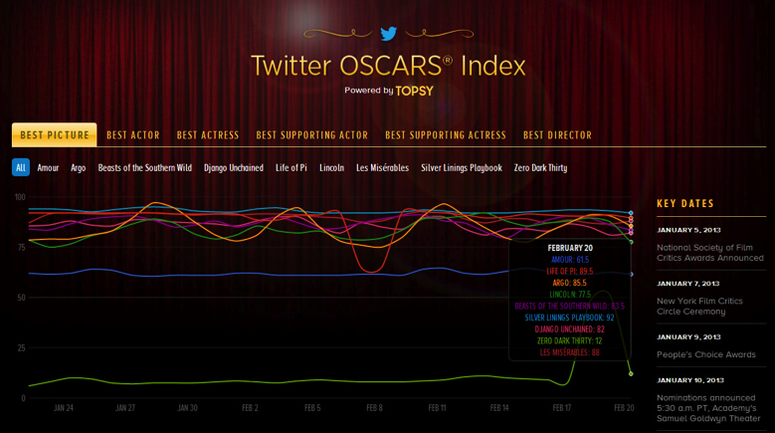
Text mining around us
Sentiment analysis

Slide 9
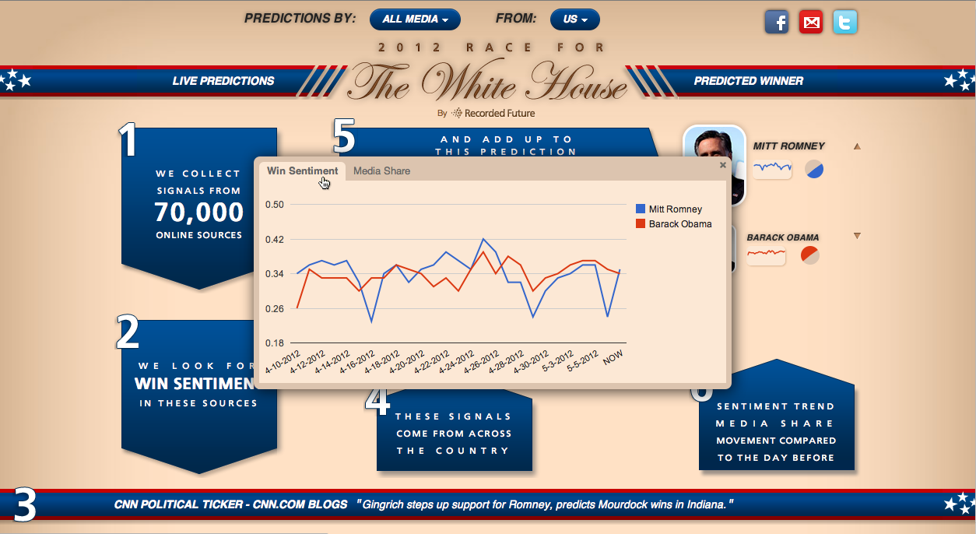
Text mining around us
Sentiment analysis

Slide 10
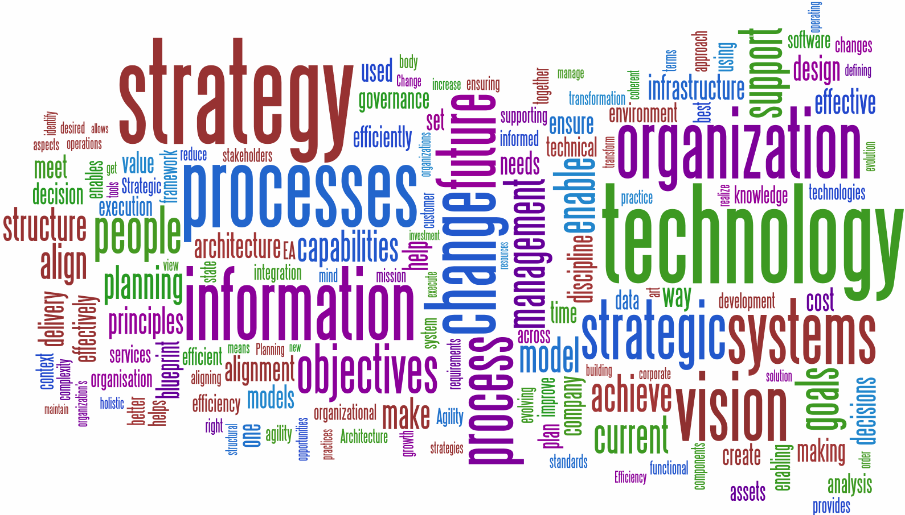
Text mining around us
Document summarization

Slide 11
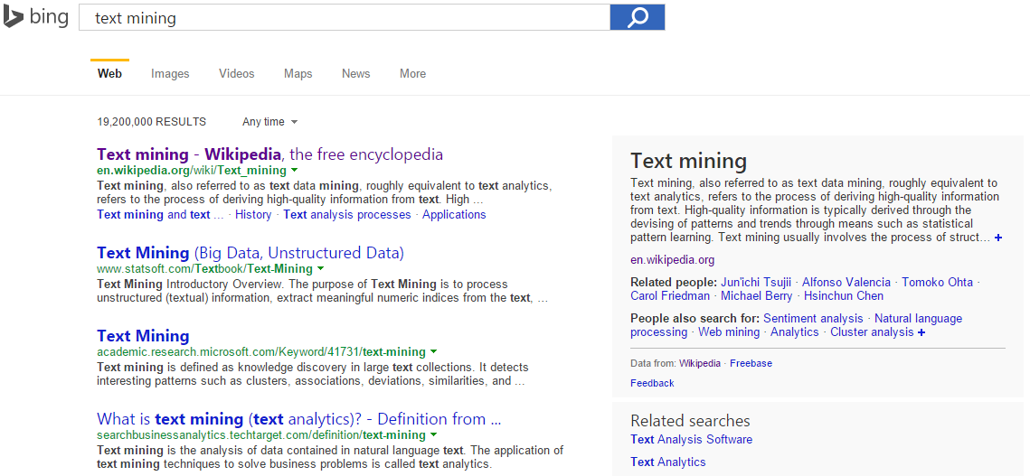
Text mining around us
Document summarization

Slide 12
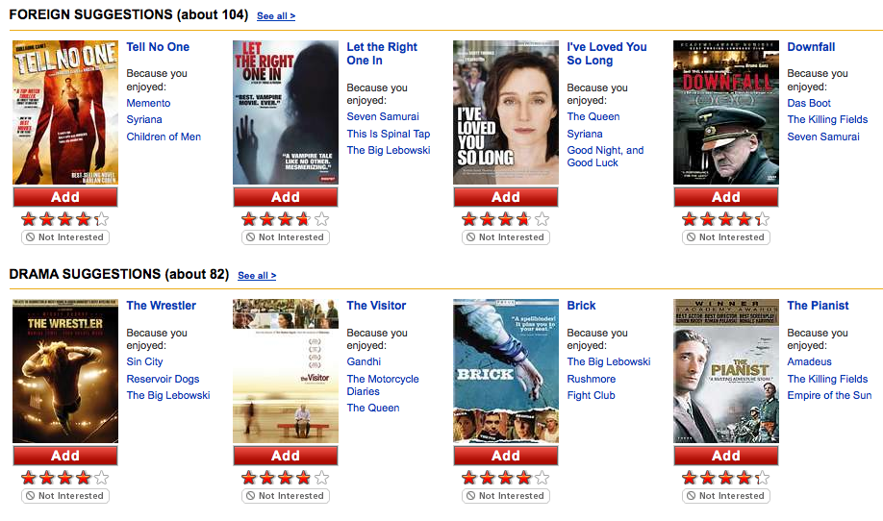
Text mining around us
Movie recommendation

Slide 13
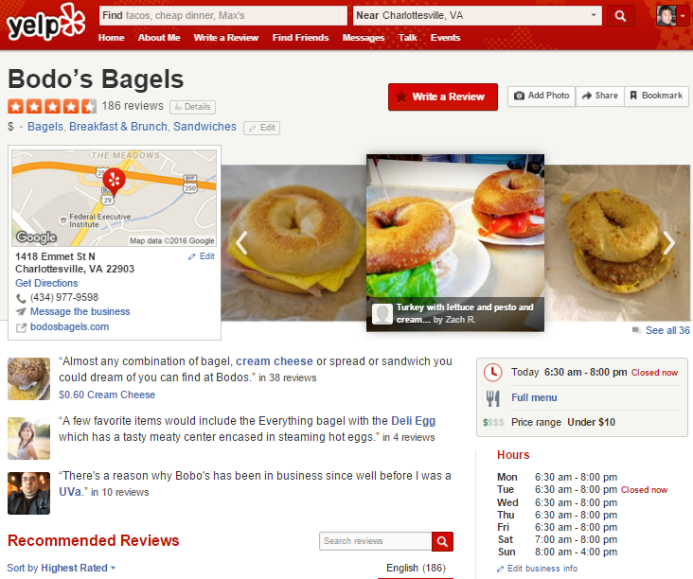
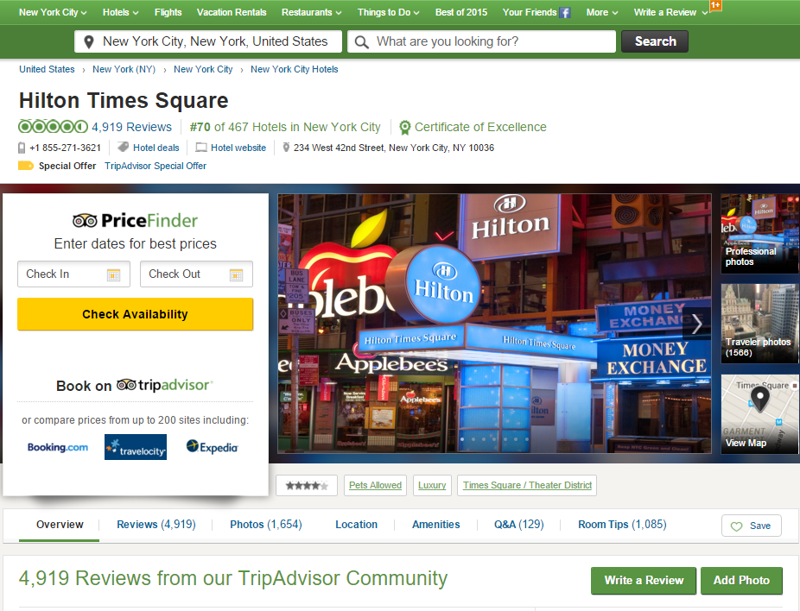
Text mining around us
Restaurant/hotel recommendation

Slide 14
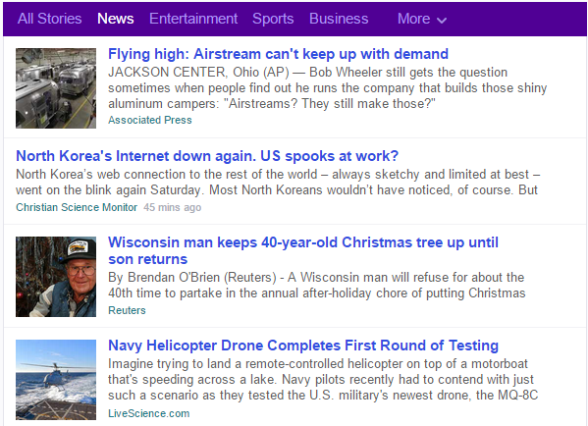
Text mining around us
News recommendation

Slide 15
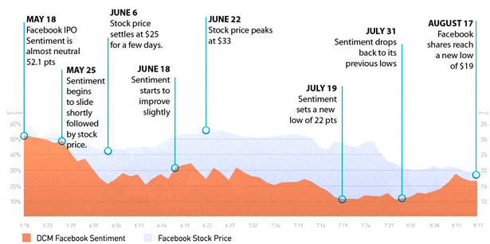
Text mining around us
Text analytics in financial services

Slide 16
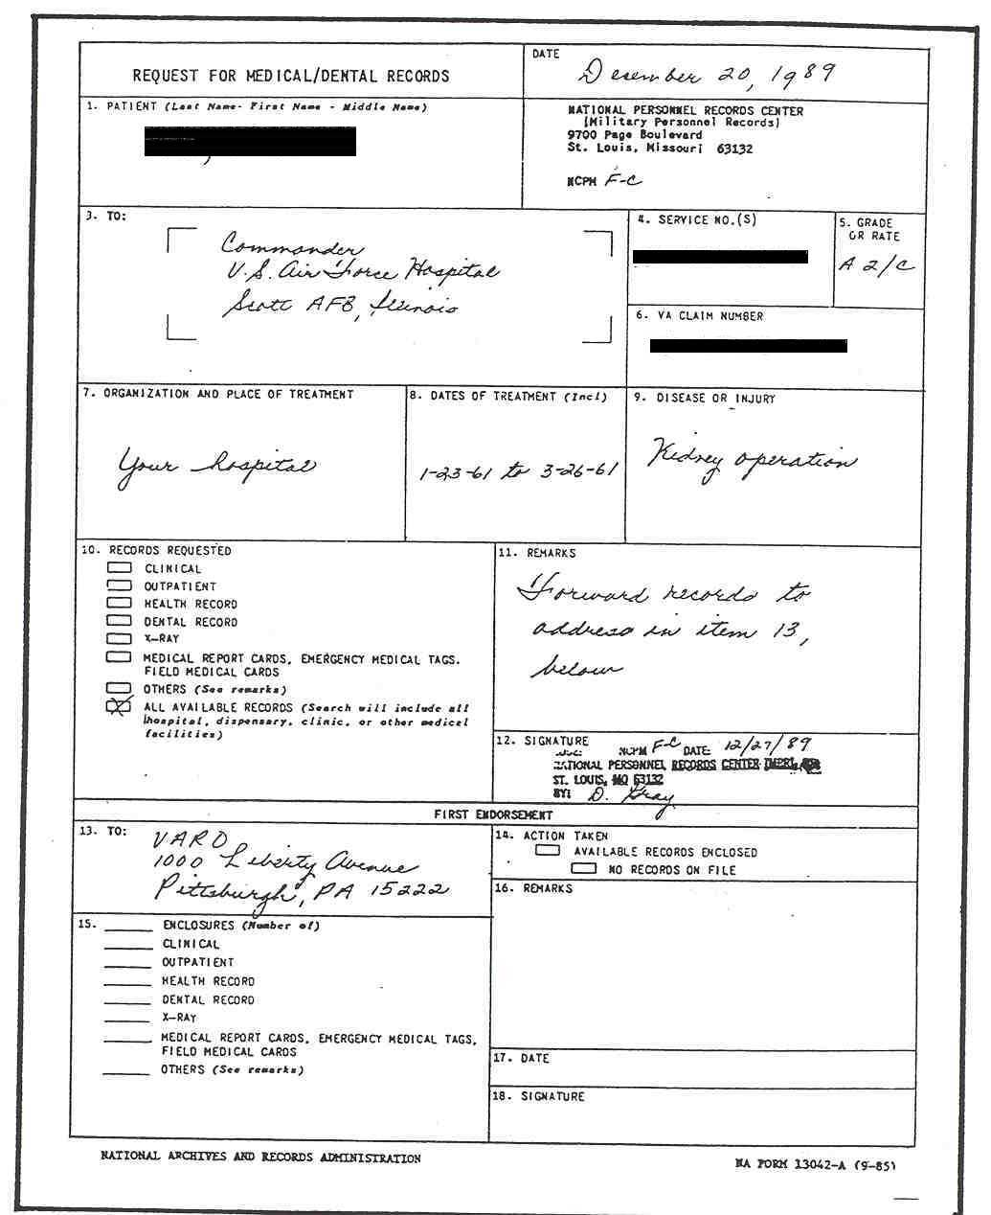

Text mining around us
Text analytics in healthcare

Slide 17
How to perform text mining?
As computer scientists, we view it as
Text Mining = Data Mining + Text Data
Emails
Scientific literature
Blogs
Tweets
Software documentations
Information retrieval
Natural language processing
Applied machine learning
Web pages
News articles

Slide 18
Text mining v.s. NLP, IR, DM…
How does it relate to data mining in general?
How does it relate to computational linguistics?
How does it relate to information retrieval?
 | Finding Patterns | Finding “Nuggets”
 |  | Novel | Non-Novel
Non-textual data | General data-mining | Exploratory data analysis | Database queries
Textual data | Computational Linguistics |  | Information retrieval
Text Mining

Slide 19
Text mining in general
Access
Serve for IR applications
Sub-area of DM research
Mining
Filter
information
Discover knowledge
Add
Structure/Annotations
Based on NLP/ML techniques
Organization

Slide 20
Challenges in text mining
Data collection is “free text”
Data is not well-organized
Semi-structured or unstructured
Natural language text contains ambiguities on many levels
Lexical, syntactic, semantic, and pragmatic
Learning techniques for processing text typically need annotated training examples
Expensive to acquire at scale
What to mine?

Slide 21
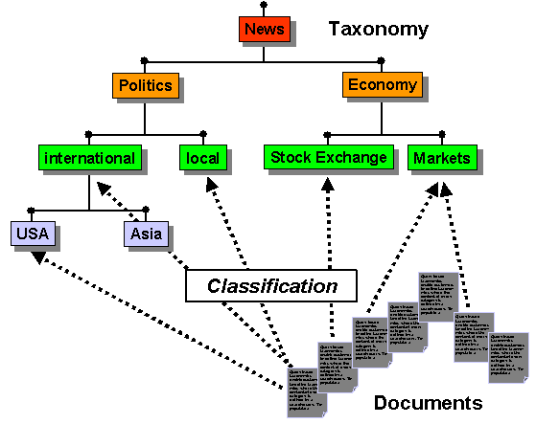
Text mining problems we will solve
Document categorization
Adding structures to the text corpus

Slide 22
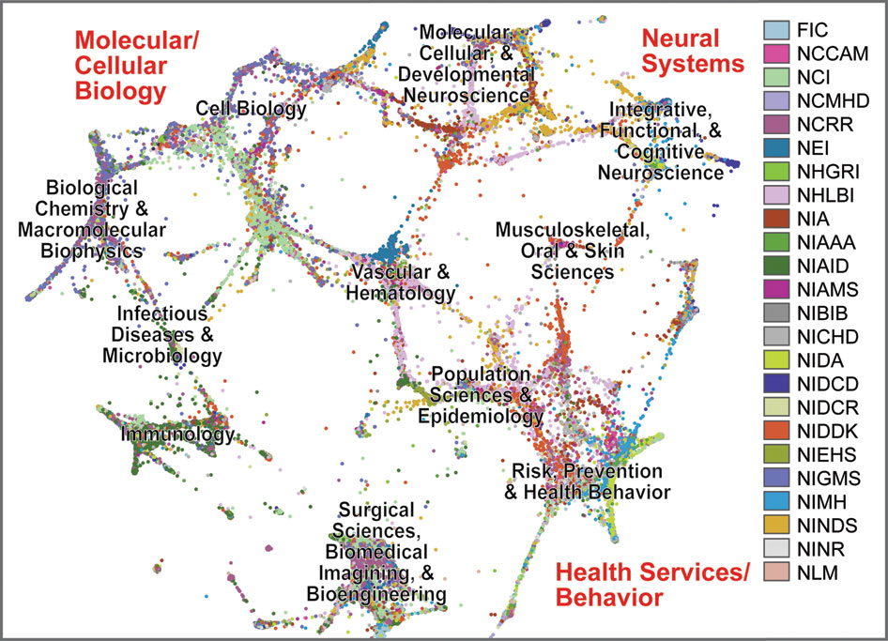
Text mining problems we will solve
Text clustering
Identifying structures in the text corpus

Slide 23
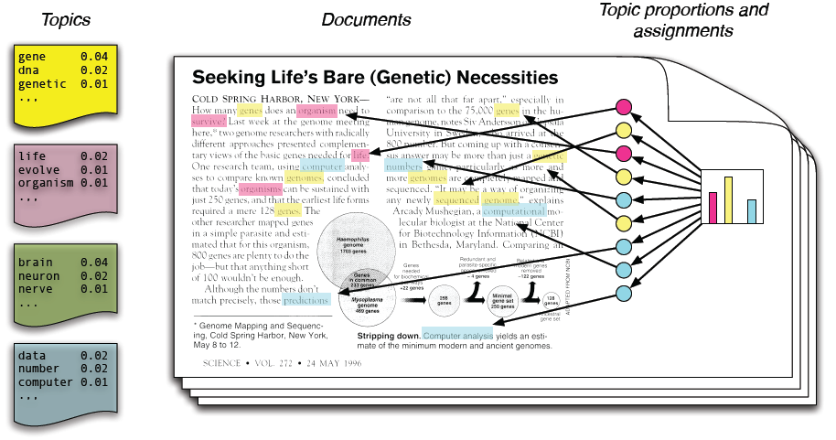
Text mining problems we will solve
Topic modeling
Identifying structures in the text corpus

Slide 24
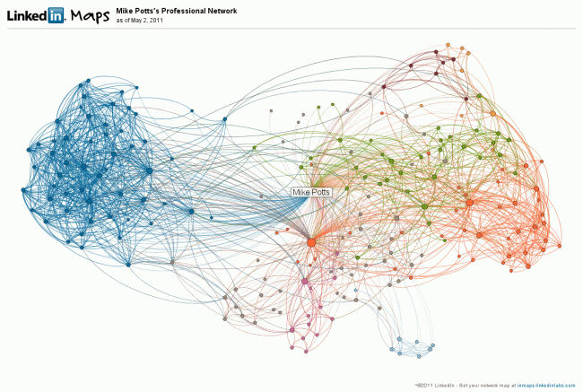
Text mining problems we will solve
Social media and network analysis
Exploring additional structure in the text corpus

Slide 25


We will also briefly cover
Natural language processing pipeline
Tokenization
“Studying text mining is fun!” -> “studying” + “text” + “mining” + “is” + “fun” + “!”
Part-of-speech tagging
“Studying text mining is fun!” ->
Dependency parsing
“Studying text mining is fun!” ->

Slide 26
We will also briefly cover
Machine learning techniques
Supervised methods
Naïve Bayes, k Nearest Neighbors, Logistic Regression
Unsupervised methods
K-Means, hierarchical clustering, topic models
Semi-supervised methods
Expectation Maximization

Slide 27
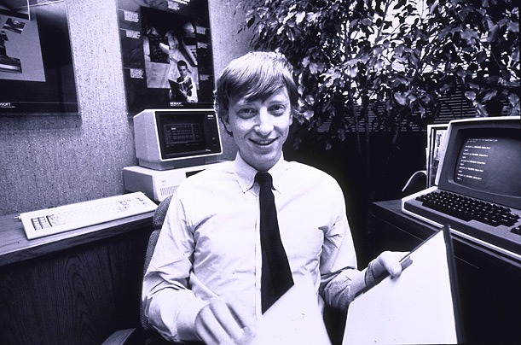
Text mining in the era of Big Data
Huge in size
Google processes 5.13B queries/day (2013)
Twitter receives 340M tweets/day (2012)
Facebook has 2.5 PB of user data + 15 TB/day (4/2009)
eBay has 6.5 PB of user data + 50 TB/day (5/2009)
80% data is unstructured (IBM, 2010)
640K ought to be enough for anybody.
Notes:
The whole motivation comes from big data. When we talk about big data, we usually mean its big size. E.g. google processes 20 petabyte every day. Previous work cared about how to process this kind of large data efficiently. However, more importantly, 80% of these data is unstructured data. So we need some techniques to extract structured facts from it. Also even more importantly, all of these data come from hetereogenous source. Such as multimedia, differnet genres, languages, and embedded in rich context. Bill gates in 1981 said 640K is probably enough for everyone. This claim is probably still true.
₂₇

Slide 28
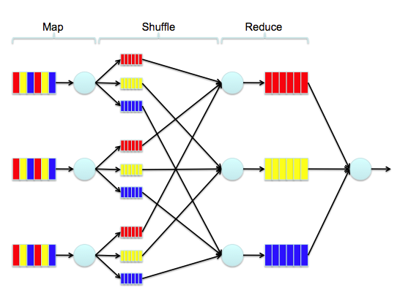
Scalability is crucial
Large scale text processing techniques
MapReduce framework

Slide 29
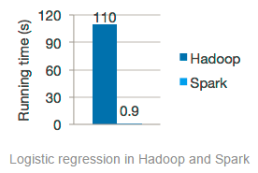
State-of-the-art solutions
Apache Spark (spark.apache.org)
In-memory MapReduce
Specialized for machine learning algorithms
Speed
100x faster than Hadoop MapReduce in memory, or 10x faster on disk.

Slide 30
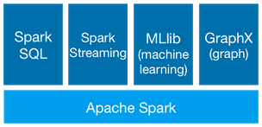
State-of-the-art solutions
Apache Spark (spark.apache.org)
In-memory MapReduce
Specialized for machine learning algorithms
Generality
Combine SQL, streaming, and complex analytics

Slide 31
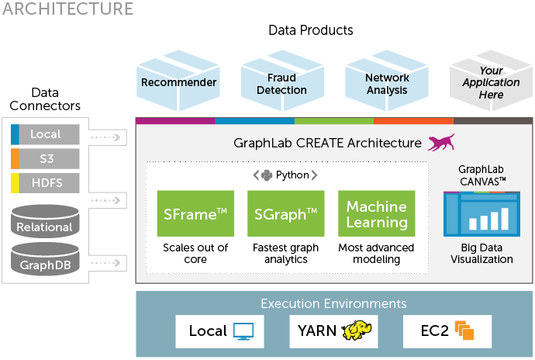
State-of-the-art solutions
GraphLab (graphlab.com)
Graph-based, high performance, distributed computation framework

Slide 32
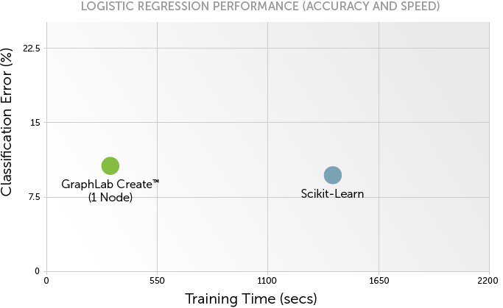
State-of-the-art solutions
GraphLab (graphlab.com)
Specialized for sparse data with local dependencies for iterative algorithms

Slide 33



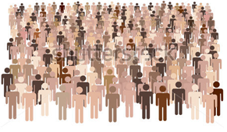
Text mining in the era of Big Data
Human-generated data
Knowledge Discovery
Text data
Behavior data
Knowledge service system
Decision Support
Data Generation Modeling
As knowledge consumer
As data producer
Challenges:
Implicit feedback
Diverse and dynamic
Challenges:
Unstructured data
Rich semantic
Human: big data producer and consumer
Notes:
First, as the producer of big data, human generate two kinds of unique data, natural language text data and interactive behavior data, both of them are extremely valuable for knowledge discovery, since they contain rich semantic information and reflect the latent intentions of people.
Most of human-generated data is non-structured, and thus the rich semantic information is not directly accessible by machines, which poses significant challenge for data mining.
Therefore, properly modeling the underlying data generation process is necessary for discovering actionable knowledge from such data.
Second, as people start to use such services, their interactive behaviors recorded in the system when accessing the knowledge reveals their particular information need and decision preferences, which can be mined by the system to further improve the service quality.
However, as the nature of big data application systems, it is inefficient, if it is not impossible, for us to get detailed and explicit feedback from users for each action they have taken in the system. What we can collect is the implicit feedback from the users, such as clicks in a retrieval system. But users’ preferences are dramatically diverse and dynamic. Both of these factors impose significant challenge for us to provide effective support to the users.

Slide 34
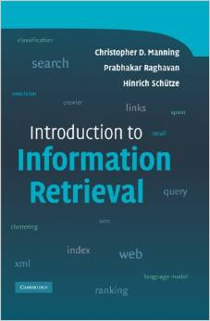

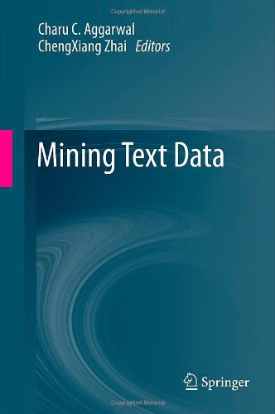
Text books
Introduction to Information Retrieval. Christopher D. Manning, Prabhakar Raghavan, and Hinrich Schuetze, Cambridge University Press, 2007.
Speech and Language Processing. Daniel Jurafsky and James H. Martin, Pearson Education, 2000.
Mining Text Data. Charu C. Aggarwal and ChengXiang Zhai, Springer, 2012.

Slide 35
What to read?
Applications
Algorithms
Web Applications,
Bioinformatics…
Machine Learning
Pattern Recognition
Statistics
Optimization
ICML, NIPS, UAI
Text Mining
Library & Info
Science
Data Mining
KDD, ICDM, SDM
NLP
ACL, EMNLP, COLING
Information Retrieval
SIGIR, WWW, WSDM, CIKM
Find more on course website for resource

Slide 36
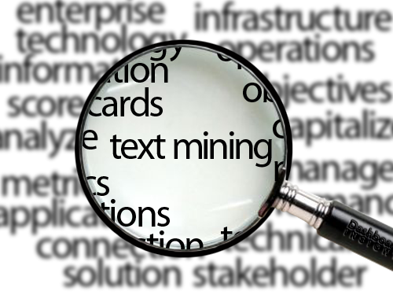
Welcome to the class of “Text Mining”!

