Slide 1
Statistical Machine Translation
Hongning Wang
CS@UVa

Slide 2
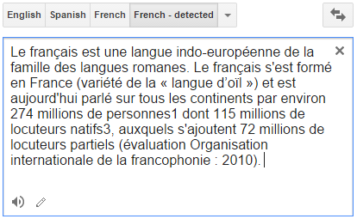

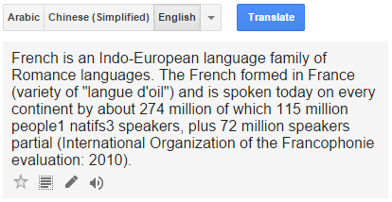
Machine translation

Slide 3
How do human translate languages?
Is a bilingual dictionary sufficient?
John loves Mary.
John told Mary a story.
Jean aime Marie.
Jean a raconté une histoire à Marie.
John is a computer scientist.
John swam across the lake.
Jean est informaticien.
Jean a traversé le lac à la nage.

Slide 4
Correspondences
A bilingual dictionary is clearly insufficient!
One-to-one
John = Jean, aime = loves, Mary=Marie
One-to-many/many-to-one
Mary = [à Marie]
[a computer scientist] = informaticien
Many-to-many
[swam across __] = [a traversé __ à la nage]
Reordering required
told Mary¹ [a story]² = a raconté [une histoire]² [à Marie]¹

Slide 5
Lexical divergences
Different senses of homonymous words generally have different translations
Different senses of polysemous words may also have different translations
English - German
(river) bank - Ufer
(financial) bank - Bank
I know that he bought the book: Je sais qu’il a acheté le livre.
I know Peter: Je connais Peter.
I know math: Je m’y connais en maths.

Slide 6
Syntactic divergences
Word order
SVO (Sbj-Verb-Obj), SOV, VSO,…
fixed or free?
Head-marking vs. dependent-marking
Dependent-marking (English): the man’s house
Head-marking (Hungarian): the man house-his
Pro-drop languages can omit pronouns
Italian (with inflection): I eat = mangio; he eats = mangia
Chinese (without inflection): I/he eat: chīfàn

Slide 7
Semantic divergences
Aspect
English has a progressive aspect
‘Peter swims’ vs. ‘Peter is swimming’
German can only express this with an adverb:
‘Peter schwimmt’ vs. ‘Peter schwimmt gerade’
Clearly, a bilingual dictionary is insufficient; and machine translation is difficult!

Slide 8
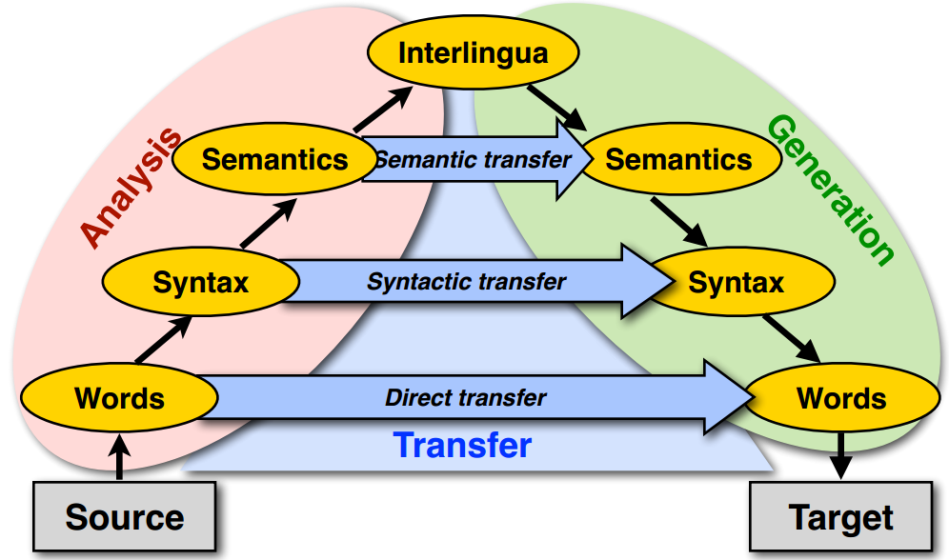
Machine translation approaches
The Vauquois triangle

Slide 9
Statistical machine translation
Main stream of current machine translation paradigm
The idea was introduced by Warren Weaver in 1949
Re-introduced in 1993 by researchers at IBM's Thomas J. Watson Research Center
Now it is the most widely studied/used machine translation method
1966: ALPAC report: human translation is far cheaper and better - kills MT for a long time

Slide 10
Noisy-Channel framework ^{[Shannon 48]}
Translating French to English
$$Eng^{∗}=argmax_{Eng}p(Eng|Fre)$$
Source
Transmitter
(encoder)
Noisy
Channel
Receiver
(decoder)
Destination
Eng
Fre
Eng’
P(Eng)
P(Fre|Eng)
P(Eng’|Fre)=?
Language model
Translation model
Observation
Guessed input

Slide 11
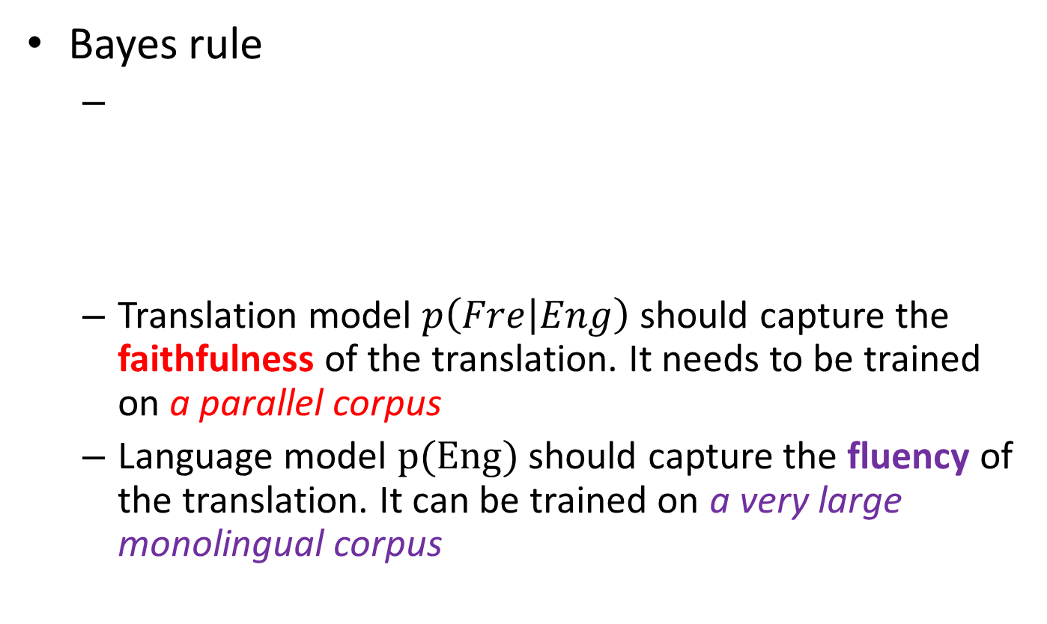
Translation with a noisy channel model
Bayes rule
Translation model $p\left(Fre | Eng\right)$ should capture the faithfulness of the translation. It needs to be trained on a parallel corpus
Language model $p(Eng)$ should capture the fluency of the translation. It can be trained on a very large monolingual corpus
$$Eng^{∗}=argmax_{Eng}p(Eng|Fre)$$
$$=argmax_{Eng}p\left(Fre | Eng\right)p(Eng)$$
Observed (given)
Translation Model
Language Model

Slide 12
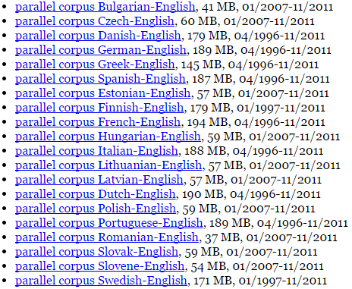
Parallel corpora
The same text in two (or more) languages
High-quality manually crafted translations
European Parliament Proceedings Parallel Corpus

Slide 13

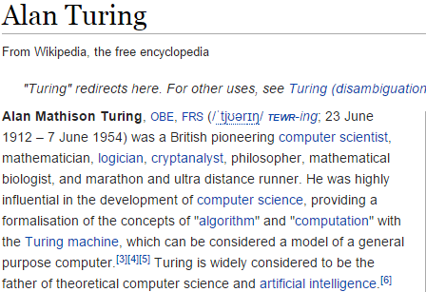
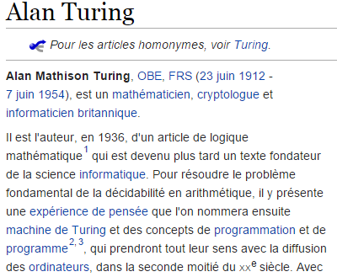
Parallel corpora
The same text in two (or more) languages
High-quality manually crafted translations

Slide 14

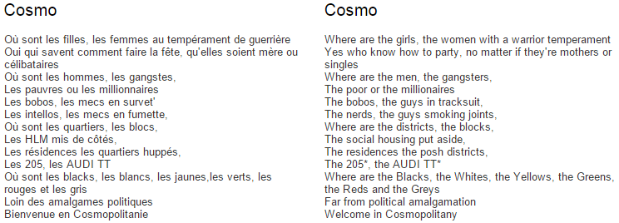
Parallel corpora
The same text in two (or more) languages
High-quality manually crafted translations

Slide 15
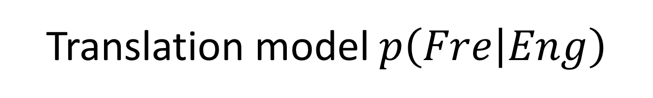
Translation model $p\left(Fre | Eng\right)$
Specifying translation probabilities
This probability needs word-alignment to estimate
English | French | Frequency
green witch | grüne Hexe | …
at home | zuhause | 10534
at home | daheim | 9890
is | ist | 598012
this week | diese Woche | …

Slide 16
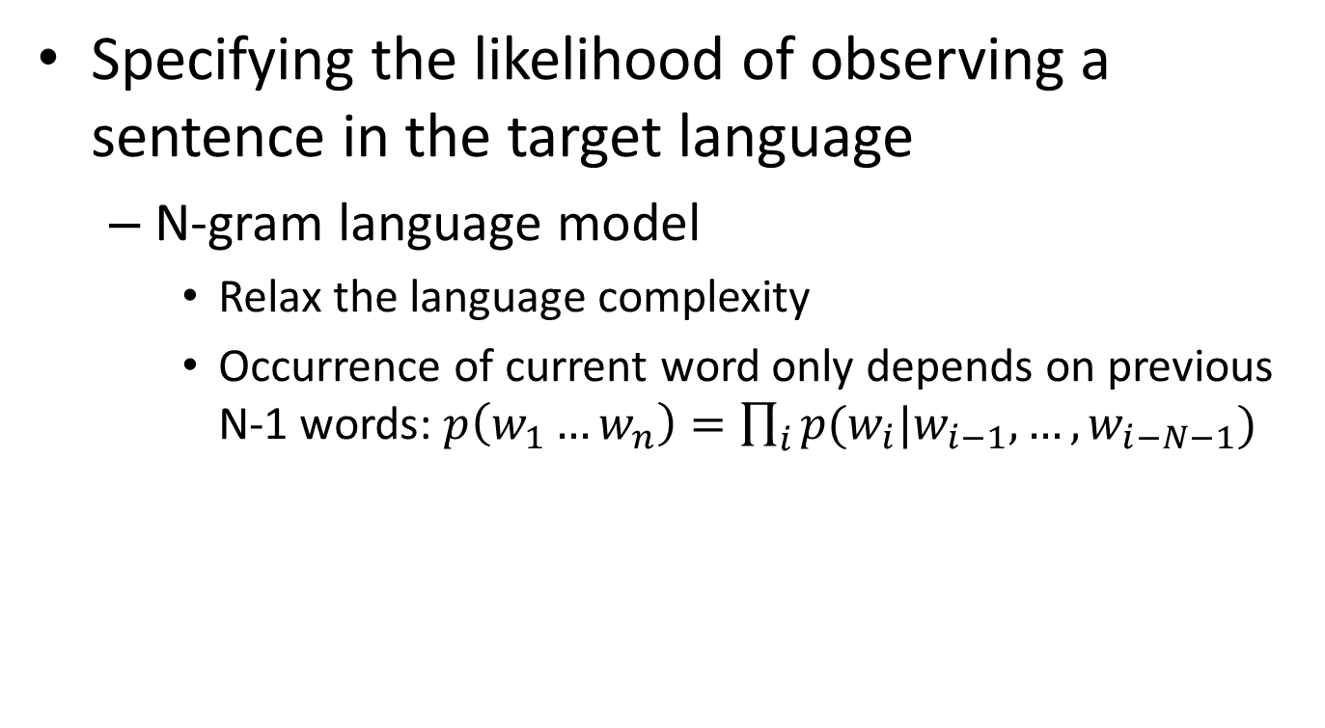

Language model $p(Eng)$
Specifying the likelihood of observing a sentence in the target language
N-gram language model
Relax the language complexity
Occurrence of current word only depends on previous N-1 words: $p\left(w_{1}…w_{n}\right)=\prod_{i}{p(w_{i}|w_{i−1},…,w_{i−N−1}) }$

Slide 17
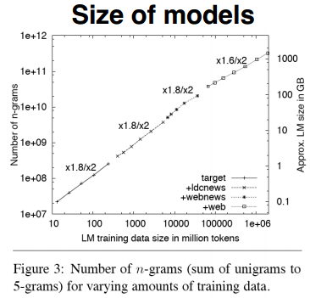
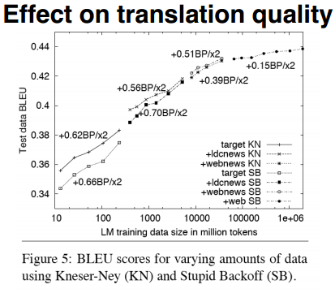
Language model $p(Eng)$
Specifying the likelihood of observing a sentence in the target language
Google (2007) uses 5-grams to 7-grams, which result in huge models, but the effect on translation quality levels off quickly

Slide 18
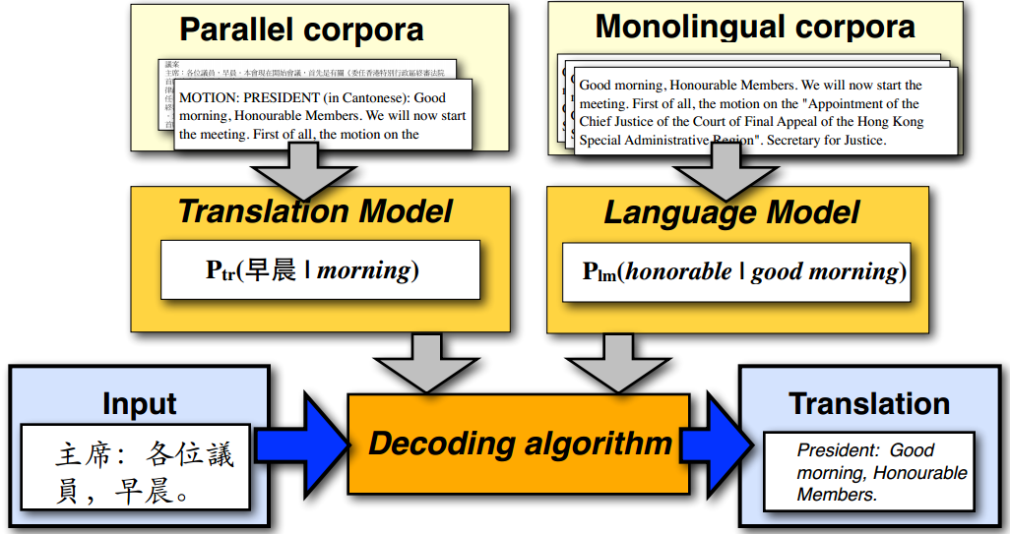
Statistical machine translation

Slide 19
IBM translation models
A generative model based on noisy channel framework
Generate the translation sentence e with regard to the given sentence f by a stochastic process
Generate the length of f
Generate the alignment of e to the target sentence f
Generate the words of f
$$Eng^{∗}=argmax_{Eng}p\left(Fre | Eng\right)p(Eng)$$

Slide 20
Word alignment
One to many
John told Mary a story.
Jean a raconté une histoire à Marie.
Target sentence
 | Jean | a | raconté | une | histoire | à | Marie
John
told
Mary
a
story
Source sentence

Slide 21
Word alignment
Many to one and missing word
John swam across the lake.
Jean a traversé le lac à la nage.
Target sentence
A special symbol
 | Jean | a | traversé | le | lac | à | la | nage
NULL
John
swam
across
the
lake
Source sentence

Slide 22
Representing word alignments
Alignment table
 |  | 1 | 2 | 3 | 4 | 5 | 6 | 7 | 8
 |  | Jean | a | traversé | le | lac | à | la | nage
0 | NULL
1 | John
2 | swam
3 | across
4 | the
5 | lake
Target Position | 1 | 2 | 3 | 4 | 5 | 6 | 7 | 8
Source Position | 1 | 3 | 3 | 4 | 5 | 0 | 0 | 2

Slide 23




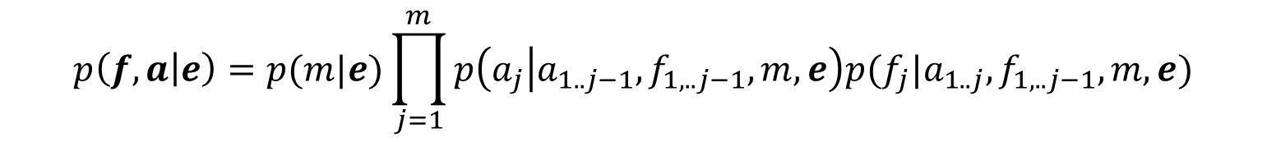
IBM translation models
Translation model with word alignment
$p\left(Fre | Eng\right)=\sum_{a∈A(Eng,Fre)}{p(Fre,a|Eng)}$
Generate the words of f with respect to alignment $a$
marginalize over all possible alignments $a$
$$p\left(f,a | e\right)=p(m|e)\prod_{j=1}^{m}{p\left(a_{j} | a_{1..j−1},f_{1,..j−1},m,e\right)p(f_{j}|a_{1..j},f_{1,..j−1},m,e)}$$
Length of target sentence f
Word alignment $a_{j}$
Translation of $f_{j}$

Slide 24
IBM translation models
Sequence of 5 translation models
Different assumptions and realization of the components in the translation models, i.e., length model, alignment model and translation model
Model 1 is the simplest and becomes the basis of follow-up IBM translation models

Slide 25
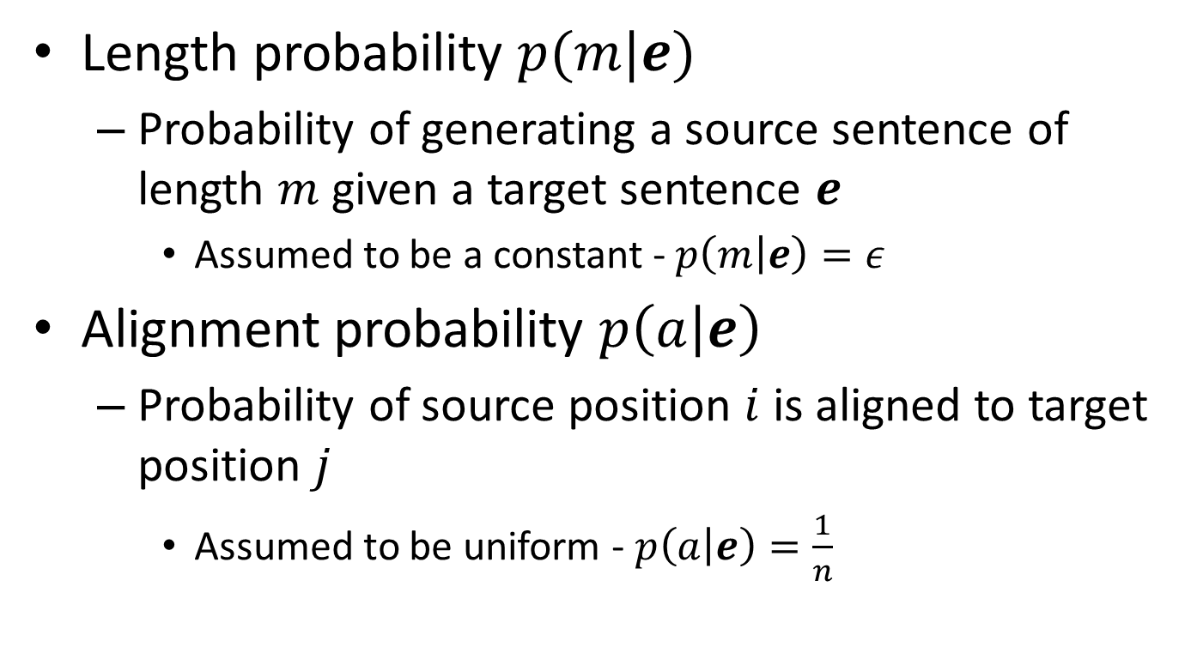
Parameters in Model 1
Length probability $p(m|e)$
Probability of generating a source sentence of length $m$ given a target sentence $e$
Assumed to be a constant - $p\left(m | e\right)=ε$
Alignment probability $p\left(a | e\right)$
Probability of source position $i$ is aligned to target position $j$
Assumed to be uniform - $p\left(a | e\right)=\frac{1}{n}$
length of source sentence

Slide 26
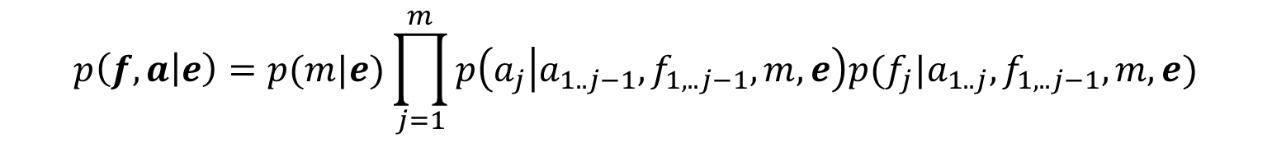

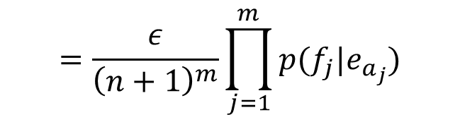
Parameters in Model 1
Translation probability $p\left(f | a,e\right)$
Probability of English word $e_{i}$ is translated to French word $f_{j}$ - $p\left(f_{j} | e_{a_{j}}\right)$
After the simplification, Model 1 becomes
$$p\left(f,a | e\right)=p(m|e)\prod_{j=1}^{m}{p\left(a_{j} | a_{1..j−1},f_{1,..j−1},m,e\right)p(f_{j}|a_{1..j},f_{1,..j−1},m,e)}$$
$$=\frac{ε}{{\left(n+1\right)}^{m}}\prod_{j=1}^{m}{p(f_{j}|e_{a_{j}})}$$
We add a NULL word in the source sentence

Slide 27
Generative process in Model 1
For a particular English sentence $e = e_{1}..e_{n}$ of length $n$
0 | 1 | 2 | 3 | 4 | 5
NULL | John | swam | across | the | lake
1. Choose a length $m$ for the target sentence (e.g m = 8)
1 | 2 | 3 | 4 | 5 | 6 | 7 | 8
? | ? | ? | ? | ? | ? | ? | ?
2. Choose an alignment $a= a_{1}…a_{m}$for the source sentence
Target Position | 1 | 2 | 3 | 4 | 5 | 6 | 7 | 8
Source Position | 1 | 3 | 3 | 4 | 5 | 0 | 0 | 2
3. Translate each source word $e_{a_{j}}$into the target language
English | John | across | across | the | lake | NULL | NULL | swam
Alignment | 1 | 3 | 3 | 4 | 5 | 0 | 0 | 2
Translation | Jean | a | traversé | le | lac | à | la | nage

Slide 28
Recap: machine translation
Challenges
Lexical, syntactic, semantic divergences
Vauquois triangle
Ideal procedure for translation

Slide 29
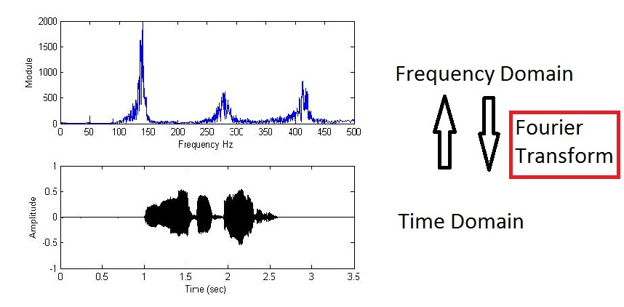





Recap: statistical machine translation
Source-channel framework in signal processing
Source
Transmitter
(encoder)
Noisy
Channel
Receiver
(decoder)
Destination
$$X$$
$$Y$$
$$X′$$
$$Y=f(X)$$
$$X^{′}=f^{−1}(Y)$$

Slide 30
Recap: statistical machine translation
Source-channel framework for translation
$$Eng^{∗}=argmax_{Eng}p(Eng|Fre)$$
Source
Transmitter
(encoder)
Noisy
Channel
Receiver
(decoder)
Destination
Eng
Fre
Eng’
P(Eng)
P(Fre|Eng)
P(Eng’|Fre)=?
Language model
Translation model
Observation
Guessed input
Naturally decompose into two sub-problems;
Independence assumptions can be introduced.

Slide 31


Recap: statistical machine translation
Source-channel framework for translation
$$Eng^{∗}=argmax_{Eng}p(Eng|Fre)$$
Source
Transmitter
(encoder)
Noisy
Channel
Receiver
(decoder)
Destination
Eng
Fre
Eng’
P(Eng)
P(Fre|Eng)
P(Eng’|Fre)=?
Language model
Translation model
Observation
Guessed input
How to define inverse operation in a probabilistic model?
$$f^{−1}\left(f\left(X\right)\right)=X$$
$$Eng^{∗}=argmax_{Eng}p\left(Fre | Eng\right)p(Eng)$$

Slide 32


Recap: statistical machine translation

Slide 33

Generative process in Model 1
For a particular English sentence $e = e_{1}..e_{n}$ of length $n$
0 | 1 | 2 | 3 | 4 | 5
NULL | John | swam | across | the | lake
Source
1. Choose a length $m$ for the target sentence (e.g m = 8)
1 | 2 | 3 | 4 | 5 | 6 | 7 | 8
? | ? | ? | ? | ? | ? | ? | ?
Order of action
2. Choose an alignment $a= a_{1}…a_{m}$for the source sentence
Target Position | 1 | 2 | 3 | 4 | 5 | 6 | 7 | 8
Source Position | 1 | 3 | 3 | 4 | 5 | 0 | 0 | 2
Transmitter
3. Translate each source word $e_{a_{j}}$into the target language
English | John | across | across | the | lake | NULL | NULL | swam
Alignment | 1 | 3 | 3 | 4 | 5 | 0 | 0 | 2
Encoded | Jean | a | traversé | le | lac | à | la | nage

Slide 34

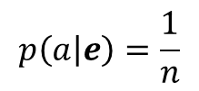


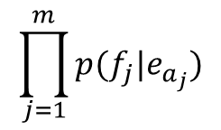

Decoding process in Model 1
$$p\left(e | f\right)=1e^{−55}$$
For a particular English sentence $e = e_{1}..e_{n}$ of length $n$
$$p(e)$$
0 | 1 | 2 | 3 | 4 | 5
NULL | John | flies | across | the | river
Search through all English sentences
1. Choose a length $m$ for the target sentence (e.g m = 8)
1 | 2 | 3 | 4 | 5 | 6 | 7 | 8
? | ? | ? | ? | ? | ? | ? | ?
Search through all possible alignments
$$p\left(m | e\right)=ε$$
2. Choose an alignment $a= a_{1}…a_{m}$for the source sentence
Order of action
$$p\left(a | e\right)=\frac{1}{n}$$
Target Position | 1 | 2 | 3 | 4 | 5 | 6 | 7 | 8
Source Position | 1 | 2 | 4 | 5 | 5 | 2 | 0 | 3
$$\prod_{j=1}^{m}{p(f_{j}|e_{a_{j}})}$$
3. Translate each source word $e_{a_{j}}$into the target language
English | John | flies | the | river | river | flies | NULL | across
Alignment | 1 | 2 | 4 | 5 | 5 | 2 | 0 | 3
Encoded | Jean | a | traversé | le | lac | à | la | nage
Receiver

Slide 35

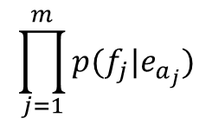

Decoding process in Model 1
$$p\left(e | f\right)=1e^{−15}$$
For a particular English sentence $e = e_{1}..e_{n}$ of length $n$
0 | 1 | 2 | 3 | 4 | 5
NULL | John | swam | across | the | lake
Search through all English sentences
$$p(e)$$
1. Choose a length $m$ for the target sentence (e.g m = 8)
1 | 2 | 3 | 4 | 5 | 6 | 7 | 8
? | ? | ? | ? | ? | ? | ? | ?
Search through all possible alignments
$$p\left(m | e\right)=ε$$
Order of action
2. Choose an alignment $a= a_{1}…a_{m}$for the source sentence
$$p\left(a | e\right)=\frac{1}{n}$$
Target Position | 1 | 2 | 3 | 4 | 5 | 6 | 7 | 8
Source Position | 1 | 3 | 3 | 4 | 5 | 0 | 0 | 2
$$\prod_{j=1}^{m}{p(f_{j}|e_{a_{j}})}$$
3. Translate each source word $e_{a_{j}}$into the target language
English | John | across | across | the | lake | NULL | NULL | swam
Alignment | 1 | 3 | 3 | 4 | 5 | 0 | 0 | 2
Encoded | Jean | a | traversé | le | lac | à | la | nage
Receiver

Slide 36
Decoding process in Model 1
Search space is huge
Presumably all “sentences” in English
English sentence length is unknown
All permutation of words in the vocabulary
Heuristics to reduce search space
Trade-off between translation accuracy and efficiency

Slide 37
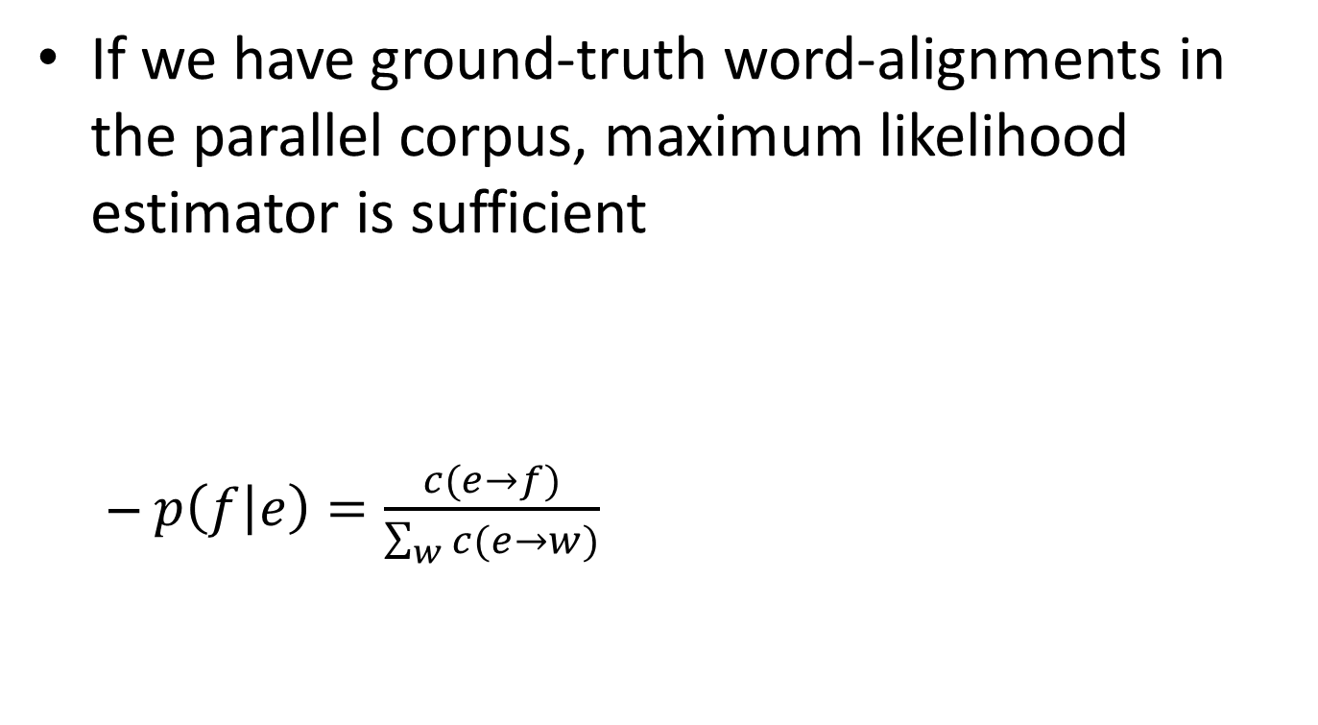
Estimation of translation probability
If we have ground-truth word-alignments in the parallel corpus, maximum likelihood estimator is sufficient
$p\left(f | e\right)=\frac{c(e→f)}{\sum_{w}{c(e→w)}}$
John told Mary a story.
Jean a raconté une histoire à Marie.

Slide 38
Estimation of translation probability
If we do not have ground-truth word-alignments, appeal to Expectation Maximization algorithm
Intuitively, guess the alignment based on the current translation probability first; and then update the translation probability
EM algorithm will be carefully discussed in our later lecture of “Text Clustering”

Slide 39
Other translation models
IBM models 2-5 are more complex
Word order and string position of the aligned words
Phase-based translation in the source and target languages
Incorporate syntax or quasi-syntactic structures
Greatly reduce search space

Slide 40
What you should know
Challenges in machine translation
Lexicon/syntactic/semantic divergences
Statistical machine translation
Source-channel framework for statistical machine translation
Generative process
IBM model 1
Idea of word alignment

Slide 41
Today’s reading
Speech and Language Processing
Chapter 25: Machine Translation

