Slide 1
Text Mining – MP1
Prepared by: Mohammad Al Boni

Slide 2

Tasks & Implementation Strategies
Some Implementation tips before you start!
1.1 Understand Zipf's Law.
1.2 Construct a Controlled Vocabulary.
1.3 Compute similarity between documents.
2.1 Maximum likelihood estimation for statistical language models with proper smoothing.
2.2 Generate text documents from a language model.
2.3 Language model evaluation.

Slide 3
Tasks & Implementation Strategies
Some Implementation tips before you start!
1.1 Understand Zipf's Law.
1.2 Construct a Controlled Vocabulary.
1.3 Compute similarity between documents.
2.1 Maximum likelihood estimation for statistical language models with proper smoothing.
2.2 Generate text documents from a language model.
2.3 Language model evaluation.

Slide 4

Implementation Tips
Use IDEs such as eclipse or netbeans.
Divide and conquer!
Parallel computing vs. multi-threading
ArrayList<Thread> threads = new ArrayList<Thread>();
for (int j = 0; j + core <FilesSize; j +=NumberOfProcessors)
analyzer.analyzeDocumentDemo(analyzer.LoadJson(Files.get(j+core)),core);
Use separate code files for separate problems.
Save and load intermediate results.
Always test your code on a small data sample.

Slide 5
Tasks - 1.3 Compute similarity between documents
Approach:
Load the controlled vocabulary from part 1.2
Load test documents
Load the reviews from query.json
Compute similarities and get the top 3 similar reviews

Slide 6
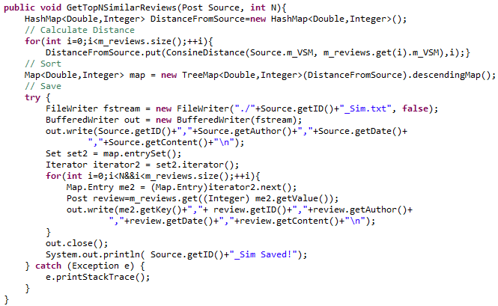
Tasks - 1.3 Compute similarity between documents
Compute similarities and get the top 3 similar reviews.

Slide 7
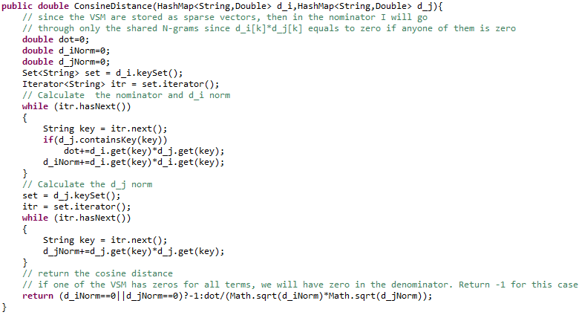
Tasks - 1.3 Compute similarity between documents
Compute similarities and get the top 3 similar reviews.

Slide 8
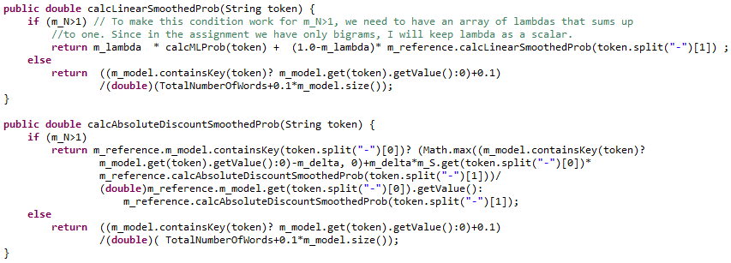
Task 2.1 LM smoothing

Slide 9
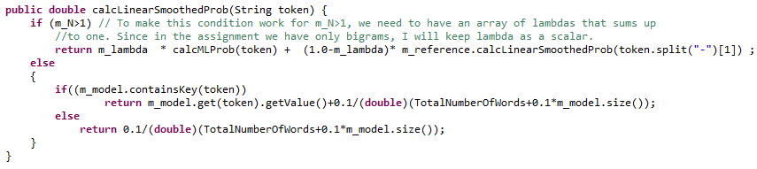

Task 2.1 LM smoothing

Slide 10
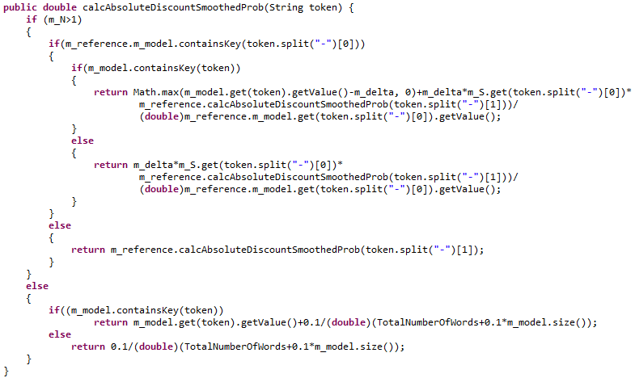

Task 2.1 LM smoothing

Slide 11
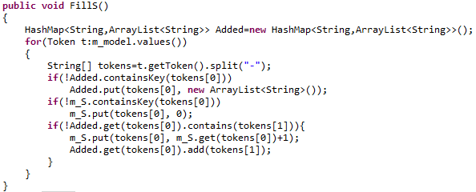
Task 2.1 LM smoothing

Slide 12
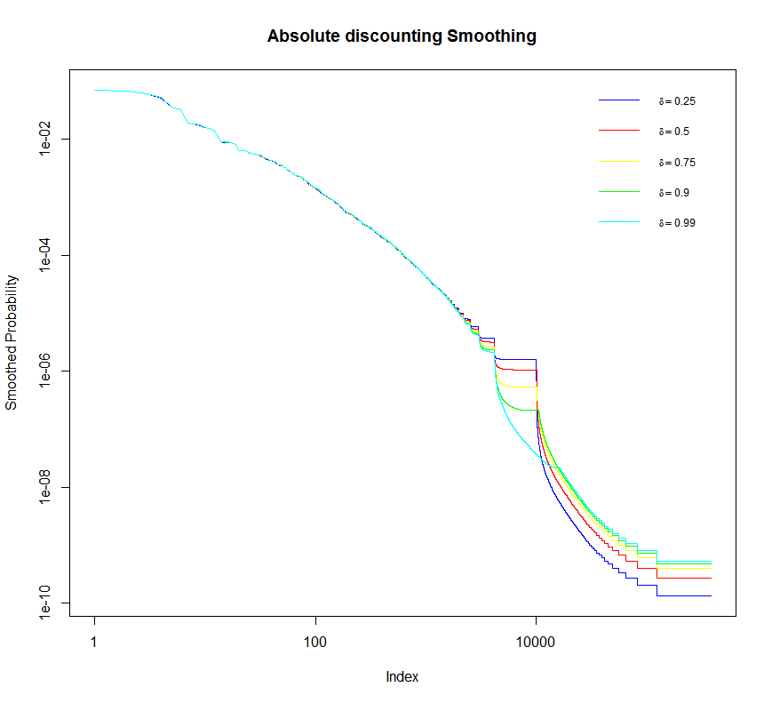
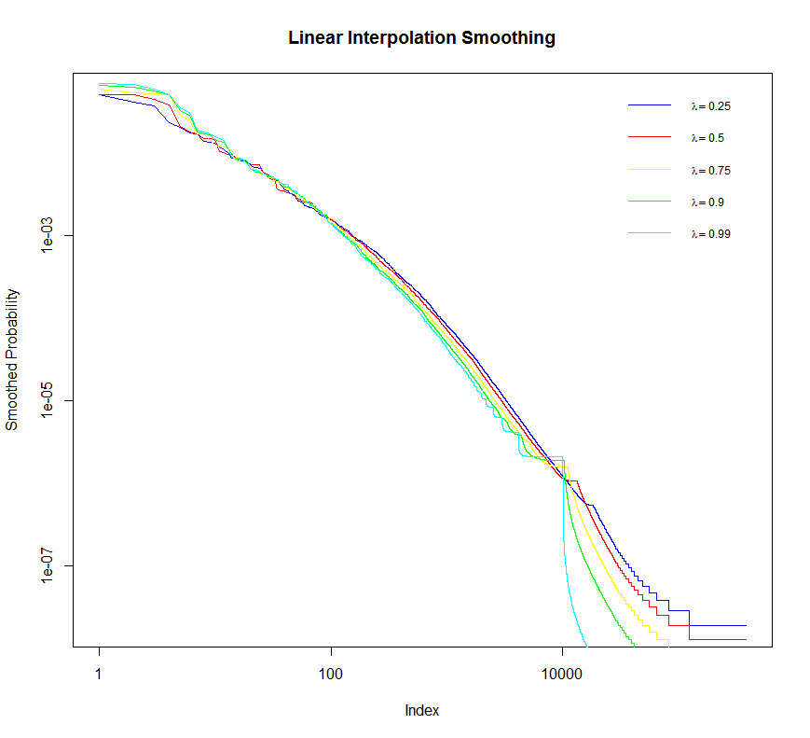
Task 2.1 Maximum likelihood estimation
Figure 3. Absolute discounting smoothing
Figure 2. Linear interpolation smoothing

Slide 13
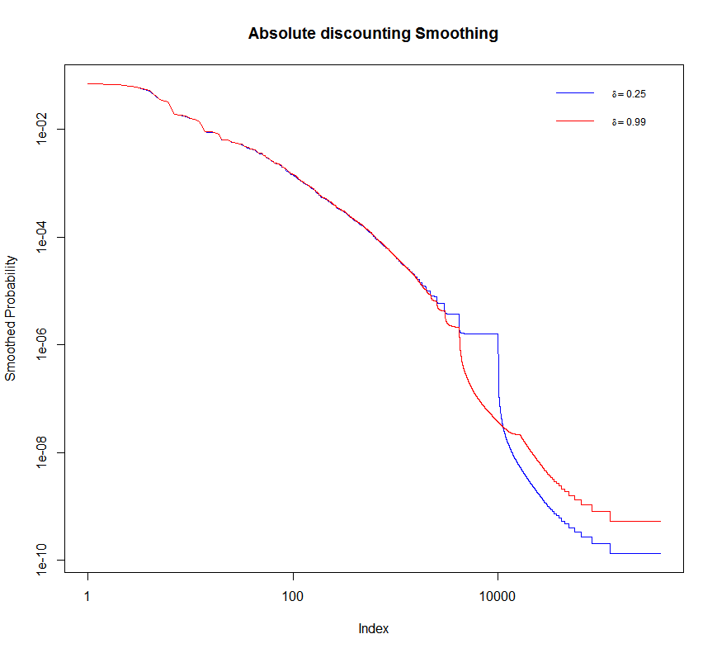
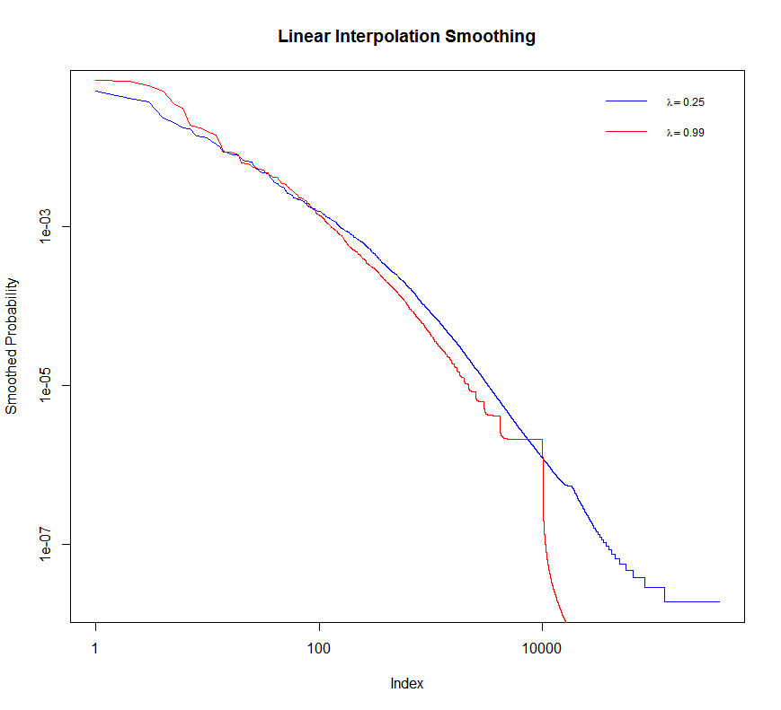
Task 2.1 Maximum likelihood estimation
Figure 5. Absolute discounting smoothing
Figure 4. Linear interpolation smoothing

Slide 14
Task 2.1 Maximum likelihood estimation
Figure 5. Absolute discounting smoothing
Figure 4. Linear interpolation smoothing

Slide 15
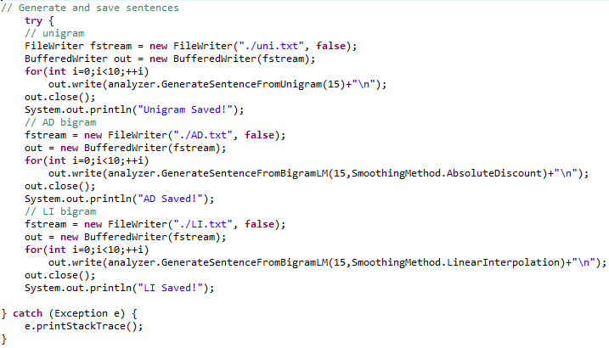
Task 2.2 Generate text documents from a language model.

Slide 16

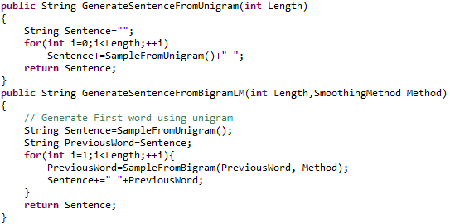
Task 2.2 Generate text documents from a language model.

Slide 17
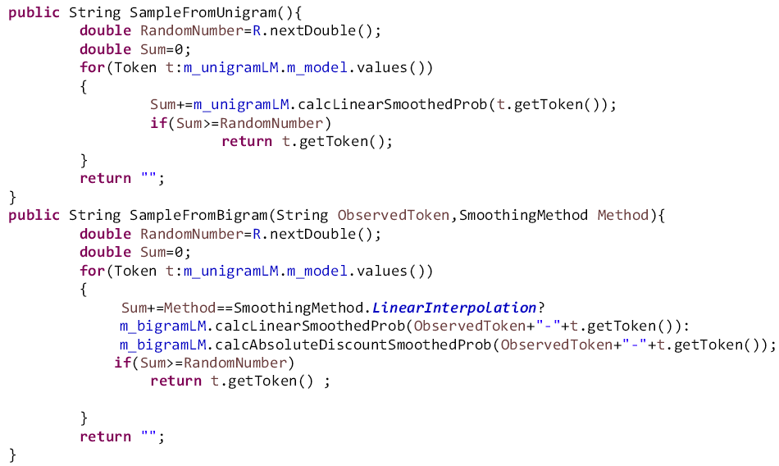
Task 2.2 Generate text documents from a language model.

Slide 18

Thank you!

