Slide 1
A Fuzzy K-Nearest Neighbor Algorithm
Prepared By: Mohammad Al Boni

Slide 2
K-Nearest neighbor (2 min crash course)
Assumptions:
Distance between two data points can be computed.
Close data points have the same class.
K=1 -> Blue
K=3 -> Red

Slide 3
Article Details
Authors: James M. Keller, Michael R. Gray and James A. Givens, JR.
Venue: IEEE Transactions on systems, man and cybernetics
Vol & Date: No. 4, July/August 1985.

Slide 4
Motivations
Known priors?
yes
Bayes decision rule
no
Two Problems when K-NN is used:
Each of the vectors have equal opportunity to be assigned to different classes.
Once a vector is assigned to a class, it has full membership.
K-Nearest Neighbor (K-NN)

Slide 5
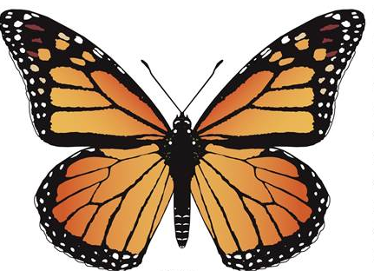

Motivations
Each of the vectors have equal opportunity to be assigned to different classes.
0.5

Slide 6
Motivations
Once a vector is assigned to a class, it has full membership.
C
A
B
A belong to Blue
How about B? Yes
How about C? Yes
However, do A, B and C belong to Blue with the same degree?

Slide 7
Motivations
Consider K=2.
Problem: Tie.
Solution: use odd K (tiebreaker).
K=2
K=3

Slide 8

Motivations
How about when we have more than two classes?
Use distance as tiebreaker.
Previous solution won’t work anymore!
K=3

Slide 9

Motivations
Consider the following case:
Equal distances!
Try different K?
Add more heuristics?
We can still encounter tie!
Last solution: Arbitrary class assignment!
K=6

Slide 10
Fuzzy K-NN
Partial membership assignments such that:
Advantages:
Deal with uncertainty (situations with tie).
Provide confidence measure.

Slide 11
Fuzzy K-NN Advantages
0.45
0.55
0.9
0.1

Slide 12
Fuzzy K-NN

Slide 13
Fuzzy Nearest Prototype
0.5
0.5

Slide 14
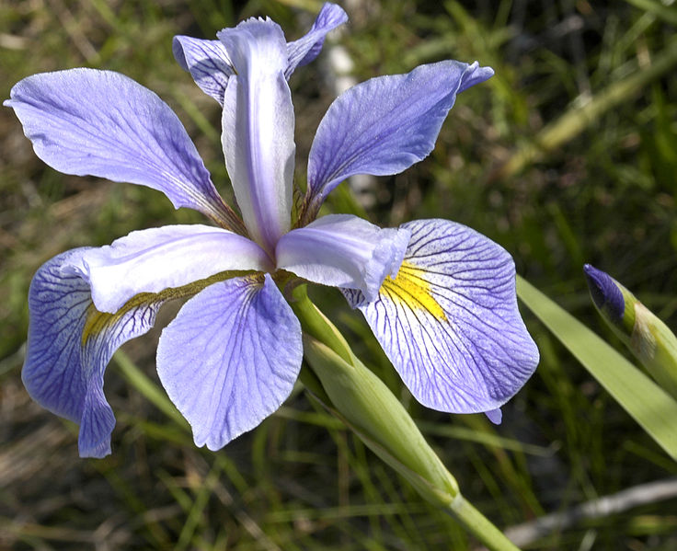
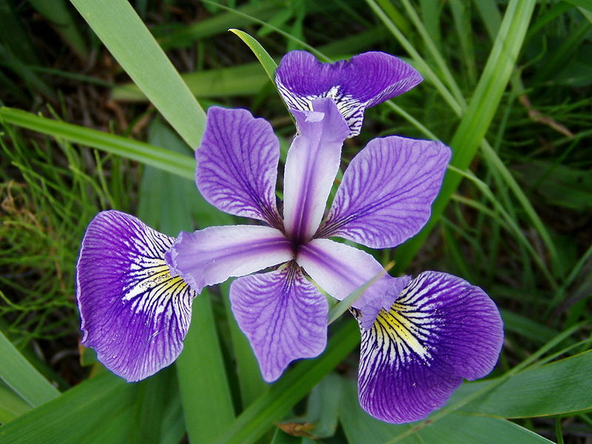
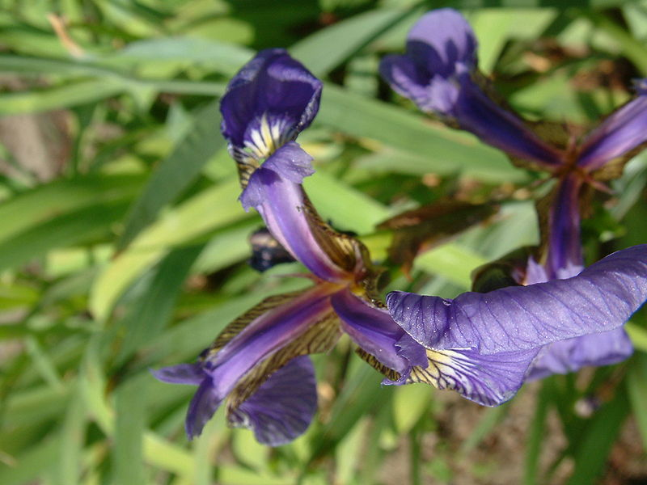
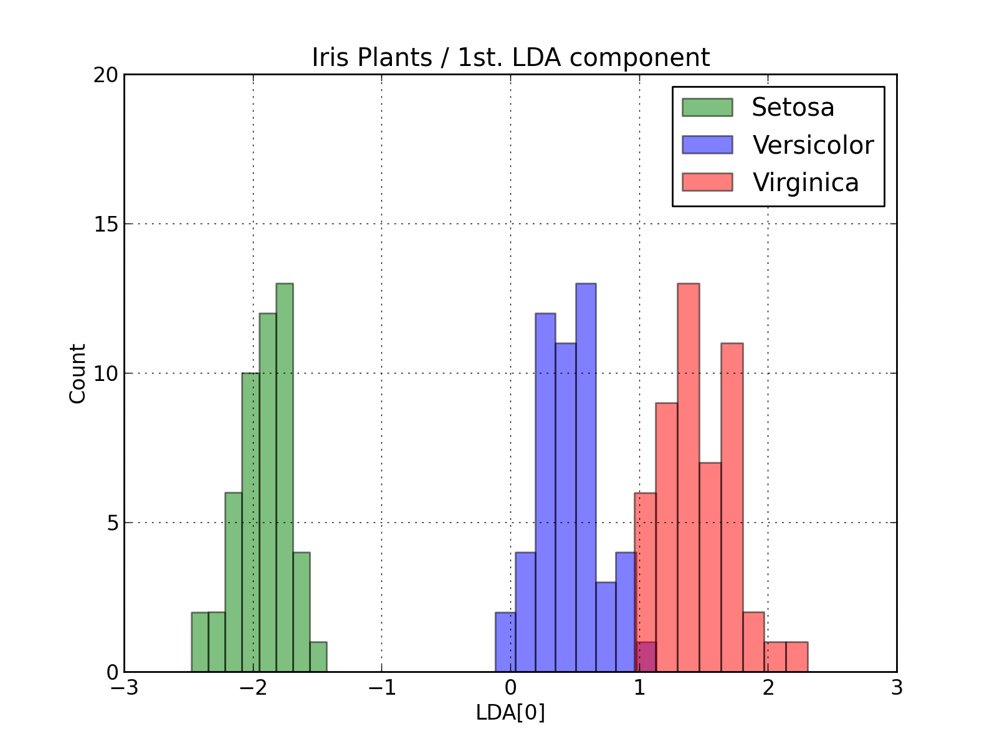
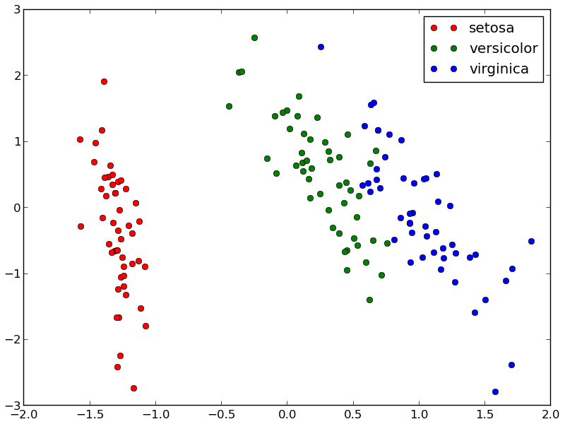
Experimental Results
Data Sets:
IRIS
IRIS23
TwoClass Gaussian
virginica
versicolor
setosa

Slide 15
Experimental Results

Slide 16
Experimental Results

Slide 17
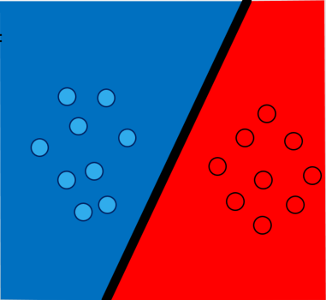
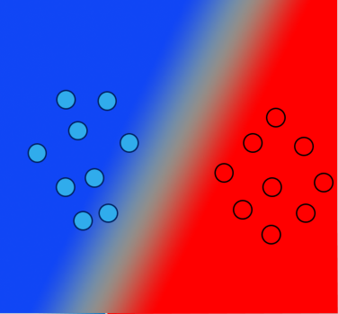

Take Away Messages
Partial membership assignments:
Two advantages:
Deal with uncertainty (situations with tie).
Provide confidence measure.
Crisp
Soft

Slide 18

Thank you! Questions?

