Slide 1
Least Squares Support Vector Machine Classifiers
J.A.K. Suykens and J. Vandewalle
Presenter: Keira (Qi) Zhou

Slide 2
Outline
Background
Classic Support Vector Machine (SVM)
Optimization for SVM
Linear Programming vs. Quadratic Programming
Least Square Support Vector Machine (LS-SVM)
Optimization for LS-SVM
Comparison

Slide 3
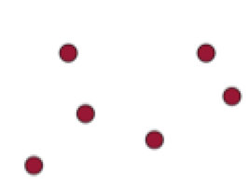

Notes:
What is the optimal line?

Slide 4
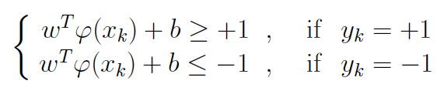

Support Vector Machine
L1: wx + b = 1
wx + b = 0
L2: wx + b = -1
Support Vectors
Margin:
2/|w|
Maximize Margin
=> Minimize |w|
Save this in your memory buffer for now
Notes:
The bigger the margin, the smaller the possibility that a new data will cross the hyperplane
2 over the norm of w

Slide 5

Support Vector Machine (Cont’d)
What if…

Slide 6
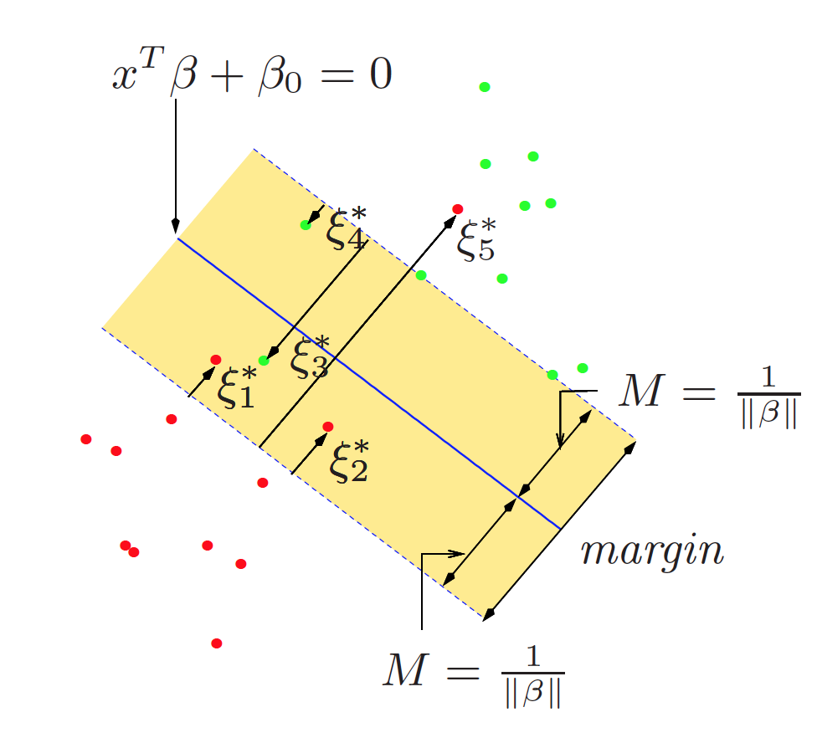
Support Vector Machine (Cont’d)
Introduce slack variables
Allow some mistakes

Slide 7
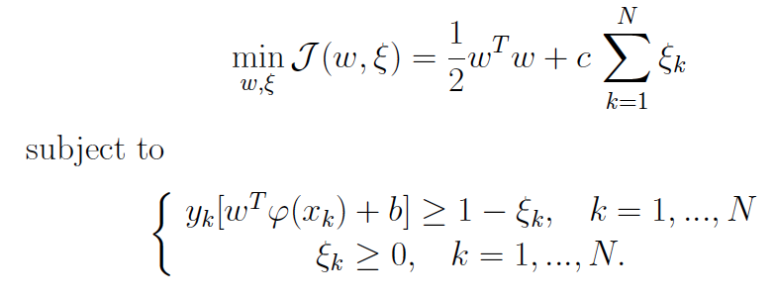
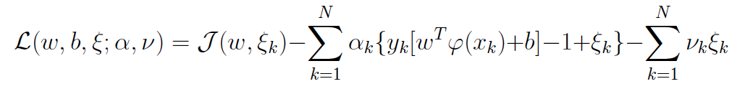
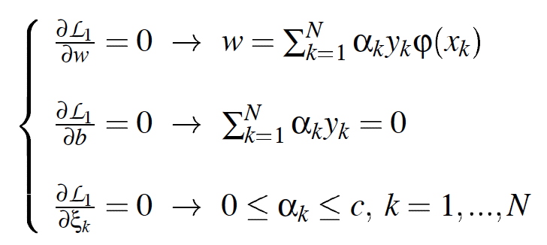
Optimization for SVM
Formulation
Lagrange Multiplier
Take the derivatives
and optimality condition
Notes:
We have 2 goals here: 1. maximize the margin; 2. minimize the slack variables
Max the dual
Why the dual?
Only involve the Lagrange multipliers
Once we have the Lagrange multipliers, we can solve w and b0

Slide 8
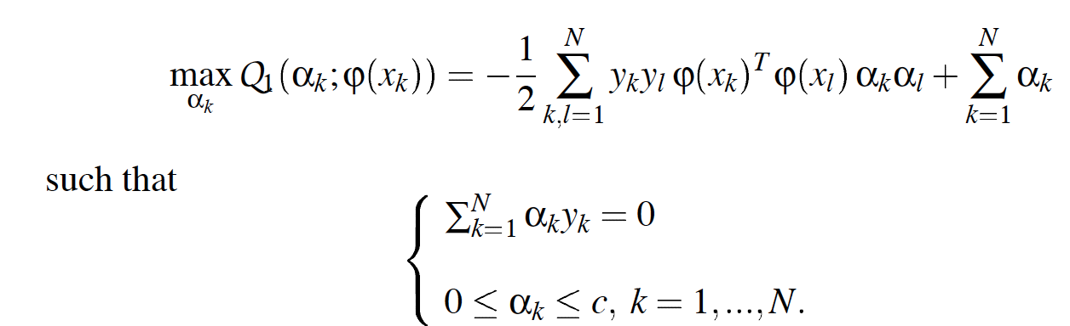
Optimization for SVM (Cont’d)
End up solving a quadratic programming problem
We first find α, then use α to calculate w and b
Notes:
After some optimization techniques, we end up….

Slide 9
Linear Programming vs. Quadratic Programming
Linear Programming
Linear objective function
Linear constraints
Quadratic Programming
Quadratic objective function
Linear constraints

Slide 10
SO…
How much one may simplify the SVM formulation without losing any of its advantages?

Slide 11
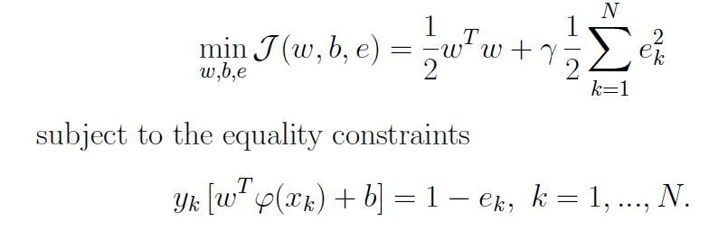
Least Square Support Vector Machine
Similar to regression?
Notes:
LS-SVM kind of like least square regression

Slide 12
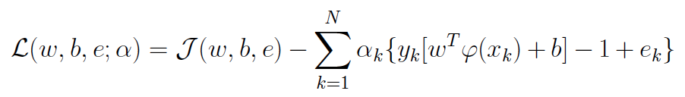
Optimization for LS-SVM
Lagrange Multiplier
Notes:
Max the dual
Why the dual?
Only involve the Lagrange multipliers
Once we have the Lagrange multipliers, we can solve w and b0

Slide 13
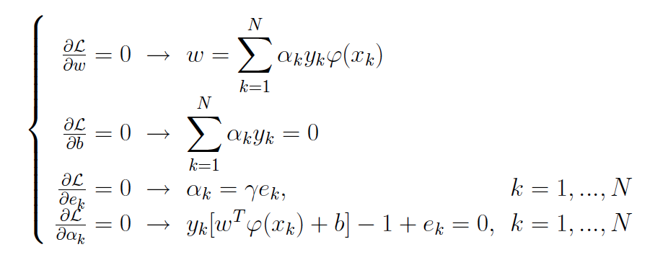
Optimization for LS-SVM (Cont’d)
Now take the derivative together with optimality condition, we end up with a set of linear equations instead of quadratic programming
#EasyToSolve !
Notes:
This is the major contribution

Slide 14
Comparison
How much one may simplify the SVM formulation without losing any of its advantages?
Experiments on 3 dataset [1]
 | ALL | LEUKEMIA | ALLAML3
SVM | 96.98 | 97.69 | 95.97
LS-SVM | 97.33 | 97.00 | 93.83
[1] Ye, Jieping, and Tao Xiong. "SVM versus least squares SVM." International Conference on Artificial Intelligence and Statistics. 2007.
Notes:
They didn’t provide the benchmark in the paper but here’s what I found from another paper

Slide 15
Question?

