Slide 1
A statistical approach to machine translation
Anish Tondwalkar, Juan Arrivillaga, Prateek Agrawal

Slide 2
Introduction
The job of the translator is to express the meaning of a text in one language to a passage of text in another language.
In this presentation we will consider translation of individual sentences

Slide 3
Introduction
The job of the translator is to express the meaning of a text in one language to a passage of text in another language.
In this presentation we will consider translation of individual sentences
We assume that any sentence in one language is a possible translation of any sentence in another language.
Let ‘T’ be the target language and ‘S’ be the source language.
So, we need to find a Target sentence ‘T’ given a Source sentence ‘S’.

Slide 4

Machine Translation
We view the problem to machine translation as:
“Given a sentence T in the target language, we seek the sentence S from which the translator produced T. We know that our chance of error is minimized by choosing that sentence S that is most probable given T. Thus, we wish to choose S so as to maximize Pr(SI T).”
Language Model
Translational Model

Slide 5
The Language Model
Pilot experiments with 3-gram model that was trained for speech recognition

Slide 6

The Language Model
Pilot experiments with 3-gram model that was trained for speech recognition
Tested on English ⇨ English sentence reconstruction
Given the words in the sentence, build the maximum likelyhood sentence with the same set of words

Slide 7
The Language Model
Pilot experiments with 3-gram model that was trained for speech recognition
Tested on English ⇨ English sentence reconstruction
Given the words in the sentence, build the maximum likelyhood sentence with the same set of words
Tested on sentences from corpus no longer than 11 words for computational tractability

Slide 8
The Language Model
Tested on sentences from corpus no longer than 11 words for computational tractability
Exact reconstruction (24 of 38)
Please give me your response as soon as possible.
Please give me your response as soon as possible.
Reconstruction preserving meaning (8 of 38)
Now let me mention some of the disadvantages.
Let me mention some of the disadvantages now.
Garbage reconstruction (6 of 38)
In our organization research has two missions.
In oar missions research organization has two.

Slide 9
The Language Model
Exact reconstruction (24 of 38)
Please give me your response as soon as possible.
Please give me your response as soon as possible.
Reconstruction preserving meaning (8 of 38)
Now let me mention some of the disadvantages.
Let me mention some of the disadvantages now.
Garbage reconstruction (6 of 38)
In our organization research has two missions.
In oar missions research organization has two.

Slide 10
The Language Model
Exact reconstruction (24 of 38)
Please give me your response as soon as possible.
Please give me your response as soon as possible.
Reconstruction preserving meaning (8 of 38)
Now let me mention some of the disadvantages.
Let me mention some of the disadvantages now.
Garbage reconstruction (6 of 38)
In our organization research has two missions.
In oar missions research organization has two.

Slide 11
The Language Model
Exact reconstruction (24 of 38)
Please give me your response as soon as possible.
Please give me your response as soon as possible.
Reconstruction preserving meaning (8 of 38)
Now let me mention some of the disadvantages.
Let me mention some of the disadvantages now.
Garbage reconstruction (6 of 38)
In our organization research has two missions.
In our missions research organization has two.

Slide 12

The Language Model

Slide 13
The Translation Model
Alignment: Jean aime Marie / John loves Mary
(Jean aime Marie | John(1) loves(2) Mary(2)) is a straighforward alignment
(Jean n’aime personne | John(1) loves(3) nobody(2,4)
Sometimes, words in the English sentence align with nothing in the French sentence, and vice versa! Essentially, the problem of correspondence. In general, we have something like this:

Slide 14
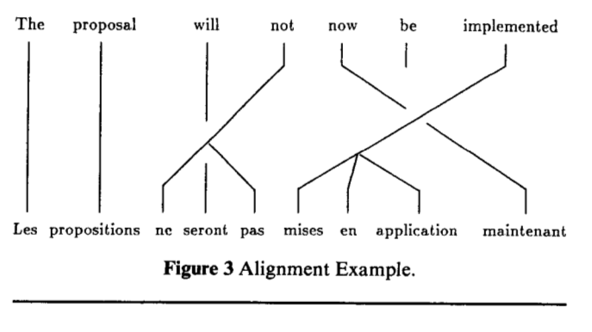

Slide 15
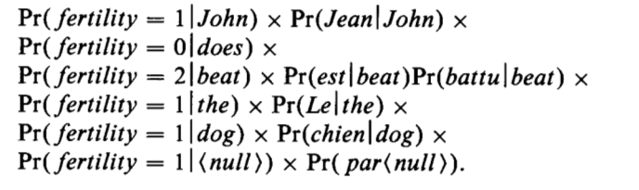
Translation Model
Consider:
(Le chien est battu par Jean | John(6) does beat(3,4) the(1) dog(2))

Slide 16
Translation Model
Distortion:
Distortion probability has the form Pr(i|j, L) where i is a target position, j a source position, and L the target length.

Slide 17
Translation Model
The model consists of:
1. A set of fertility probabilities, P(n|e) for every English world e for each fertility n from 0 to some limit (25 in this case)
2. A set of translation probabilities: P(f|e)
3. A set distortion probabilities: Pr(i|j, l)

Slide 18
Searching
Find ‘S’ that maximizes the probability of P(S)P(T/S)
Difficulty:
Too Many Sentences to search from

Slide 19
Searching
Find ‘S’ that maximizes the probability of P(S)P(T/S)
Difficulty:
Too Many Sentences to search from
Solution:
Use Stack Search!!

Slide 20
Stack Search
Keeps a list of ‘n’ candidates, these candidates are incomplete solution to the search.
Initially, this list contains only one entry corresponding to the hypothesis that the target sentence arose in some way from a sequence of source words that we do not know.
The search proceeds by iterations, each of which extends some of the most promising entries on the list
For example: (Jean aime Marie I *); where * is the placeholder for possible sequence of words
We can extend the * with one or more following entries
(Jean aime Marie I John(1)*)
(Jean aime Marie I *loves(2))
(Jean aime Marie I *Mary(3))
(Jean aime Marie I Jeans(1)*)

Slide 21
The search ends when there is an alignment that is significantly more promising than any other alignment.
Sometimes a sentence S’ is found which is not the same as the actual sentence S.
Problem:
When S’ is not acceptable translation
There exists two cases for such possible a problem

Slide 22
Case 1:
If Pr(S')Pr(T|S') > Pr(S)Pr(TIS),
The problem lies in our modeling of the language or of the translation process. ),
Case 2: If Pr(S')Pr(T| S') < Pr(S)Pr(TIS
Then our search has failed to find the most likely sentence.
We refer case 2 as Search error.
we can be sure that our search procedure has failed to find the most probable source sentence.
But we cannot be sure that by correcting the search we would also correct the error.
We might simply find an even more probable sentence that nonetheless is incorrect!!!
Pr(S’)Pr(T|S’)<Pr(S’’)Pr(T|S”) <Pr(S)Pr(T|S)

Slide 23
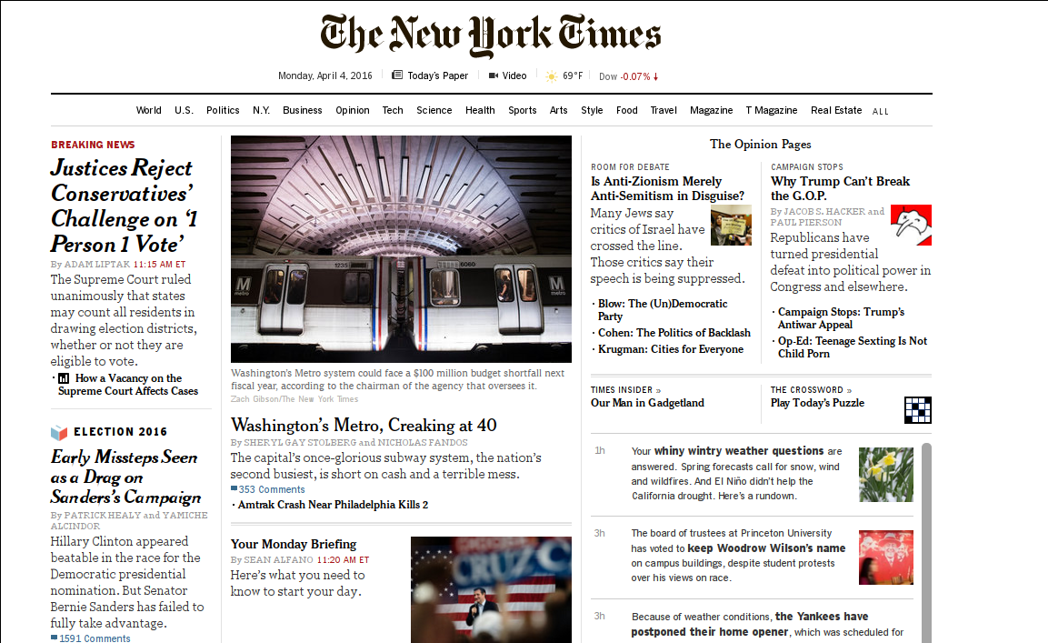
Parameter Estimation
Both the Language Model and the Translation Model need training
It's easy to find English text for the Language Model!

Slide 24
Parameter Estimation
Both the Language Model and the Translation Model need training
It's easy to find English text for the Language Model!
But Parallel Corpora are harder!

Slide 25
Parameter Estimation
Both the Language Model and the Translation Model need training
It's easy to find English text for the Language Model!
But Parallel Corpora are harder!
By law, the proceedings of the Canadian parliament are kept in both French and English!
100 million words in English and their translations
99% are sentence pairs

Slide 26

Parameter Estimation
Both the Language Model and the Translation Model need training
It's easy to find English text for the Language Model!
But Parallel Corpora are harder!
By law, the proceedings of the Canadian parliament are kept in both French and English!
What about alignment data?
Use Expectation Maximization
(Start with uniform probability)

Slide 27
Two Pilot Experiments
First Experiment: Estimating the parameters.
9,000 most common English and French words from parallel corpus.
Estimating p(f|e) is the dominating factor… 9,000^2 = 81 million parameters.
But also includes the fertility and distortion probabilities
Trained on 80,000 sentence pairs

Slide 28
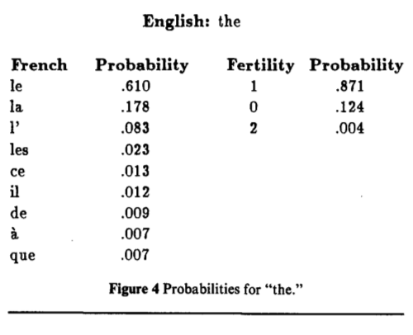

Slide 29
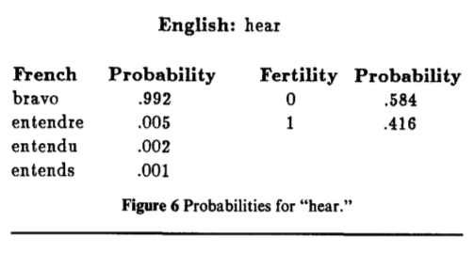

Slide 30
Two Pilot Experiments
Second Experiment: Translate from French to English
Limited V_{E} to 1,000 and V_{F} to 1,700
Trained translation model on 117,000 sentence pairs from corpus
Trained English language model on 570,000 sentences from English portion of corpus

Slide 31
Two Pilot Experiments
Translation Results:
On 73 sentence pairs not used to train to the model
Divided results into different categories:
Exact,
Alternate,
Different,
Wrong,
Ungrammatical

Slide 32
Two Pilot Experiments
5% exact match,
If you include exact, alternate, and different, 48%

Slide 33
Questions?

