Slide 1
Finding Deceptive Opinion Spam by Any Stretch of the Imagination
Myle Ott, Yejin Choi, Claire Cardie, Jeffrey T. Hancock
Cornell University
Yu Huang

Slide 2
What Does It Mean?
“Finding Deceptive Opinion Spam by Any Stretch of the Imagination”

Slide 3
What Does It Mean：Deceptive Opinion Spam?
Disruptive Opinion Spam: uncontroversial
Deceptive Opinion Spam: hard to tell from truthful reviews
Made by human beings
Deliberately written to sound authentic

Slide 4
What Does It Mean: Stretch of Imagination?
Informative writing vs. imaginative writing
Describe something based on imagination: not real experience!

Slide 5

Motivation
Consumers increasingly rate, review and research products online
Related work mostly focused on manually identifiable instances of opinion spam:
Disruptive opinion spam

Slide 6
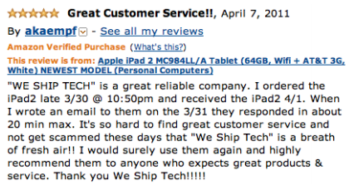
Motivation
Consumers increasingly rate, review and research products online
Related work mostly focused on manually identifiable instances of opinion spam: Disruptive opinion spam

Slide 7
Challenges
Few good sources of labeled data
Hard to evaluate
Solution: Constructing the first large-scale publicly available dataset for deceptive opinion spam research → gold standard deceptive opinion spam corpus

Slide 8

Gathering Data
Truthful Reviews: True
400 truthful reviews
TripAdvisor.com
20 most popular hotels in Chicago area
All 5-star truthful reviews

Slide 9
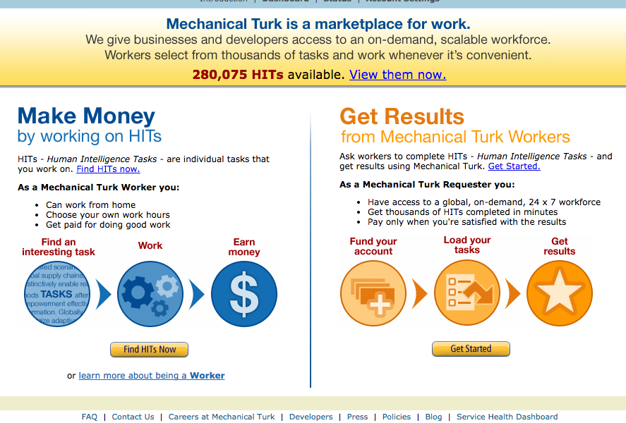
Gathering Data
Deceptive Reviews: False
Mechanical Turk
20 hotels
20 reviews / hotel
Offer $1 / review
400 reviews
https://www.mturk.com/mturk/welcome

Slide 10
Human Performance
Why bother?
Baseline to compare other approaches
Validate deceptive opinions
Question: Are human beings reliable on detecting deceptive opinion spams?

Slide 11
Which of them is fake?
I have stayed at many hotels travelling for both business and pleasure and I can honestly say that The James is tops. The service at the hotel is first class. The rooms are modern and very comfortable. The location is perfect within walking distance to all of the great sights and restaurants.Highly recommend to both business travellers and couple.
My husband and I stayed at the James Chicago Hotel for our anniversary.This place is fantastic! We knew as soon as we arrived we made the right choice! The rooms are BEAUTIFUL and the staff very attentive and wonderful!!! The area of the hotel is great, since I love to shop I couldn’t ask for more!! We will definitely be back to Chicago and we will for sure be back to the James Chicago.

Slide 12
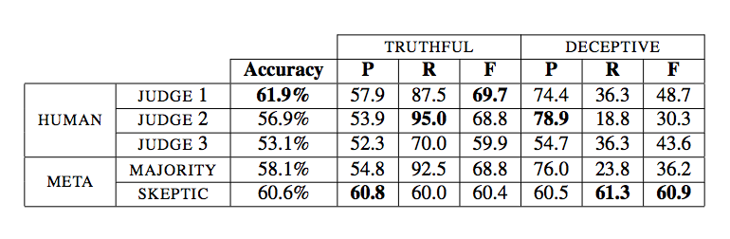
Human performance
80 truthful and 80 deceptive reviews
3 undergraduate students
2 virtual meta-judges
Majority: False if ≥ 2 human judges vote false
Skeptic: False if ≥ 1 human judge votes false
Classified fewer than 12% of opinions as deceptive
Fail to reject the Ho: J2 and J3 perform at-chance
Truth bias

Slide 13
Human performance
Inter-annotator agreement
Fleiss’ kappa
Among a fixed number of raters
Cohen’s kappa
Can only be used between two raters
Both kappa values are low!
Humans are not reliable at all!
http://en.wikipedia.org/wiki/Fleiss%27_kappa
http://en.wikipedia.org/wiki/Cohen%27s_kappa

Slide 14
Overview
Motivation
Research Challenges
Data set construction
Human performance
3 automated approaches: classifier performance
Results and analysis
Conclusion

Slide 15
Classifier: feature selection
Three feature sets
Genre identification
Psycholinguistic deception detection
Text categorization
Naïve Bayes, linear SVM

Slide 16
Classifier: Genre identification
Genre identification
48 POS features
Baseline for automated approaches
Expectations
Truth similar to informative writing
Deception similar to imaginative writing
Relationship?

Slide 17
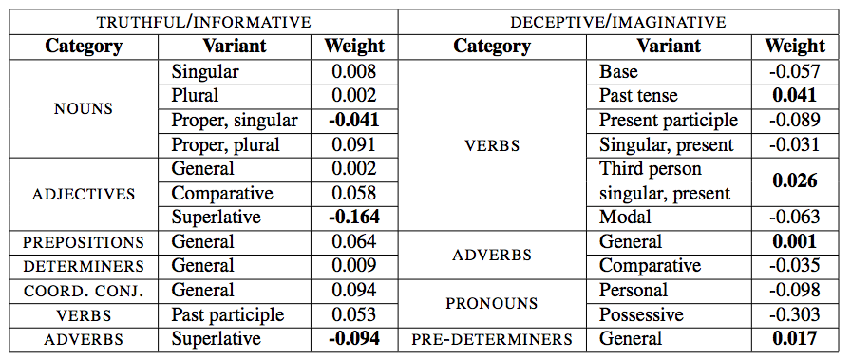
Classifier: Genre identification
Genre identification
Rayson et. al. (2001)
Informative on left (>0), imaginative on right(<0)
exceptions

Slide 18
Classifier:Psycholinguistic deception detection
Psycholinguistic deception detection
Linguistic Inquire and Word Count
(Pennebaker et. al., 2007)
Counts instances of ~4500 keywords
Keywords are divided into 80 psycholinguistically meaningful dimensions across 4 broad groups
Create a feature for each of the 80 dimensions

Slide 19
Classifier: Psycholinguistic deception detection
Psycholinguistic deception detection
Keywords are divided into 80 psycholinguistically meaningful dimensions across 4 broad groups
Linguistic processes
e.g., average number of words per sentence
Psychological processes
e.g., happy, feeling, eat, feeling
Personal concerns
e.g., job, cook, family
Spoken categories
e.g. umm, blah, yes

Slide 20
Classifier: Text categorization
Text categorization (n-grams)
Unigrams
Bigrams⁺
Includes unigrams
Trigrams⁺
Includes unigrams and bigrams

Slide 21
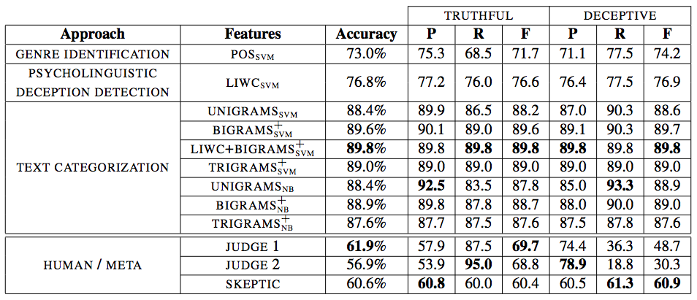
Classifier evaluation
5-fold nested cross-validation
Inner loop: fitting parameters
Outer loop: performance estimation

Slide 22
Classifier performance
Automated approaches outperform human judges
Recap: Judges 2 classified fewer than 12% of opinions as deceptive

Slide 23
Classifier performance
All the rest of automated approaches outperforms the simple genre identification baseline

Slide 24
Classifier performance
Unigram-based model (simplest) outperforms all non-text-categorization approaches
A context-sensitive approach might be necessary, while keywords-based model (LIWC) is not the best.

Slide 25
Classifier performance
The best approach: LIWC+BIGRAMS⁺

Slide 26
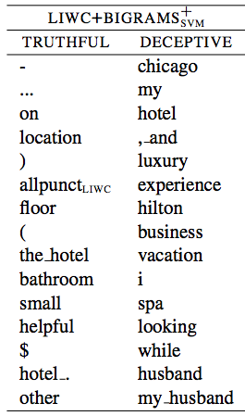
Results analysis
Features of deceptive opinions
Spatial difficulties
(Vrij et.al., 2009)
Psychological distancing
(Newman et.al., 2003)

Slide 27
Conclusion
First large-scale gold-standard deception dataset
http://myleott.com/op_spam/
Evaluated human performance
Developed automated classifiers capable of nearly of 90% accuracy
Relationship between deceptive and imaginative text
Importance of moving beyond universal deception cues

Slide 28
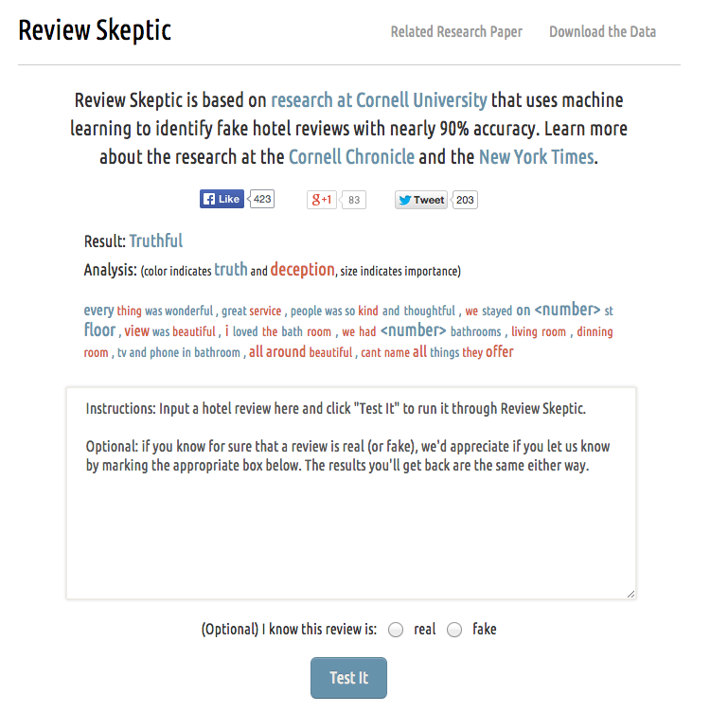
Demo
http://reviewskeptic.com/
Only apply to hotel reviews

Slide 29
Questions?
Thanks.

