Slide 1
Text Mining Project: Using Textual Content from Twitter for Next-Place Prediction
Mingjun Wang
Apr 30th, 2015

Slide 2
Content
Introduction
Previous Work
Methodology and Preliminary Work
Hypothesis
Models and Experiments
Future Works
Conclusion

Slide 3
Introduction
Motivation
Crimes are correlated with people’s daily movement [13]
People’s movement are difficult to model and predict
Objective
Apply next-place prediction to model individuals’ daily movement for predicting crimes

Slide 4
Introduction
In this project, we are focus on using textual contents to model and predict individuals’ movement pattern
Research Question
Will online activities in social media correlate with individuals’ movement pattern?

Slide 5
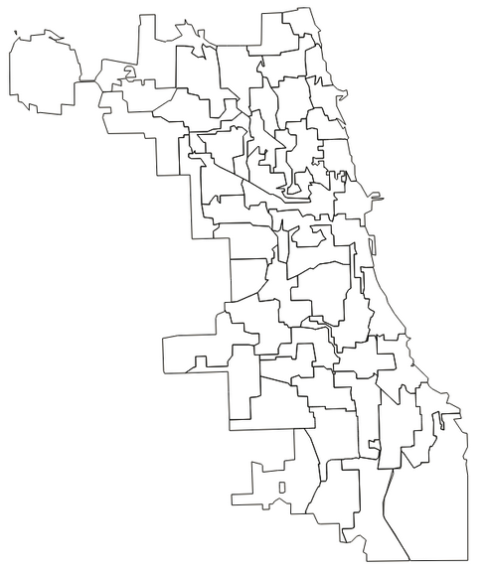
0.05 Topic 1: flight, delay, …
0.85 Topic 2: beer, party, rib, …
0.1 Topic 3: church, film, …
0.75 Topic 1: flight, delay, …
0.2 Topic 2: beer, party, rib, …
0.05 Topic 3: church, film, …

Slide 6
Example 1
Intuitively,
Predict next visiting place based on the features extracted from social media
College
Transport
Shop
Food
Venue
Hard to remember when to take school shuttle
I was stuck in loyola on the way to buy gifts
@Bmfayy I admit I am hungry after travelling
I always like the food here
Tweet
Coordinates
(-87.57,42.01)
(-87.55, 41.95)
(-87.69, 41.97)
(-87.70, 41.76)
Time
5:20 PM
5:22 PM
5: 26 PM
5:43 PM

Slide 7
Example 2
Intuitively,
Retrieve possible types of venues based on textual content
User @omgitskelcey
Shop
Food
Document as historical contents in each venue
Doc 1 : Historical tweets matched with Shop 1
Doc 2 : Historical tweets matched with Event 1
Doc 3 : Historical tweets matched with Food 1
Doc 4 : Historical tweets matched with Shop 2
….
@Bmfayy I admit I am hungry after travelling.
I always like the food here
Using tweet as query to retrieve the Document in the right place
5: 26 PM
5:43 PM
Time

Slide 8
Previous Work in Next Place Prediction
Location prediction is a traditional task in mobile computing
Home/Work area Prediction [1–3, 10]
Prediction of an individual’s location at any time [6, 7, 12, 18]
There are a variety of variables used in previous works
Trajectories of geographical coordinates
GPS [4, 5, 12, 14]
Wi-Fi [20]
Types of venues
Check-ins from Location Based Social Network (LBSN) [11, 16, 19]

Slide 9
Previous Work in Next Place Prediction
Our work is different from previous studies
Incorporate textual content in next-place prediction
Match geographical coordinates with type of venues to describe the physical environment

Slide 10
Hypothesis
To incorporate textual content to next-place prediction, we propose,
A user’s historical textual contents correlate with his/her future venue trajectory.

Slide 11
Data
Twitter
Geotagged tweets with textual contents from Twitter’s public API [15].
User ”63011649”; 2014-01-05 00:25:15; ”@LauraRoppo eat clean train mean”; (-87.79786403, 41.93277408)
Foursquare
Provide check-in and real-time location sharing [17].
Users’ historical check-ins ,which are type of venues, show the physical environment around them.
There is no overt connection between type of venues and textual contents.

Slide 12
Data Preparation
Apply Part-of-Speech ( POS ) tagging and remove meaningless parts
Calculate the distance between the geotagged tweets with venues

Slide 13
Data Preparation
Remove meaningless part
Using Twitter POS model with the coarse 25-tag tag set from TweetNLP [9].
Hard to remember when to take school shuttle
I was stuck in loyola on the way to buy gifts
@Bmfayy I admit I am hungry after travelling
I always like the food here
Tweet
hard, remember, take, school, shuttle
stuck, loyola, way, buy, gifts
admit, hungry travelling
like, food, here
Words

Slide 14
Data Preparation
Calculate the distance between the geotagged tweets with venues
Match tweet with type of venues to stand for physical environment
Strip Club
Office
Street
Pizza Place
I always like the food here
Food
Medical Center

Slide 15
Data Preparation
There are two ways to describe the physical environment
Nearest venue type
Distance to each nearest venue type

Slide 16
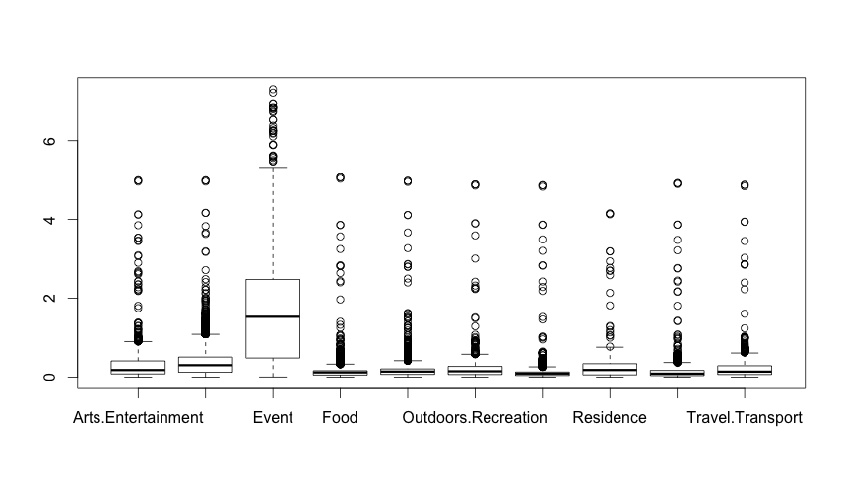
Data Preparation

Slide 17
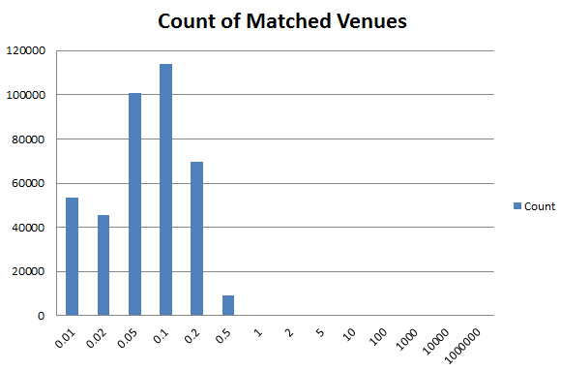
Data Preparation

Slide 18
Models and Experiments
Classification Model to Identify the nearest venue type
Regression Model for the distance to each nearest venue type
Text Retrieval Model to identify the location from textual content

Slide 19
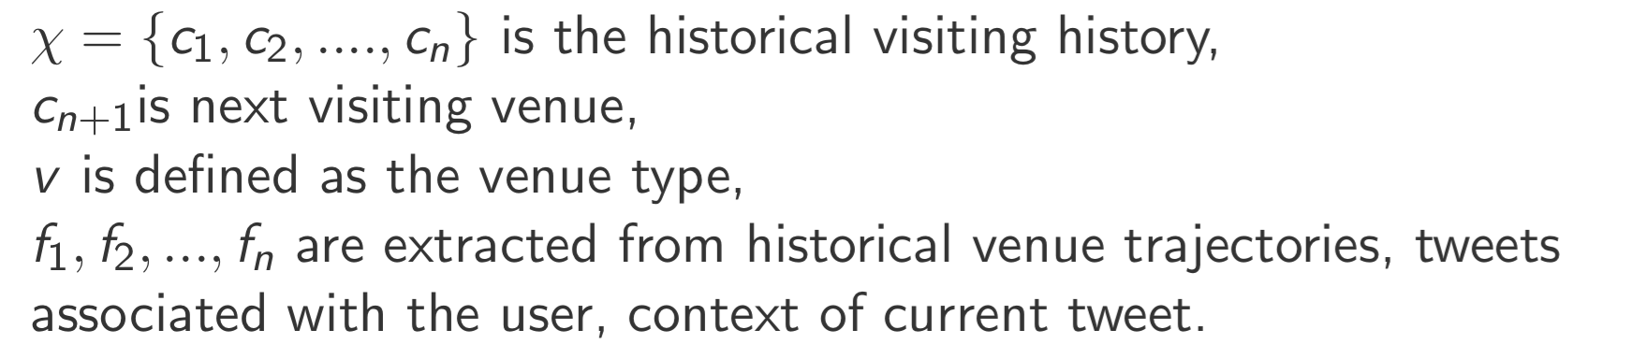
Classification Model (General)
First Step: Classify whether the individual will visit a new place or not.
Second Step : Classify which new place the individual will go in the subset of tweets classified as go to new place in first step.
s

Slide 20
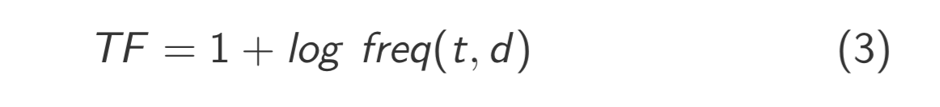
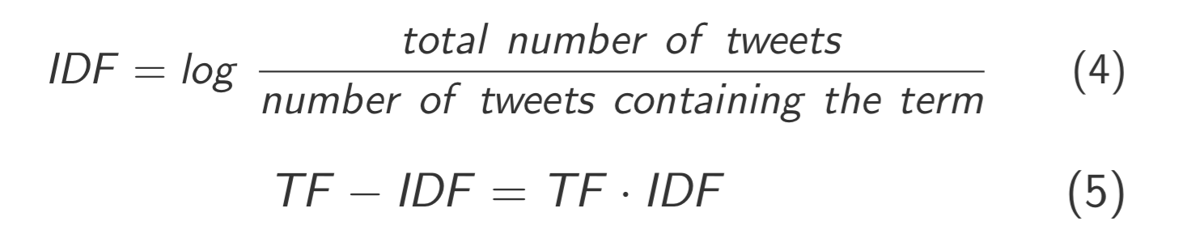
Text Enriched Model
Hypothesis : Textual content in a user’s current tweet correlates with his/her future venue trajectory.
Assumption : Features extracted from textual content as term frequency inverted document frequency (TF-IDF) could stand for textual content of current tweet.

Slide 21
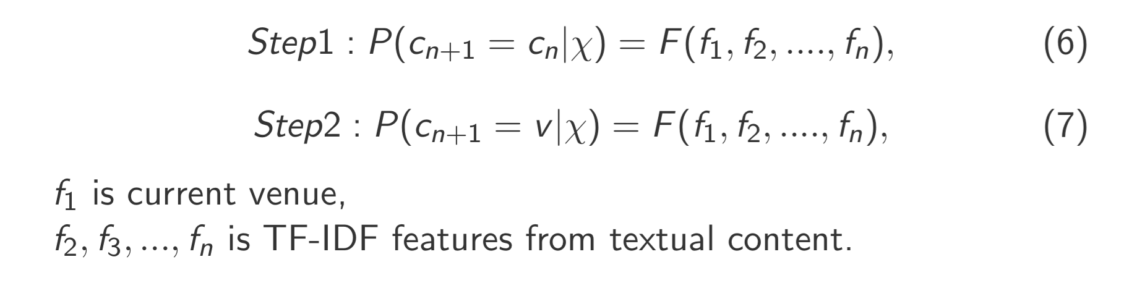
Text Enriched Model
Hypothesis : TF-IDF features from textual content in a user’s current tweet correlates with his/her future venue trajectory.

Slide 22
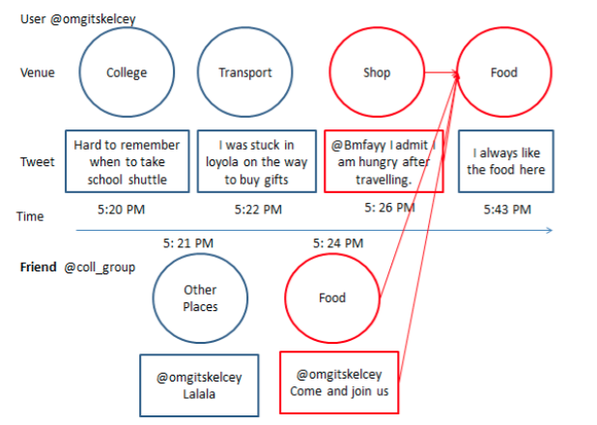
Text Enriched with @-link Model
We hypothesize the venue type and textual content of the tweet most recently mention current user correlates with the user’s own venue trajectory.

Slide 23
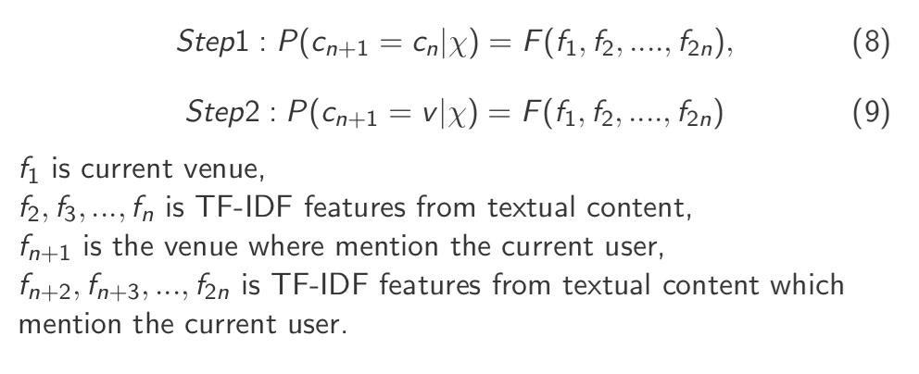
Text Enriched with @-link Model
Thus, the Text-Enriched with @-link Model will be the extension of Text-Enriched Model

Slide 24
Baseline Models
Most Frequent Check-in Model
Order - k Markov Model [4]
Historical Model [6]
Classification Model with historical visiting Information

Slide 25
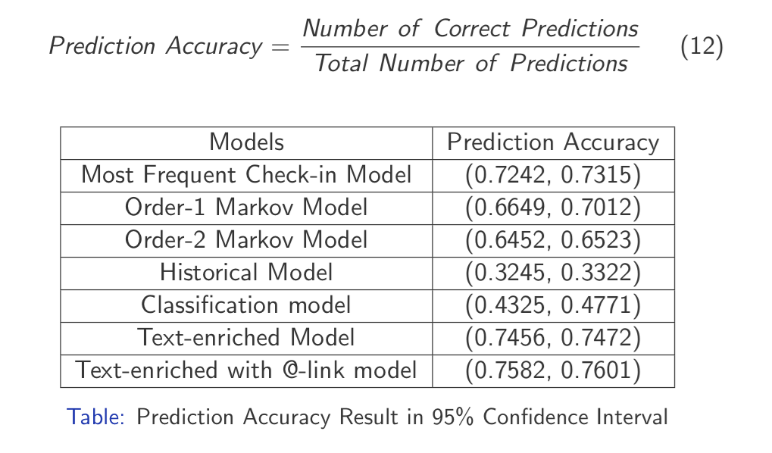
Results 1

Slide 26
Regression Model
Regression Model for the distance to each nearest venue type
Using the same features as described in the classification model
Baseline
Average distance to each venue type

Slide 27
Results 2
(km) | Mean Distance of Test Set | MSE (Raw Model) | MSE(two-stage Model)
Travel&Transport | 271 | 0.015252829 | 0.018597382
Food | 125 | 0.014529229 | 0.013495641
Residence | 301 | 0.012723374 | 0.019364779
Outdoors&Recreation | 255 | 0.01434006 | 0.01628372
Professional&OtherPlaces | 62 | 0.011052592 | 0.009840732
Arts&Entertainment | 283 | 0.026257121 | 0.026432174
NightlifeSpot | 172 | 0.018325964 | 0.018896978
College&University | 421 | 0.035374125 | 0.060547641
Shop&Service | 126 | 0.013573609 | 0.011224759
Event | 6748 | 0.309573899 | 0.332126214

Slide 28
Text Retrieval Model
Query : Geotagged Tweets
Document : A collection of historical tweets matched with each venue type
Rank the documents based on the query terms

Slide 29


Text Retrieval Model
BM25

Slide 30
Result 3
In this model, we only consider the textual content → inter – relation between each tweet with the document (collections of historical tweets in one venue )
Therefore, we both use the textual content to predict the current venue and next venue
 | Current Venue | Next
Prediction Accuracy | 0.181 | 0.2016

Slide 31
Future Work
Finish the Text Retrieval Model
Improve next place prediction by further investigate the social relation between different users
Apply the result from above models to understand individuals’ movement pattern and crime prediction

Slide 32
Summary
To incorporate textual content in next-place prediction,
To understand how online social relationships correlate with individuals’ movement patterns.

Slide 33
Reference
[1] Lars Backstrom, Eric Sun, and Cameron Marlow. Find me if you can: improving geographical prediction with social and spatial proximity. In Proceedings of the 19th international conference on World wide web, pages 61–70. ACM, 2010.
[2] Zhiyuan Cheng, James Caverlee, and Kyumin Lee. You are where you tweet: a content-based approach to geo-locating twitter users. In Proceedings of the 19th ACM international conference on Information and knowledge management, pages 759–768. ACM, 2010.
[3] Manoranjan Dash, Hai Long Nguyen, Cao Hong, Ghim Eng Yap, Minh Nhut Nguyen, Xiaoli Li, Shonali Priyadarsini Krishnaswamy, James Decraene, Spiros Antonatos, Yue Wang, et al. Home and work place prediction for urban planning using mobile network data. In Mobile Data Management (MDM), 2014 IEEE 15th International Conference on, volume 2, pages 37–42. IEEE, 2014.
[4] Trinh Minh Tri Do and Daniel Gatica-Perez. Contextual conditional models for smartphone-based human mobility prediction. In Proceedings of the 2012 ACM Conference on Ubiquitous Computing, pages 163–172. ACM, 2012.
[5] Trinh Minh Tri Do and Daniel Gatica-Perez. Where and what: Using smartphones to predict next locations and applications in daily life. Pervasive and Mobile Computing, 12:79–91, 2014.

Slide 34
[6] Huiji Gao, Jiliang Tang, and Huan Liu. Exploring social-historical ties on location-based social networks. In ICWSM, 2012.
[7] Huiji Gao, Jiliang Tang, and Huan Liu. Mobile location prediction in spatio-temporal context. In Nokia mobile data challenge workshop. Citeseer, 2012.
[8] Matthew S Gerber. Predicting crime using twitter and kernel density estimation. Decision Support Systems, 61:115–125, 2014.
[9] Kevin Gimpel, Nathan Schneider, Brendan O’Connor, Dipanjan Das, Daniel Mills, Jacob Eisenstein, Michael Heilman, Dani Yogatama, Jeffrey Flanigan, and Noah A Smith. Part-of-speech tagging for twitter: Annotation, features, and experiments. In Proceedings of the 49th Annual Meeting of the Association for Computational Linguistics: Human Language Technologies: short papers-Volume 2, pages 42–47. Association for Computational Linguistics, 2011.
[10] Brent Hecht, Lichan Hong, Bongwon Suh, and Ed H Chi. Tweets from justin bieber’s heart: the dynamics of the location field in user profiles. In Proceedings of the SIGCHI Conference on Human Factors in Computing Systems, pages 237–246. ACM, 2011.

Slide 35
[11] Defu Lian, Vincent W Zheng, and Xing Xie. Collaborative filtering meets next check-in location prediction. In Proceedings of the 22nd international conference on World Wide Web companion, pages 231–232. International World Wide Web Conferences Steering Committee, 2013.
[12] Zhongqi Lu, Yin Zhu, Vincent W Zheng, and Qiang Yang. Next place prediction by learning with multiple models.
[13] Fernando Mir ́o. Routine activity theory. The Encyclopedia of Theoretical Criminology, 2014.
[14] Anna Monreale, Fabio Pinelli, Roberto Trasarti, and Fosca Giannotti. Wherenext: a location predictor on trajectory pattern mining. In Proceedings of the 15th ACM SIGKDD international conference on Knowledge discovery and data mining, pages 637–646. ACM, 2009.
[15] Fred Morstatter, Ju ̈rgen Pfeffer, Huan Liu, and Kathleen M Carley. Is the sample good enough? comparing data from twitter’s streaming api with twitter’s firehose. arXiv preprint arXiv:1306.5204, 2013.

Slide 36
[16] Anastasios Noulas, Salvatore Scellato, Neal Lathia, and Cecilia Mascolo. Mining user mobility features for next place prediction in location-based services. In ICDM, volume 12, pages 1038–1043. Citeseer, 2012.
[17] Anastasios Noulas, Salvatore Scellato, Cecilia Mascolo, and Massimiliano Pontil. An empirical study of geographic user activity patterns in foursquare. ICwSM, 11:70–573, 2011.
[18] Salvatore Scellato, Mirco Musolesi, Cecilia Mascolo, Vito Latora, and Andrew T Campbell. Nextplace: a spatio-temporal prediction framework for pervasive systems. In Pervasive Computing, pages 152–169. Springer, 2011.
[19] Takuya Shinmura, Dandan Zhu, Jun Ota, and Yusuke Fukazawa. Destination prediction considering both tweet contents and location transition hitstory. In Mobile Computing and Ubiquitous Networking (ICMU), 2014 Seventh International Conference on, pages 95–96. IEEE, 2014.

Slide 37
[20] Libo Song, David Kotz, Ravi Jain, and Xiaoning He. Evaluating next-cell predictors with extensive wi-fi mobility data. Mobile Computing, IEEE Transactions on, 5(12):1633–1649, 2006.
[21] Xiaofeng Wang, Matthew S Gerber, and Donald E Brown. Automatic crime prediction using events extracted from twitter posts. In Social Computing, Behavioral-Cultural Modeling and Prediction, pages 231–238. Springer, 2012.

