Slide 1
Part-of-Speech Tagging for Twitter:
Annotation, Features, and Experiments
Lihua Cai, Constance Hu
Notes:
Why we want to create a new pos tagger for twitter
Twitter data has its own characteristics and the tools that are trained on newstext before perform badly on twitter

Slide 2
Goal:
Build a Twitter part-of-speech tagger in a short time
Notes:
With the careful design, supervised machine learning can be applied to rapidly produce effective language technology

Slide 3
Plan
Outcome
Large team of annotators
Simple, carefully-designed annotation scheme
Features leveraging existing resources(treebanks) and unannotated data
Tag set for Twitter
1827 annotated English tweets
POS tagger with ~90% accuracy
Finish the task within 250 person-hours
Notes:
17 researcher to annotate the tags
The annotation scheme fit the unique characteristics of the twitter dataset and provide an appropriate level of linguistic details
A feature set that captures twitter-specific properties and exploits existing resources such as tag dictionaries and phonetic normalization

Slide 4
Tag

Slide 5

Data set - Example
Hashtag
URLs
Symbols
typos, multi-word abbreviations, non-standard spelling ...
Notes:
140-character limit, the conversational nature of the text, the lack of conventional orthography

Slide 6
Tag set
Start with coarse set of Penn Treebank tags
Add Twitter-specific tags
Notes:
Most POS taggers are trained from treebanks in the newstext domain.
And Penn Treebank contains corpus from wall street journal

Slide 7
Coarse treebank tags
common noun
determiner
proper noun
preposition
pronoun
verb particle
verb
coordinating conjunction
adjective
numeral
adverb
interjection
punctuation
predeterminer / existential there
Notes:
The author design a coarse tagset that captures standard POS.

Slide 8
Twitter-specific tags
hashtag
at-mention
URL / email address
emoticon
Twitter discourse marker
other (multi-word abbreviations, symbols, garbage)
Notes:
There are two tags that should be clarified. Hashtag and twitter discourse marker

Slide 9
Problem
Penn Treebank tokenization is unsuitable for Twitter
Example:
@user1 OMG ur from PA ? i am too (: where abouts ?
@user2 ima get me a flip phone for real
ur = you’re ima = I’m going to
{Nominal, proper noun} * {Verb, possessive}
Compound tag
Notes:
Due to non standard spelling conventions, tokenizing under a tradition scheme is harder than for standard english text
Apostrophes are often omitted. So the author didn’t split contractions and possessives. And new tags are introduced by combining forms.

Slide 10
Hashtag
Twitter hashtags are sometimes used as ordinary words (35% of the time) and other times as topic markers.
Innovative , but traditional , too ! Another
fun one to watch on the #iPad !
http://bit.ly/ @user1 #utcd2 #utpol #tcot
We only use “hashtag” for topic markers.
proper noun
topic marker
Notes:
Hashtag may apply to categorize a tweet
Hashtag can serve as words or phrases within a tweet. We tag hashtags with their appropriate POS as if they didn’t start with #

Slide 11
Twitter Discourse Marker ~
RT @user1 : I never bought candy bars from
those kids on my doorstep so I guess they’re
all in gangs now .
RT @user2 : LMBO ! This man filed an
EMERGENCY Motion for Continuance on account
of the Rangers game tonight ! 〈〈 Wow lmao
Twitter Discourse Marker
Notes:
RT means “retweet”. The construction function is to publish a message with attribution
We apply ~ (tilde) to RT and :(colon)
Ellips dot (...) at the end of a tweet indicate that a message is cut to fit the 140-character limit and will be continued in the following tweet or at a URL.

Slide 12
Resulting tag set: 25 tags
Notes:
Twitter-specific tags has strong positional preference in a tweet.
At-mentions and twitter discourse markers tend to occur at the beginning of messages while hashtag, URLs and emoticons tend to occur near the end.

Slide 13
Annotation

Slide 14
Step 0
Obtain a tag set including tags from treebanks and twitter-specific
Tokenize tweets by a twitter tokenizer and pre-tag tokens using WSJ-trained Stanford POS tagger
For special twitter categories, Heuristics takes precedence over the Stanford tags
Notes:
Use the tag set we built before
for speeding up annotation
It is case-by-case
Heuristics is used to mark tokens belonging to special twitter categories,

Slide 15
Step 1
17 researchers from Carnegie Mellon
Each spent 2-20 hours annotating
Annotators corrected output of Stanford tagger
Penn Treebank consulted for difficult cases
Notes:
Step 1 Is a round of manual annotation
17 corrected the automatic predictions from stage 0
There are some situations that our tagset, annotation guidelines and tokenization rules can’t conver.

Slide 16
Step 2
Two annotators corrected and standardized annotations from the original 17 annotators
A third annotator tagged a sample of the tweets from scratch
Inter-annotator agreement: 92.2%
Cohen’s kappa: 0.914
One annotator made a single final pass through the data, correcting errors and improving consistency
Notes:
2 annotators reviewed and corrected all of tweets tagged in stage 1
A third annotator read the guidelines and annotated 72 tweets from scratch to estimate the inner-annotator agreement
inner -annotator agreement:
Cohen’s kappa:
Cohen's kappa coefficient is a statistic which measures inter-rater agreement for qualitative (categorical) items. It is generally thought to be a more robust measure than simple percent agreement calculation, since κ takes into account the agreement occurring by chance.
A final sweep wa made by a single annotator to correct error and improve consistency of tagging decision across the corpus

Slide 17
Experiment

Slide 18
Experimental Setup
1,827 annotated tweets
1,000 for training
327 for development
500 for testing (OOV rate: 30%)
Systems:
Stanford tagger (retrained on our data)
Our own baseline CRF tagger
Our tagger augmented with Twitter-specific features
Notes:
In the experiment, the author compares the current system against the stanford tagger.
Due to the different tagset, the author retrain stanford tagger on the labelled dataset by using the standard set of features.
In the current system, some new features are added.
The baseline is a conditional random field, CRF with base features. Also, we test the features that can leverage specific properties of twitter dataset.

Slide 19
Experimental Setup
Model CRF - conditional random field
Basic features:
a feature for each word type, a set of features that check whether the word contains digits or hyphens, suffix features up to length 3, and features looking at capitalization patterns in the word.
Twitter specific features
Notes:
This model enable the incorporation of arbitrary local features in a log-linear model.
It is a popular method in natural language processing
Also, we test the features that can leverage specific properties of twitter dataset.

Slide 20
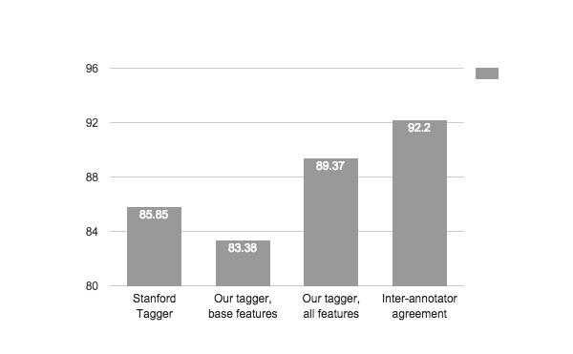
Result
Notes:
The tagger with full feature set perform better than stanford tagger and tagger with base features.
The author also remove a feature from the full feature set to conduct feature ablation experiments.

Slide 21
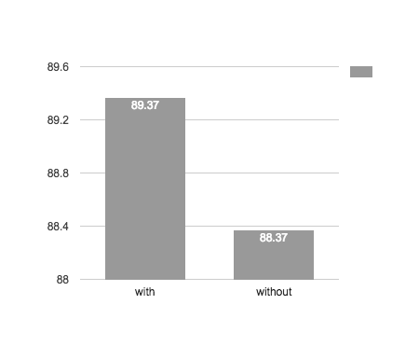
Twitter Orthographic Feature
Regular expressions to detect at-mentions, hashtags, and URLs

Slide 22
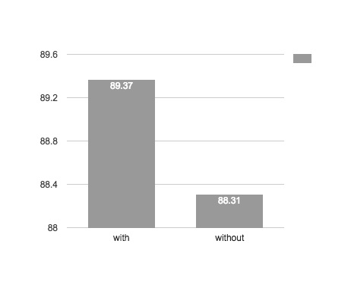
Distributional Similarity Feature
Embeddings in a low dimensional space based on neighboring words
Computed using 134k unannotated tweets
Notes:
When training data is limited, distributional features from unlabeled text can improve performance
The author use 134,000 tweets to construct the distributional features from the predecessor and successor probabilities and concatenated transition matrices into a sparse matrix. Then we use SVD method to lower the dimensionality and create feature vectors for each term.

Slide 23
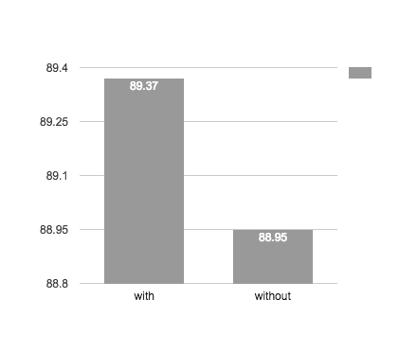
Phonetic Normalization Feature
Metaphone algorithm (Philips, 1990)
maps tokens to equivalence classes
based on phonetics
tomarrow tommorow tomorr
tomorrow tomorrowwww
Notes:
Since twitter includes many alternative spellings of words, the author use metaphone algorithm to simply terms.
The metaphone includes 19 rules.

Slide 24
Tag Dictionary Feature
One feature for each tag a word occurs within the Penn Treebank, with its frequency rank
A similar feature for Metaphone classes of Penn Treebank words
Notes:
Instead of using tag dictionaries as hard constraints, the author uses them as soft constraints since twitter varies significantly from the PTB domains.

Slide 25
Conclusions
Developed a tag set, annotated data, designed features, and trained models
Case study in rapidly porting a fundamental NLP task to a social media domain
Data may be useful for domain adaptation or semi-supervised learning

Slide 26
Tagger, tokenizer, and annotations are available:
www.ark.cs.cmu.edu/TweetNLP/

Slide 27
Q&A

